Slide 1
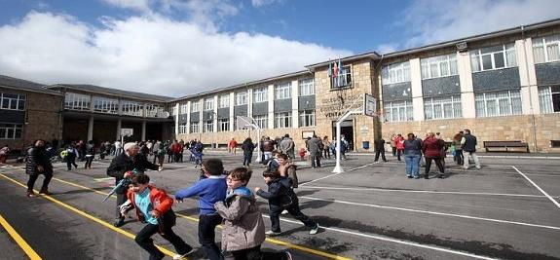
This is our school !

Slide 2
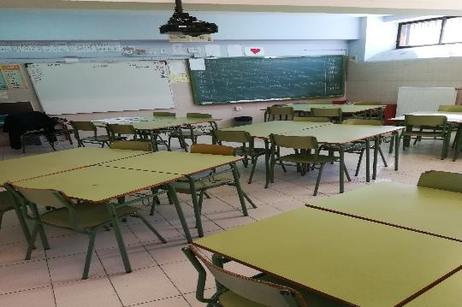
Ian’s classroom is where we learn English literacy .

Slide 3
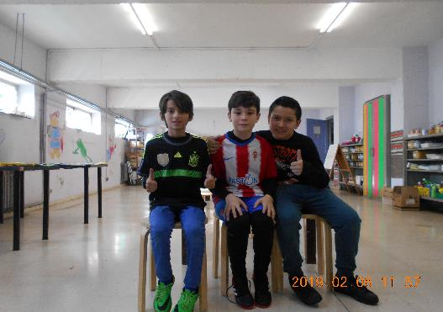
In this class you make art

Slide 4
Our IT room has some new computers .

Slide 5
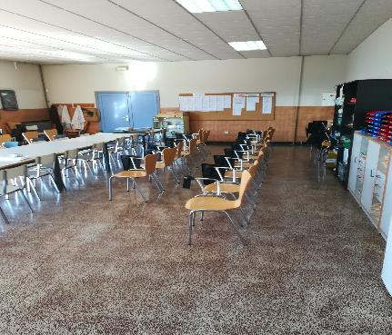
These are the school offices and the teachers´ staff room .

Slide 6
The reception area has flags from different European countries.

Slide 7
The main entrance shows the full name of the school .

Slide 8
The playground will soon have a new covered area to protect us from the rain.

Slide 9
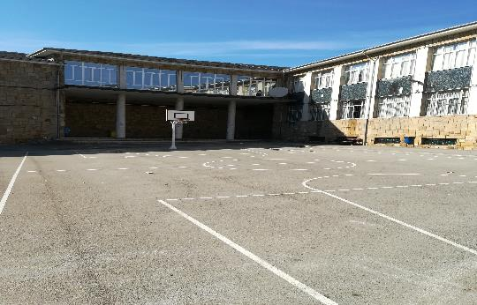
It also has basketball courts.

Slide 10
A lot of children eat lunch in the canteen every day!

Slide 11
The toilets are very clean and smell nice!

Slide 12
The library has a lot of books in Spanish, English and Asturian.

Slide 13
In the gym we do a lot of exercises and games

Slide 14
The sports pavilion is very big and we play lots of different sports there.

Slide 15
The canteen entrance is next to the sports pavilion

Slide 16
We listen to talks and attend prize-givings in the school hall.

Slide 17
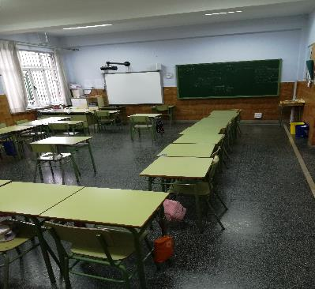
This is our tutor classroom. We are class group 5A!
5ºA

Slide 18
END
My school is very cool

