Slide 1
Friendship through the Net
Sixth Grade of 14 Elementary School of Ilion
February of 2016
(Τάξη ΣΤ2 του 14^{ου} Δημοτικού Σχολείου
Ιλίου)

Slide 2
Summary
This presentation is our effort to search and collect pictures through the web that truly reflect our view on friendship.
The idea is to visualise our expectations and experiences… and to create an emotional response!
☺
Therefore, friendship is:

Slide 3
Being together…

Slide 4
Giving a hug and support…

Slide 5
To understand each other…

Slide 6
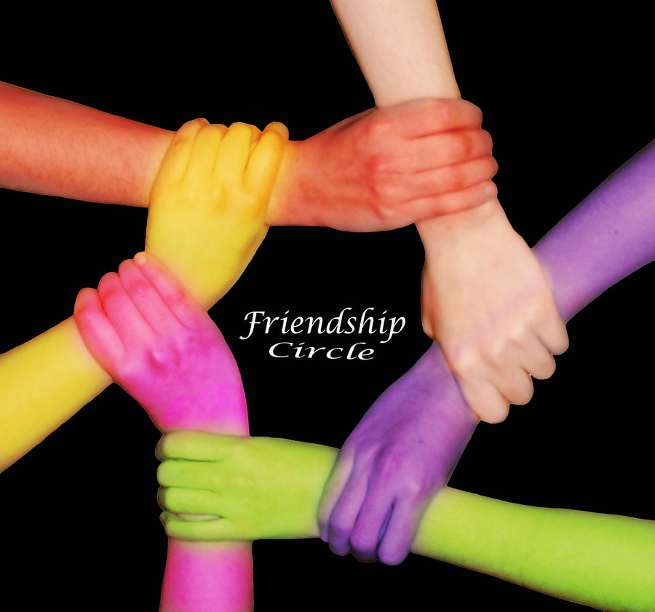
To love…

Slide 7
To be there for better or worse…

Slide 8
To play with and to learn…

Slide 9
To share extraordinary moments…

Slide 10
There is a Greek saying:
Show me your friends so as to be able to understand you
(through them)

Slide 11
Thank you! And take care of your friends because they are really so important!!!

