Slide 1
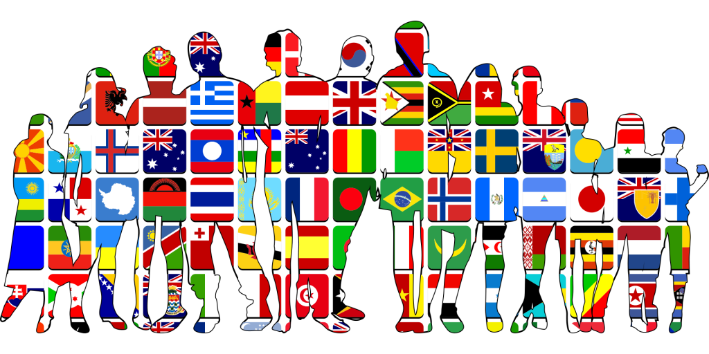

Slide 2
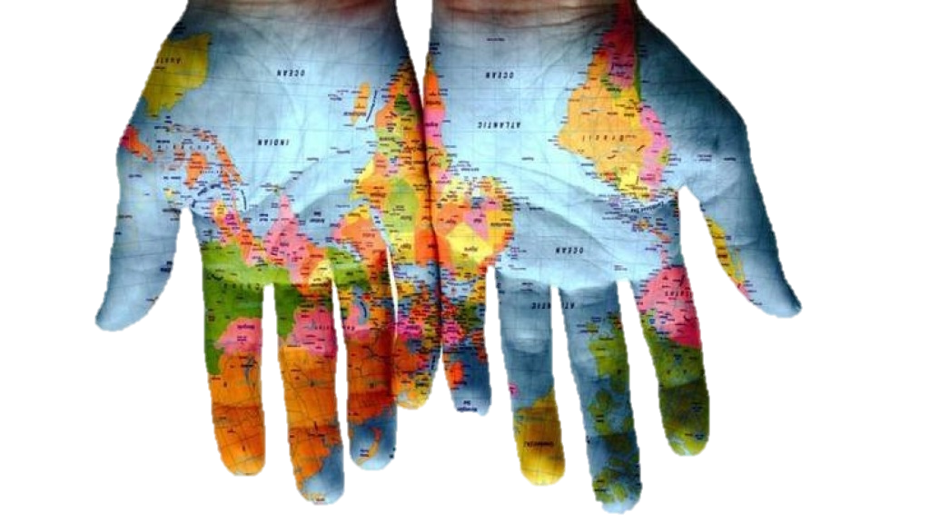
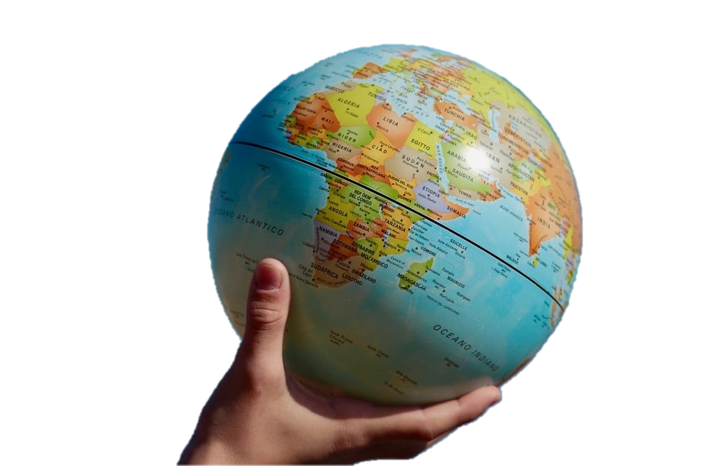
In the era of internationalization and globalization, communication between different cultures is of increasing importance.
Intercultural communication offers many benefits, in particular it enriches one's cultural background; collaborating and sharing with other people from different countries, we learn about customs and traditions different from ours.

Slide 3
GLOBALIZATION
In recent years, the dialogue between different cultures has expanded: at the local level thanks to the solidarity of communities of different ethnic groups in the cities (multiethnicity), at the national level with initiatives to promote the integration of immigrants and at the international level with the construction of bodies and institution.

Slide 4
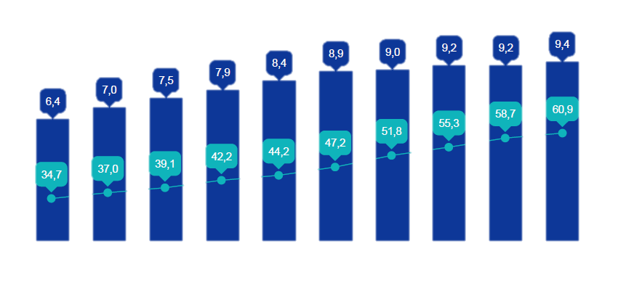
MULTIETHNICITY
Communication and collaboration between individuals or associations with different cultures does not only take place at a distance but also in the same society, where people from very distant countries live.
This graph shows us the percentage incidence of foreign students on the total of Italian students, from 2010 to 2020, and we can see that the figure is growing every year.

Slide 5
GLOBALIZATION ON THE WEB
Fundamental for the expansion of globalization processes is the web and social networks that allow you to increase contacts between people who are very distant from each other.
For almost two years we have been forced to remain closed at home due to the covid pandemic, only thanks to the internet and the network have we continued intercultural exchanges and dialogue with new people, without ever stopping our desire to know.

Slide 6
CULTURAL DIFFERENCES
Communication is the exchange of messages between two or more interlocutors.
There are many different cultures in the world, which is why intercultural communication is difficult to teach and learn, but we must be aware that each individual is influenced by his or her education.
There are 4 things to watch out for when talking to a foreign boy or girl…

Slide 7
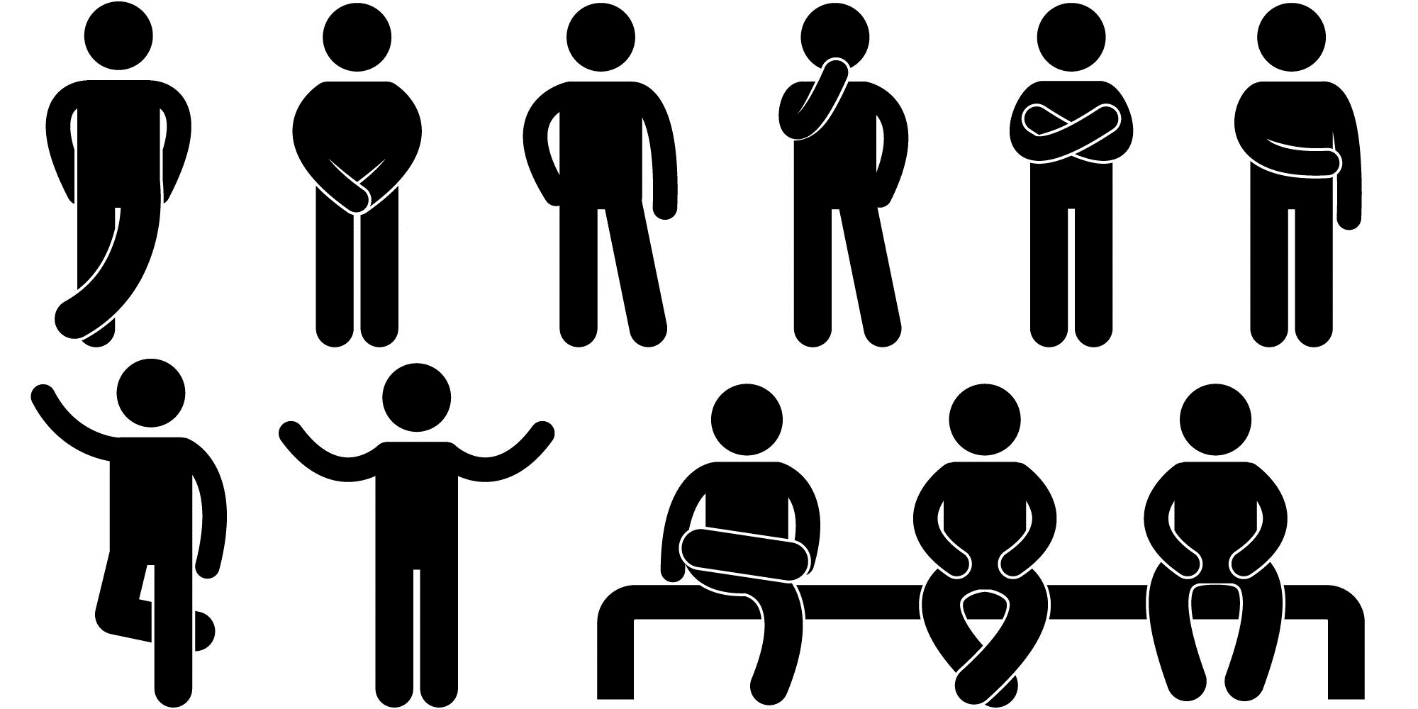
1. ATTITUDE
Facial expressions in Mediterranean Europe are expansive and instinctive, while in Northern Europe they are expected to be controlled. In Europe, during a conversation, one usually looks into the eyes of the person with whom one is conversing, but in many cultures, for example Asian and African, it is not allowed to do the same with a superior.

Slide 8
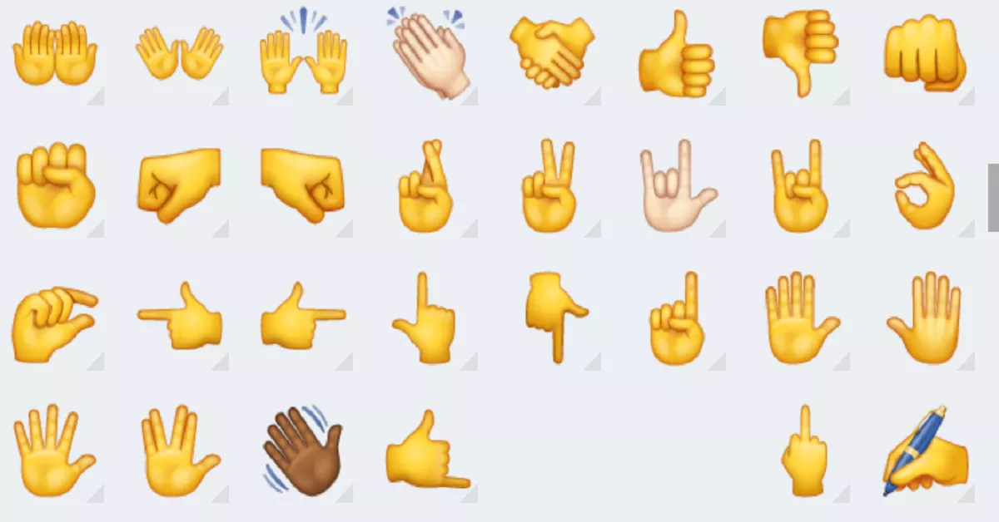
2. GESTURES
Arms and hands also occupy an important position in non-verbal communication.
Hand and arm gestures accentuate and replace the spoken language but have different meanings depending on the culture and language.
We Italians gesticulate a lot and sometimes our gestures are considered aggressive and intrusive. This becomes more serious if this feeling is confirmed by a very high tone of voice. Furthermore, many Italian gestures have a completely different meaning in other cultures, especially in the Turkish one.

Slide 9
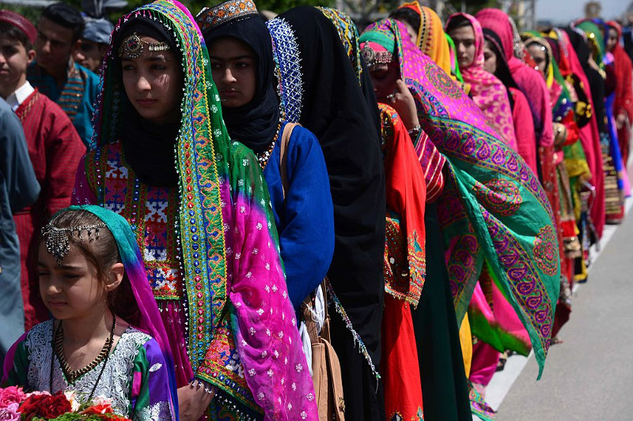
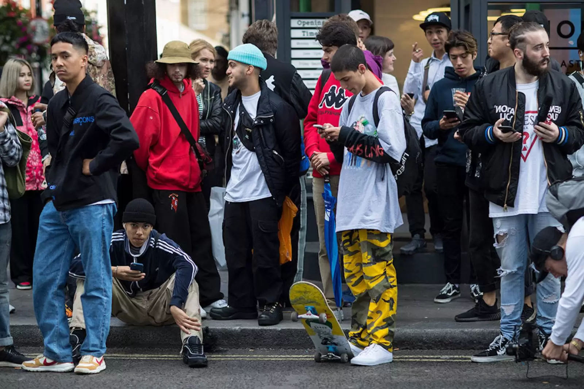
3. CLOTHING
The choice of clothing plays an important role in good intercultural communication.
For example, the formal suit in Italy is intended as a "jacket, tie and shirt"; in America, on the other hand, only the tie is enough, which in other eastern countries is absolutely forbidden.
Even the objects take on particular values, for example during Muslim events it is forbidden to drink alcohol, or even the flowers are classified as "dangerous" objects, in some parts of the world, such as in Mexico where it is not recommended to give yellow flowers and in Germany, the laurel wreaths.

Slide 10
4. LANGUAGE
The sonority of each language is the first aspect that is perceived and analyzed unconsciously.
An English person who listens to two Italians speaking freely may assume that they are arguing: in England that kind of tone and mutual interruption would only be used during a verbal quarrel.
Italian culture accepts the overlap between speakers while almost all other cultures in the world forbid it.

Slide 11
Despite the numerous problems that can be caused by the coexistence of different cultures, these diversities create a human wealth of inestimable value: which must be protected and encouraged.

