Slide 1
EQUALITY
Presentation of:
SIMONE QUARTA,
MICHAEL VICENTELLI - 2am
FOR Erasmus PROJECT
IISS E. FERMI - LECCE
A.S. 2021/2022

Slide 2
FUNDAMENTAL CHARTER OF RIGHTS
The charter of fundamental rights recover the civil, political, economic and social rights of European citizens and those who live in the European territory.
It was proclaimed on December 7, 2000 in Nice.
The charter includes an introductory preamble and 54 articles concerning:

Slide 3
EQUALITY
CHAPTER 3 of the EU CHARTER OF FUNDAMENTAL RIGHTS is on EQUALITY. Articles 20-26 protect the following rights:
equality before the law;
non-discrimination;
cultural, religious and linguistic diversity;
equality between women and men;
the rights of the child;
the rights of the elderly;
integration of persons with disabilities;

Slide 4
EQUALITY BEFORE THE LAW
Everyone is equal before the law. This right is enshrined in article 20 of the Charter of Fundamental Rights.
According to this principle, men are equal by nature and have the same rights. Race, political views etc. they determine important differences among citizens, but they do not make some superior and others inferior from the point of view of rights.

Slide 5
NO-DISCRIMINATION
Any discrimination based on any ground such as sex, race, colour, ethnic or social origin, genetic features, language, religion or belief, political or any other opinion, membership of a national minority, property, birth, disability, age or sexual orientation shall be prohibited.
Any discrimination on grounds of nationality shall be prohibited.
This right is enshrined in article 21 of the Charter of Fundamental Rights.

Slide 6
CULTURAL, RELIGIOUS AND LINGUISTIC DIVERSITY
The Union shall respect cultural, religious and linguistic diversity.
This right is enshrined in article 22 of the EU Charter of Fundamental Rights.

Slide 7
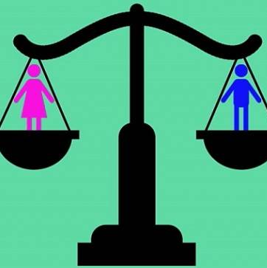
EQUALITY BETWEEN WOMEN AND MEN
Equality between women and men must be ensured in all areas, including employment, work and pay.
The principle of equality shall not prevent the maintenance or adoption of measures providing for specific advantages in favour of the under-represented sex.
This right is enshrined in article 23 of the Charter of Fundamental Rights.

Slide 8
THE RIGHTS OF THE CHILD
Children shall have the right to such protection and care as is necessary for their well-being. They may express their views freely. Such views shall be taken into consideration on matters which concern them in accordance with their age and maturity.
In all actions relating to children, whether taken by public authorities or private institutions, the child's best interests must be a primary consideration.
Every child shall have the right to maintain on a regular basis a personal relationship and direct contact with both his or her parents, unless that is contrary to his or her interests.
These rights are enshrined in article 24 of the Charter of Fundamental Rights.

Slide 9
THE RIGHTS OF THE ELDERLY
The Union recognises and respects the rights of the elderly to lead a life of dignity and independence and to participate in social and cultural life.
This right is enshrined in article 25 of the Charter of Fundamental Rights.

Slide 10
INTEGRATION OF PERSONS WITH DISABILITY
The Union recognises and respects the right of persons with disabilities to benefit from measures designed to ensure their independence, social and occupational integration and participation in the life of the community.
This right is enshrined in article 26 of the Charter of Fundamental Rights.

Slide 11
...THE END

