Slide 1

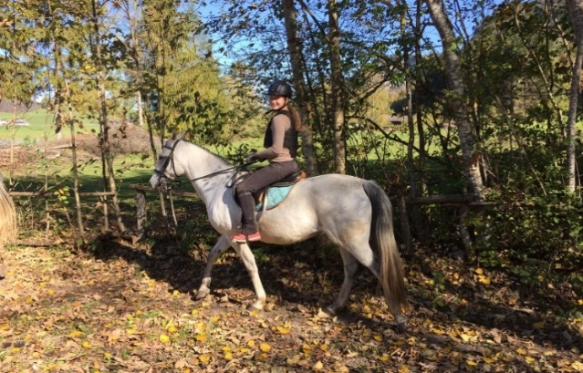
WORK between the PROJECT MEETINGS
Subproject 1: Man and his Values
The following ARTICLES were written:
Liebe und Freundschaft – Gefühle, die glücklich machen
Love and Friendship – feelings that make happy
Positive Metamorphose
Positive metamorphosis

Slide 2
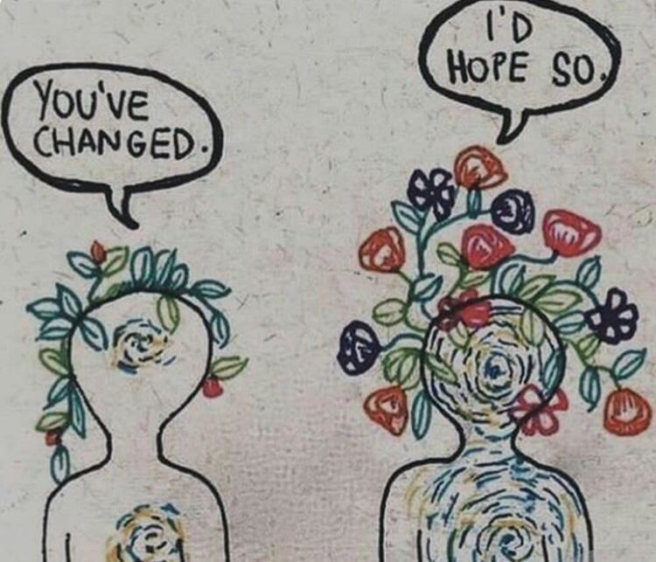
Subproject 1: Man and his Values
Articles
Der Kampf zwischen Gut und Böse
The struggle between good and evil
Der Fall von Idealen
The fall of ideals

Slide 3

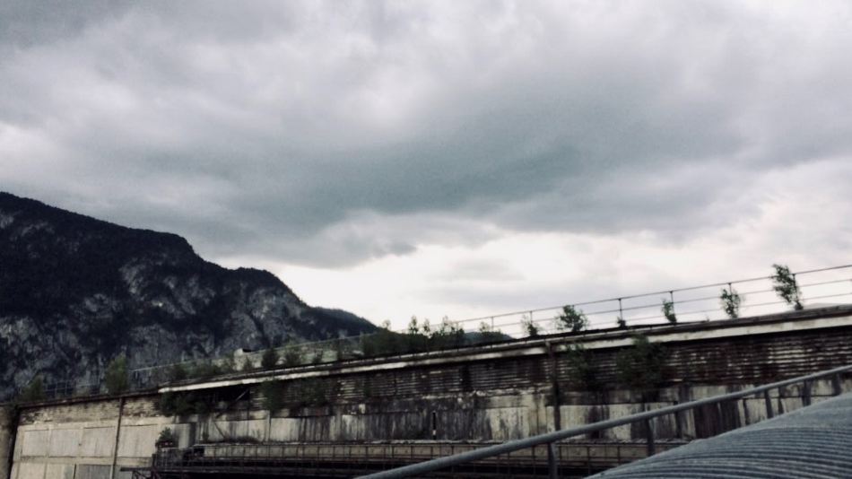

Subproject 1: Man and his Values
Articles
Der Autor, den es sich zu treffen lohnt / The author worth meeting
Wir schreiben gemeinsam ein Buch / We are writing a book together
Welt ohne Bücher / World without books

Slide 4
Subproject 1: Man and his Values
COMMENTS
About 50 comments were written in answer to the articles

Slide 5
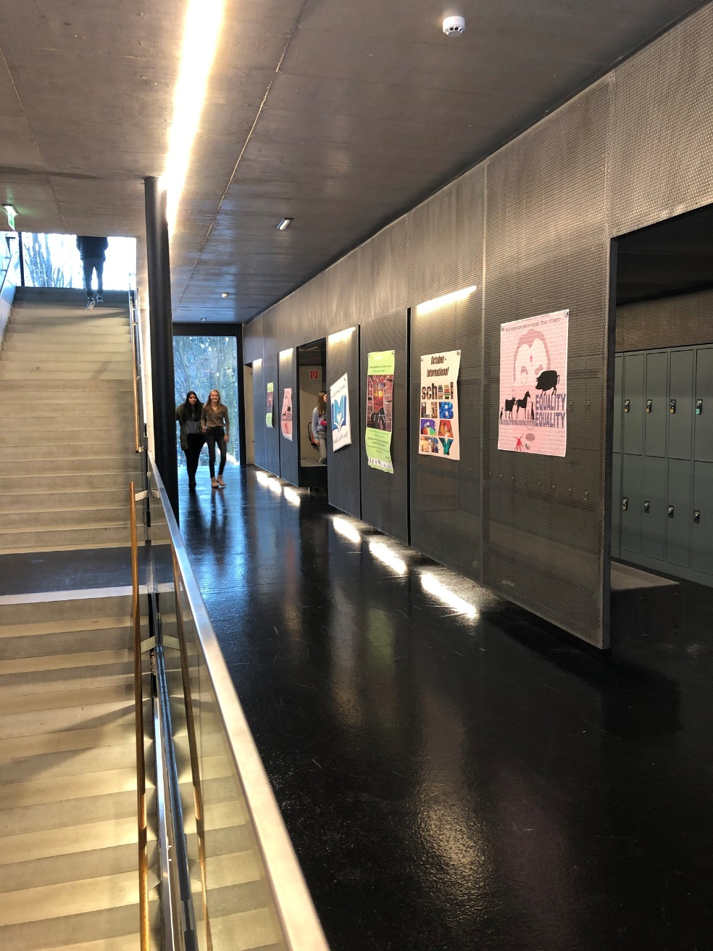
Subproject 1: Man and his Values
READING CAMPAIGN - Nov. 20th - Nov. 28th 2018
BG/BRG Kufstein - Classes:
5C, 6D – German lesson
5D, 6A – English lesson
6B, 6C – Lesson in mother tongue
5A - Discussion forum – Animal Farm
Mittelschule Kiefersfelden – German lesson

Slide 6
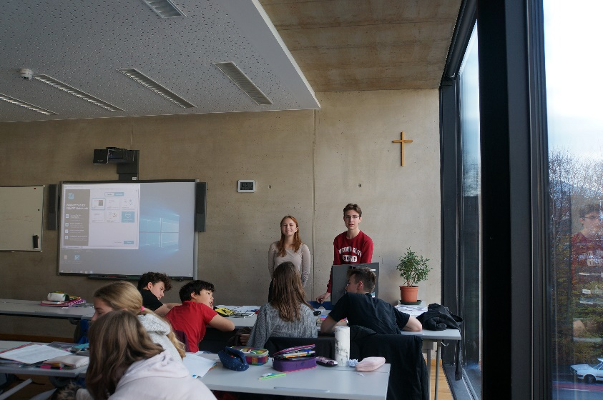
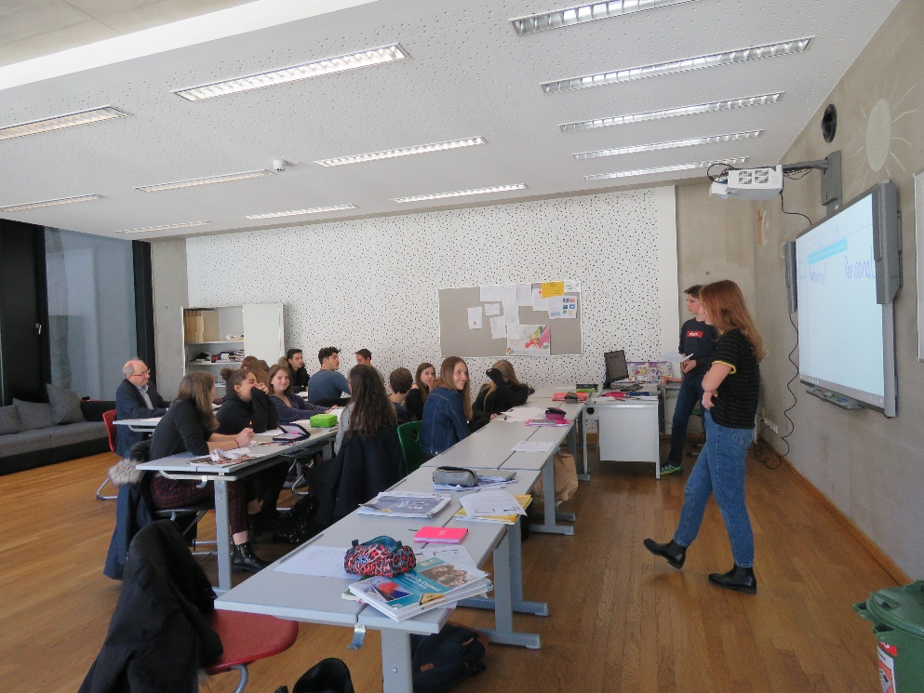
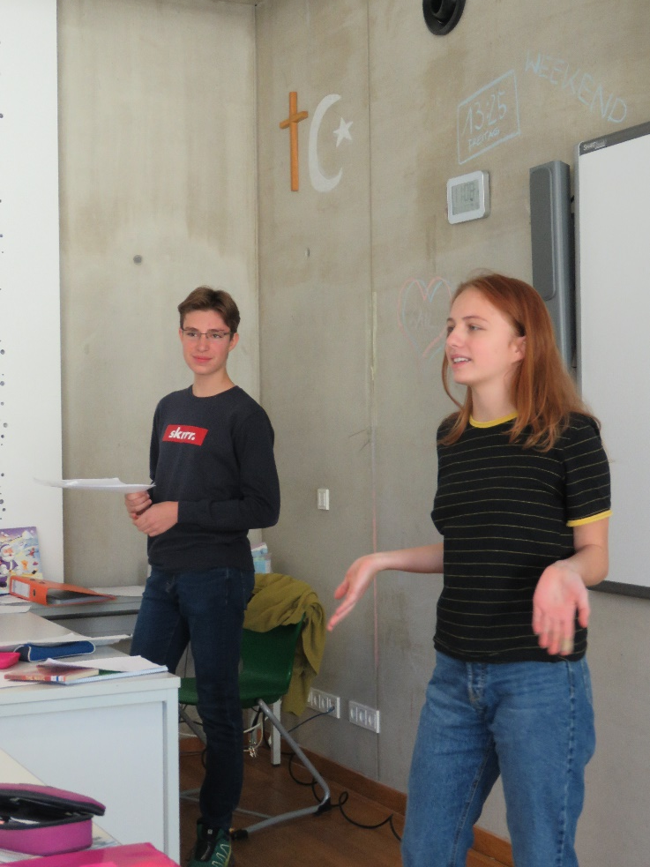
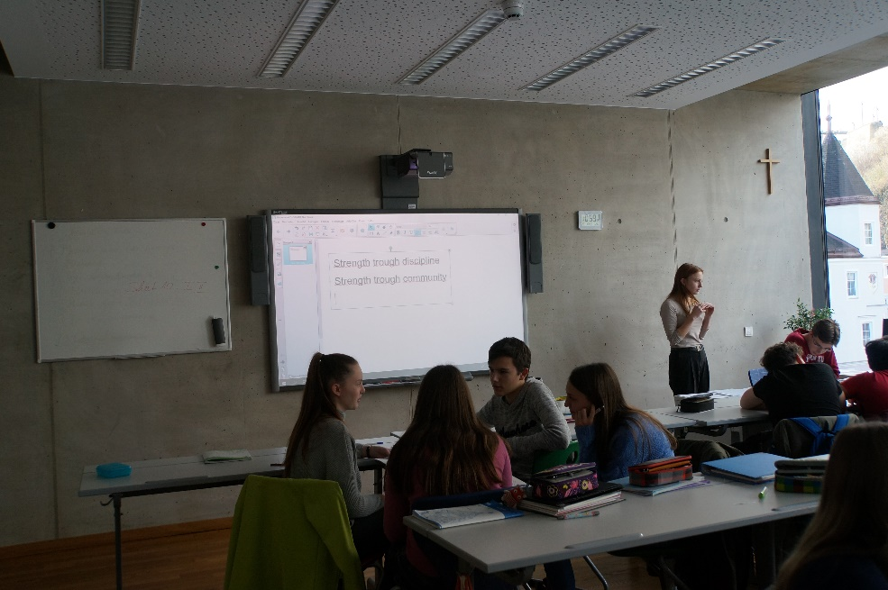
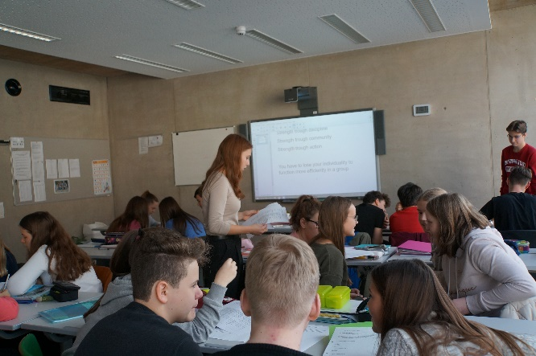
Subproject 1: Man and his Values
READING CAMPAIGN – The WAVE

Slide 7
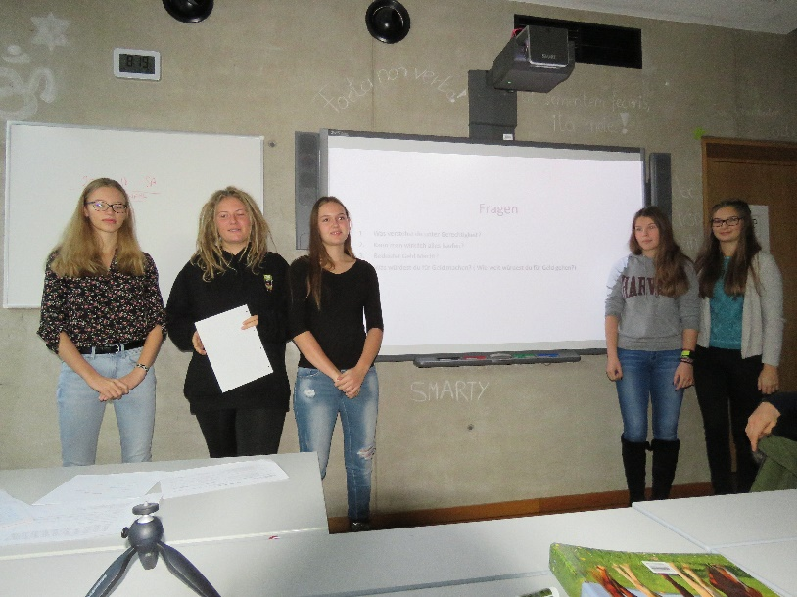
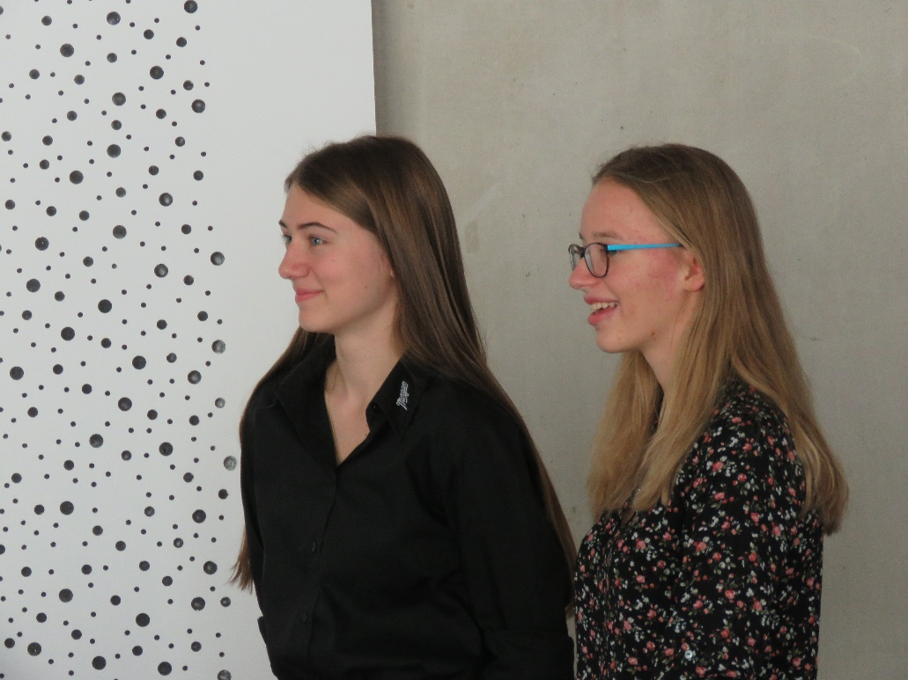
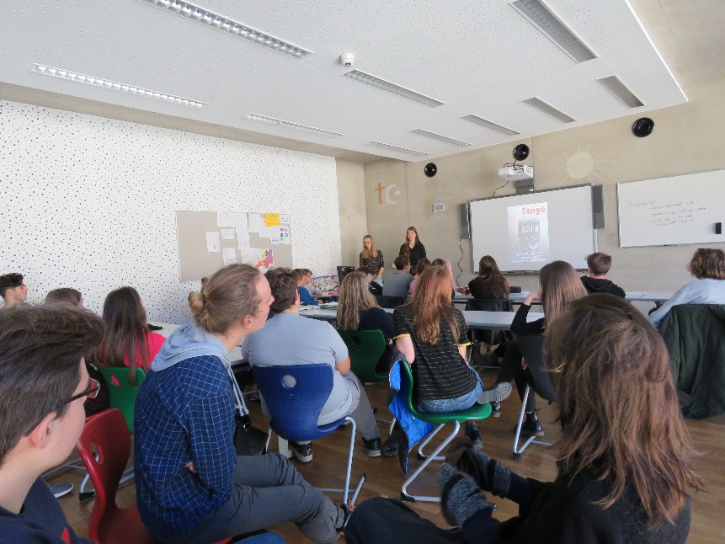
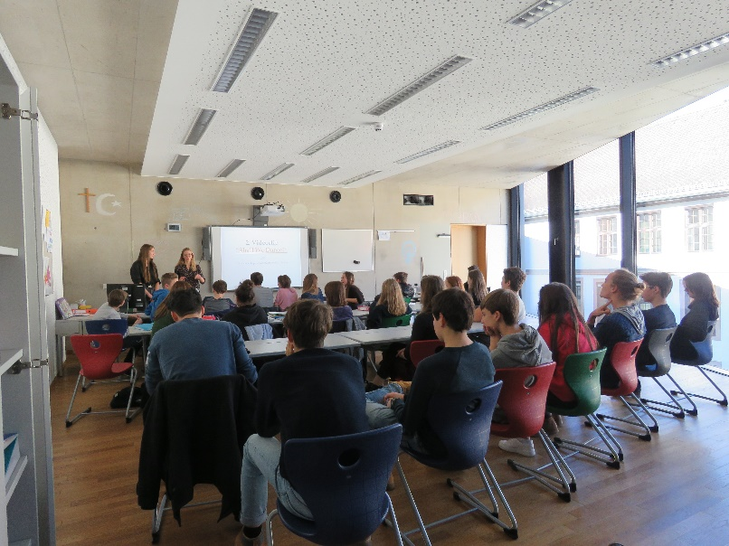
Subproject 1: Man and his Values
READING CAMPAIGN – TANGO

Slide 8
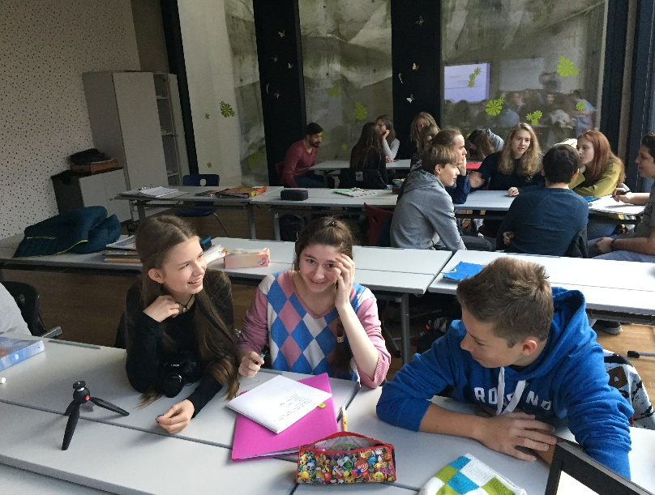
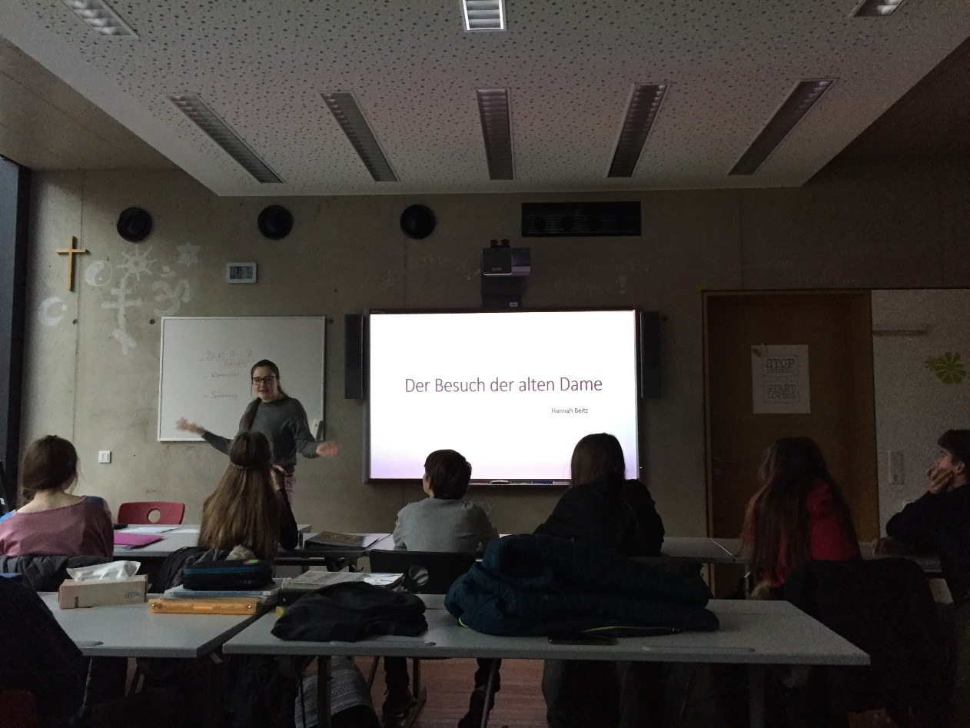
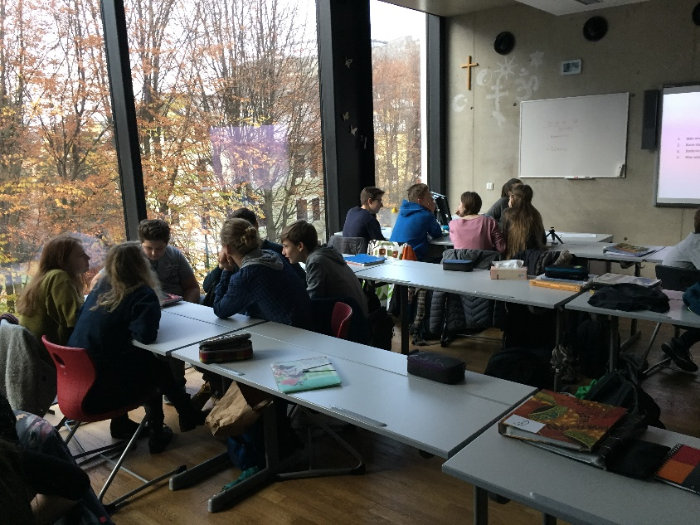
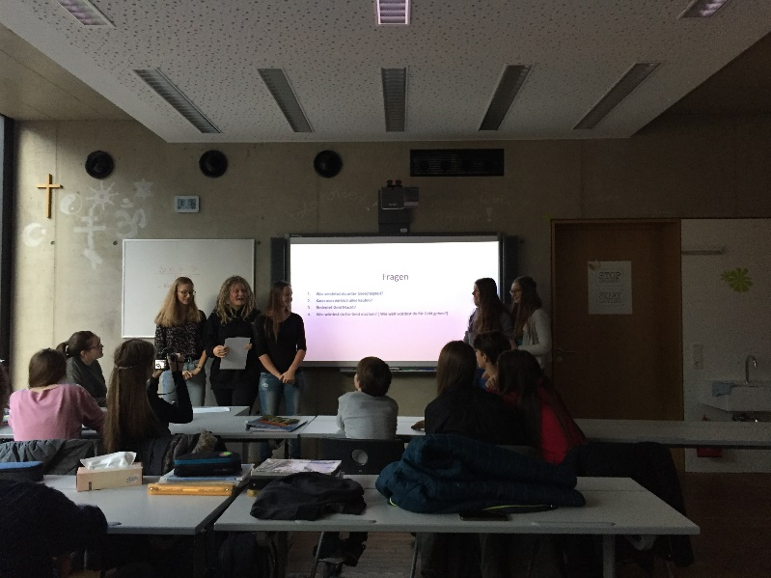
Subproject 1: Man and his Values
READING CAMPAIGN – BESUCH der ALTEN DAME

Slide 9
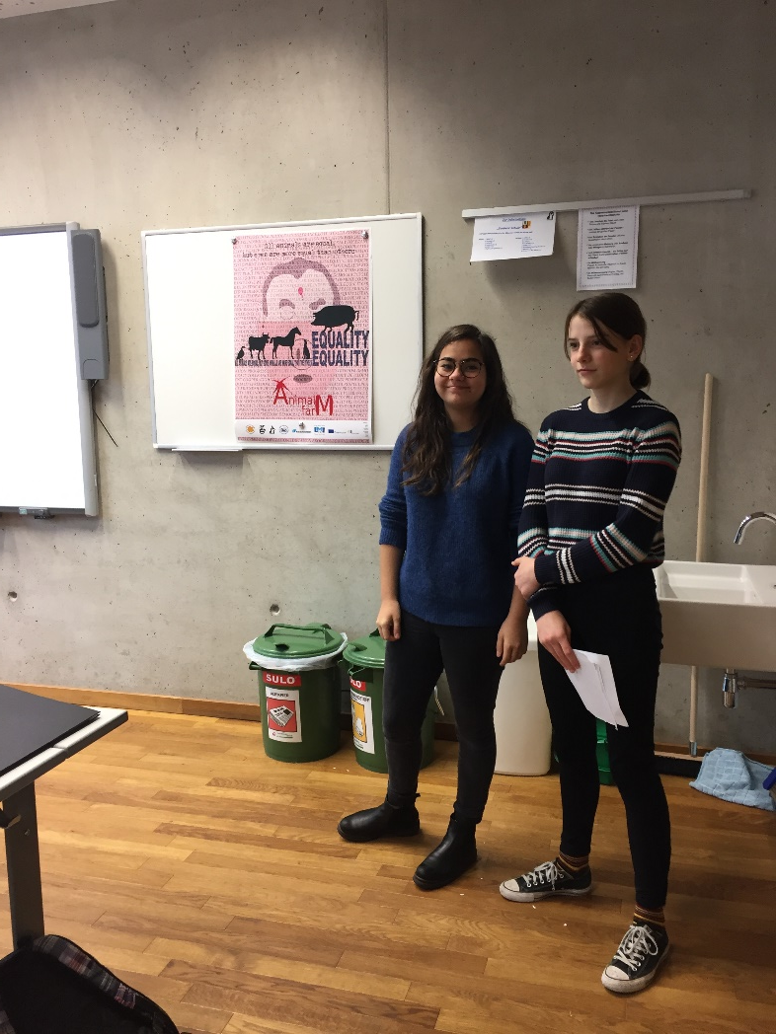
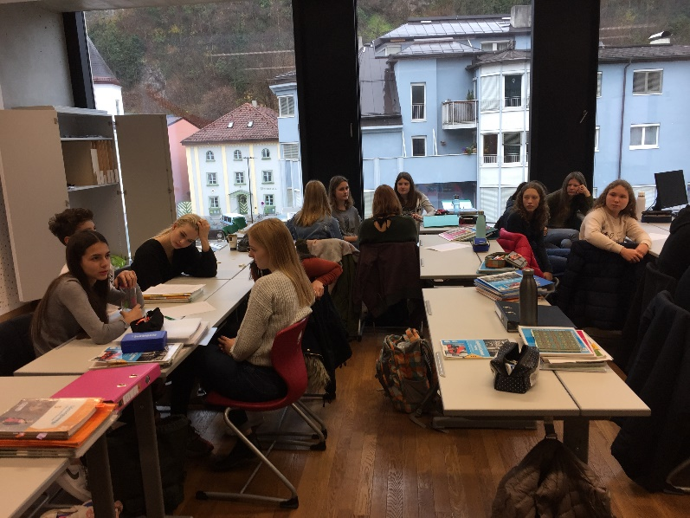
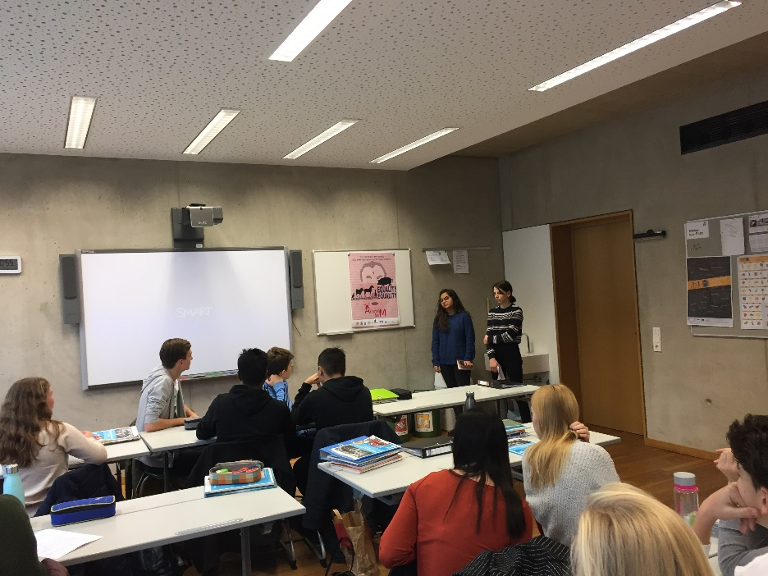
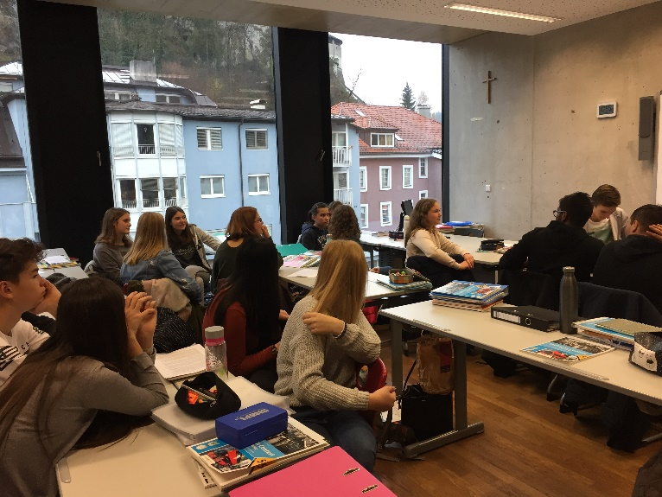
Subproject 1: Man and his Values
READING CAMPAIGN – ANIMAL FARM – Discussion Forum

Slide 10
Subproject 1: Man and his Values
READING CAMPAIGN

