Slide 1
What we have achieved
Results of our work

Slide 2
Articles
We wrote articles to publish them on TwinSpace:
“There can be situations in life in which you don´t know what to do. Either you have got a big problem which is difficult to solve or you have lost sight of the meaning of life.”(“Is there a way out at all?”)
„Heutzutage hat sich die Bedeutung einer aussichtslosen Situation für jeden in einer anderen Art und Weise verändert. Wir sind nicht in der gleichen Situation wie Anne Frank und die Art der Verzweiflung hängt immer von den Lebensumständen ab. Jedoch können wir darüber spekulieren, was Menschen dazu bewegt hat, nicht aufzugeben.“ („Die Hoffnung stirbt zuletzt“)
We prepared them in small groups

Slide 4
Comments
Each of us commented on at least one article:
“I totally agree with you. In my opinion, words are the strongest power in this world. Only by using a couple of words you can start a war or end it.”
(“Quotations worth remembering”)
We read comments below our own articles:
“I've never really thought about what creates my value system so this text really opened my eyes on a lot of things”
(“Factors influencing our system of values”)

Slide 6
Lessons
Lessons have been prepared in Krakow to each of the books
Tango Native language
The Wave English
The Visit German
Erasmus+ students teached grade 9 and 10 students
The overall feedback we received was very positive
appealing presentations
Interesting book choices
Main criticism: low preparation time for Erasmus students

Slide 7
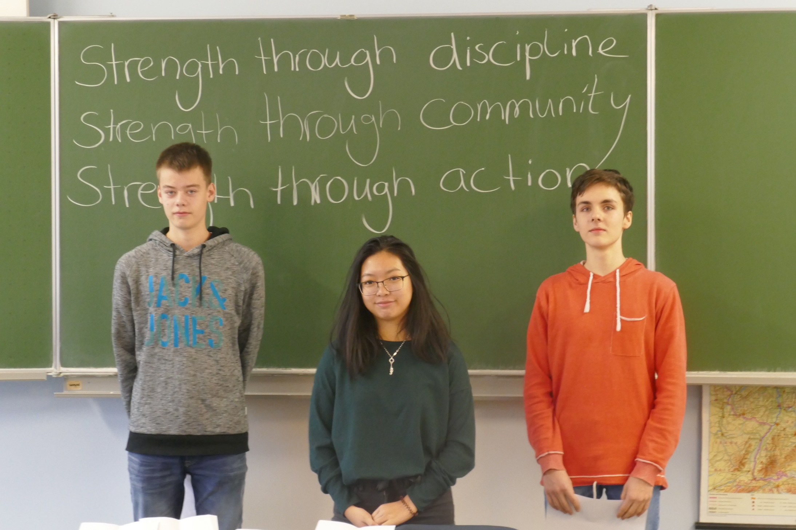

Slide 8
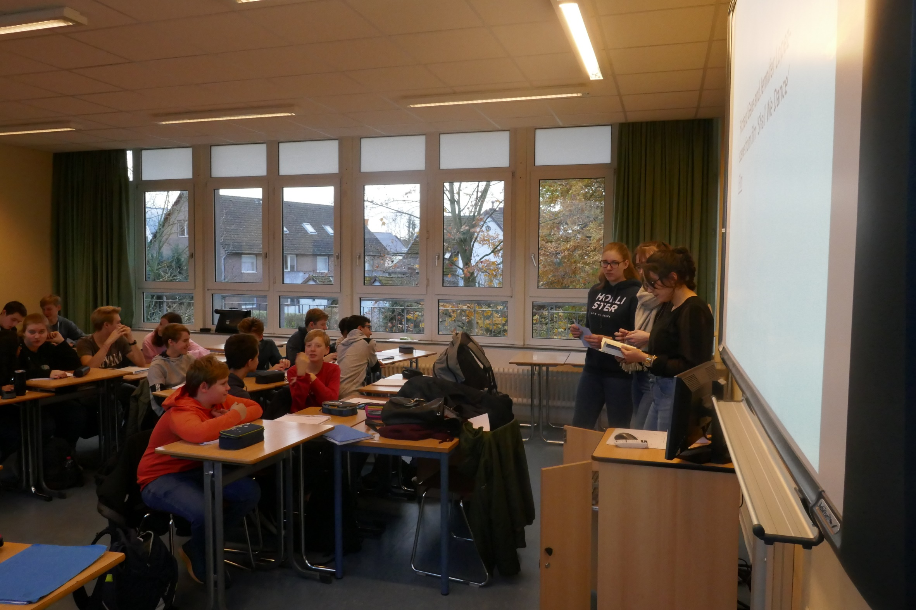

Slide 9
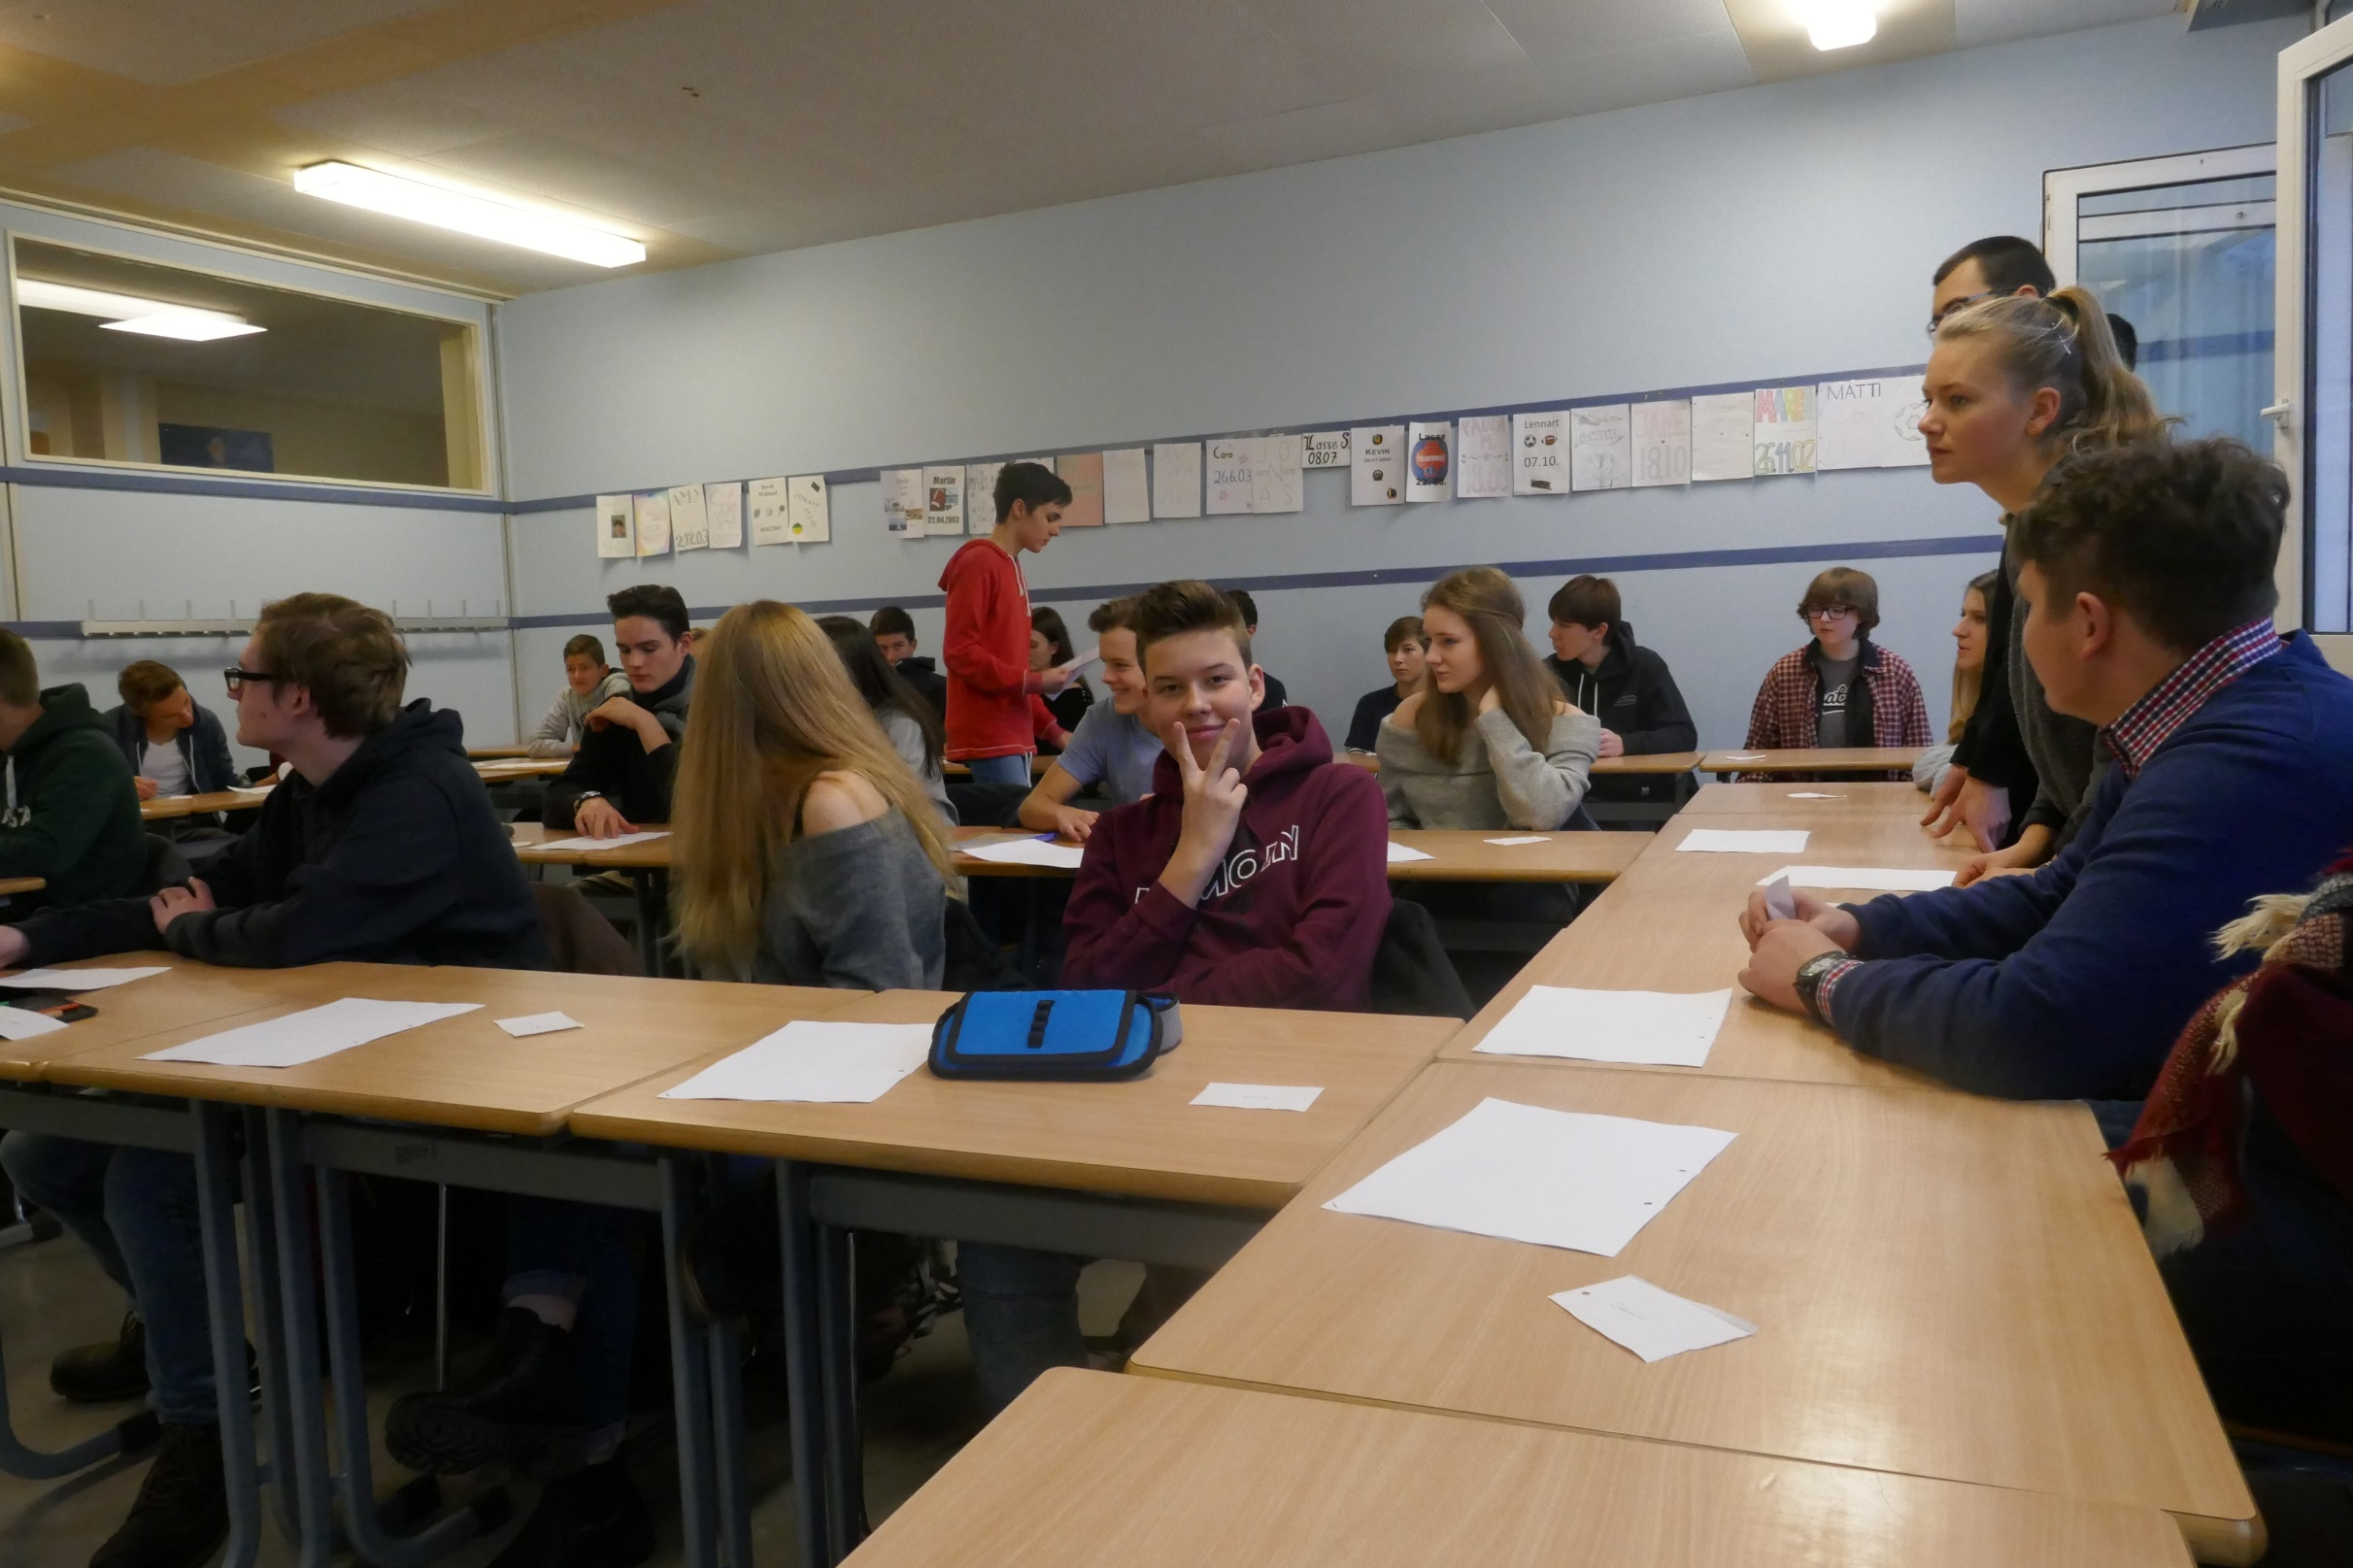

Slide 10
We are looking forward to carry on working together in Buxtehude!

