Slide 1
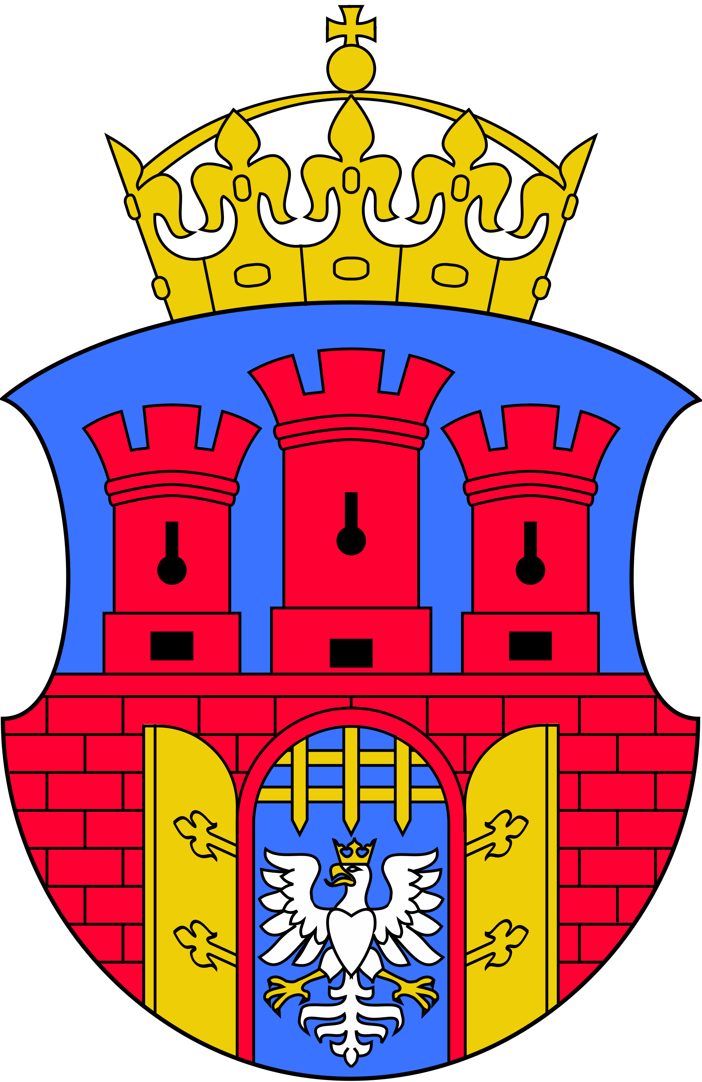
Kraków

Slide 2
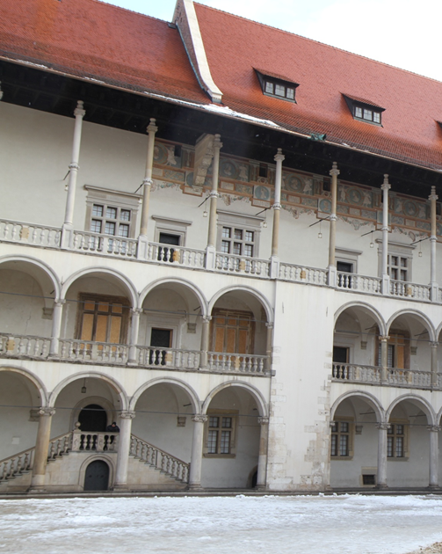
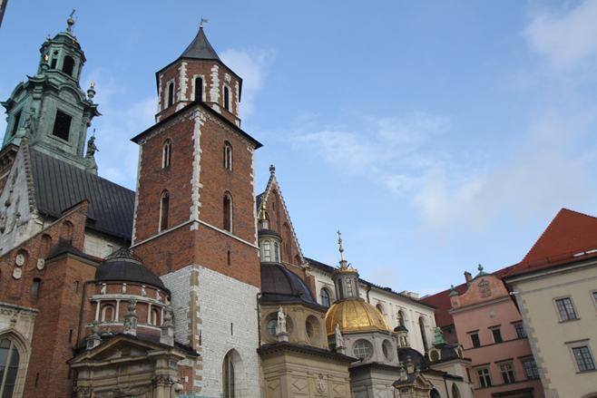
Wawel

Slide 3
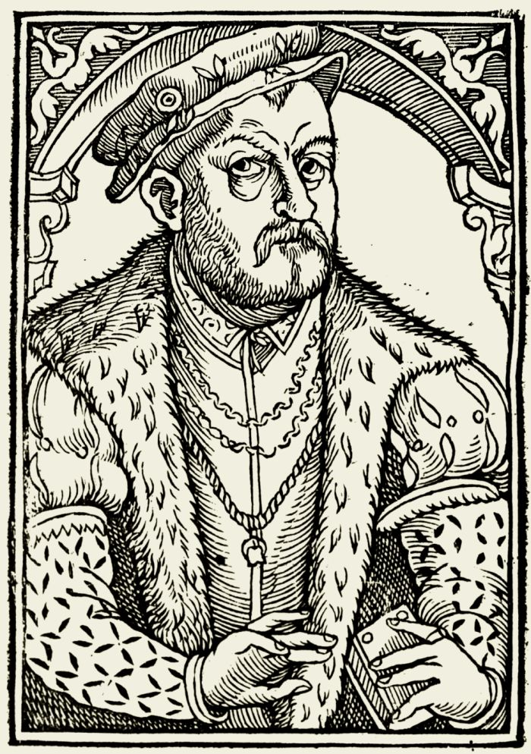
Kraków – the „cradle” of Polish literature
Die Völker außerhalb sollen aber wissen, dass die Polen keine Gänsesprache, sondern ihre eigene Sprache haben!“
"Let it by all and sundry foreign nations be known that Poles speak not a Goose but a tongue of their own."
Mikołaj Rej

Slide 4
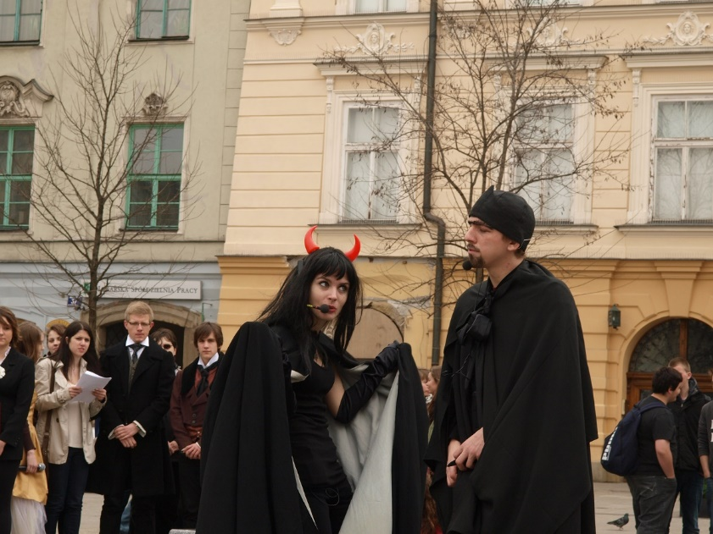
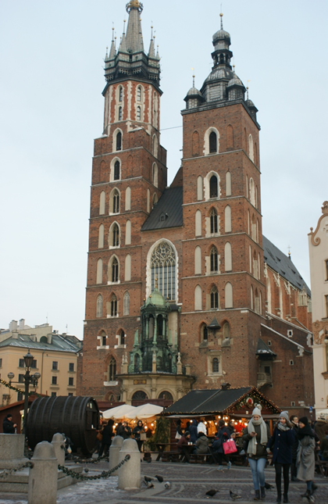
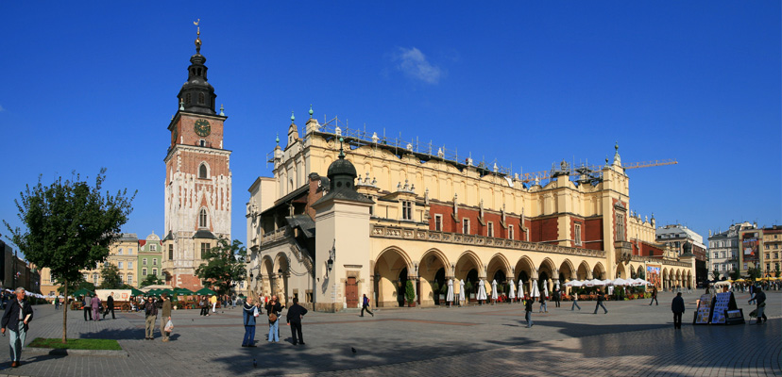
Cracow
Main Market Square
- the heart of the city

Slide 5
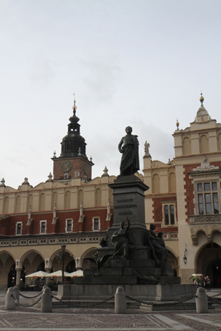
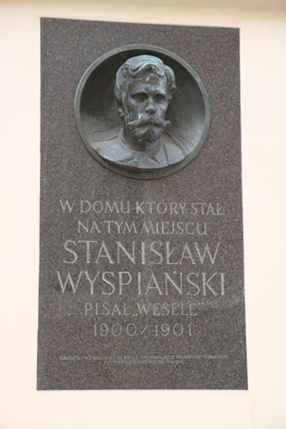
Polish poets are constantly present in Kraków
Adam Mickiewicz
Stanisław Wyspiański

Slide 6
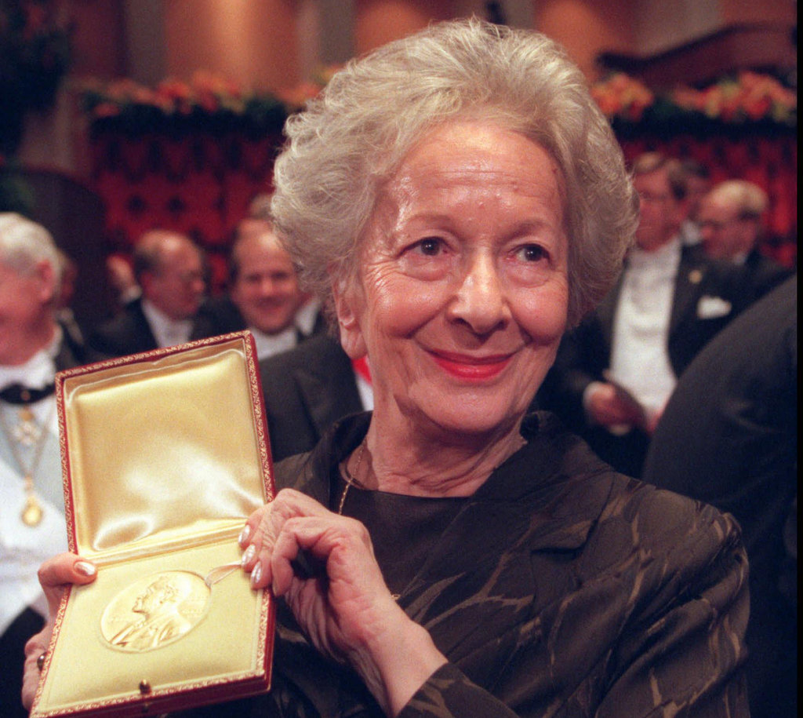
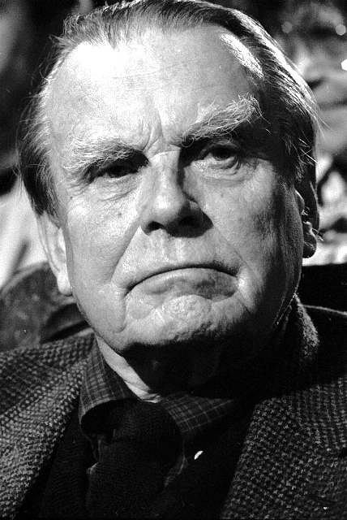
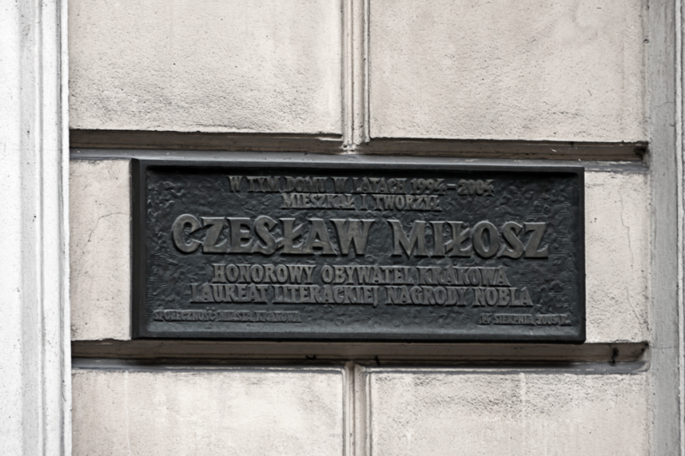
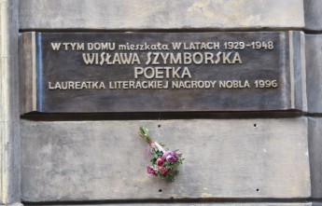
Krakow Nobel laureates in Literature

Slide 7
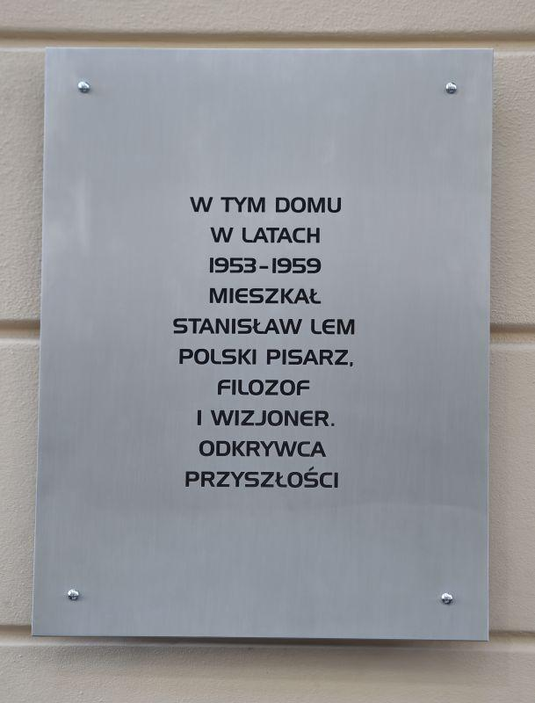

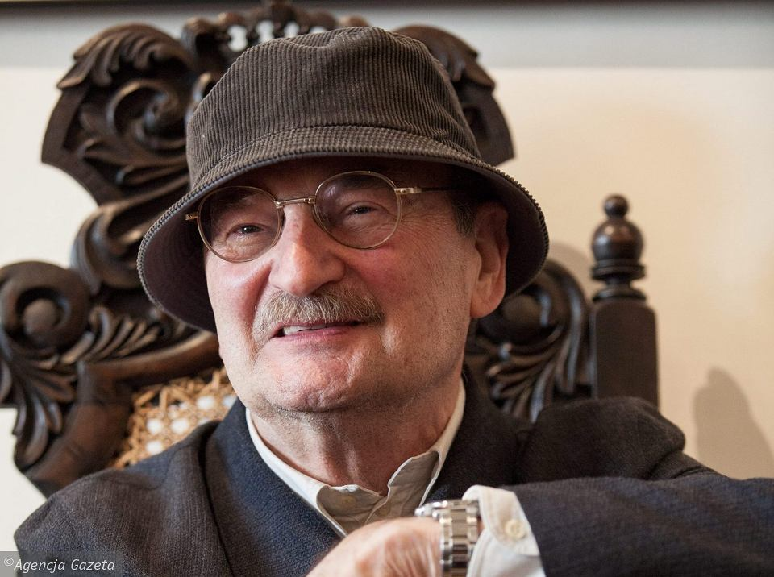
The city of literature creators
Sławomir Mrożek
Ul. Bonerowska 5

Slide 8
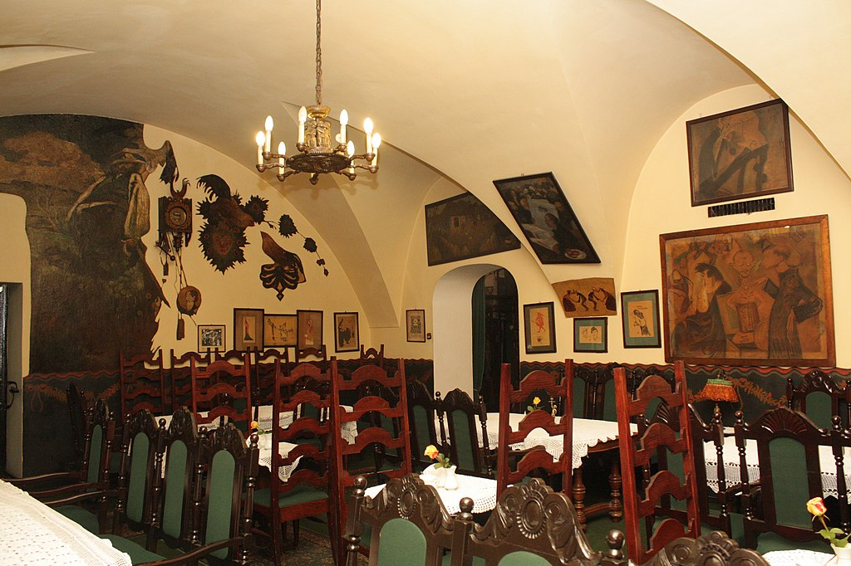

Literary life of contemporary Kraków
International Literary Festival named after Joseph Conrad
Jama Michalika - literary cafe from the 19th century

Slide 9

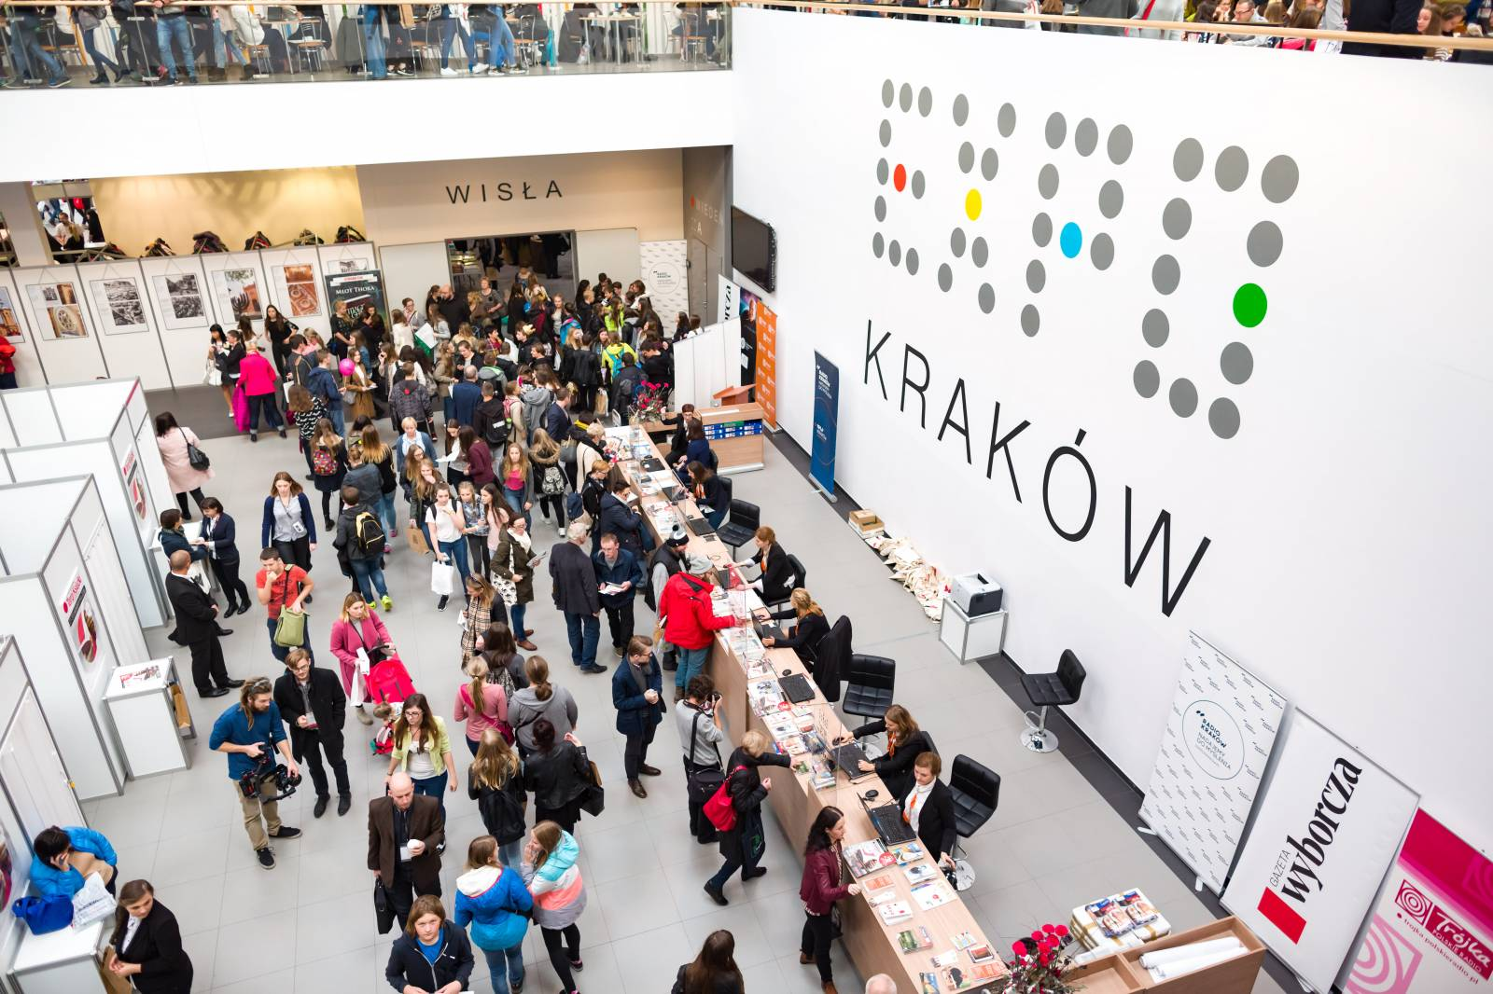
International
Book Fairs

Slide 10
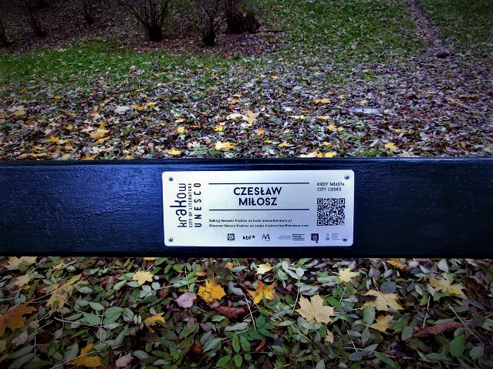
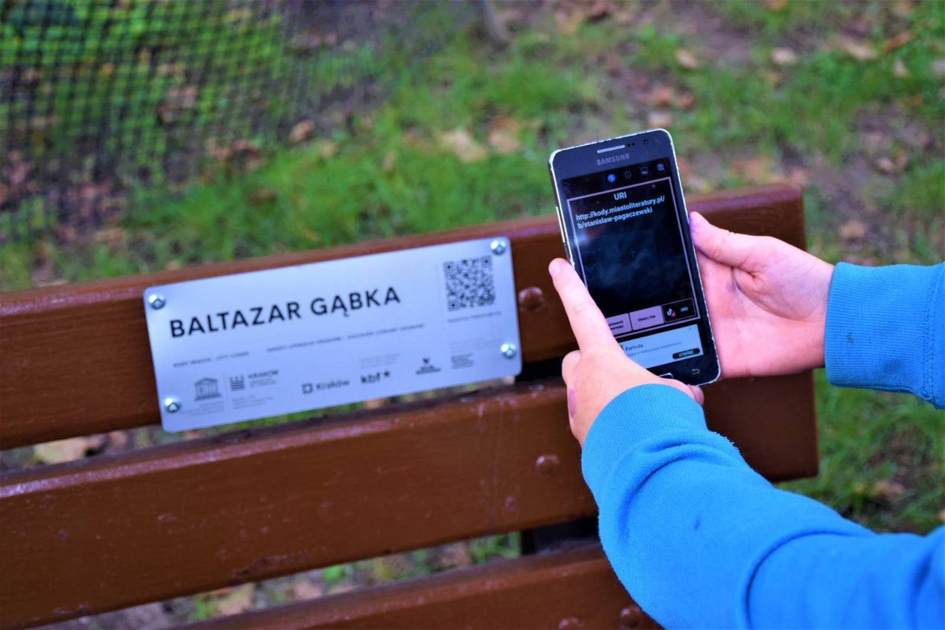
Literary benches in Krakow Planty Park

Slide 11
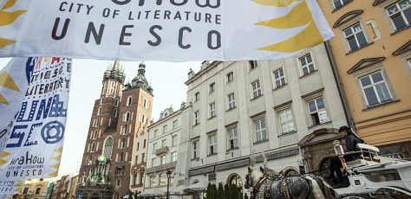
Kraków - UNESCO City of Literature

