Slide 1
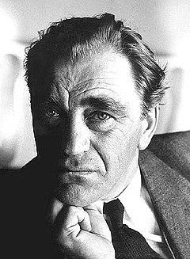
Vilhelm Moberg
1898-1973
Notes:
Edit
This is a presentation of Vilhelm Moberg. Växjös pride. He was born 1898 and died 1973.
Now we’re going to play an act from his book ‘Utvandrarna’. This scene is from a chapter named ‘Gröten’ in English ‘porridge’ It’s about Karl Oskar, Kristina and her daughter Anna who eats too much porridge. It was a great starvation in Sweden during the middle of the 19th century.
Anna died because of the porridge. Her stomach bag swelled up. This made Kristina change her mind about emmigrating.

Slide 2
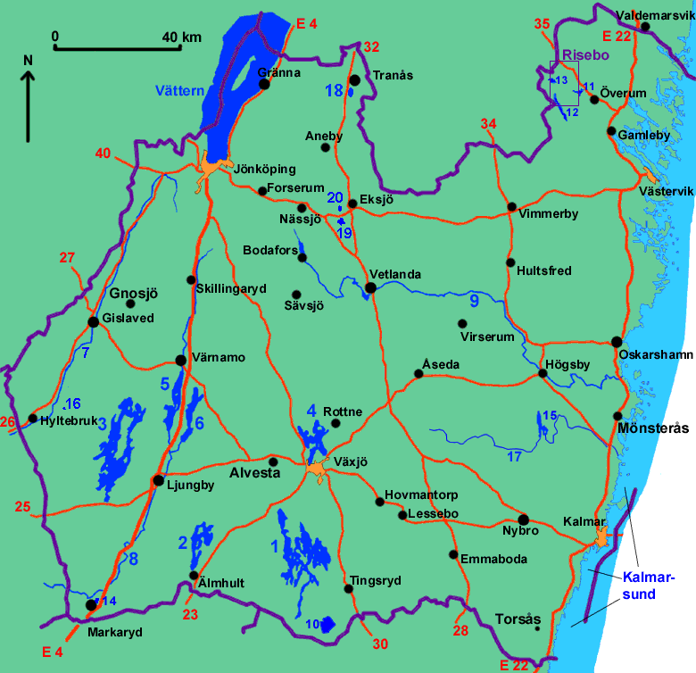
Childhood/early life
Born in 1898 in Moshultamåla; Father: Karl Gottfrid Moberg (soldier) and mother: Ida Charlotta Aronsdotter.
6 siblings, only 2 reached adulthood
Went to school in Moshultamåla
Family was very poor
Moshultamåla
Notes:
Axel

Slide 3
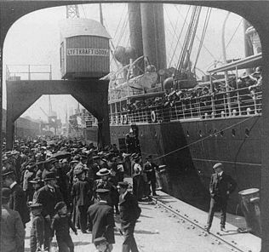
Swedish emigration to USA mid 1850 - mid 1914
Sweden was a poor country with a high death rate
The emigration started around 1850
Around 1,5 million Swedes (about 1/5 of Sweden's population) left, however some returned.
Left because of famine, religion, and because of the cheap land and freedom in USA
Notes:
Emma

Slide 4
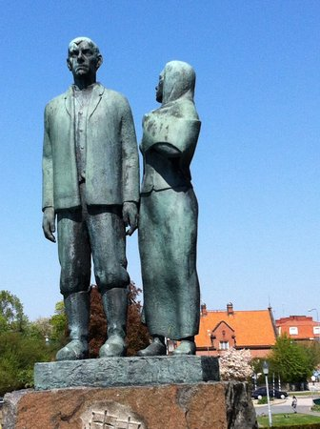
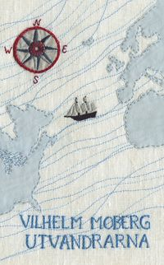
Utvandrarna
The book series Utvandrarna (the Emigrants), Invandrarna (the Immigrants), Nybyggarna (the Settlers), Sista brevet till Sverige (The Last Letter to Sweden)
The first book Utvandrarna published in 1949 (adapted to a film in 1971) is about Karl-Oskar and Kristina deciding to move to America and their voyage across the Atlantic
Notes:
Felicia
ska också nämna om hur Kristina tvekade på att åka medans Karl-Oskar såg det som en bra chans till ett nytt liv

Slide 5
The Musical “Kristina from Duvemåla”
Based on “Utvandrarna”

Slide 6
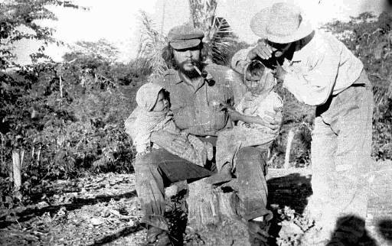
Gold Can Turn to Sand
Musical: Kristina from Duvemåla
https://www.youtube.com/watch?v=cIaf9fvCJ4Y

