Slide 1
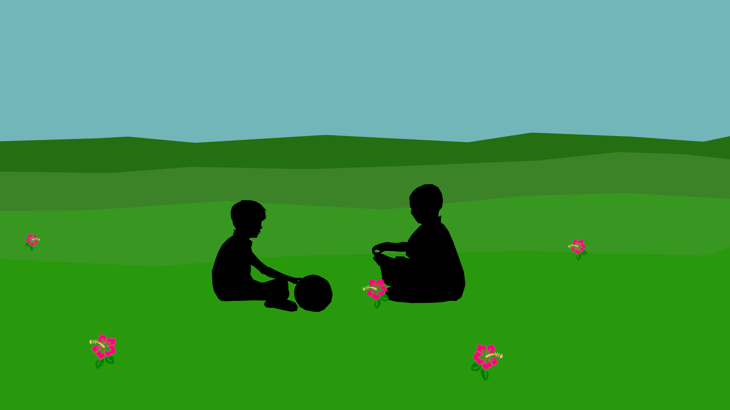

Slide 2
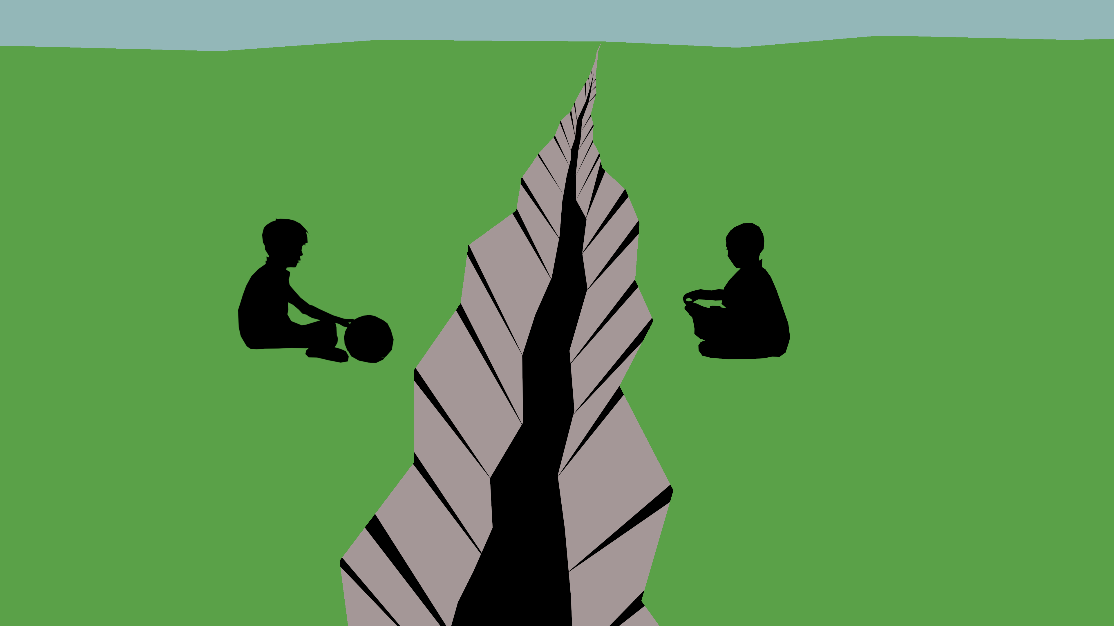

Slide 3
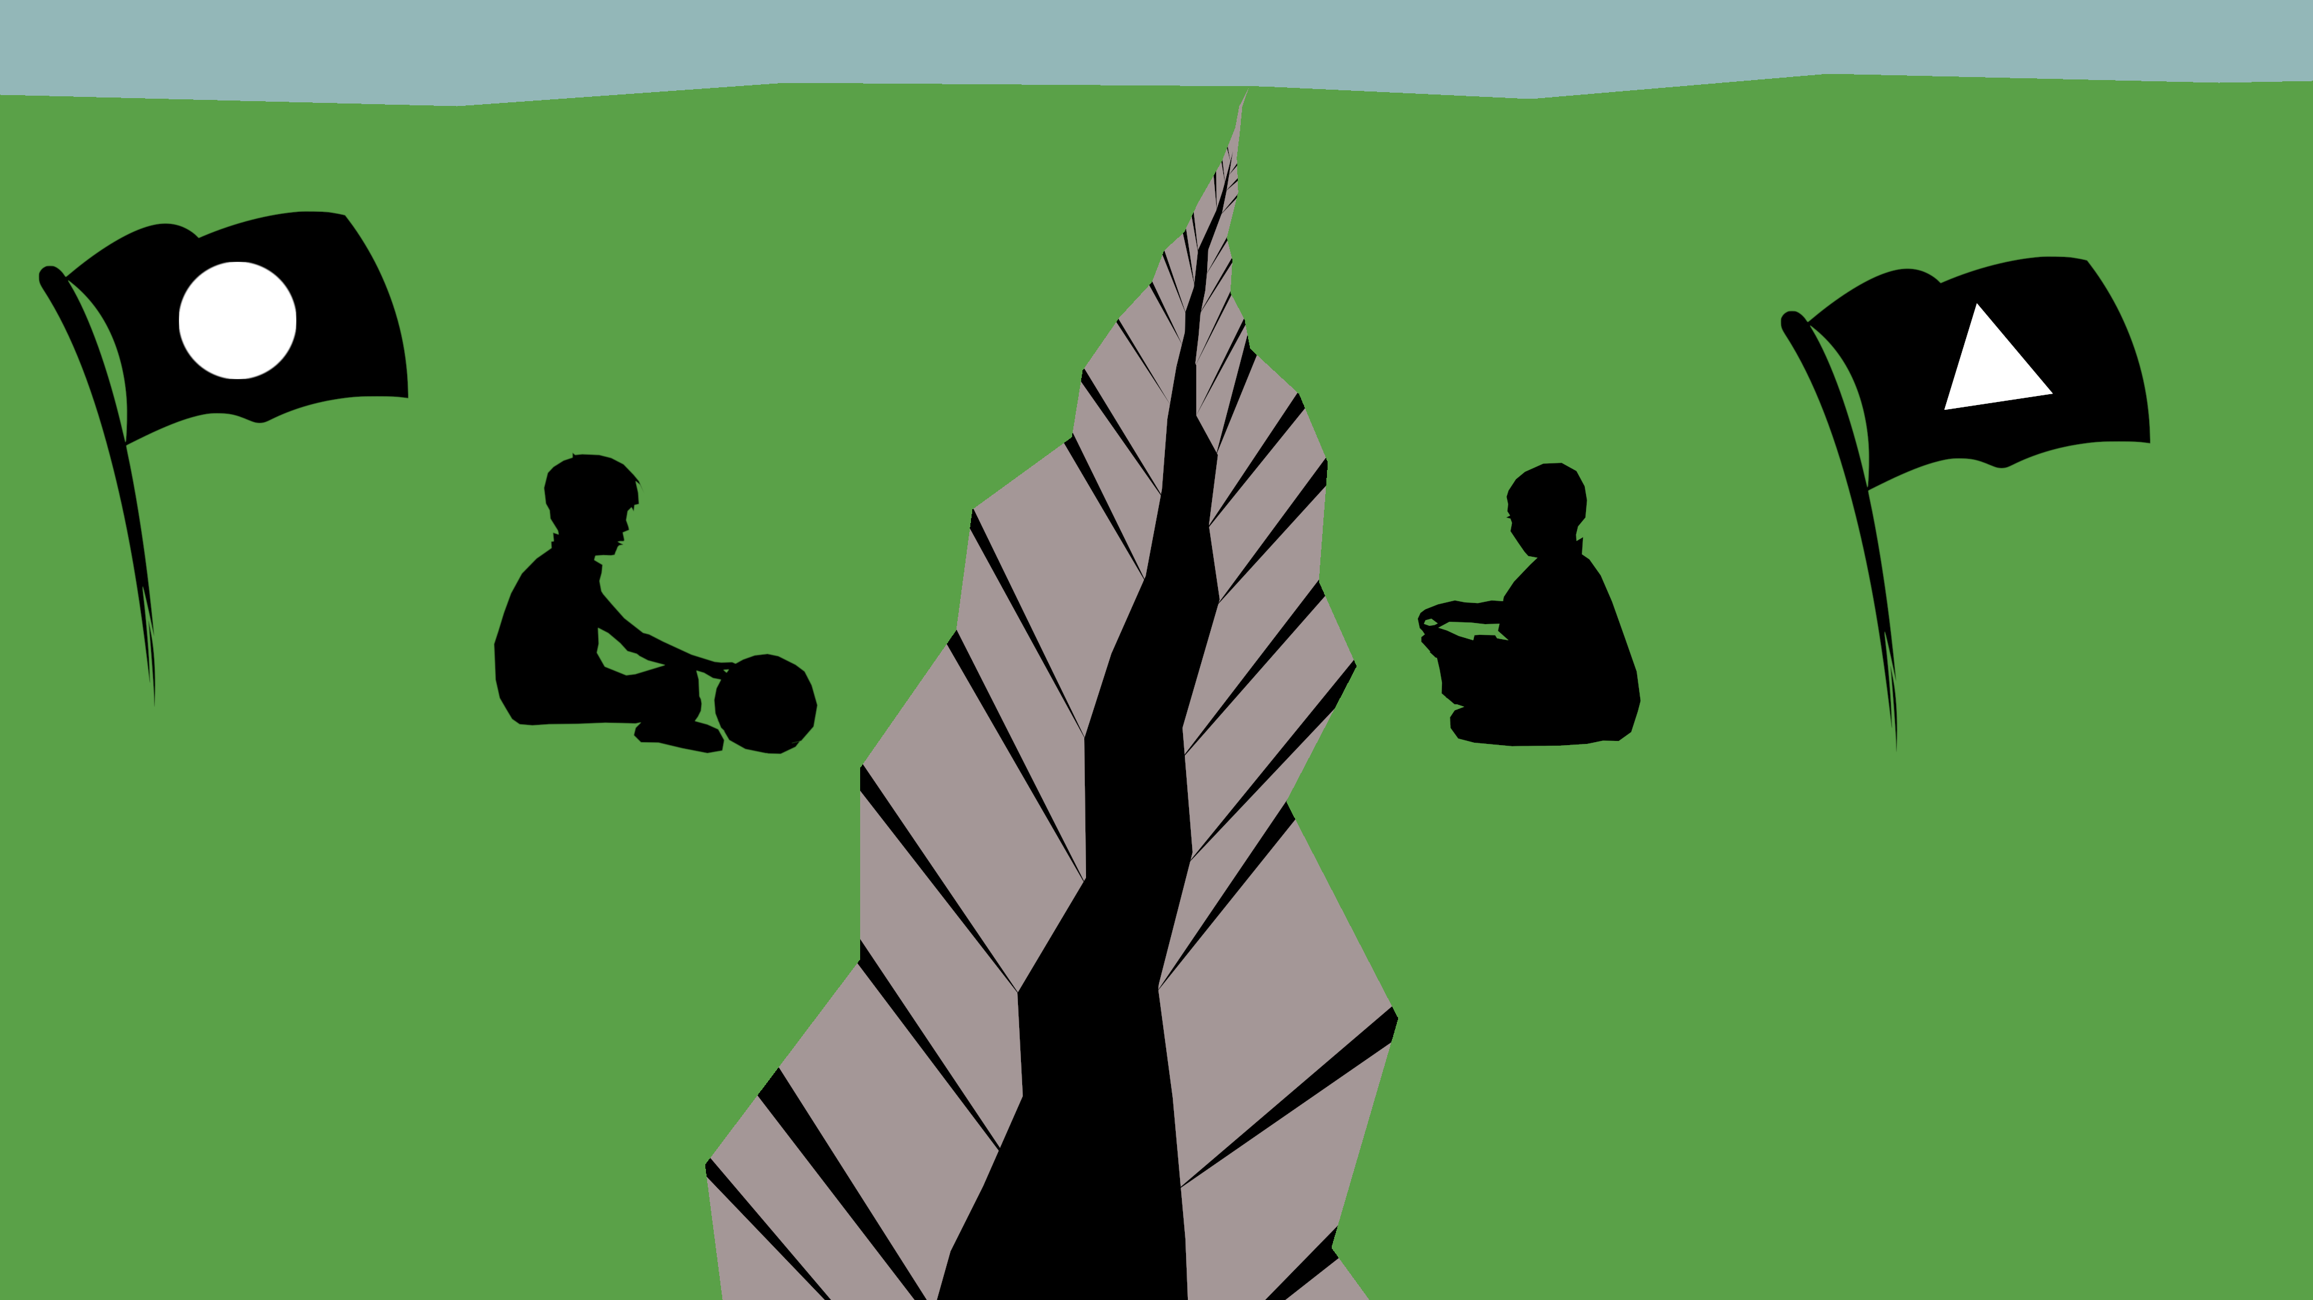

Slide 4
The meaning of friendship in different situations
Erasmus English lesson

Slide 5
“I came home from school and my mother was making armbands for us from a special cloth and drawing a star on each one. Like this. Using his finger he drew a design in the dust ground beneath him.
`And every time we left the house, she told us we had to wear one of these armbands. My father wears one too said Bruno. On his uniform. It´s very nice. It´s bright red with a black-and-white-deign on it. Using his finger he drew another design in the dusty ground on his side of the fence.
Yes, but they´re different, aren´t they? said Shmuel. No one´s ever given me an armband, ` said Bruno. `But I never asked to wear one, ` said Shmuel. ‘All the same,’ said Bruno, I think I’d quite like one. I don’t know which one I’d prefer though, your one or Father’s.”
Chapter 12 (p. 126-127) ”The Boy in the Striped Pyjamas”

Slide 6
Thank you for your attention

