Slide 1
Halepaghen-School
Buxtehude, Germany

Slide 2
The HPS
number of students: 1118
principal: Bettina Fees-McCue
form of school: Gymnasium
committees: joint committee, pupils committee, parents committee and schools committee

Slide 3
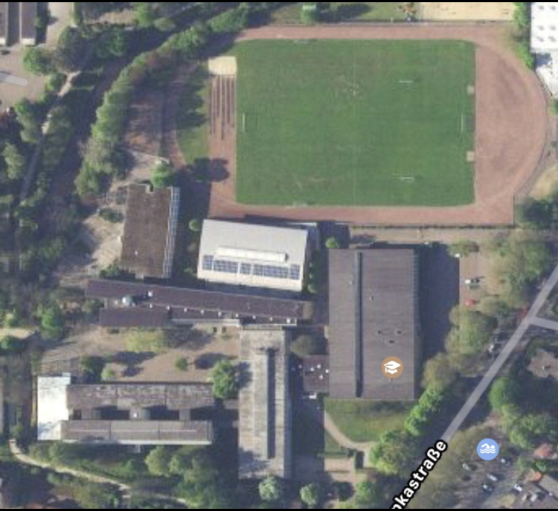
map
6
Main entrance
School hall
Secretary´s office
Break hall
Canteen
Sports field
Library
Biology rooms
Physics and chemics rooms
8
7
2
9
1
5
4
3

Slide 4
library

Slide 5
our new canteen

Slide 6
school hall

Slide 7
life in school
exchanges
France
Sweden
Lithuania
Spain
USA
language projects
Cambridge
DELF
CertiLingua
Europapass
Trait d‘Union
Comenius and Erasmus
France Mobil
more
School without Racism – School with Courage
MINT
UNESCO

Slide 8
life in school
pupils
Labour communities
Pupils help pupils
Ambulance service
advices
advisory teachers
prefects
pastoral services

Slide 9
Questions?

Slide 10
Thank you for your attention!

