Slide 1
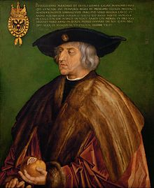
Emperor Maximilian I. (1459 – 1519)
2019 – 500th anniversary of Maximilian‘s death
Maximilian – expanded the influence of the House of Habsburg in Europe

Slide 2
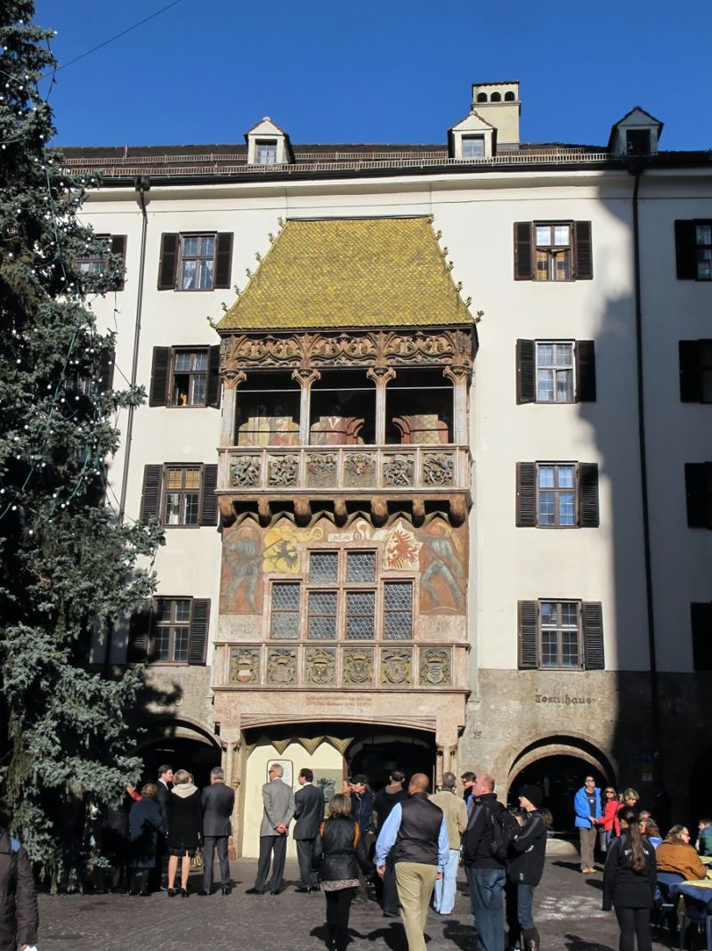
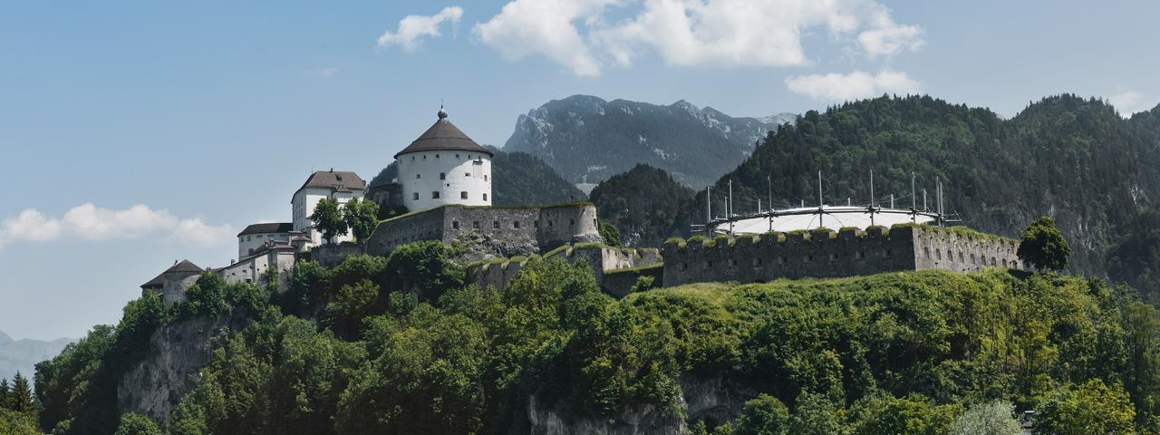
Emperor Maximilian I. (1459 – 1519)
Built the ‚Golden Roof‘ in Innsbruck
Conquered the Fortress of Kufstein in 1504 from Bavaria

Slide 3
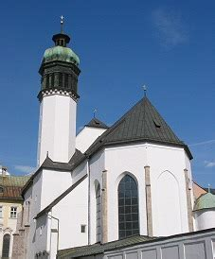
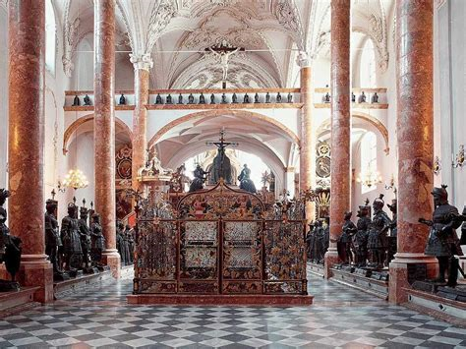
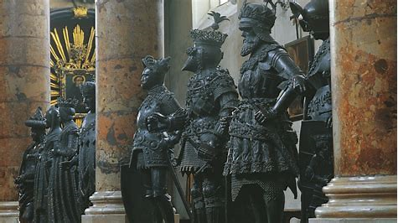
Emperor Maximilian I. (1459 – 1519)
Maximilian‘s cenotaph tomb in the ‚Hofkirche‘ – also called ‚Schwarzmandakirche‘ – Innsbruck

Slide 4
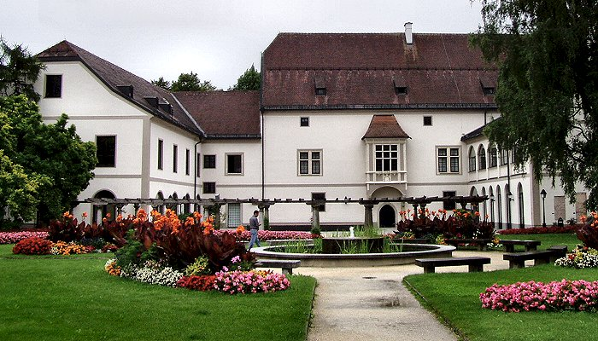
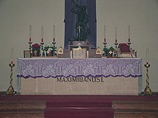
Emperor Maximilian I. (1459 – 1519)
Died in the Castle of Wels (Upper Austria)
Buried in the St. George‘s Chapel in Wiener Neustadt (Lower Austria)

Slide 5
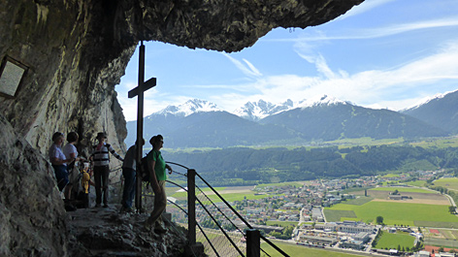
The ‚Martinswand‘ near Innsbruck

