Slide 1
FIT FOR FUTURE
Emirhan ALTINTAŞ

Slide 2
Activities in School
Day 1

Slide 4
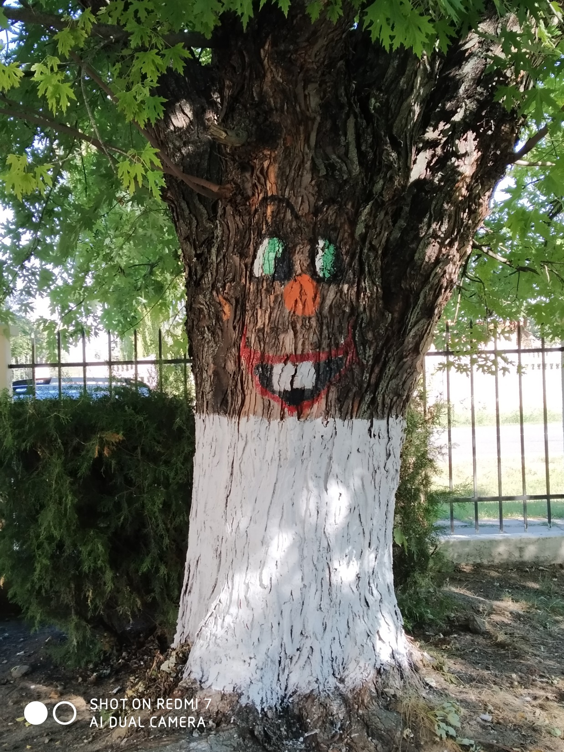

Slide 6
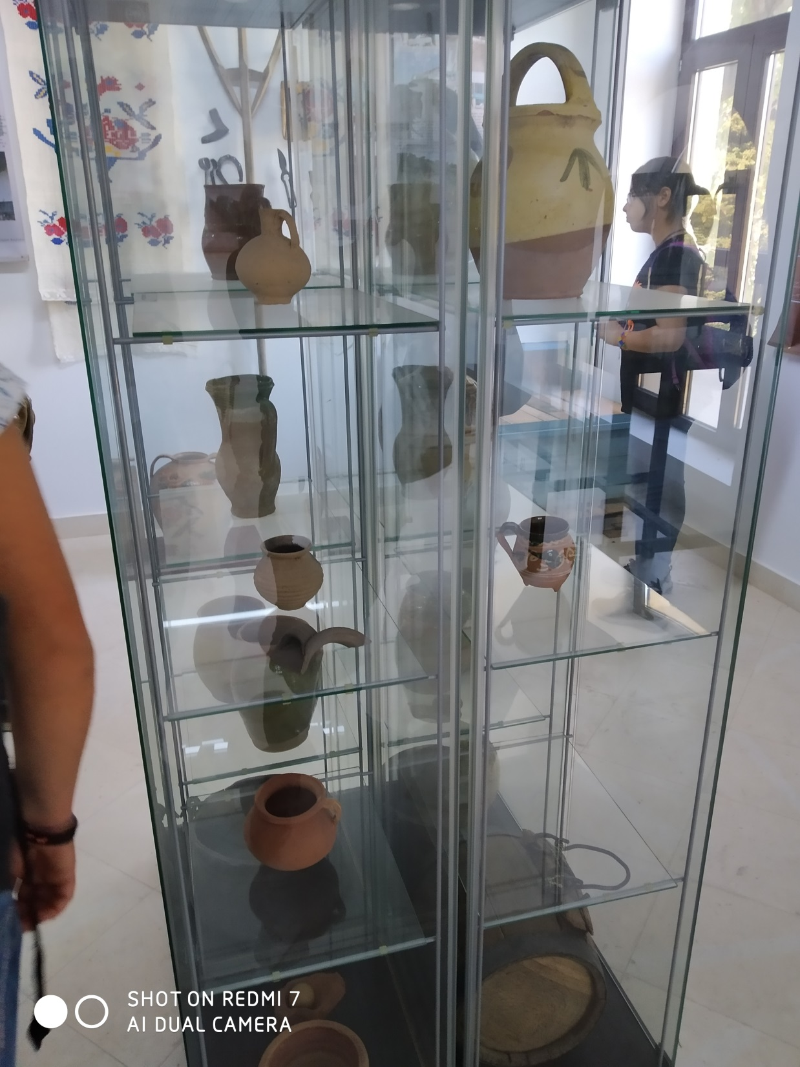
Ostrovity Vineyard
Day 2

Slide 8
Bâlea Lake

Slide 9
Travel to Alba Lulia

Slide 10
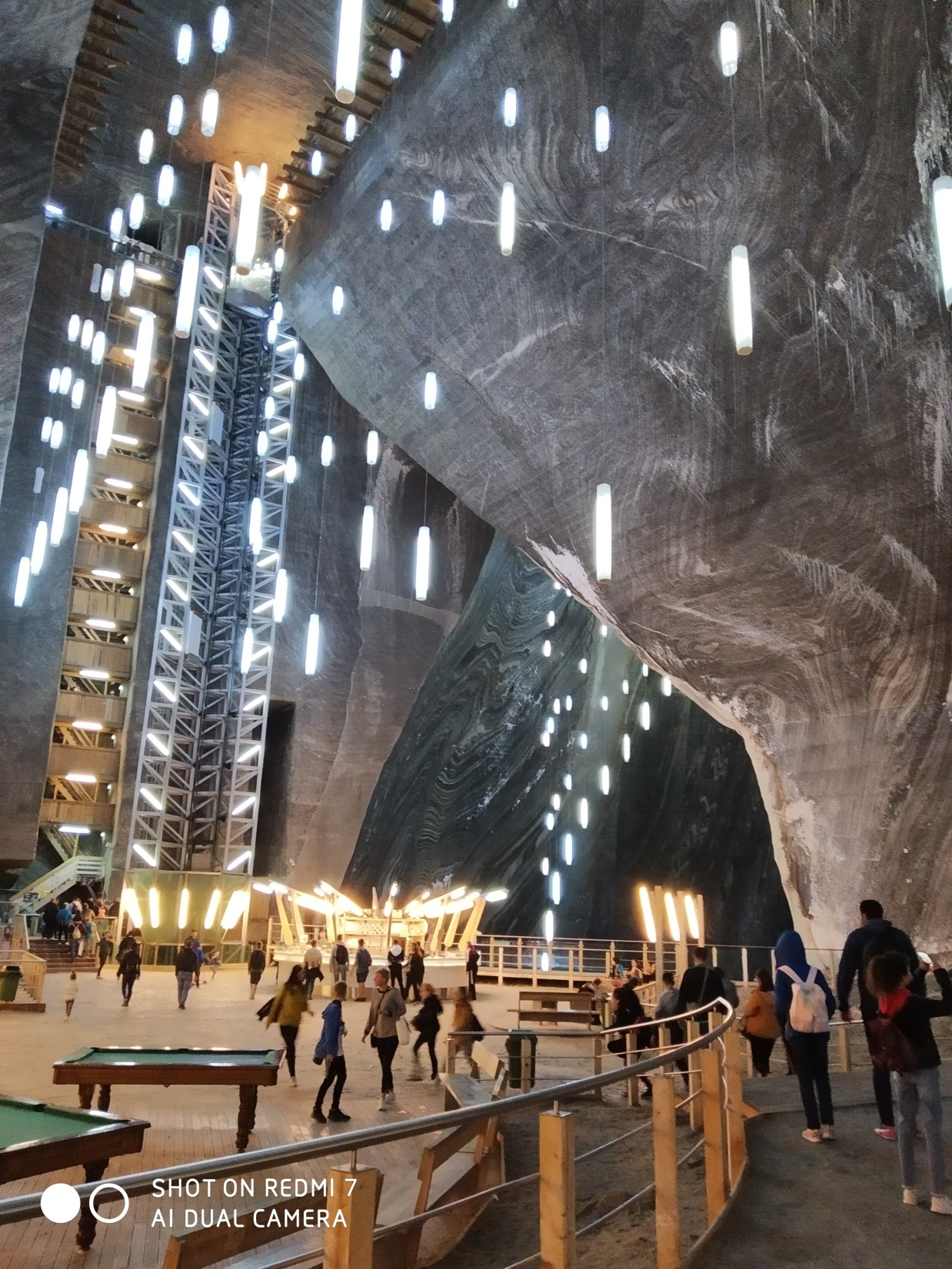

Slide 11
Mandala

Slide 13
THANK YOU
ZAĞNOS PAŞA ORTAOKULU

