Slide 1
My school
Name: Alexandra Chițu & Ramona Savu
Grade: 7
Dichiseni School
Călărași County
Romania

Slide 2
School
That's what the Dichiseni school looks like. It is great, beautiful and welcoming.
It is amazing and it has some very good and hard-working students .
The courtyard of the school is very large and decorated very nicely with benches, trees and lawn.

Slide 3
o

Slide 4
All classes are very beautiful.

Slide 5
Our school it isn’t a place where teachers and students are meeting. Actually, it is a place where we are learning about many things, it is an intersection in life which allows us to take it, depending on our interests or skills, on one of the roads that open up to us.
Here, we are doing not only formal classes, we are doing a lot of extracurricular activities when we have a lot of fun.
Take a look!

Slide 6
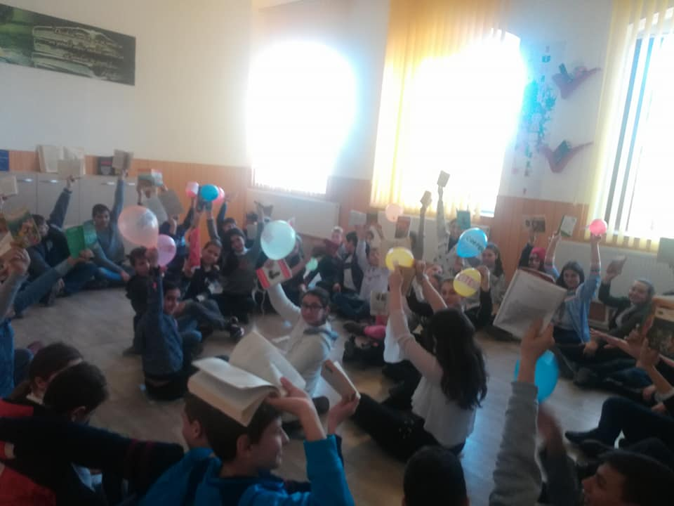
Run and Read!

Slide 7
Theatre

Slide 8
Games of autumn

Slide 9
The day of becoming Green!

Slide 10
Europe day

Slide 11
October 5th, the day of Education

Slide 12
For Christmas, a lot of Carols!

Slide 13
And here are some images from the 2nd school, in Coslogeni, for primary cycle:

Slide 14
Beautiful class

Slide 15
Thank you for your attention!

