Slide 1
My school
FIT FOR FUTURE
An Erasmus + project

Slide 2
my School...
My school is for me, a lot of opportunity for my future also mean learning new and beautiful things and developing my abilities.
It is where I socialize with other pupils, even from other European countries, which I like it very much.

Slide 3
Also mean these...

Slide 4
My school is a small public school, in rural area, is situated in Dichiseni, in South East of Romania, near Danube and near border with Bulgaria.
Here we have kindergarten, primary and secondary school in two main buildings, in Dichiseni and Coslogeni.
In every school year, beside compulsory curriculum we have a lot of extracurricular activities.
Now, I will let the images to speak...

Slide 5
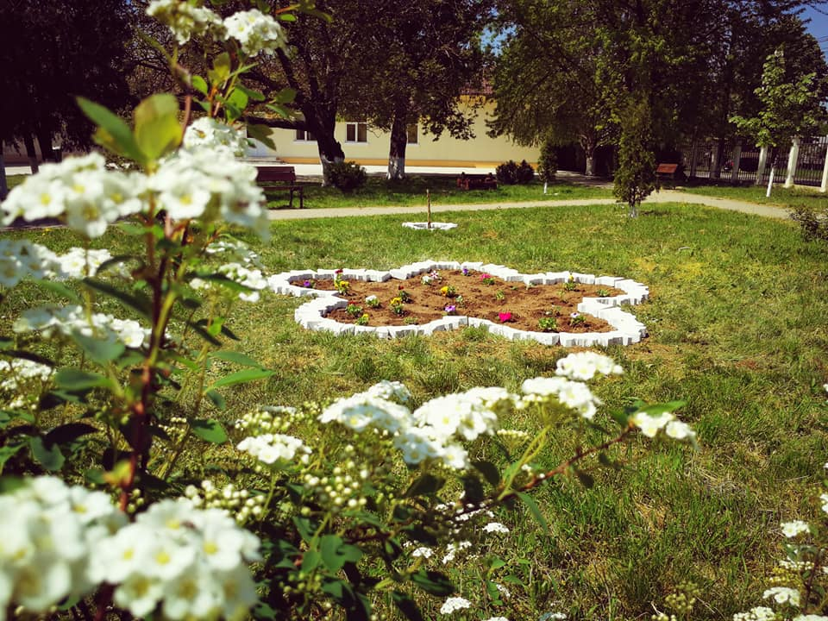
The school with its beauties

Slide 6
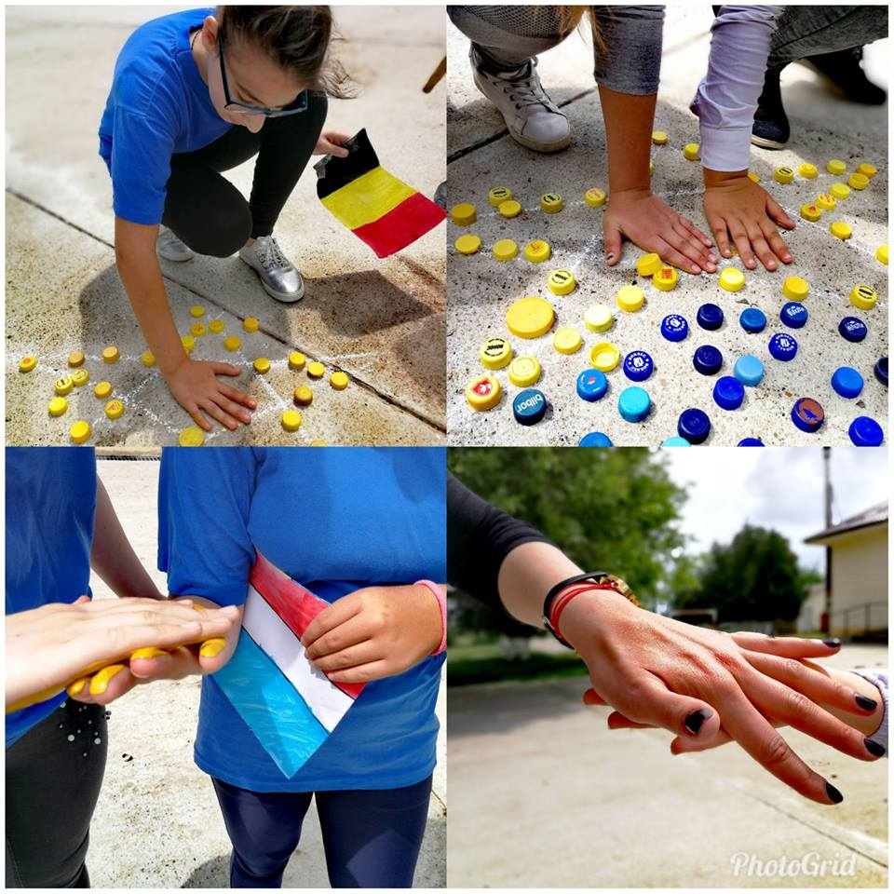
9 May Europe Day

Slide 7
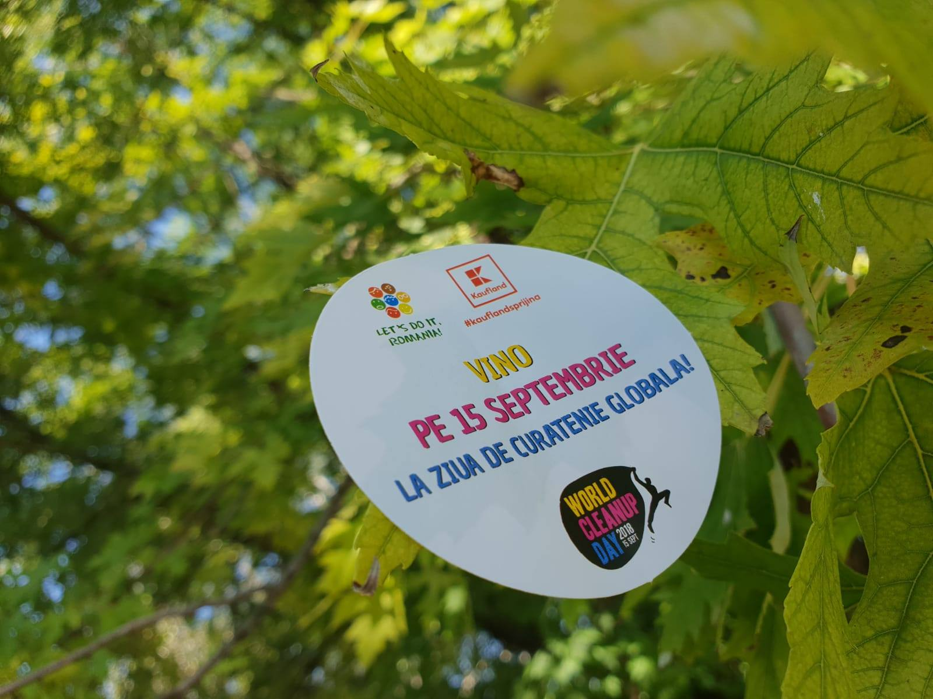
Let's Do It, Romania!

Slide 8
Reading gives us the most beautiful hug!

Slide 9
Small actors!

Slide 10
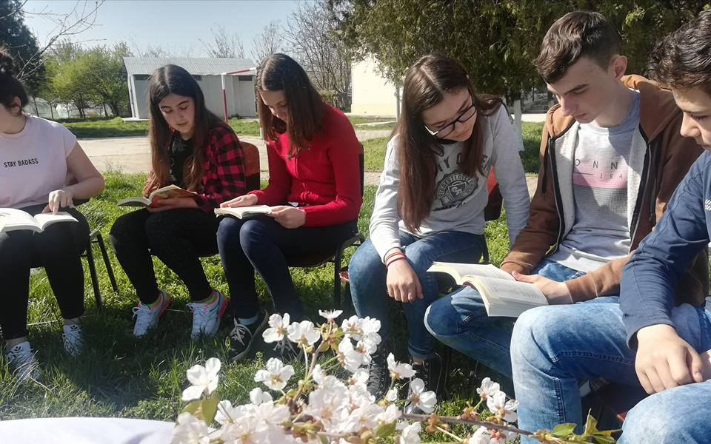
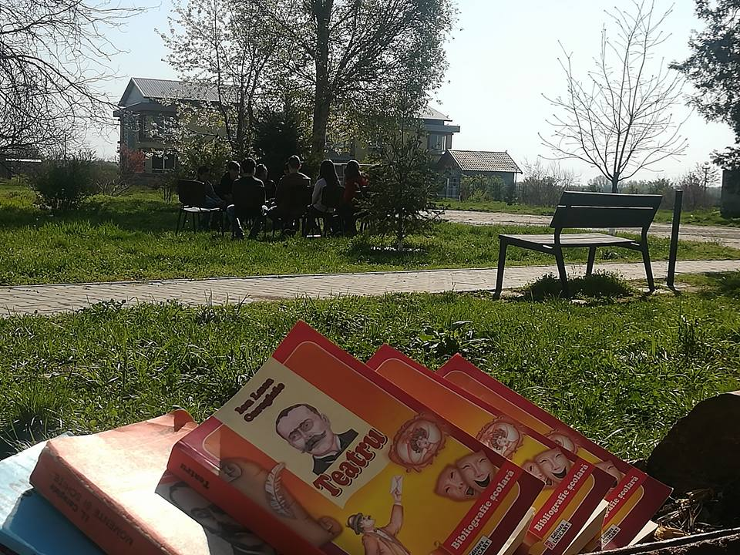
Reading develops our intelligence

Slide 11
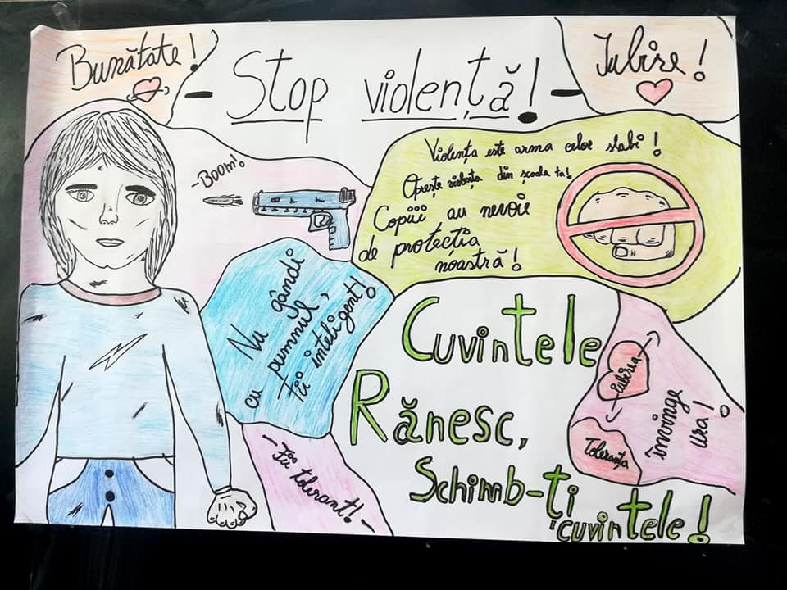
Stop bullying!

Slide 12
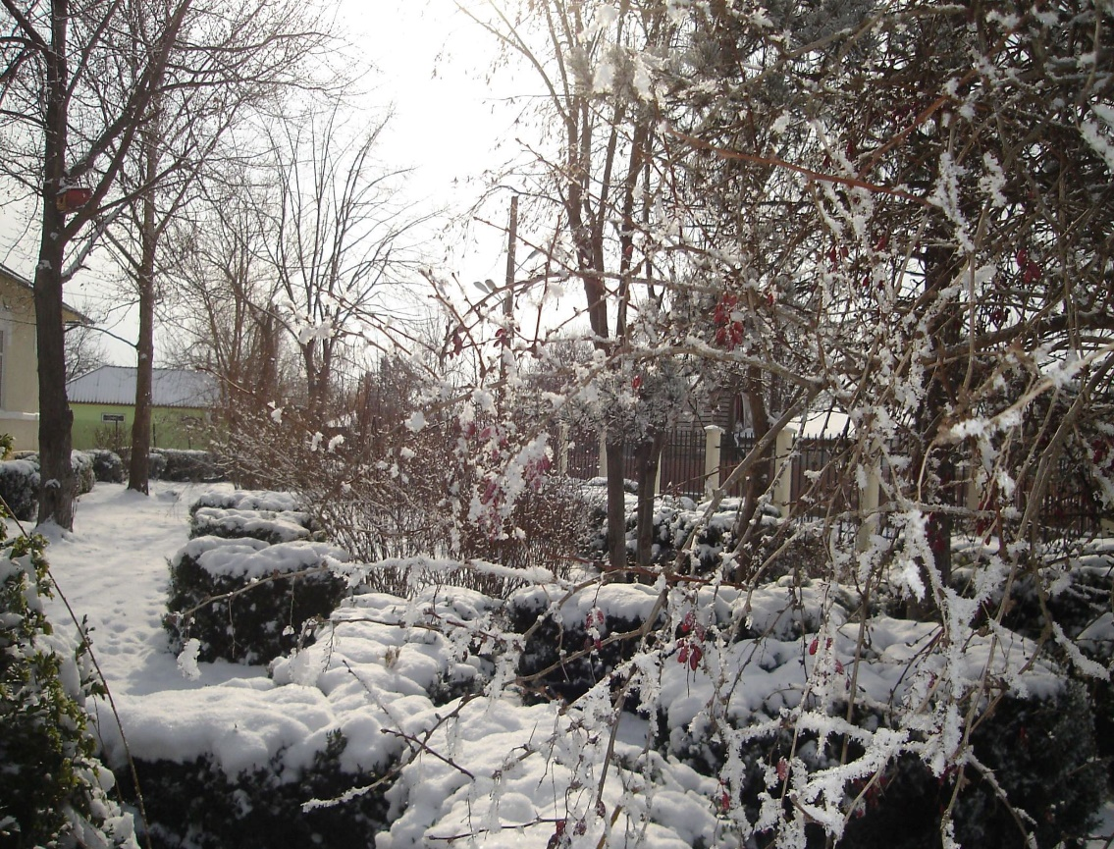
Story of winter...

Slide 13
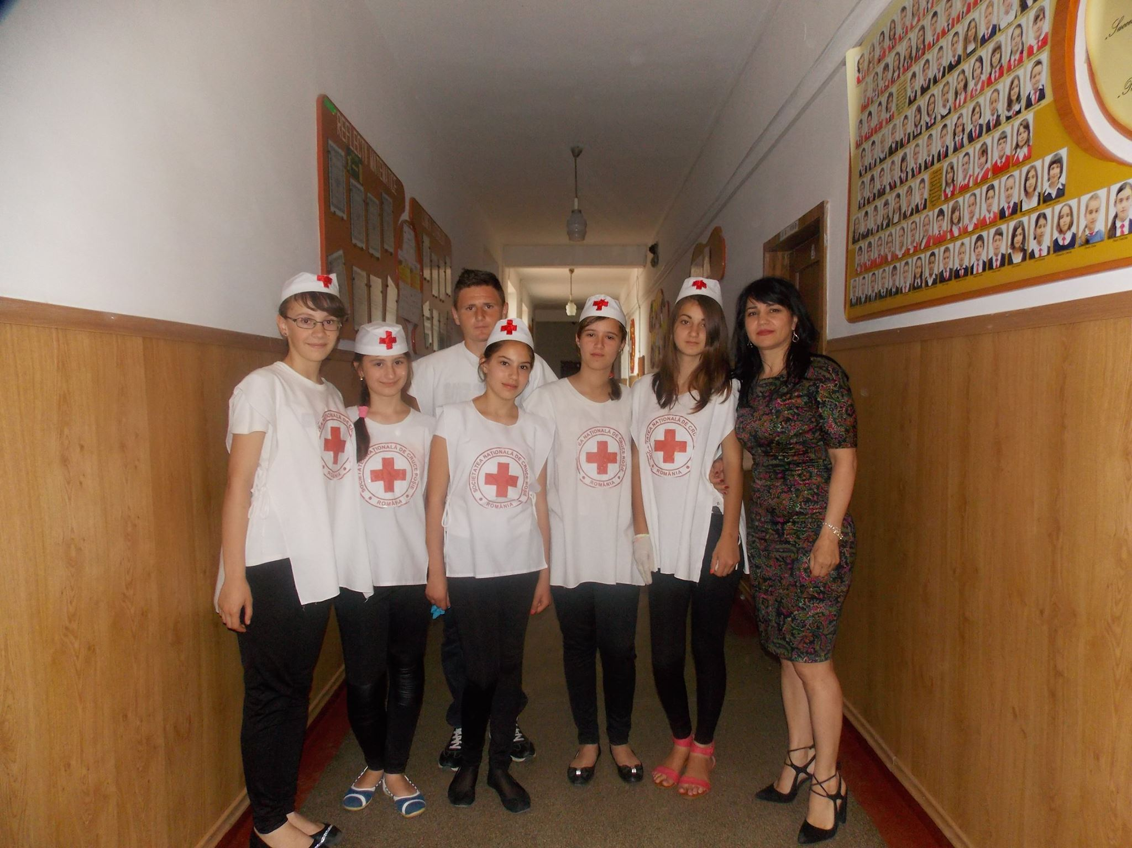
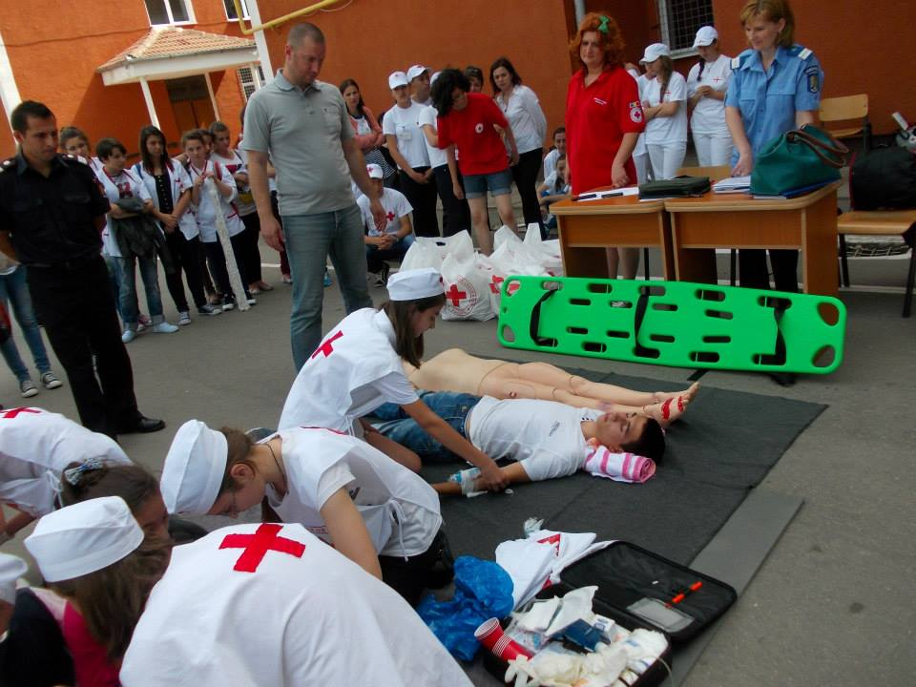
Handy paramedics

