Slide 1
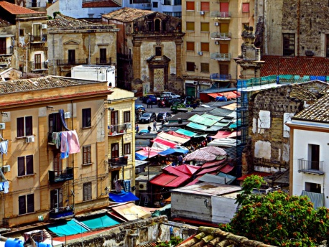
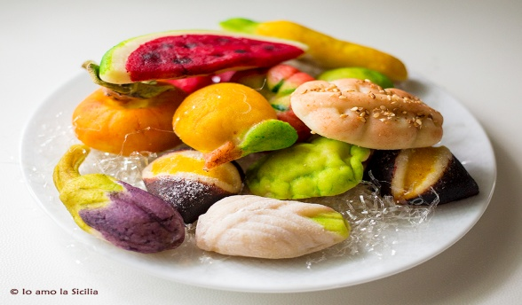
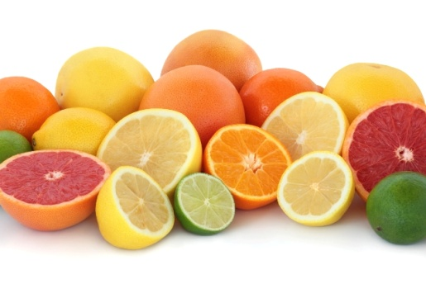
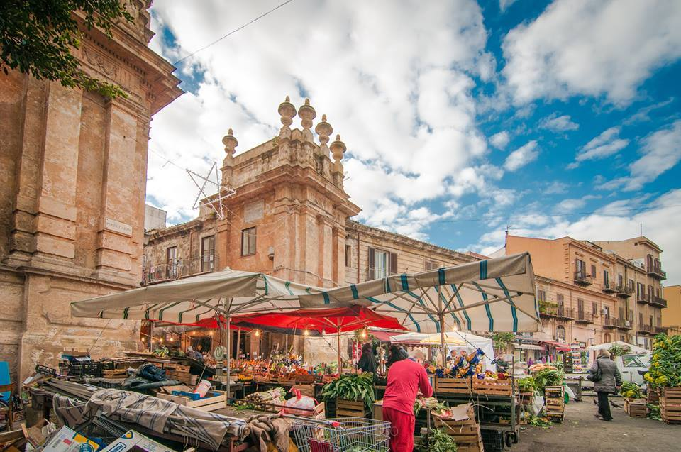
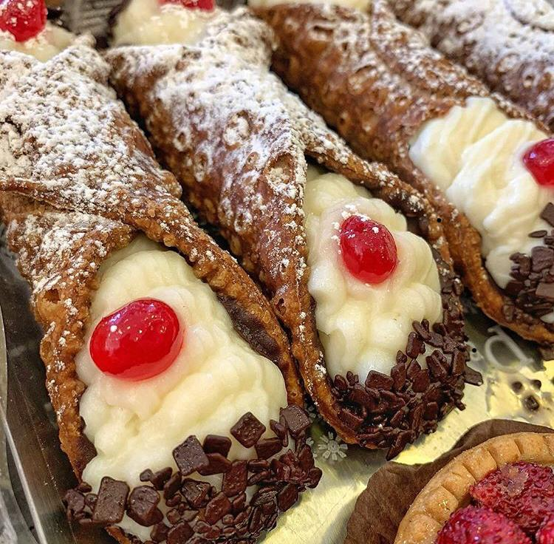
Sicilian culinary traditions

Slide 2
Ballaro’
The permanent market stretches from Piazza Casa Professa to Corso Tukory towards Porta Sant'Agata. The market is famous for selling the first fruits that come from the countryside of Palermo. Ballarò is the oldest of the city's markets, frequented daily by hundreds of people, animated by the merchants’ shouting called "abbanniate", that attracts the customers, also with their characteristic and colorful local accent.

Slide 3
Capo
The Capo market, together with the other markets of Palermo, is an important point of agro-food retailing. It is an active, daily street market whic gives the passers-by the possibility to buy both groceries and other merchandise. It extends along Via Carini and Via Beati Paoli, Via Sant'Agostino and Via Cappuccinelle, the most ancient area of Palermo.

Slide 4
Traditional foods

Slide 5
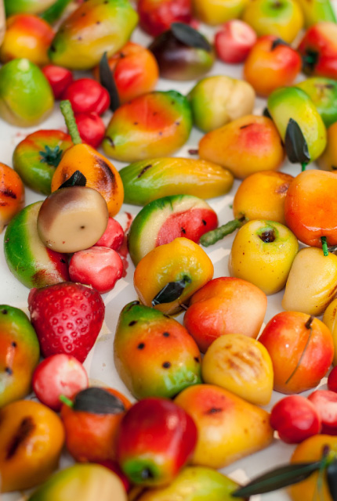
The fruit of Martorana
The fruit of Martorana (Sicilian marturana fruit) is a typical Sicilian sweet (the origin of which was in Palermo). It was traditionally prepared in the celebrations of the Feast of the Dead (November 2nd). According to a well-known tradition, the fruit of Martorana was born because the nuns of the Martorana monastery, in order to replace the fruits collected from their garden, created new ones with almond flour and sugar, to decorate the monastery for the visit of the Pope of the time .

Slide 6
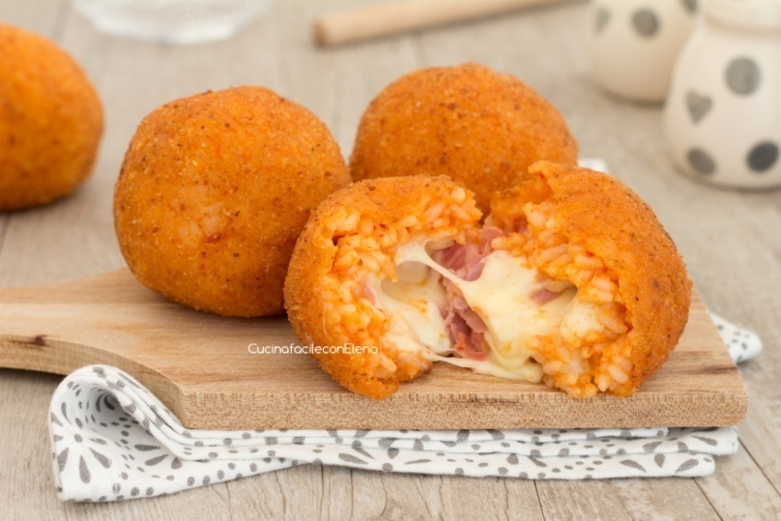
Arancine
Arancina is a speciality of Sicilian cuisine. It is a ball or a cone of fried rice, 8-10 cm in diameter, generally stuffed with meat sauce, peas and caciocavallo cheese, or diced ham and mozzarella cheese. The name derives from the original shape and the typical golden color, reminiscent of an orange, but it is said that in eastern Sicily the arancine have a conical shape and for this reason they are called «arancini», creating a competition between the two big Sicilian cities of Palermo in the western part and Catania in the eastern one.

Slide 7
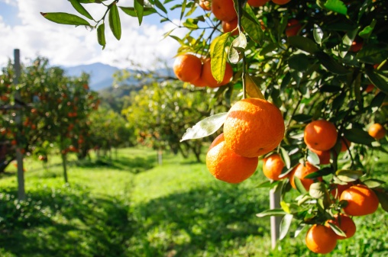
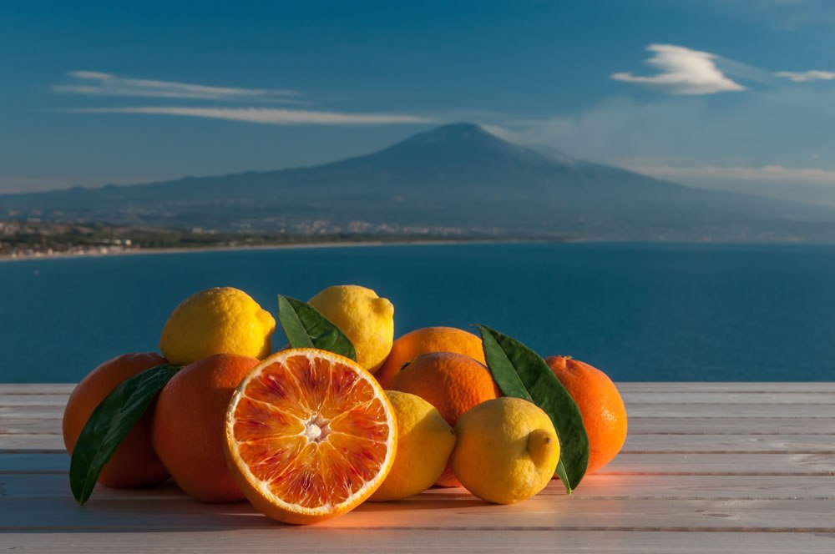
Citrus fruit
the cultivation of the citrus fruit is among the most important in Sicily, the major part is represented, of course, by the oranges, the mandarins, the lemons and the cedars, that develops especially in the coastal borders of the island.

