Slide 1
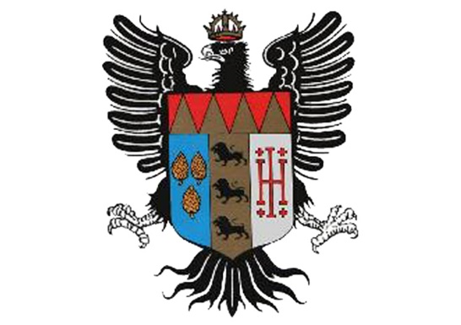
Friederich’s Itinerary
Class 3D
Liceo Umberto I
Palermo

Slide 2
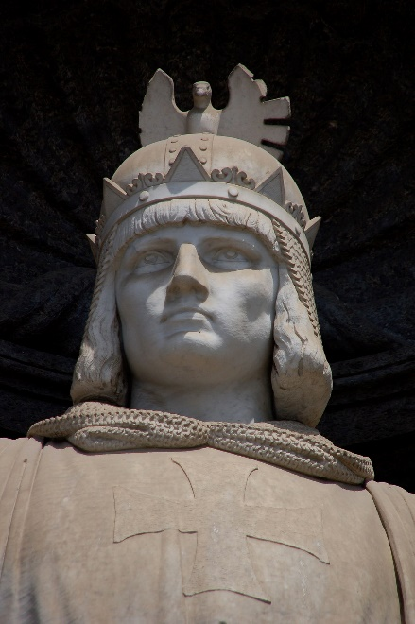
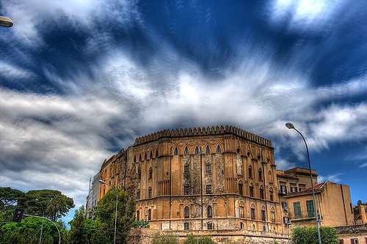
The Friederich’s Itinerary is a journey into the past through all the most important places that had a main role in his empire.
We wanted to let you discover all the hidden gems all around Sicily such as:
Castello Maredolce(PA);
Palazzo dei Normanni / The Norman Palace(PA);
Castello svevo di Augusta(SR);
Castello Maniace di Siracusa(SR);
Castello Bellumvider(TP);
Castello Ursino(CT);
Chiesa di Santa Maria Alemanna(ME);
Chiesa di San Francesco D’Assisi(PA);
Duomo di Cefalù(PA);
Tombe della Cattedrale di Palermo(PA).

Slide 3
Friederich’s infancy in Castello di Maredolce (Palermo)
The building, umproperly called «castle», was built in 1071; it is in arab style and was modified during the following centuries. It first was Ruggero’s II, he modified the building adding an artificial lake around the palace .
Castello di Maredolce was really important in Friederich’s life because he spent all of is infancy in this palace, and then he modified it too adding new walls around it as a defence.
Here all the literary activities were developed, in fact it was the seat of the Sicilian Poetic School.

Slide 4
The Norman Palace
Even though this palace wasn’t built by Friederich II it was the center of hi empire. This palace has Phoenicians foundations but it was modified several times. During the swabian period it was the seat of the government and of all the arts and intellectuals.
The palace is composed of towers connected by arches alternated to gardens.

Slide 5
Castello svevo di Augusta (Siracusa)
The building of this castle started in 1232 ca., work of Riccardo da Lentini, and it was finished in 1242.
This castle, builti in a small peninsula in front of Augusta, was used as a defence from sea attacks.
The building has a rectangular planimetry and eight squared towers.

Slide 6
Castello Maniace di Siracusa (Siracusa)
It is located in Ortigia, the island in front of Siracusa, and it was built between 1230 and 1240.
This castle was erected by Riccardo da Lentini too.
Years after the Swabian the castel was used by lots of other kings from all over the Europe.
Originally there was a ditch around the castle that was drained years later its building.
The entrance (>) has a really wonderful roof made of 24 vaults.

Slide 7
Castello Bellumvider (Trapani)
The only parts left two octagonal towers found in the basements of Pignatelli palace in the center of Castelvetrano(>).
It should have had Eight octagonal towers and a squared basement.
Fortunatelly there are a lot of ancient documents that are very helpful to pursue the studies about this castle.

Slide 8
Castello Ursino (Catania)
Built before 1239, this castle is connected to the ones of Augusta and Siracusa probably because the emperor planned to create a defensive system with many spots along the seashore.
The castle has a squared basement with eight towers and a ditch as many of the Swabian castles do.

Slide 9
Chiesa di Santa Maria Alemanna (Messina)
Some scholars think that this church, one of the few built by Friederich due to his conflicts with the Pope, was built in 1220 in occasion of the first Crusade organized by the emperor.
It was built as a place for resting and for supply in Messina harbor for all the knights applied for the Crusades.

Slide 10
Chiesa di San Francesco D’Assisi (Palermo)
It is located in the historical center of Palermo, the construction of this church started in 1254 on the basements of another church destroyed by the emperor. It is really unique because of its facade that has lot of balanced late-romanic elements.

Slide 11
Duomo di Cefalù (Palermo)
This church wasn’t built by the will of Friederich II, but he decided to continue the building of thr church during his reign.
Inside the chuech we can find the shirne of Ruggero II.
It has the common layout of a basilica; inside it has three aisles flanked by columns.
The inside of the church is full of mosaics.

Slide 12
Palermo’s Cathedral graves
Friederich II died in 1250 in Puglia but he was buried in Palermo’s Cathedral.
Inside the cathedral there are the graves of many members of the royal family; in addiction to these graves under the cathedral there’s a crypt in wich we can find the tombs of many archibishops and the tomb of an illegittimate son of Friederich.

