Slide 1
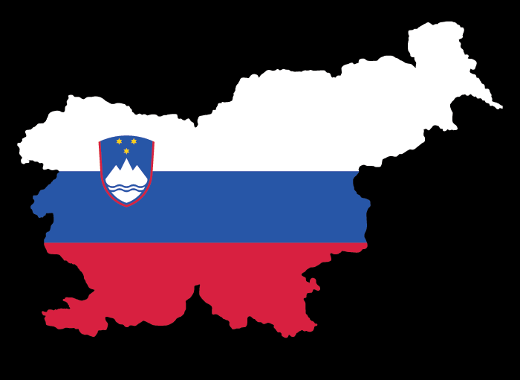
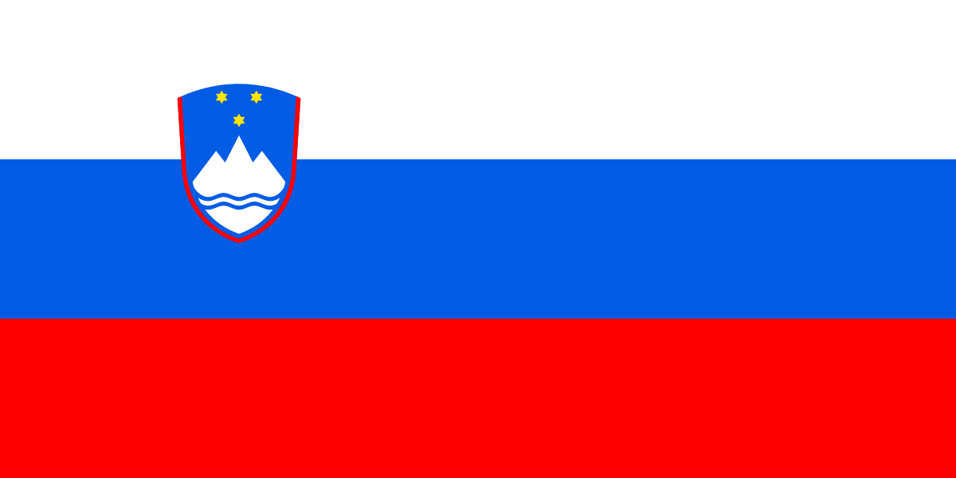
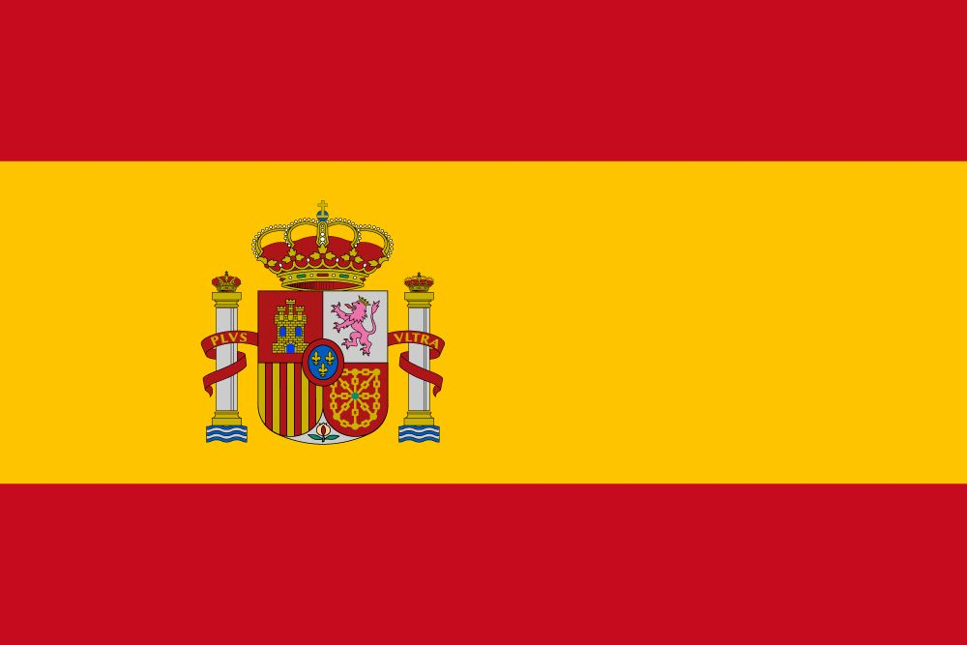
Lenght and azimuth of the shadows
Produced by: Ksenija Kržan, Maruša Renko, Ula Kličič, Ema Cimperman, Neža Jakelj
~ Group 6, Faculty od Education, Ljubljana~
INTRODUCTION
We are five girls from Slovenia and we were comparing the size of the toothpicks shadow and their azimut (angle beetwen north and the shadow of the toothpick) in different hours at the same day. In this experiment we were working whit group 6 from Spain and group 6 from Iceland so we had information from this countries too.
First we set ourselves a hypothesis that shadow change length throughout the day because the angle at which the sun shines on stationary objects changes with the Earth's rotation. We also suppose that when the sun is high overhead during the middle of the day, the shadows become shorter and when sun is rising or setting the shadow is the longest.
MATHERIALS
toothpick
compass
A4 paper
pencil
something to attach a toothpick on a paper
METHODS
Course of the experiment:
First attach the toothpick on a paper at an angle of 90 deegres. Than find the north with compass and mark it on a paper. You pick a sunny day when you do this experiment. Every two hours beetwen 10 AM and 4 PM (4 times per day) measure the azimut and the lenght of the toothpicks shadow.
and
RESULTS
TIME | LENGHT OF THE SHADOW | AZIMUTH
10 AM | 15,4 cm | 316 degrees
12 AM | 12,2 cm | 8 degrees
2 PM | 17 cm | 41 degrees
4 PM | 31,4 cm | 64 degrees
TIME | LENGHT OF THE SHADOW | AZIMUTH
10 AM | 23,7 cm | 86 degrees
12 AM | 12 cm | 21 degrees
2 PM | 11,5 cm | 329 degrees
4 PM | 18 cm | 316 degrees
TIME | LENGHT OF THE SHADOW | AZIMUTH
1:30 PM | 25 cm | x
3:30 PM | 28 cm | x
5:30 PM | x | x
CONCLUSION
From our results we can conclude that the position of the sun in our three countries is different. The length of the shadow at 12 AM is the same in Slovenia and Spain(we don’t have information for Iceland). In the morning is shadow longer in Spain, but at the evening is longer in Slovenia. The length of shadow from Iceland at the afternoon is more similar to Slovenia than Spain. Azimuth is also different. But we don’t find any connection with differences from azimuth in Slovenia and in Spain

