Slide 1
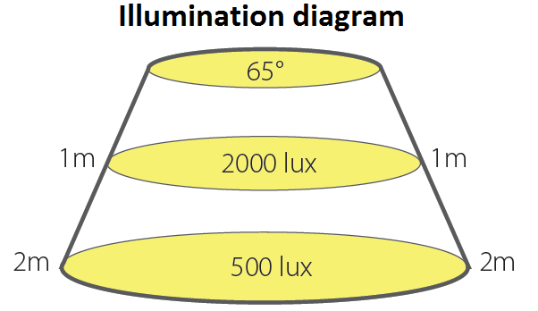
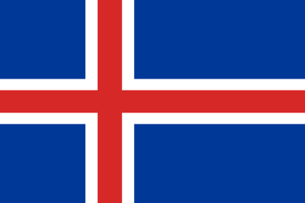
ILLUMINANCE
GROUP 10 from Slovenia- Faculty of Education Ljubljana: Lucija Štihec, Miha Babič, Tjaša Sedlar, Maša Grm, Tina Debevc
INTRODUCTION
Research of group 10 from Slovenia was about light levels. We were collecting data at four different hours of the day. We wanted to see if there was any difference in lighting in the other countries.
Here are some examples of intensity in different conditions (to help you understand what numbers in results mean):
Lux is unit of illumination. One lux is the amount of illumination provided when one lumen is evenly distributed over an area of one square metre.
One lux is equal to one lumen per square meter:
1 lx = 1 lm/m²
Illuminance | Example
111,000 lux | Bright sunlight
20,000 lux | shade illuminated by entire clear blue sky, midday
1,000 - 2,000 lux | Typical overcast day (midday)
400 lux | sunrise or sunset on a clear day (ambient illumination)
40 lux | Fully overcast, sunset/sunrise
RESULTS
Measurements from Iceland
Measuring date: March 18th, 2020 (cloudy day)
March 19th, 2020 (sunny day)
*It got cloudy after 14:00
Measurements from Slovenia
We also measure illuminace one sunny day in Slovenia.
Date: March 14th, 2020
MEASUREMENT TIME | CLOUDY DAY | SUNNY DAY *
9:00 | 326 LUX | 4083 LUX
12:00 | 1451 LUX | 3910 LUX
15:00 | 1930 LUX | 1654 LUX
18:00 | 896 LUX | 315 LUX
MATERIALS & METHODS
for collecting data, we use application called
Lux light meter
the app made a measurement through the sensor and our job was just to read the numbers
CONCLUSION
From our results, we can conclude that the illuminance in Slovenia is higher than in Iceland.
Because the difference is large, we conclude that light levels does not depend only on the weather but also on the location of the country.
TIME | MEASUREMENT
9:30 | 8179 LUX
12:00 | 11802 LUX
15:00 | 8518 LUX
18:00 | 183 LUX
REFERENCES
https://www.britannica.com/science/lux (8.4.2020)
https://en.wikipedia.org/wiki/Daylight (8.4.2020)
Notes:
1

