Slide 1
Sound – group 12 Etwinning task
Date : 5.4.2020

Slide 2
Team 12 (Slovenia) members
Liza Ivić
Maša Žičkar
Sanja Ivančević
Sara Jovič
Tia Kovačič

Slide 3
Task we recieved from Iceland
We had to observe the weather for seven continuous days (amount of rain, wind speed and direction, cloud shapes,…)
Our observation started on March 16th and ended on March 22nd
Measurements were taken everyday at 12 pm

Slide 4
Task we recieved from Spain
We had to ask around (fishermen and in stores) what kinds of fish is sold in Slovenia
We also had to collect information about autochthonous fish in Slovenia

Slide 6
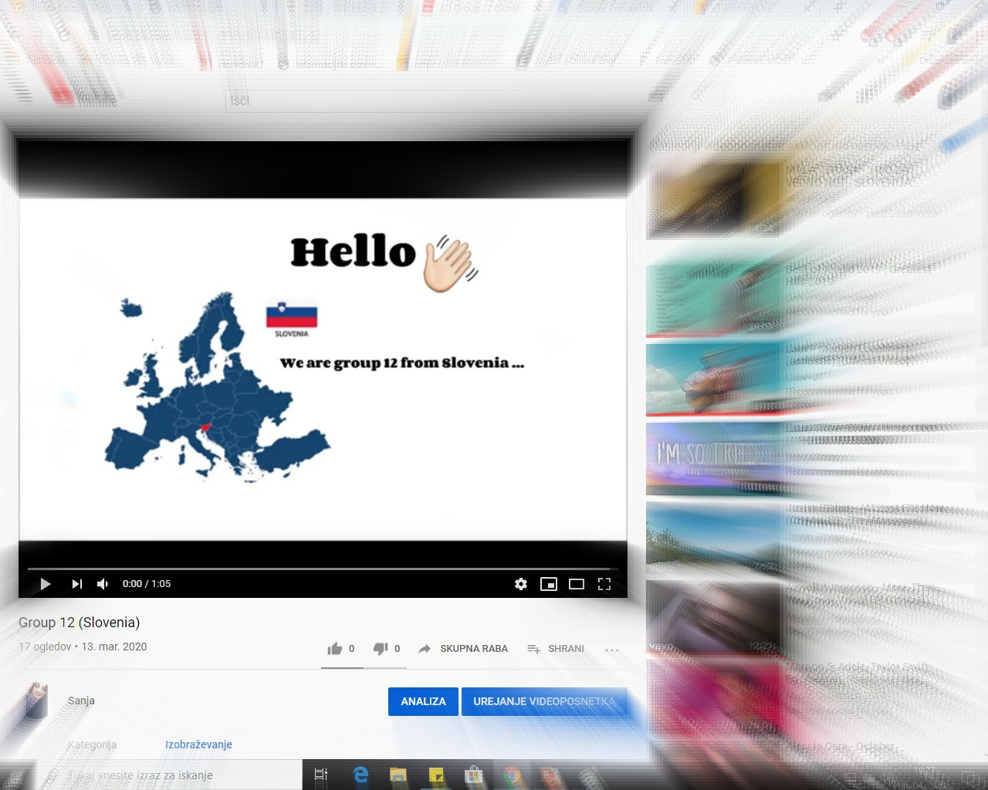
Our assignment for them…
It all began once we chose sound and assigned them to measure it for us …
Video was made and it had instructions in it

Slide 7
Scientific explanation - sound
Sound is a longitudinal wave that requires a medium to propagate,
The sound is heard when sound waves in the air reach the ear →here, it is converted into electrical impulses that the brain processes into a sensory signal,
The volume is defined as the amount of sound energy that falls on a surface per unit of time → it is directly related to the pressure difference between the densities and the dilutions ; the greater the pressure difference, the more energy the sound wave contains.
SOURCE

Slide 8
The task
They had to download an app , called Soundmeter, on their phones.
They had to measure at least 7- 8 different sounds with that app.
Sounds had could have been measured outside or inside, we let them decide this, due to current situation we are all facing
The results had to be collected by 22nd March

Slide 9
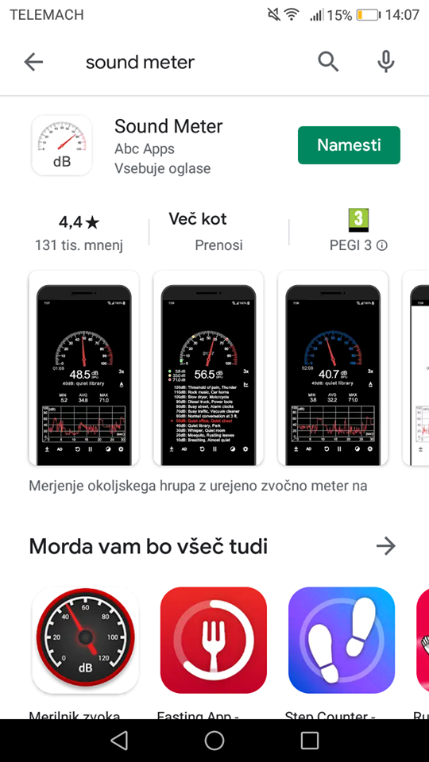
Sound Meter app
Sound Meter app for phone,
available in Google Play

Slide 10
The results
We recieved 12 sound measurements
Sounds :
Singing „lalalala“
Banging a pen to a metal canister
Banging a metal flask
Clapping hands
Making a „prff“ sound
Making „eee“ sound
Humming
Some sounds were measured in nature and some in busy areas

Slide 11
1.Singing „lalalala“

Slide 12
2.Banging a pen to a metal canister

Slide 13
3.Banging a metal flask

Slide 14
4.Clapping hands

Slide 15
5.Making a „prff“ sounds

Slide 16
6.Making a „eee“ sound

Slide 17
7.Humming

Slide 18
Measured sounds seem to have similar volume
Frequency analysis gave us a clearer picture of the measured sounds
At each point of the measurement she showed us what frequencies the sound was composed of
From the measurements we recieved we can say that sound is all around us - even somewhere in the nature, which seems quiet
Basic sound volume chart :
20 dB sound studio (sound insulation)
50 dB office
60 dB department store
90 dB subway
120 dB pneumatic hammer (pain threshold, discomfort)
SOURCE

Slide 19
Closure
We had a lot of fun while completing our tasks
We enjoyed being part of this project
Thank you to all of our partners from Spain and Iceland ☺

