Slide 1
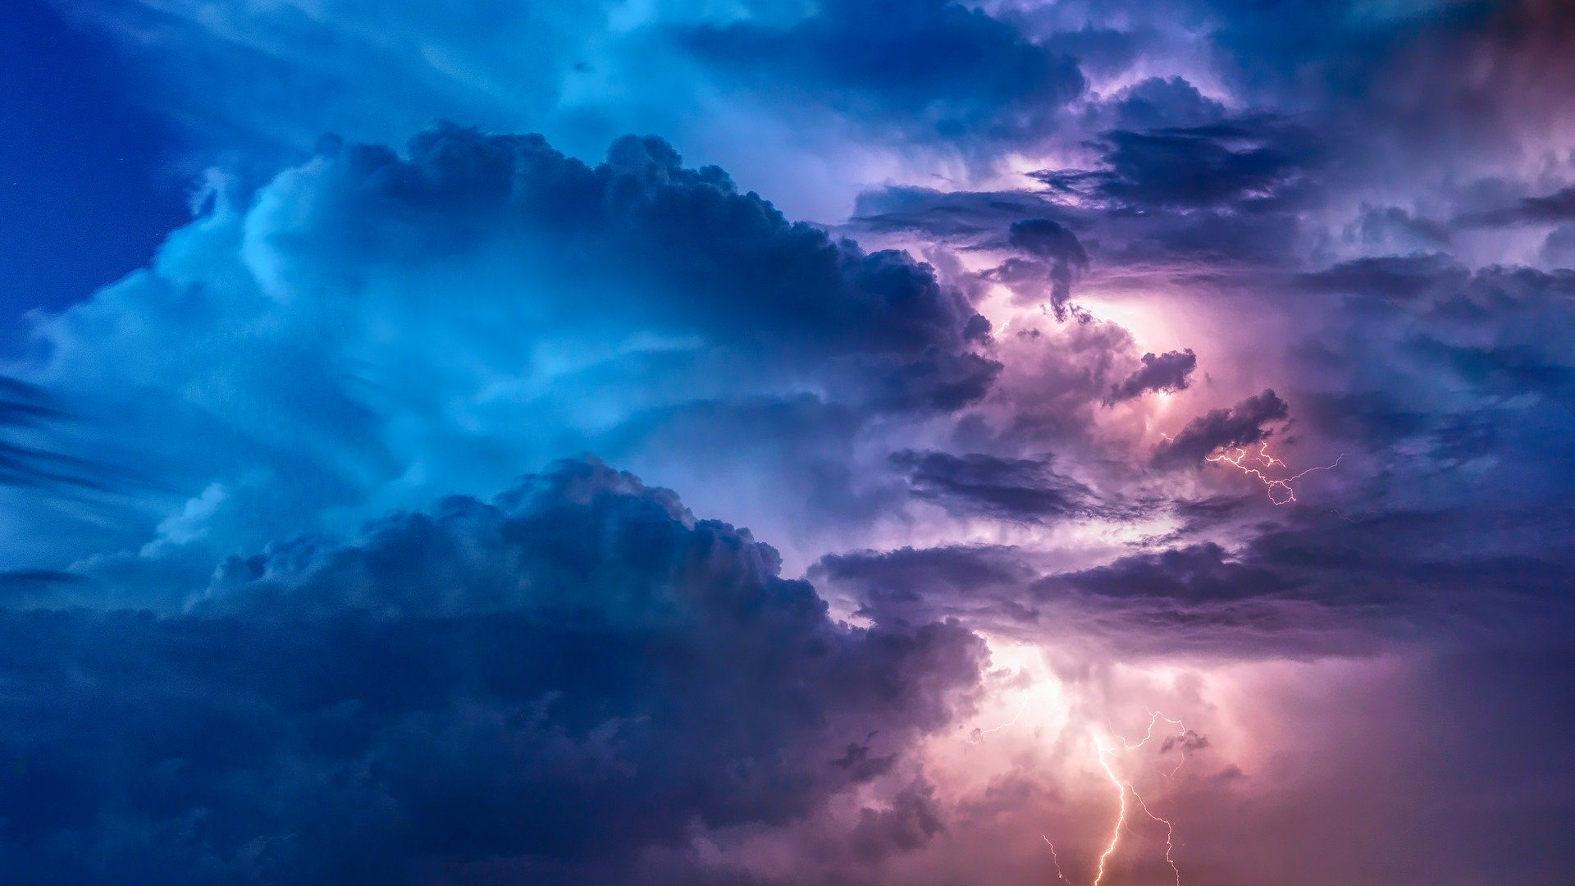
WEATHER
(group 11)
Tijana Milakovič, Nika Marušič, Hana Zagorc, Kaja Bajc, Klavdija Mrak, Aleksandar Petrović

Slide 2
INTRODUCTION
We are a group of students from University of Ljubljana, Faculty of Education and together with two other universities, one from Iceland and the other from Spain, we decided to do the research about weather across Europe.

Slide 3
Our two research questions were:
1. OBSERVATION OF THE SKY AND AMOUNT OF RAIN
We had to observe which kind of clouds we see and measure how much precipitation falls per square meter in a week (from 18.3. to 25.3. 2020, around 10.00am and 17.00 pm).
2. MEASUREMENT OF A PERSON ’S SHADOW
We had to measure the length of a person’s shadow(from 18.3. to 25.3. 2020, around 10.00am and 17.00 pm).

Slide 4
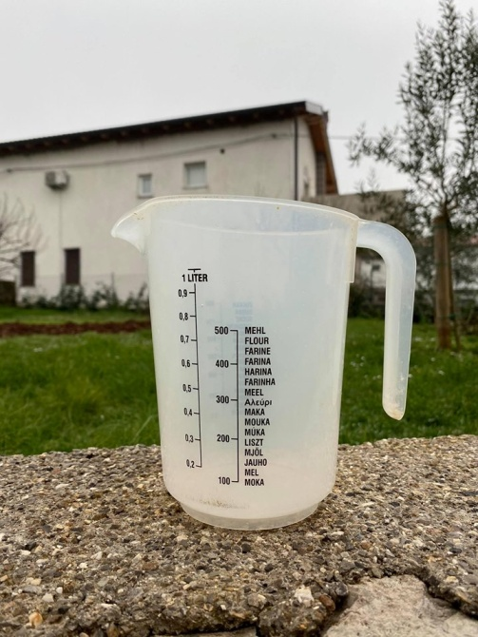
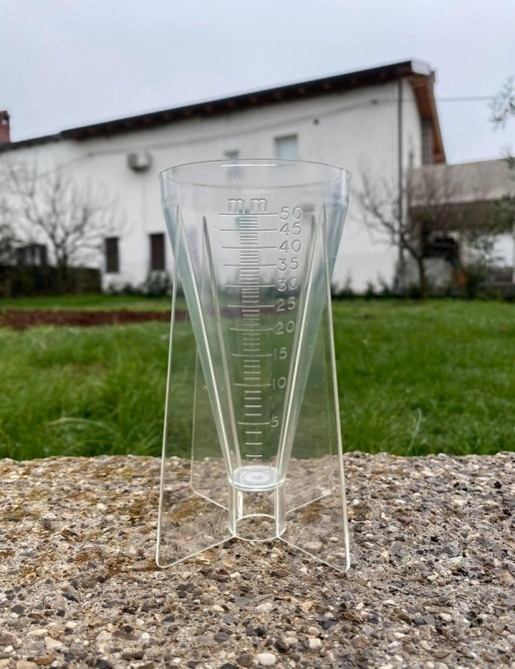
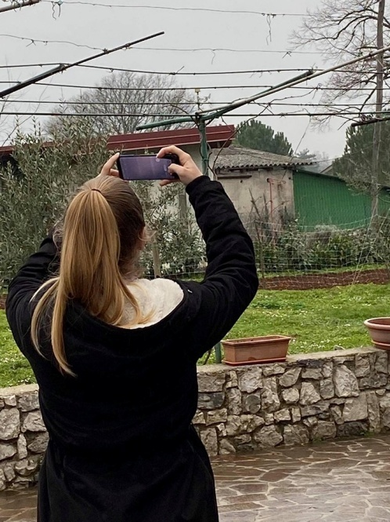
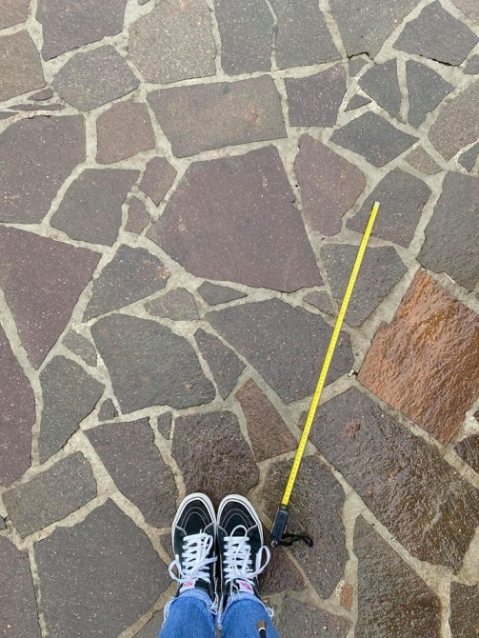
MATERIALS:
measuring vessel or rain gauge,
phone,
measuring tape.

Slide 5
CLIMATE IN SLOVENIA
Climatic conditions in Slovenia vary. There is a Continental climate in the northeast, a severe Alpine climate in the high mountain regions, and a sub-Mediterranean climate in the coastal region. Yet there is a strong interaction between these three climatic systems across most of the country. This variety is also reflected in climatic variability over time and is an important factor determining the impact of global climate change in the country.

Slide 6
January is thec oldest month with day time temperatures usually around zero in the north, but in some cases winter months can be very cold with temperatures far below zeroand strong, cold north easterly winds, called Bora, especially in the mountainous regions, where the weather is strongly influenced by the nearbyAlps. In the coastal areas long-lasting frost periods and snow are quite seldom because of the influence of the warm water temperatures of the mediterranean sea.

Slide 7
In summer day time temperatures reach 20-25°C, but sometimes quite higher, 30°C or more. In most ofthe time is dry weather with sunny spells, although sometimes heavy thunder storms can occur at the end of the day, especially in the mountainous regions. July is the warmest month with an average Temperature of 22°C.

Slide 8
The weather is best May-September, when days are warm and the nights are cool, although it rains more in spring than in summer. Autumn and winter are usually a little chilly and wet, and often foggy in the mountainous regions.

Slide 9
PRECIPATION
Great differences can be recorded not only in temperatures, but also in precipitation. Actually, there are areas, where annual precipitation is about 3500 mm, what is fourtimes more than in relatively weak moistened north east part of the country.
Annual average precipitation varies from 400 mm in the southern low land areas, and up to 1000 mm in the mountainous regions.
Sources:
https://www.arso.gov.si/en/Weather/climate/Climate_of_Slovenia_at_glance.pdf
https://www.weatheronline.co.uk/reports/climate/Slovenia.htm

Slide 10
RESULTS

Slide 11
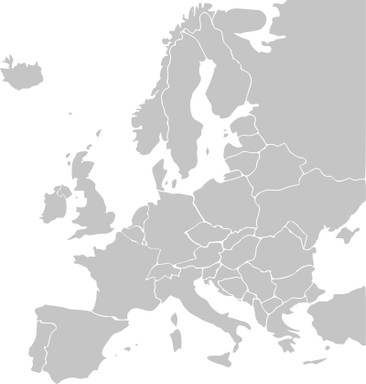
SLOVENIA
THE MAIN CHARACTERISTICS OF THE SHADOWS AND RAIN:
there is no afternoon shade, and just after noon it begins to extend (till evening),
on a cloudy day, ther is no shade,
no participation.
WEATHER ON A NORMAL DAY IN MARCH:
Morning –occasional wind, temp. from -2° to 4°
Noon -sun, temp. from 5° to 13°
Afternoon–sun, wind (sometimes), temp. from 10° to 14°
Evening- clear sky, some wind, temp. Around 2°

Slide 12
ICELAND
THE MAIN CHARACTERISTICS OF THE
SHADOWS AND RAIN:
when the weather is bad, the shadows are not visible,
the shadow is bigger at 17.00 than at 12.00.
WEATHER ON A NORMAL DAY IN MARCH:
Morning - windy, temp. from 0° to 3°
Noon -hail+ wind+ rain, temp. from 3° to 6°
Late afternoon-rain+ sun+ wind = rainbow, temp. from 5° to 7°
Evening- clear sky and a soft breeze, temp. from 0° to -3°

Slide 13
SPAIN
THE MAIN CHARACTERISTICS OF
THE SHADOWS AND RAIN:
no participation,
some clouds during the day.
WEATHER ON A NORMAL DAY IN MARCH:
Morning–a bit of wind, temp. from 5° to 9°
Noon –sun, (sometimes wind), temp. from 9° to 13°
Afternoon–sun, temp. from 13° to 14°
Evening–clear sky, temp. from 5° to 8°

Slide 14
CONCLUSION
Tthrough cooperation with the Icelanders and the Spaniards we have learned the differences in the climatic characteristics of each country. These differences are mainly due to the different position of the countries. Even though we didn't get all the information exactly, we were able to identify certain climatic characteristics with the information provided from the Icelandic Group.

Slide 15
Working together is success ☺

