Slide 1
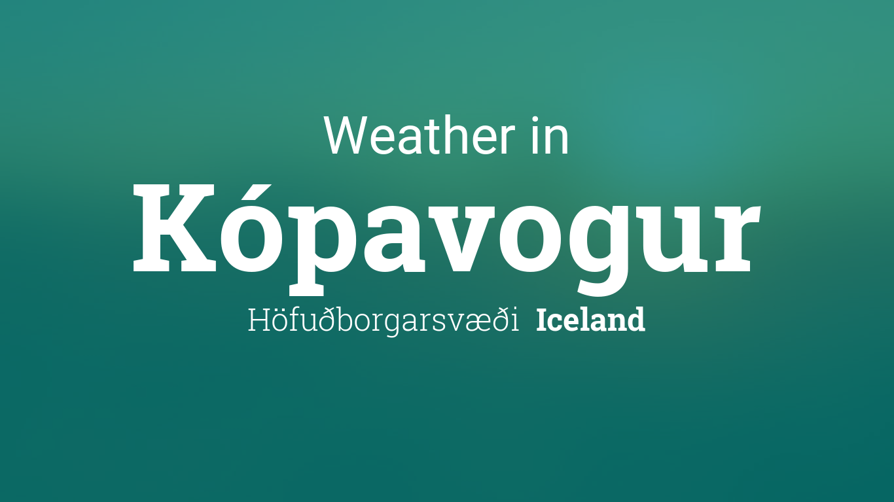
SLOVENIJA

Slide 2
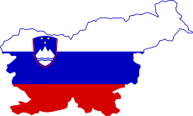
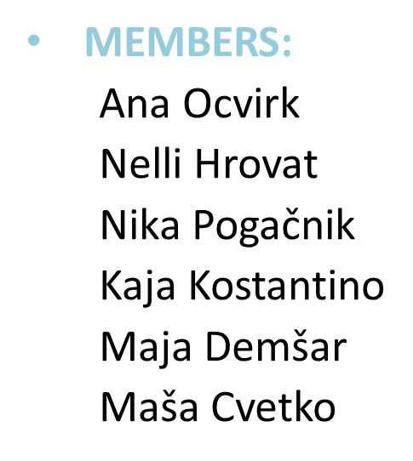



WHO ARE WE?
GROUP 13 from SLOVENIA

Slide 3



INTRODUCTION:
The aim of our group was to find out what the temperatures in Iceland (Kópavogur) are and how their climate differs from the weather in Slovenia
We asked the Icelandic team to measure the temperature in their area for two days and also observe the weather conditions
Based on the results, we have come to new findings

Slide 4
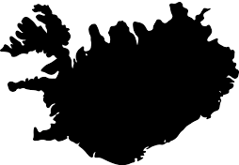
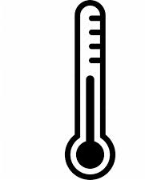

OUR TASK FOR THE OPPOSITE GROUP:
do some measurements of air temperature
measure temperature for 2 days from morning to night (8-22) every 2-3hours
Observe also the weather conditions

Slide 5

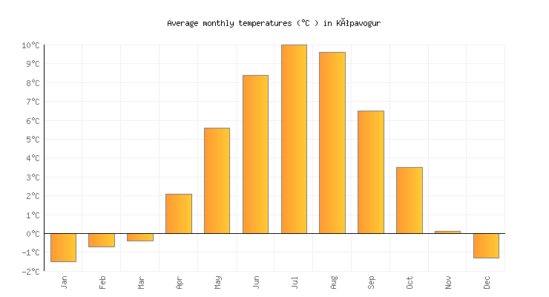
RESULTS FOR 21.3.2020:
bright day, a little bit windy (about 7 meters per second)
9:00 → -1,4°C
13:00 → 0,9°C
16:00 → -0,2°C
19:00 → -1,5°C
22:00 → -1,5°C
Average monthly temperatures in Kópavogur Iceland

Slide 6
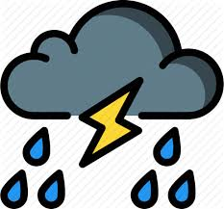
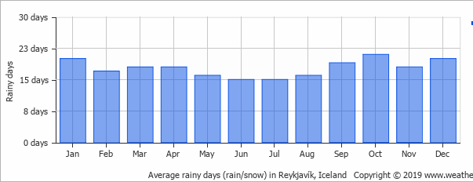
RESULTS FOR 22.3.2020:
dark day , a lot of raining, windstorm (about 15 meters per second)
9:00 → 1,8°C
13:00 → 3,3°C
16:00 → 3,9°C
19:00 → 3,5°C
22:00 → 3,6°C
Average rainy days in Kópavogur Iceland

Slide 7

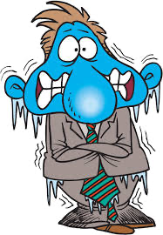
CONCLUSION
For the conclusion, we would like to pay attention to the biggest difference in weather between Iceland, Nordic island country and Slovenia, country in central Europe, which is definitely in the temperature. While Kopavogur had temperatures below zero, average temperature in Ljubljana was around 15°C.

Slide 8


FOR THE END:
We would like to thank the Icelandic group for their help and measurements.

