Slide 1
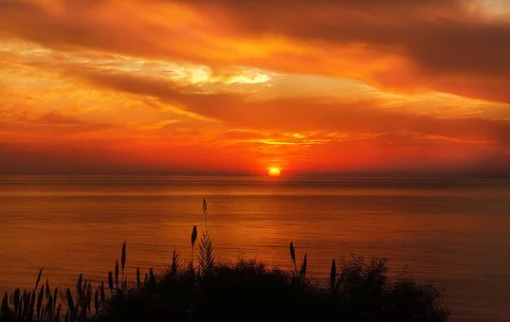
Sunset and sunrise
Evita Cizl, Manca Beguš, Lara Čede, Petra Novak, Kristina Legat, Aljaž Dobnikar

Slide 2
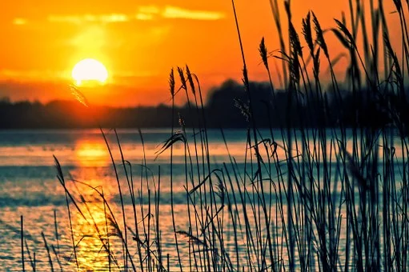
Introduction
There are four main cardinal directions when it comes to field orientation: north, south, east and west.
East and west are opposite directions, with east at 90 degrees on the lest from north and west 90 degrees on the right from north.
The point on the horizon in which the Sun rises is calls the rising point. The rising point of the Sun the Moon changes. The rising point of the Sun on the equinox is the exactly east.
The point on the horizon on which Sun sets is called the setting point. The setting point of the Sun also changes. On the equinox is exactly west.
Twice a year on the spring equinox (21.3.) and on the fall equinox (23.9.), the Sun rises exactly on the east and sets exactly on the west.

Slide 3
Materials and methods
Materials: thermometer
With a thermometer, we measured the temperature during the setting for seven days, then we wrote the measurements in the temperature table.
We researched about the time of the rising and setting of the Sun for our country/town/city on the internet.
We also described weather during the setting.

Slide 4
Slovenia
Our group collected data from 23rd to 29th of March 2020
The weather was dry all week, with no clouds, except for Monday. On Monday it was partly cloudy, with mainly stratocumulus type of clouds.
Date | Sunrise | Sunset | Temperature °C (sunset)
23.3. | 5:58 | 18:18 | 1 °C
24.3. | 5:56 | 18:20 | 2 °C
25.3. | 5:54 | 18:21 | 1 °C
26.3. | 5:52 | 18:22 | 4 °C
27.3. | 5:50 | 18:24 | 9 °C
28.3. | 5:49 | 18:25 | 11 °C
29.3. | 6:47* | 19:26 | 11 °C

Slide 5
Iceland
Our colleagues collected data about temperature at both sunrise and sunset. They also wrote time of the measurement, but did not observe weather.
Icelanders measured temperature for 7 days, from 17th to 23rd of March 2020.
The sun rose up earlier each following day by three or four minutes. The results show that the length of day increased.
Morning temperatures varied from -6°C (day 3) to 3 °C (day 4). First two days and the on the last measuring day the morning temperature was 0°C. On 6th and 7th day our colleagues measured temperature of -1°C or 1°C.
The sunset time during the week had changed for 18 minutes (from 19:31 to 19:49).
Temperature at sunset was similar to that at sunrise, but some days were warmer. The coldest evening was recorded on 21st March (day 5) at -2°C. Just one day before the thermometer showed 5°C. The temperature on other days were: -1°C (day 2), 0°C (day 1 and 3), 1°C (day 7) and 2°C (day 6).

Slide 6
Spain
Our colleagues from Spain recorded data about air temperature and weather conditions in Pamplona from 18-24th March.
Their measurements were made everyday at 19:20, so they did not pay attention on the exact time of sunset. The temperature has been rising from first day (14°C) to the last one (17°C). The only exception was day 6 (14°C) when temperature increased for two degrees relating to day 5.
The Weather was not much different. It was cloudy most of the time (days 1, 2, 3, 5). The weather was partially cloudy on days 4 and 7. It was raining on the day 6.

Slide 7
Conclusion
Interacting with foreign students and the whole process of giving and receiving instructions and measurements was an interesting journey.
As expected, Iceland's temperatures were lower than temperatures in Spain and Slovenia and it is no surprise that sunset time in Iceland had changed for almost 20 minutes due to this time of the year.
After all, we did have some trouble anayising measurement from our colleagues. Unfortunately, we did not receive weather data from Iceland, moreover, Spain students measured temperature at 19:20 insted at the setting.
We understand that measuring and making notes is not as easy as it would be in normal conditions, but it would still be interesting to compare weather data from three such different countries. In the end, this project was enjoyable and we are glad we could perform it despite current circumstances.

Slide 8
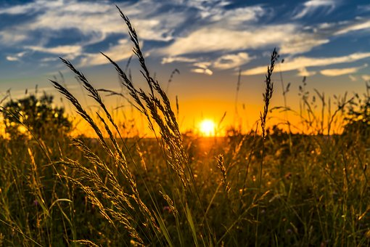
References
https://www.rad.sik.si/wp-content/uploads/2016/03/Vzhod.pdf https://www.sunrise-and-sunset.com/en

Slide 9
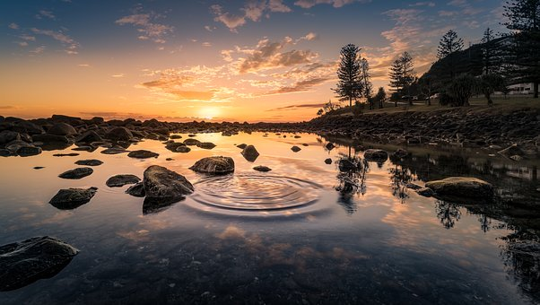
ACKNOWLEDGEMENTS
We would like to thank to our friends from Spain and Iceland for all of the instructions and also measurements, that were made for us. Big acknowledgement goes to our professor, Jerneja Pavlin, which gave us detailed instructions for the work and helped us with the website etwinning.

