Slide 1


AROUND THE WORLD WITH MATH
PROJECT
EVALUATION RESULT
ETWINNING PROJECT

Slide 2
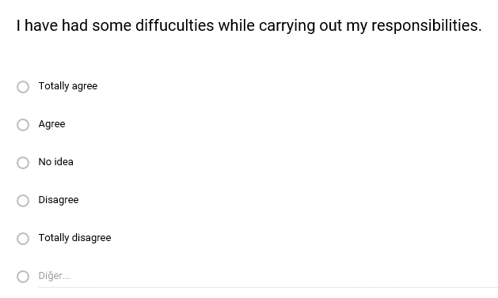
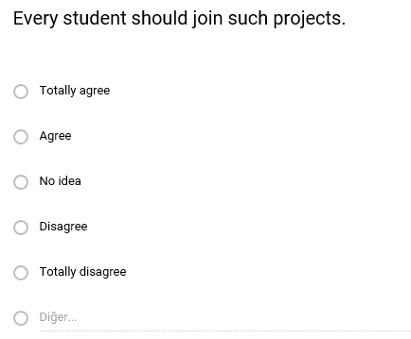
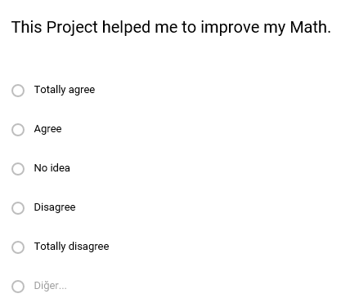
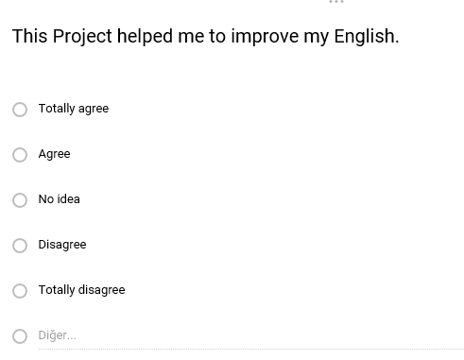

Slide 13
MANY THANKS TO ALL INVOLVED IN THE PROJECT.
BURDUR SCIENCE AND ART CENTER -TURKEY
IT SEEMS THAT WE’VE DONE A SUCCESSFUL WORKING TOGETHER.

