Slide 1
Task 10
Elena Lukačević 8.a Primary School Eugen Kumčić Slatina, Croatia

Slide 2
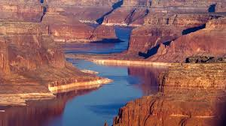
Colorado river
The Colorado River is one of the principal rivers of the Southwestern United States and northern Mexico. Source La Poudre Pass and Mouth Gulf of California.

Slide 3
Task and data
James and Mia sailed in the boat on the Colorado river. James sailed 53% of the lenght of the river. Mia sailed 15% less than James. How many km did they sail together? Find out how long is the Colorado river :)
Mia= 15%
James= 53%
Colorado river is 2 334 km long

Slide 4
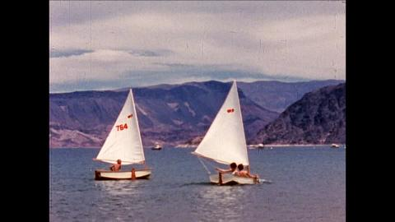
Calculation
James: 0.53* 2334= 1237.02 km
Mia: 1237.02 - (0.15* 2334) = 1237.02 - 350.1 = 886.92 km
They sailed 886.92 km together

Slide 5
The End
Greetings from Croatia!

