Slide 1
The biggest city of
Brazil

Slide 2
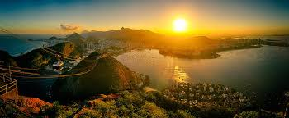
Gertrúda, Jožo, Uršuľa, Fero and Stela went to the biggest city of Brazil. They visited monument which is 30 metres high and 1000 tons weight. It is very popular mostly in Catholics. They wanted to document it buy photograph from each side.

Slide 3
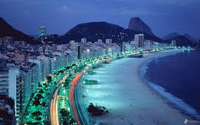
How many photos did they have to take if each of them could snap only 1,5 metre?

Slide 4
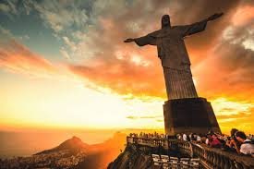
Answer:

Slide 5
Answer: 9 photographs

Slide 6
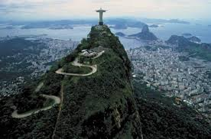
Solving: 1,5 . 30 =

Slide 7
Solving: 1,5 . 30 = 45

Slide 8
Solving: 1,5 . 30 = 45
45 : 5 =

Slide 9
Solving: 1,5 . 30 = 45
45 : 5 = 9

