Slide 1
Task 6
Elena Lukačević 8.a
Primary school Eugena Kumičića Slatina, Croatia

Slide 2
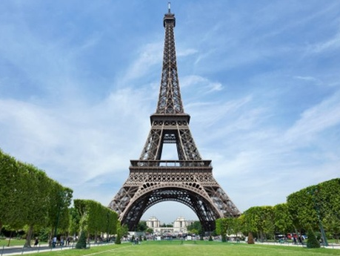
Eiffel Tower
The Eiffel is an iron lattice tower located on the Champ de Mars in Paris, France. It was named after the engineer Alexandre Gustave Eiffel, whose company designed and built the tower. Erected in 1889 as the entrance arch to the 1889 World's Fair, it was initially criticized by some of France's leading artists and intellectuals for its design, but has become both a global cultural icon of France and one of the most recognisable structures in the world.

Slide 3
Task
One group of 9th grade students will go to the 2nd floor of the Eiffel Tower by the stairs, the second group will take the lift. How long can the second group stay in the cafe at the base of the tower so that they all reach the 2nd floor at the same time?

Slide 4
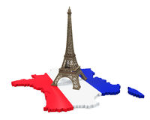
Informations
Lift average speed: 1 m/s
Eiffel tower height to the 2nd floor: 115m
Stair height: 20 cm
Man’s average speed: One stair=1 sec

Slide 5
Calculate
Stairs to the 2nd floor=
11500cm/20cm= 575 stairs
Time for first group: 575*1 sec= 575sec = 9,5min
Time for second group: 115m * 1 m/s= 115 s= 1,9 min
Cafe time: 9,5 min – 1,9 min= 7,6 min

Slide 6
The End!
Greetings from Croatia! ☺

