Slide 1
TASK 3
Author : Patricija Kovačić, 8th grade
OŠ Eugena Kumičića, Slatina
Croatia

Slide 2
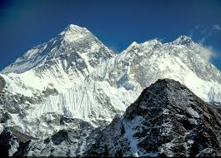
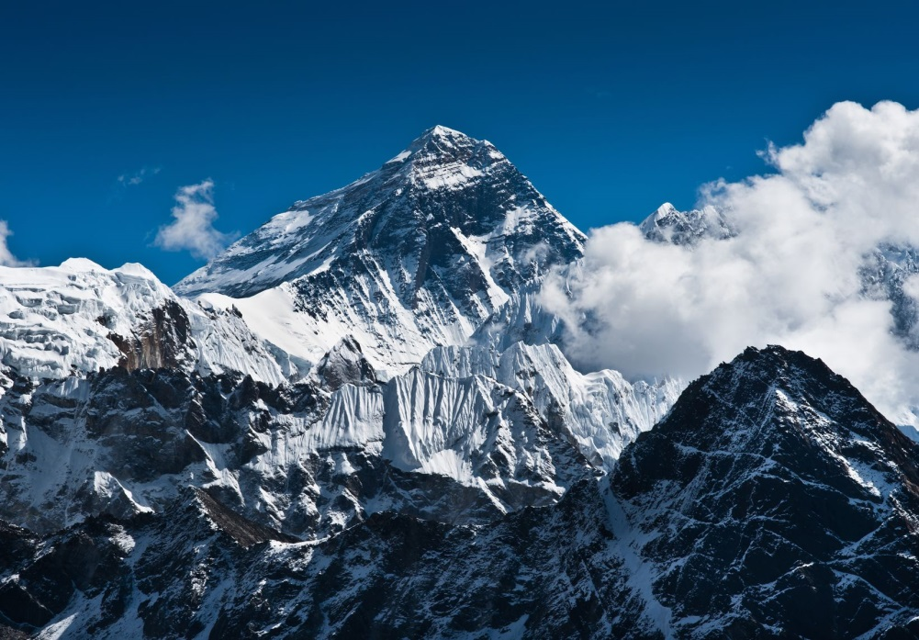
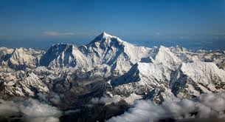
Mount Everest

Slide 3
Task no.3
Katka, Kristýna, Matěj, Vítek, Jirka, Jarda and Michal want beat the highest mountain of the world, but they were losing their energy during the way up. How high they each climbed, if Katka climbed 56 % of the mountain height, Kristýna 52 %, Matěj 64 %, Vítek 51 %, Jirka 73 %, Jarda 82 % and Michal 79 % of the mountain height?

Slide 4
Missing data
The missing data that we need to solve the problem:
- What is the highest mountain of the world?
- How high is that mountain?
We link this with geography

Slide 5
Solution
Kristýna 52% of 8848m is 4600.9m ≈ 4601m
Katka 56% of 8848m is 4954.8m ≈ 4955m
Matěj 64% of 8848m is 5662.7m ≈ 5663m
Vítek 51% of 8848m is 4512.4m ≈ 4512m
Jirka 73% of 8848m is 6459m
Jarda 82% of 8848m is 7255.3m ≈ 7256m
Michal 79% of 8848m is 6989.9m ≈ 6990m

Slide 6
Steps:
After reading the text of a task I realized what data I am missing.
I found out that the highest mountain in the world is Mount Everest with height of 8848m (now it is easy do finish the task).
I’ve calculated the percantages and found who climbed on which height.
The end!

