Slide 1
Task 1
Elena Lukacevic 8.a Primary school Eugen Kumičić from Slatina, Croatia

Slide 2
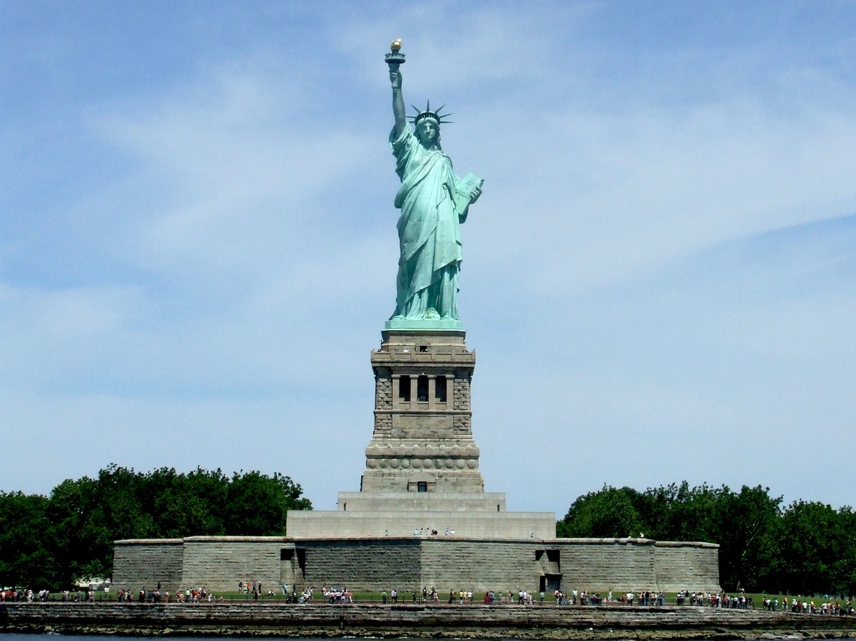
The Statue of liberty
The Statue of Liberty is a colossal neoclassical sculpture on Liberty Island in New York Harbor in New York City, in the United States. The copper statue, designed by Frédéric Auguste Bartholdi, a French sculptor, was built by Gustave Eiffel and dedicated on October 28, 1886. It was a gift to the United States from the people of France.

Slide 3
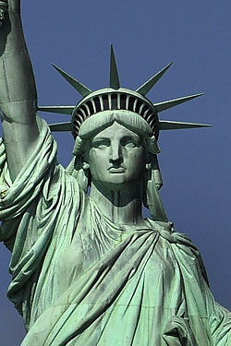
Informations
the height of the Statue of Liberty: 92,99 m
Woman height: 46,05 m
Stair height: 0.21 m
My height: 1.68 m
The length of my arm: 0.76 m
Torch: 6 m

Slide 4
Calculus
P% = 76 cm/168 cm = 0.45 * 100= 45%
Arm height= 0.45 * 46,05 m = 20, 72 m
Height woman to shoulders:
92,99m – 20, 72= 72,27 m
Number of stairs up to the shoulder:
72,27/0,21 = 344
Number of stairs up to the torch: 26,72/0,21= 127
The total number of stairs: 344+127= 471

Slide 5
The End!
Greetings from Croatia ☺

