Slide 1
Colorado river

Slide 2
EXERCISE
James and Mia sailed in the boat on the Colorado river.
James sailed 53% of the lenght of the river.
Mia sailed 15% less than James.
How many km did they sail together?
Find out how long is the Colorado river :)

Slide 3
SOLUTION
The lenght of the Colorado river = 2330 km
53% - 15% = 38%
Mia – 38%
James – 2330 : 100 = 23,3 x 53 = 1234,9
Mia – 2330 : 100 = 23,3 x 38 = 885,4
1234,9 + 885,4 = 2120,3
They sailed 2120,3 km together.

Slide 4
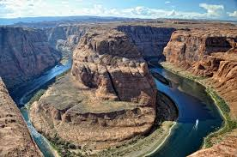
Created by: Simona Majstráková , Barbora Smiešková , Viktória Kuruczová , Barbora Peniašková , Simona Chvalovská

