Slide 1
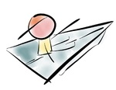

AROUND THE WORLD WITH MATH
ETWNINNING PROJECT

Slide 2
BURDUR SCINECE AND ART CENTER
TURKEY

Slide 3
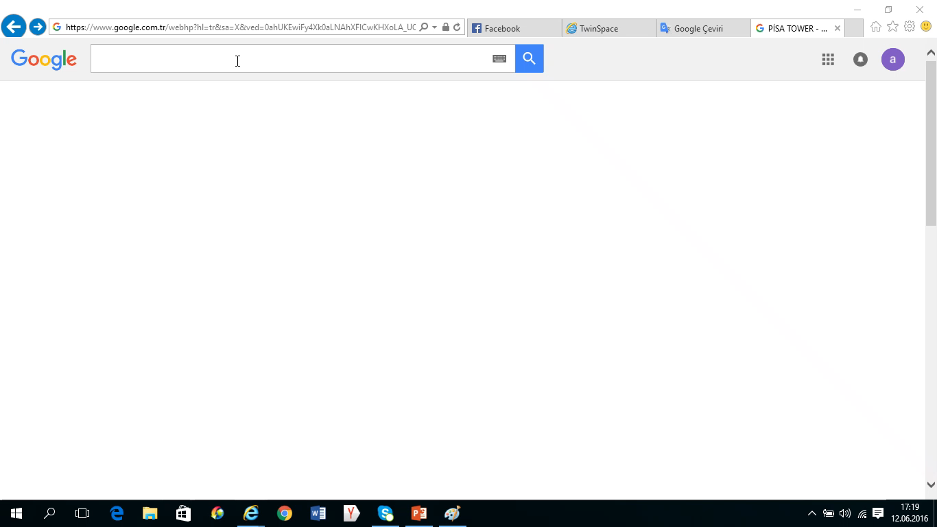

Slide 4
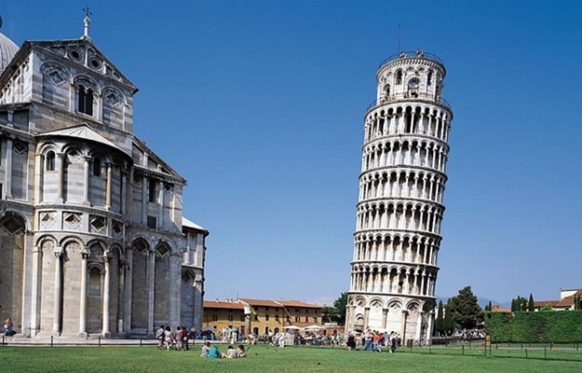
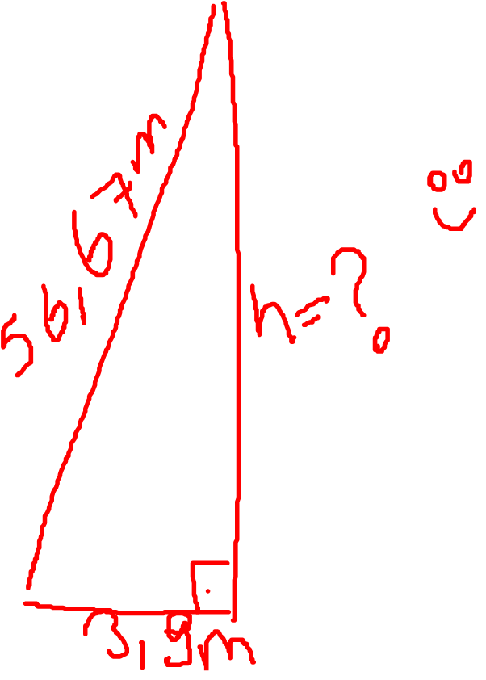

Slide 5


Solutıon task no 13.
ANSWER=

