Slide 1
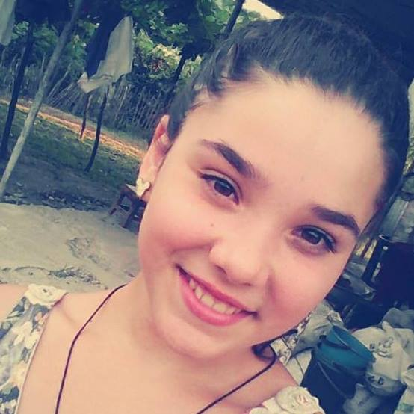
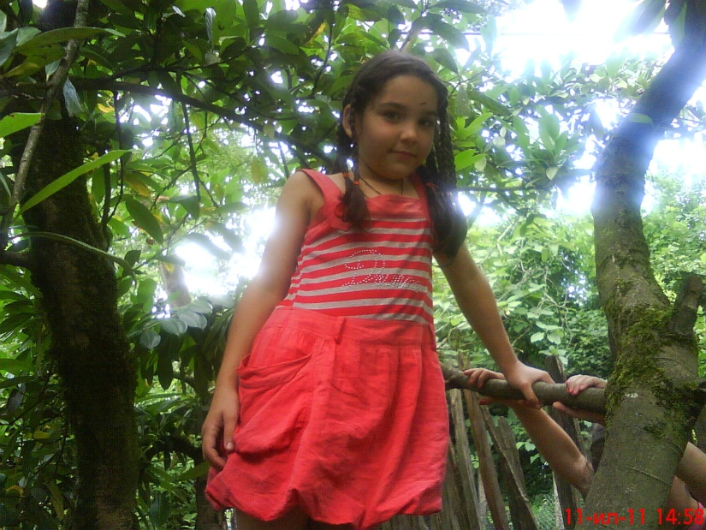
Hello..my name is vika khekhelashvili an I tell you about my country and my town….

Slide 2
Georgia has its coat of arms And Flag

Slide 3
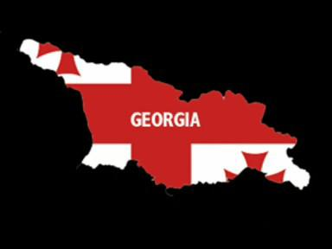
This is my country…it is very small but we have a very nice country…. ♥

Slide 4
Georgia has many regions…

Slide 5
Qartli

Slide 6
kaxeTi

Slide 7
Samegrelo

Slide 8
Imereti

Slide 9
Guria

Slide 10
Racha

Slide 11
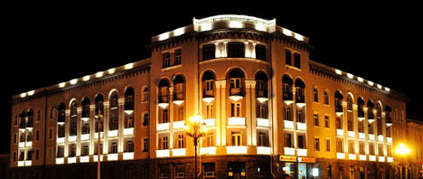
My town is Rustavi

Slide 13
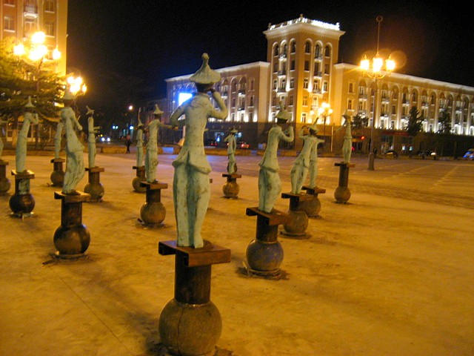

Slide 14
This is my school

Slide 15
My school has a lot of smart kids

Slide 16
It is me…

Slide 17
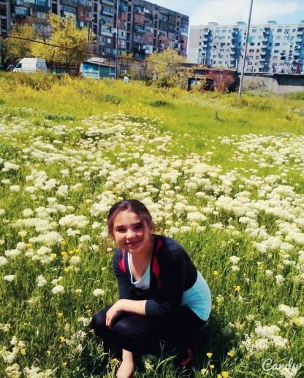
Good bye ♥ ♥ ♥

