Slide 1
Task 9
Elena Lukačević 8.a Primary school Eugen Kumičić Slatina, Croatia

Slide 2
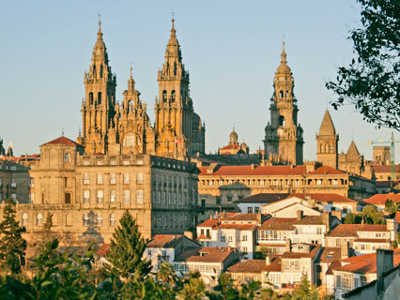
Santiago de Compostela
Santiago de Compostela, commonly known as Santiago, is the capital of the autonomous community of Galicia in northwestern Spain.
The city has its origin in the shrine of Saint James the Great, now the city's cathedral, as destination of the Way of St. James, a leading Catholic pilgrimage route originated in the 9th century. In 1985 the city's Old Town was designated a UNESCO World Heritage Site.

Slide 3
Task
The 1º ESO group from Alca School, living from Santiago De Compostela, is going on a trip to the Czech Republic by coach.
The coach travell 3,24m, for each time the wheels go round.
How many times do the wheels have to go round for the complete length of the journey, using the shortest route?

Slide 4
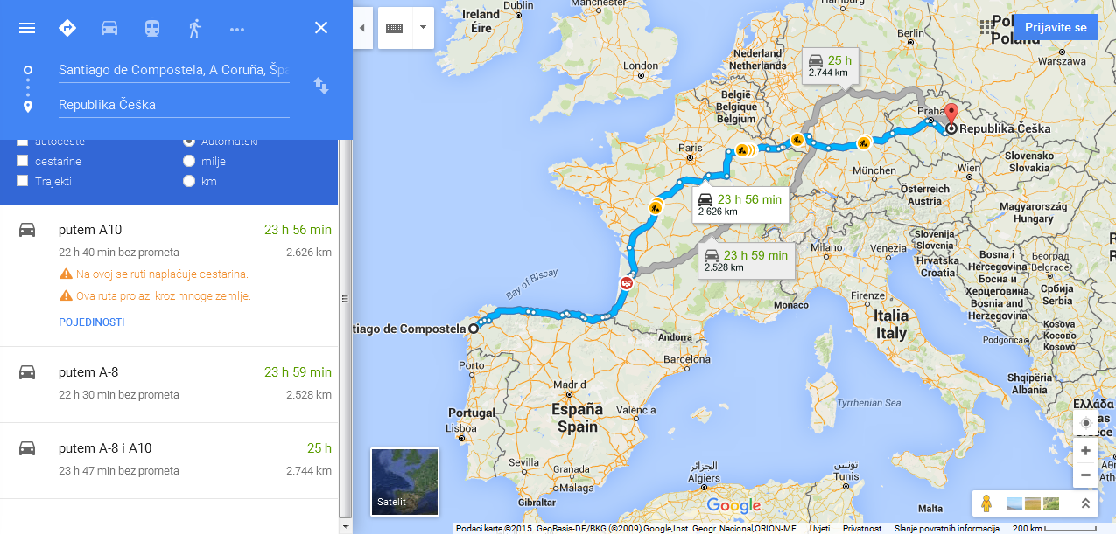
Informations
Wheels go round for every 3, 24 m
Length of the route: 2 626 km= 262 600 m

Slide 5
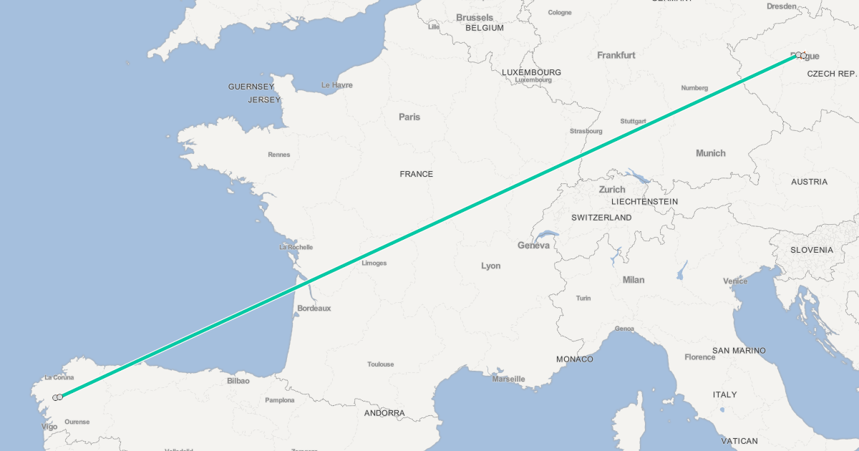
Calculate
Result: 262 600m/3,24m= 81049
Wheels must go round for 81049 times

Slide 6
The End!
Greetings from Croatia and have a good trip ☺ !

