Slide 1
Republic of Serbia

Slide 2
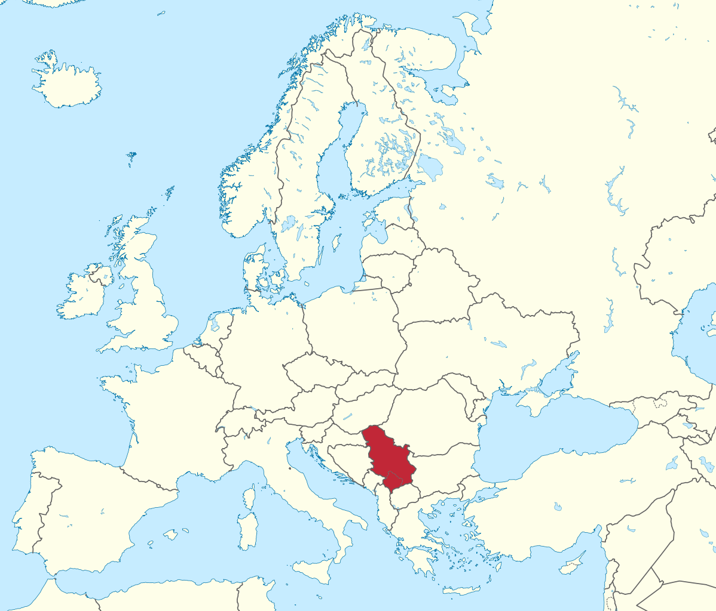
Serbia

Slide 3
Something about Serbia
Located in Europe,on the Balkan peninsual.
Area including Kosovo spikes 88,361 km square
Serbia is borders Hungary to the north;
Romania and Bulgaria to the east;
Macedonia to the south;
Croatia, Bosnia and Herzegovina, and Montenegro to the west.
Language: Serbian. We use Cyrillic alphabet and Serbian Latin
The capital of Serbia is Belgrade.
Religion is mostly Orthodox, little part Catholics and one little
part is Muslims.

Slide 4
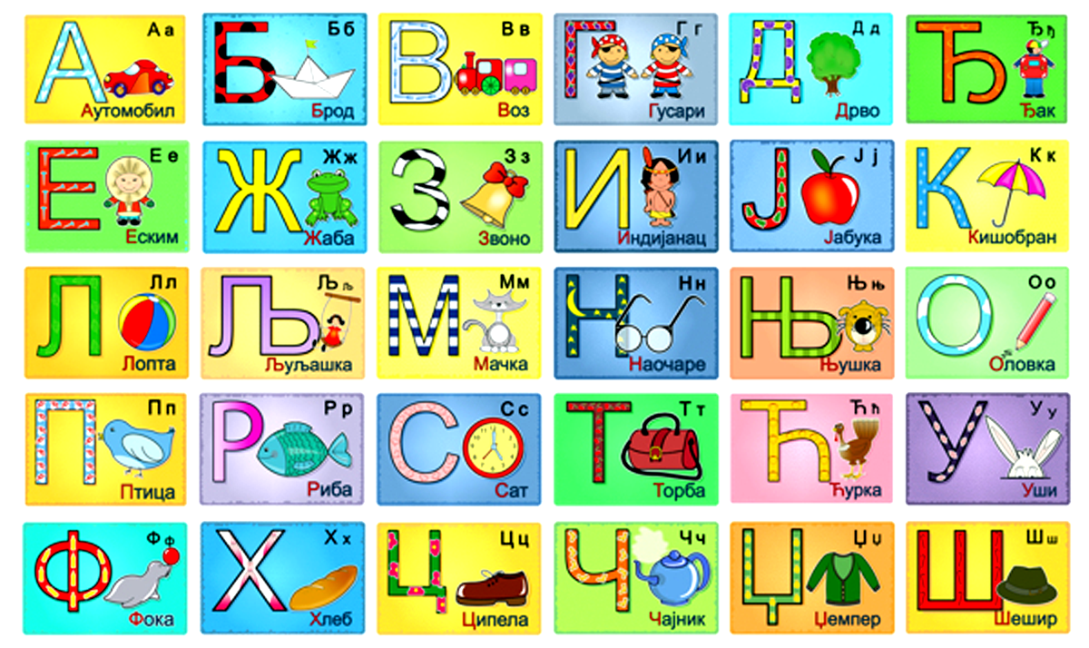
Cyrillic alphabet

Slide 5
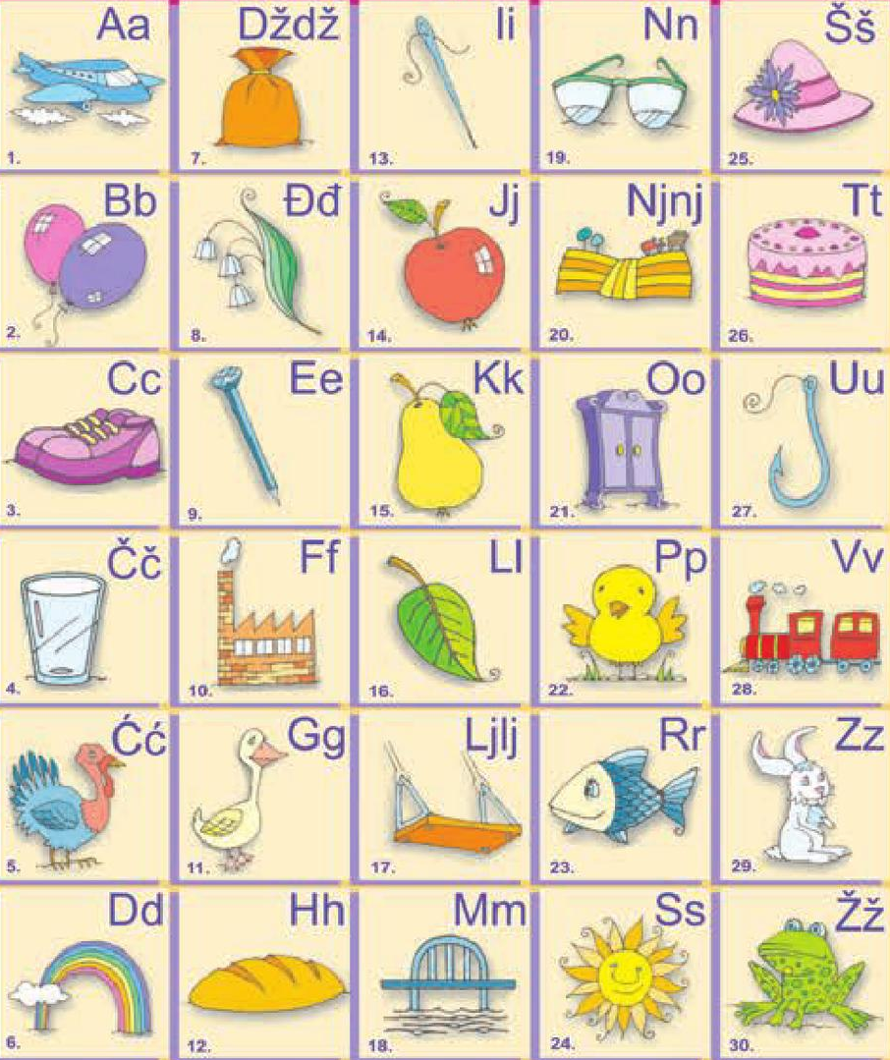
Serbian latin
alphabet

Slide 6
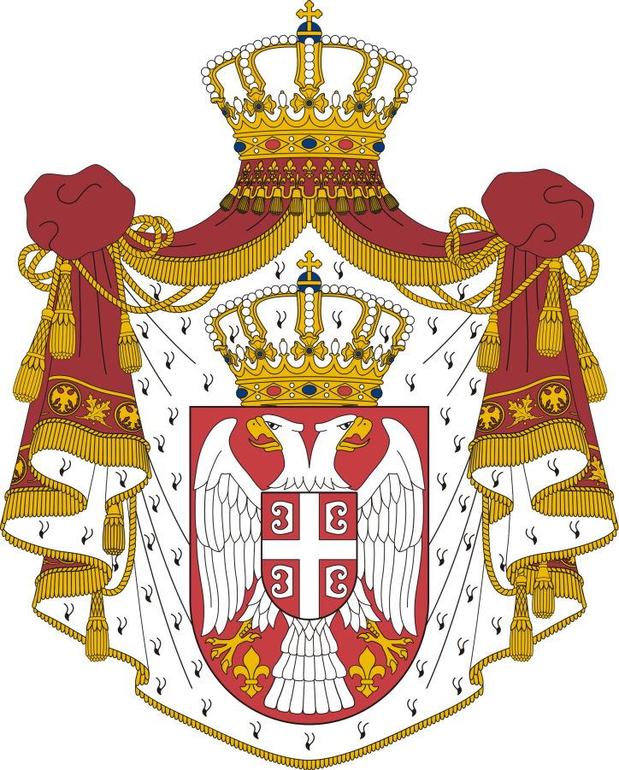
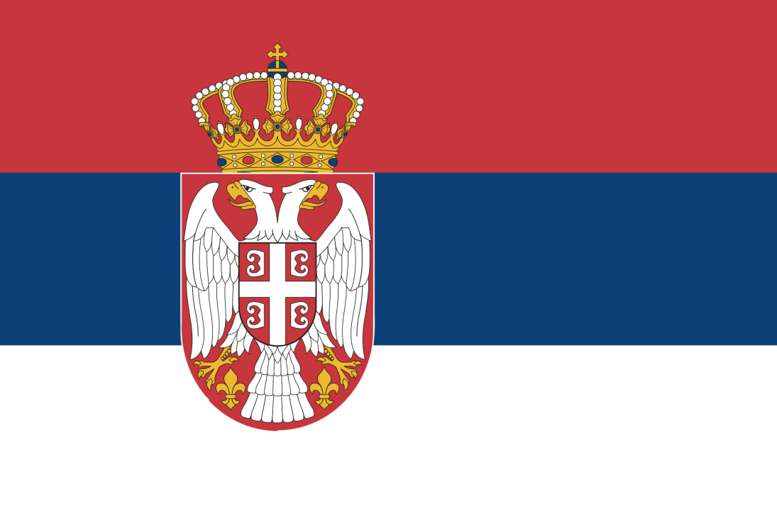
The flag and coat of arms

Slide 7
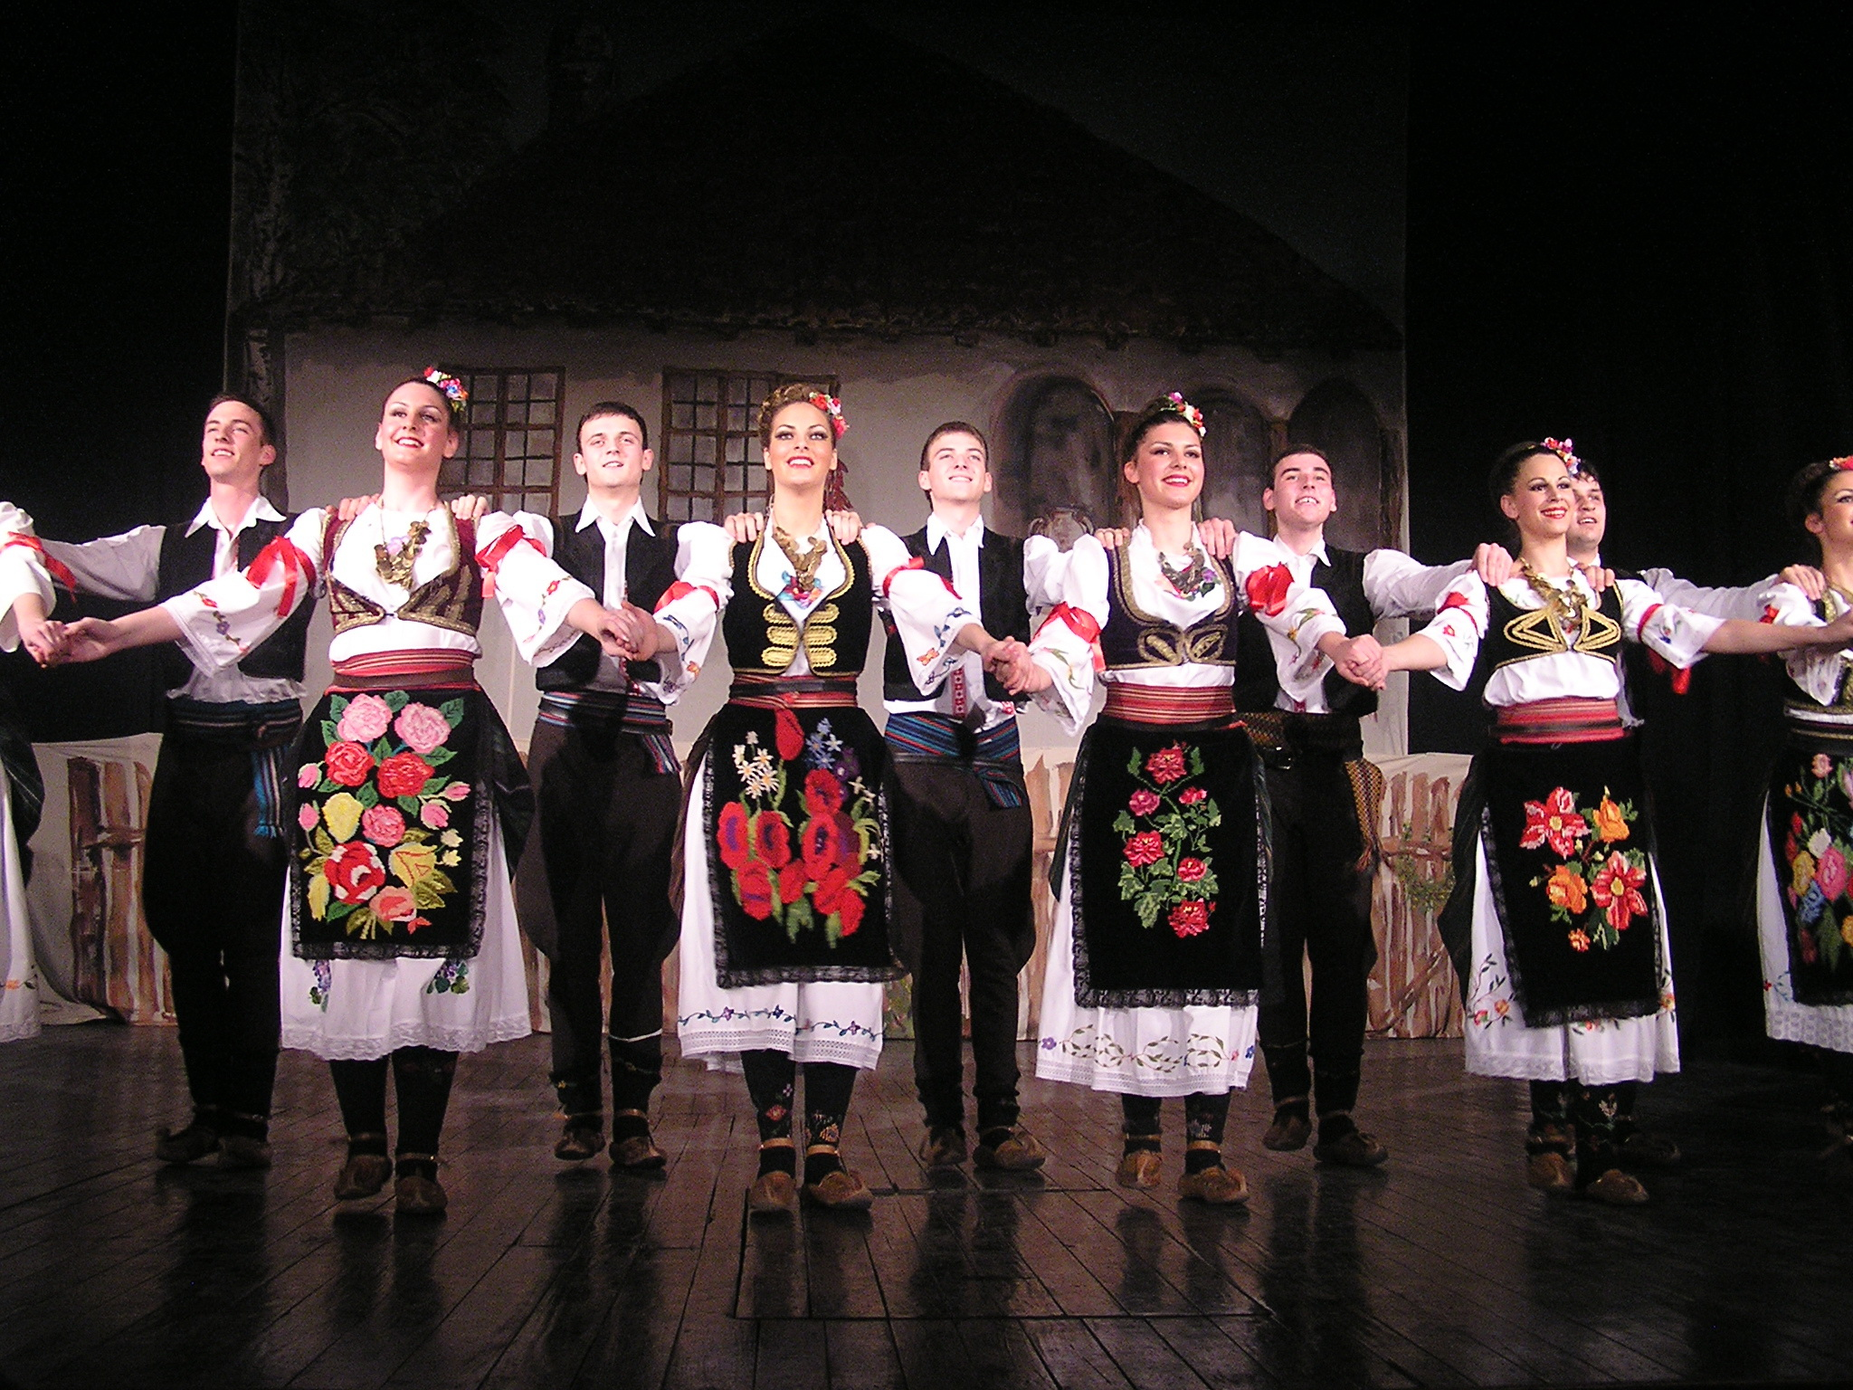
National costume

Slide 8
BELGRADE
(BEOGRAD)

Slide 9
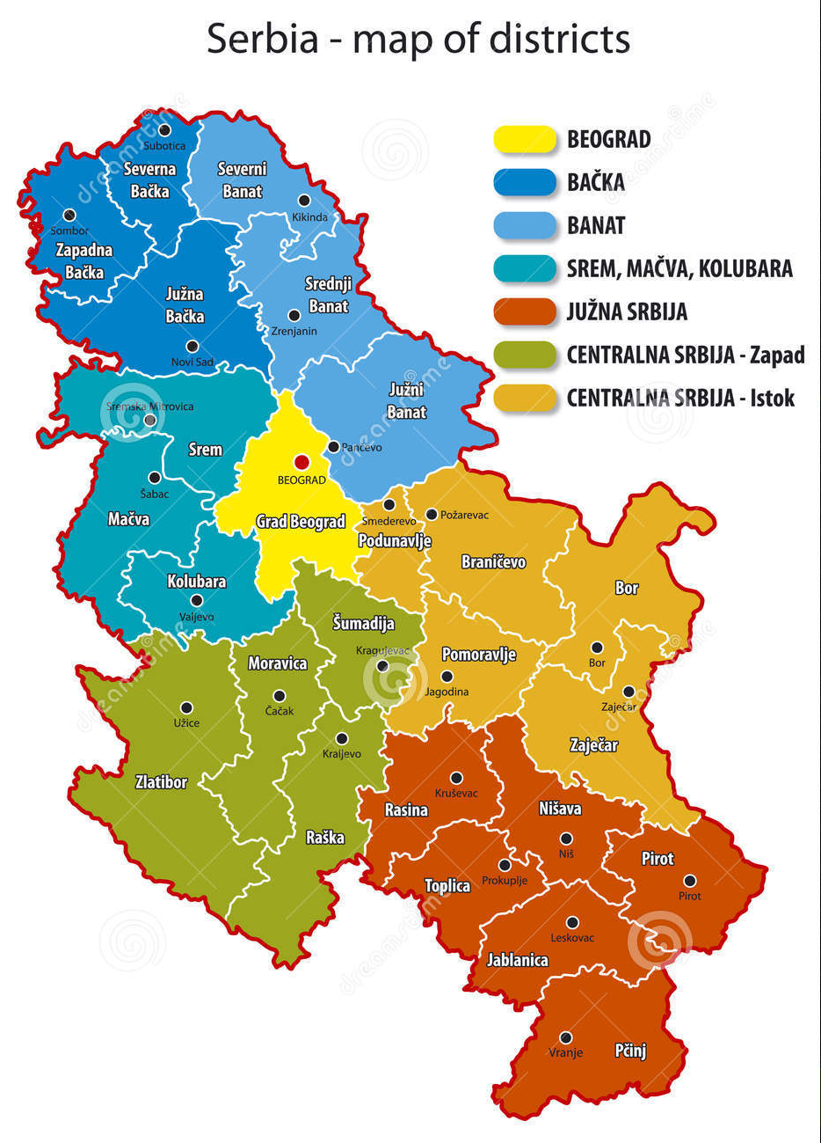
BELGRADE
It is located at the
confluence of
the Sava and
Danube rivers.
The city has a
population of 1.23
million, while over
1.65 million people
live in its metro are.

Slide 10
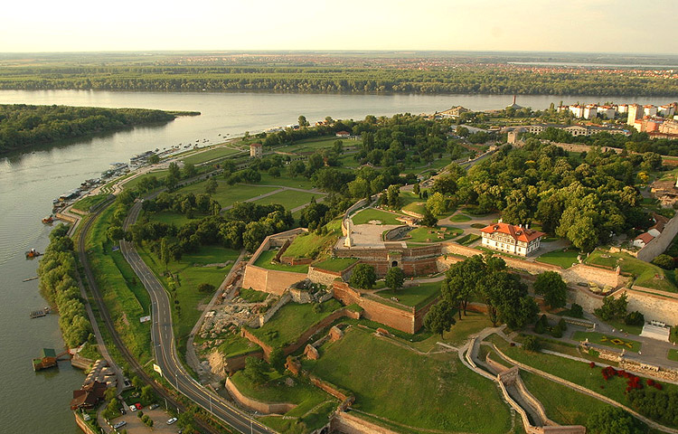
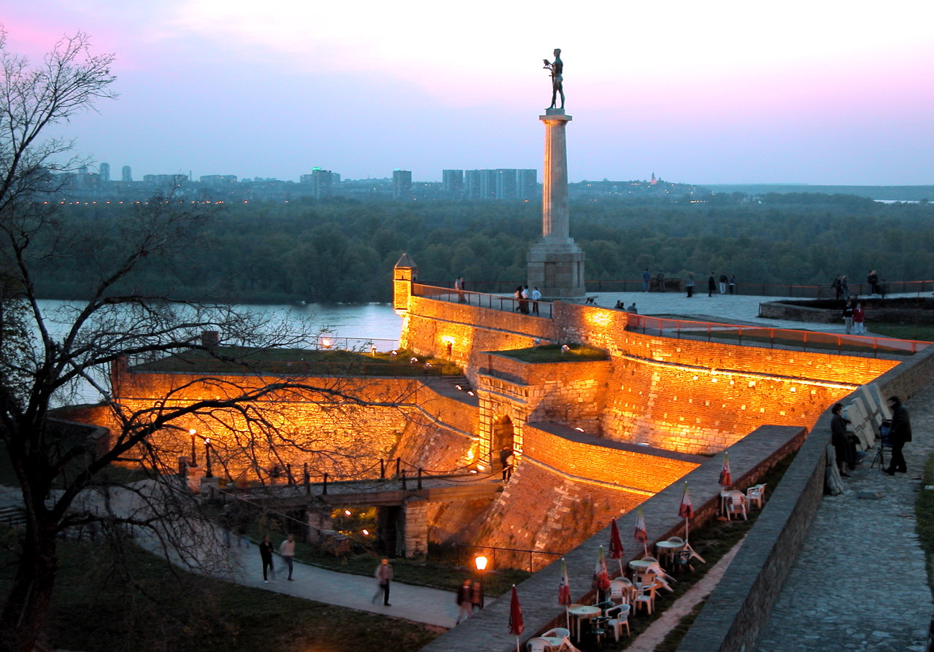
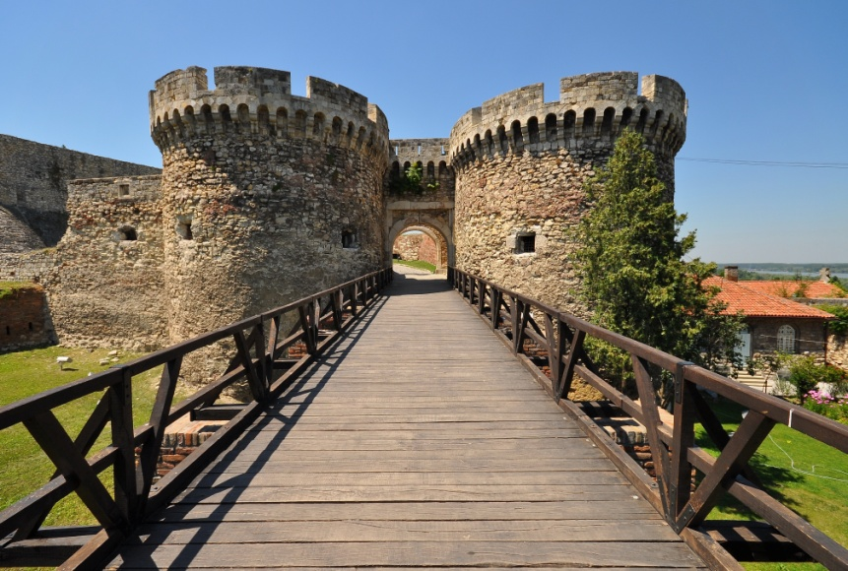
Belgrade fortess - Kalemegdan park

Slide 11
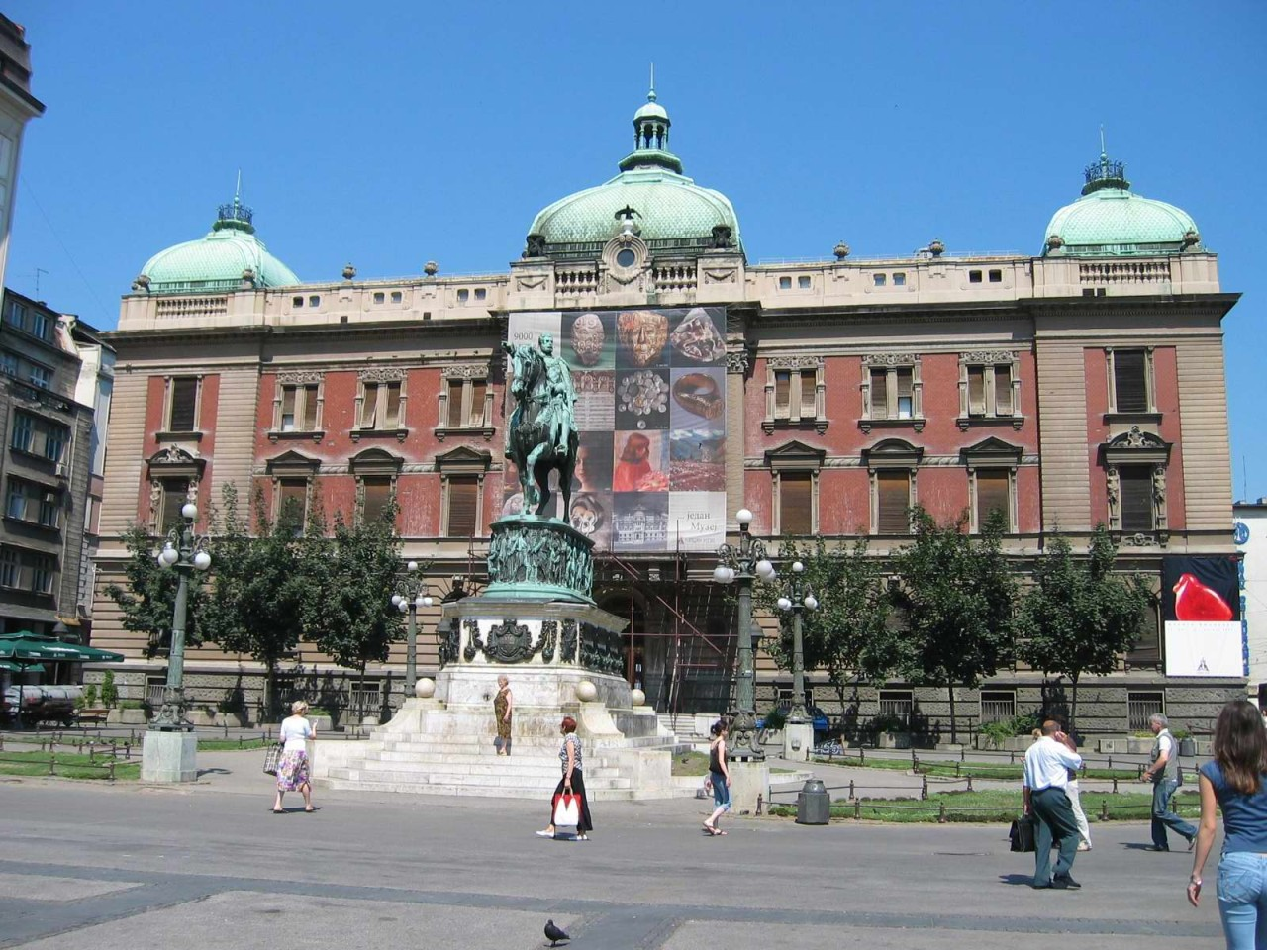
Republic square
National Museum

Slide 12
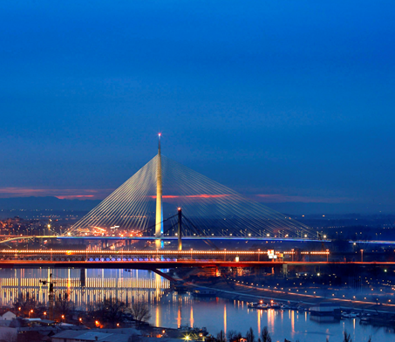
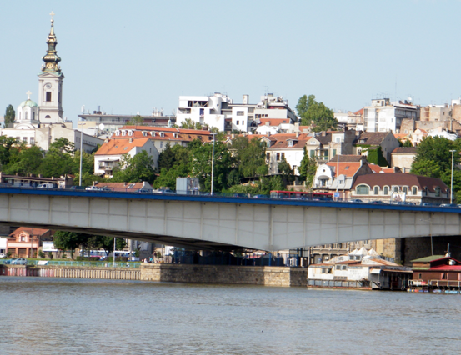
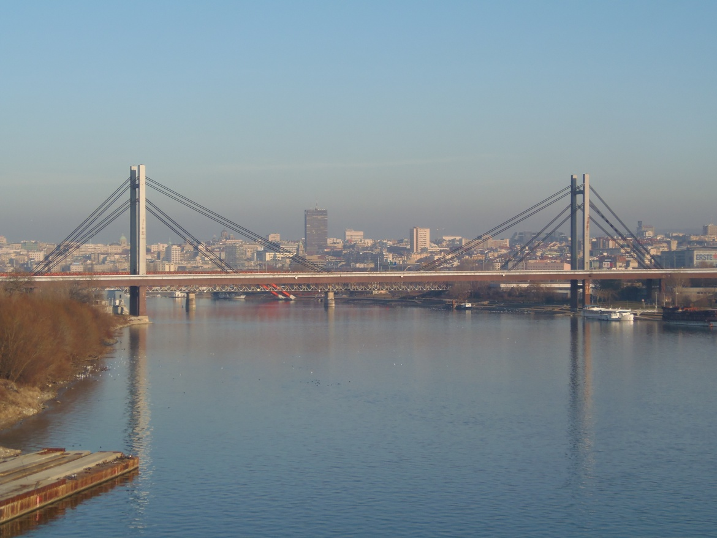
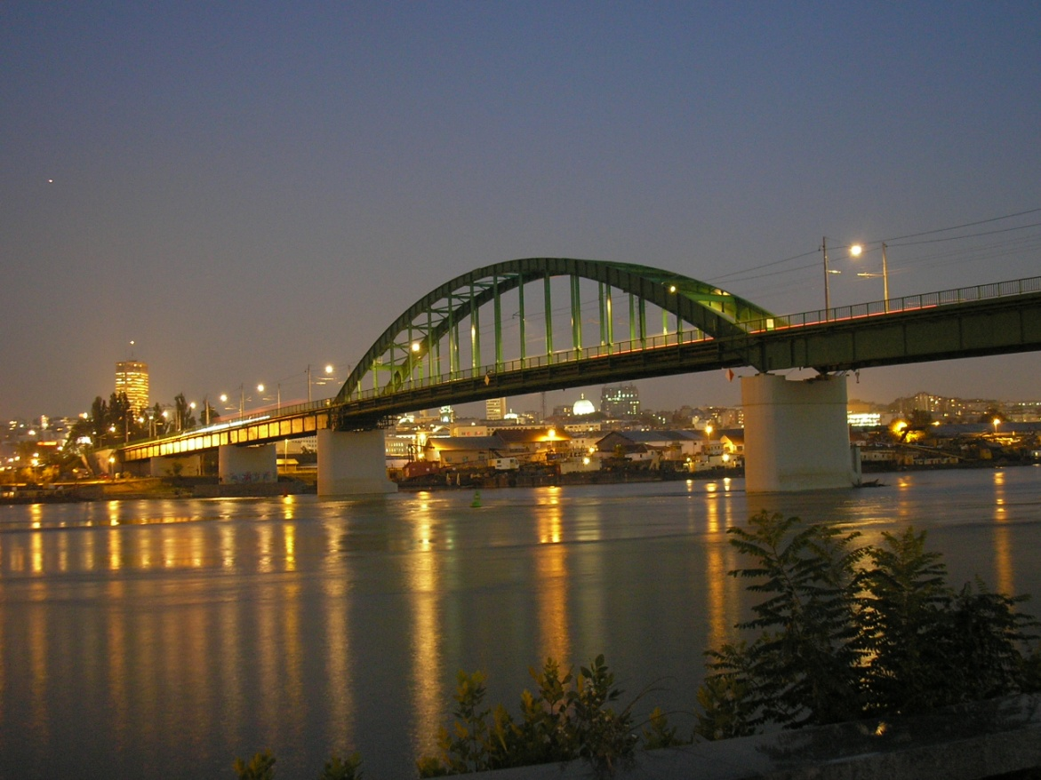
Belgrade bridges

Slide 13
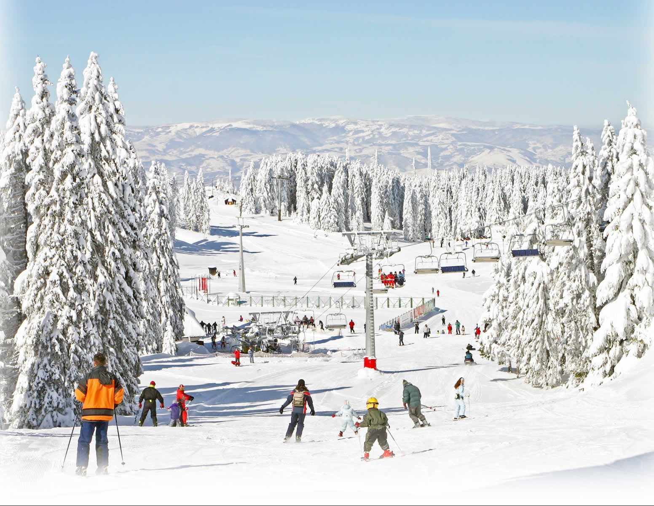
Mountains and lakes in Serbia
Kopaonik
The big mountains are:
Kopaonik
Zlatibor
Rudnik
Stara planina
Tara
Divčibare
Golija
Fruška gora

Slide 14
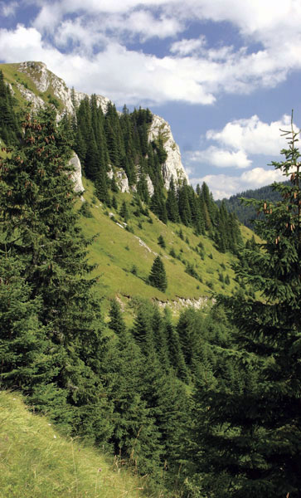
KOPAONIK
Kopaonik, the biggest mountain
of the central Serbia.
Climate of Kopaonik, with almost
200 sunny days a year, why is
rightfully called the "Mountain
of the Sun".
The bigest peak is Pancic's Peak
(2017 m).

Slide 15
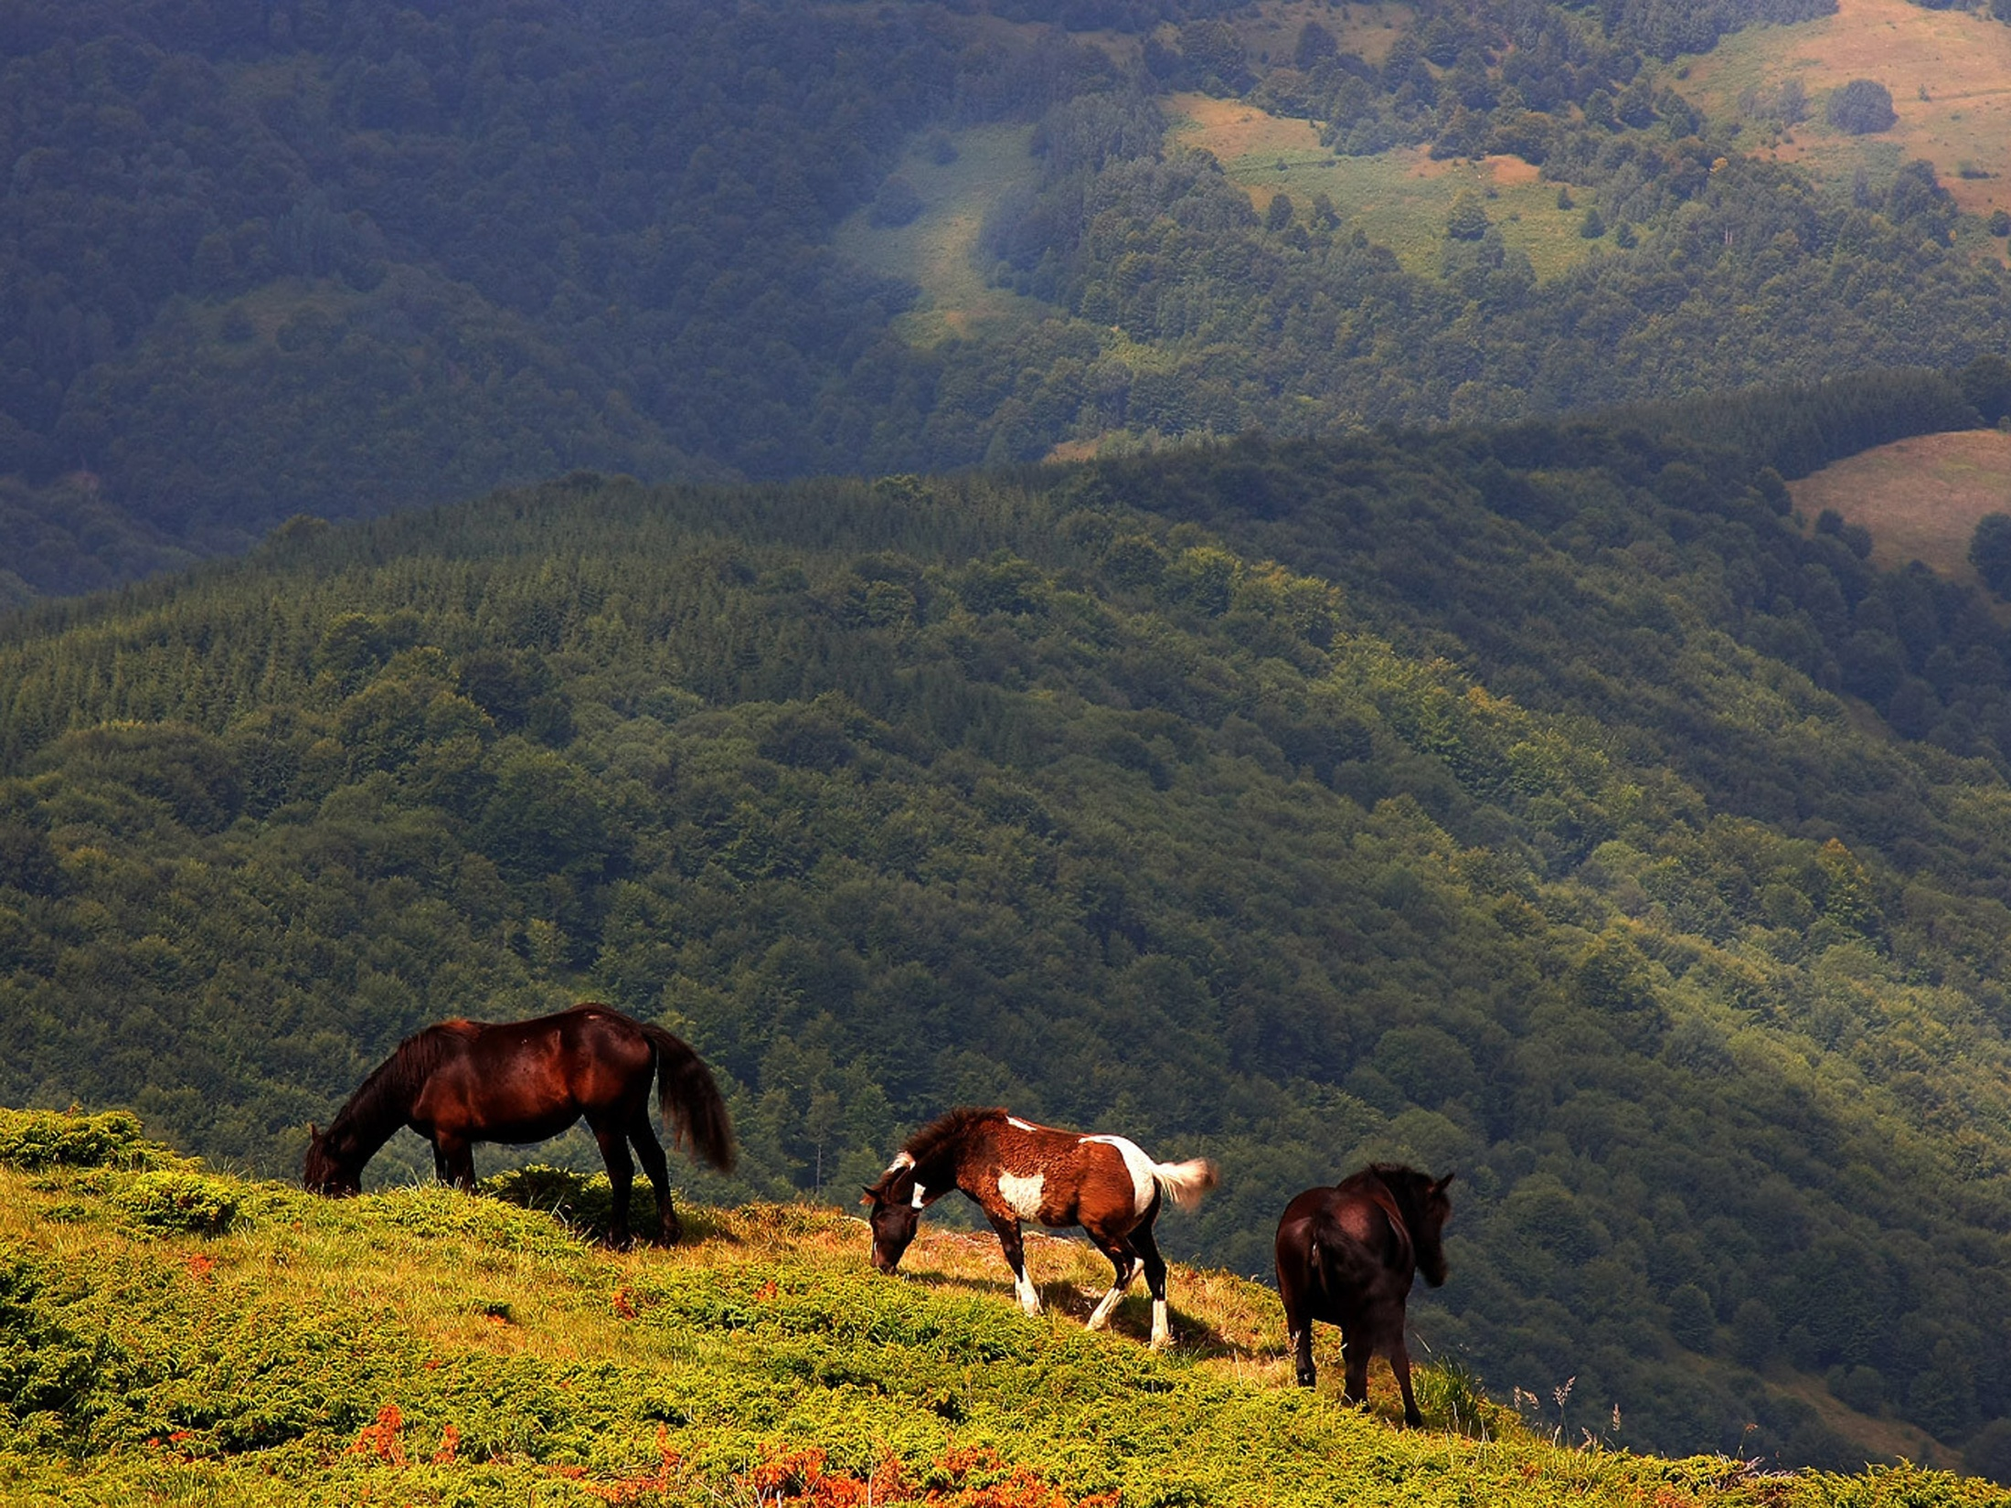
Stara planina (Old mountain)

Slide 16
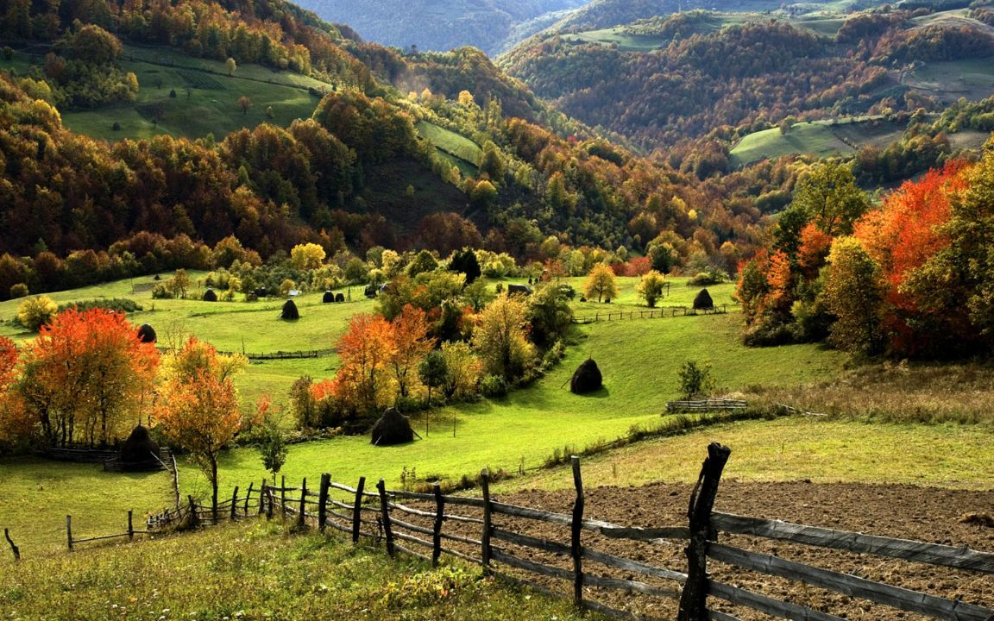
ZLATIBOR

Slide 17
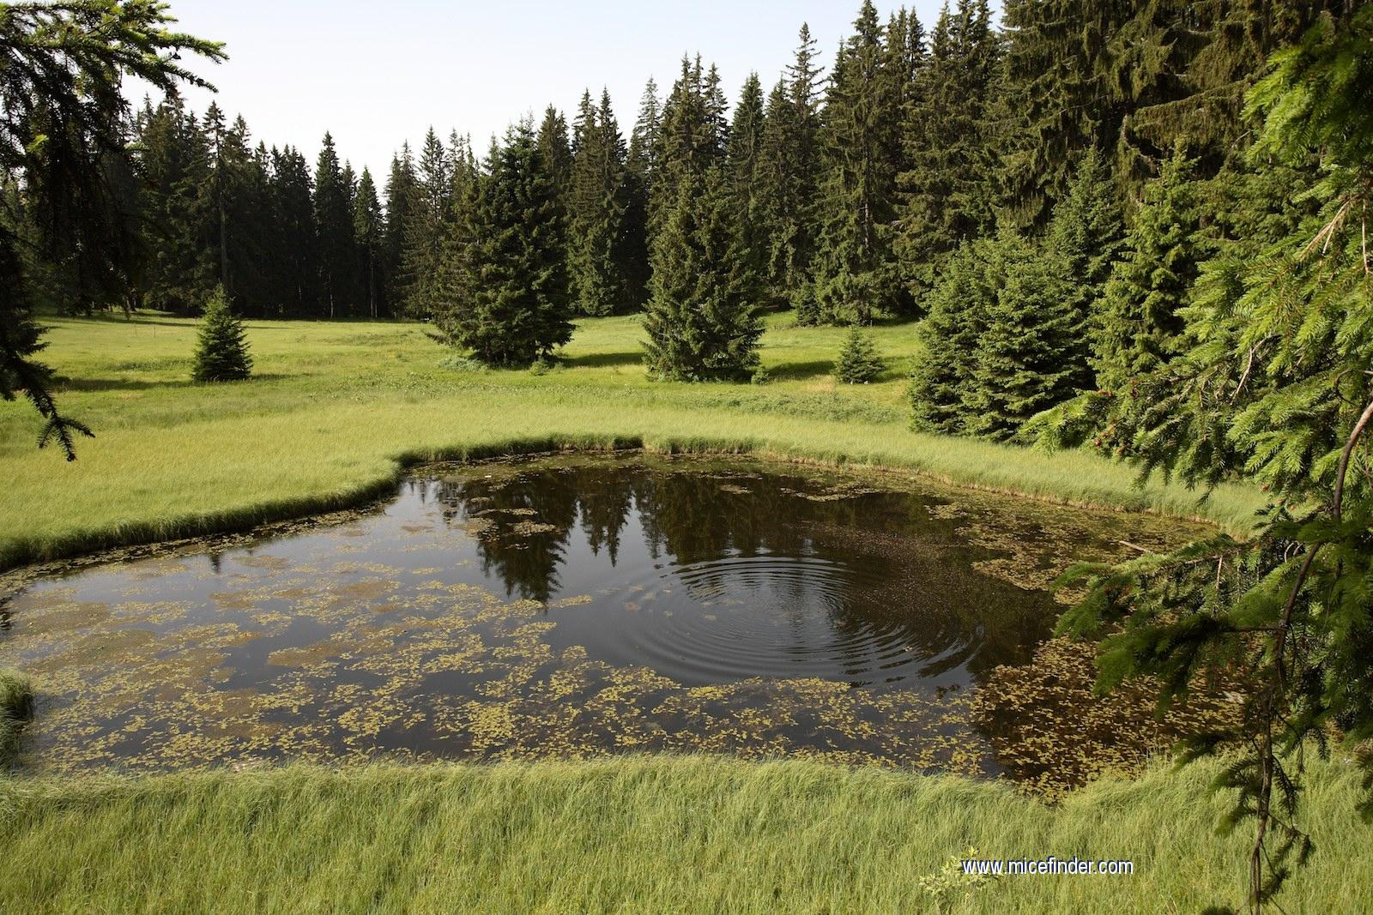
GOLIJA

Slide 18
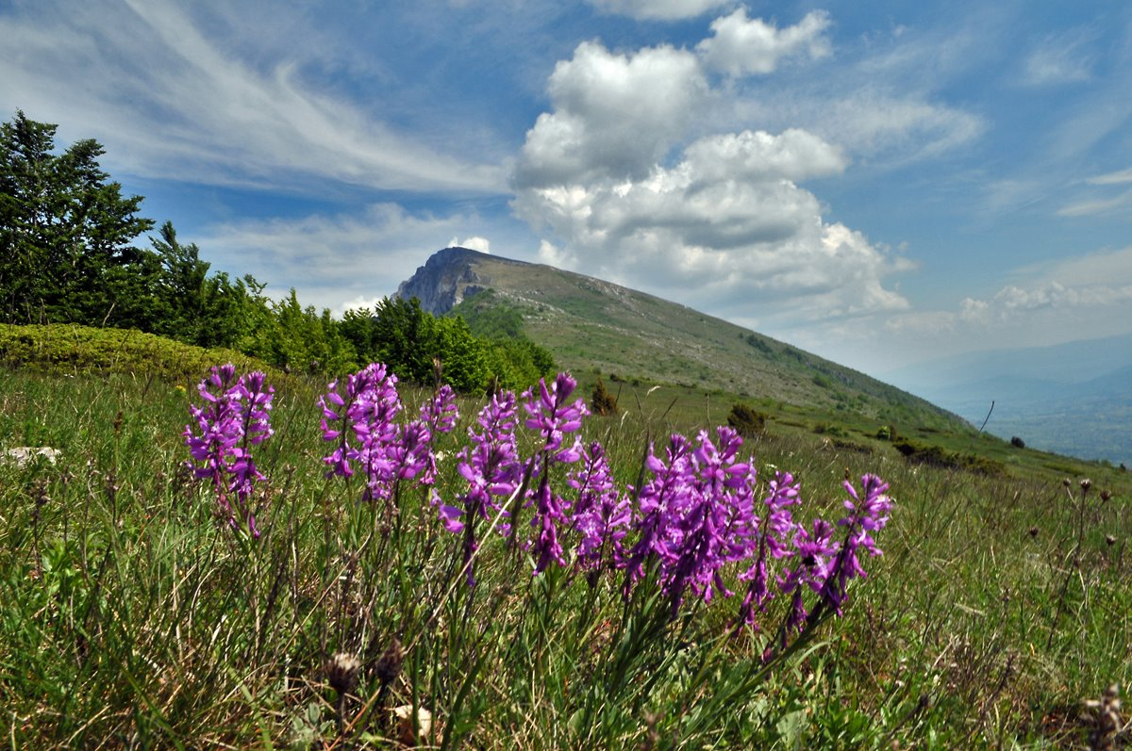
SUVA
PLANINA

Slide 19
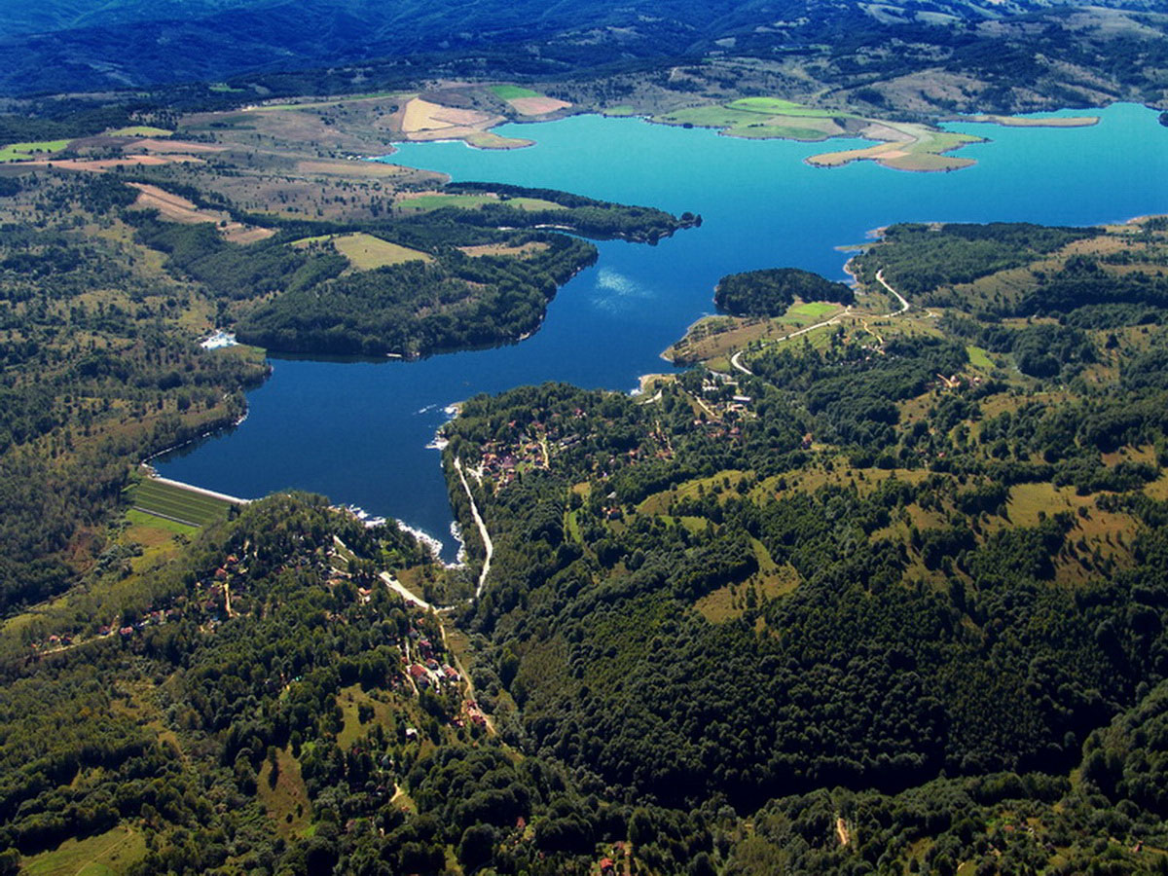
The biggest lakes:
Palićko,
Đerdapsko,
Zvorničko,
Belo,
Perućačko,
Vlasinsko

Slide 20
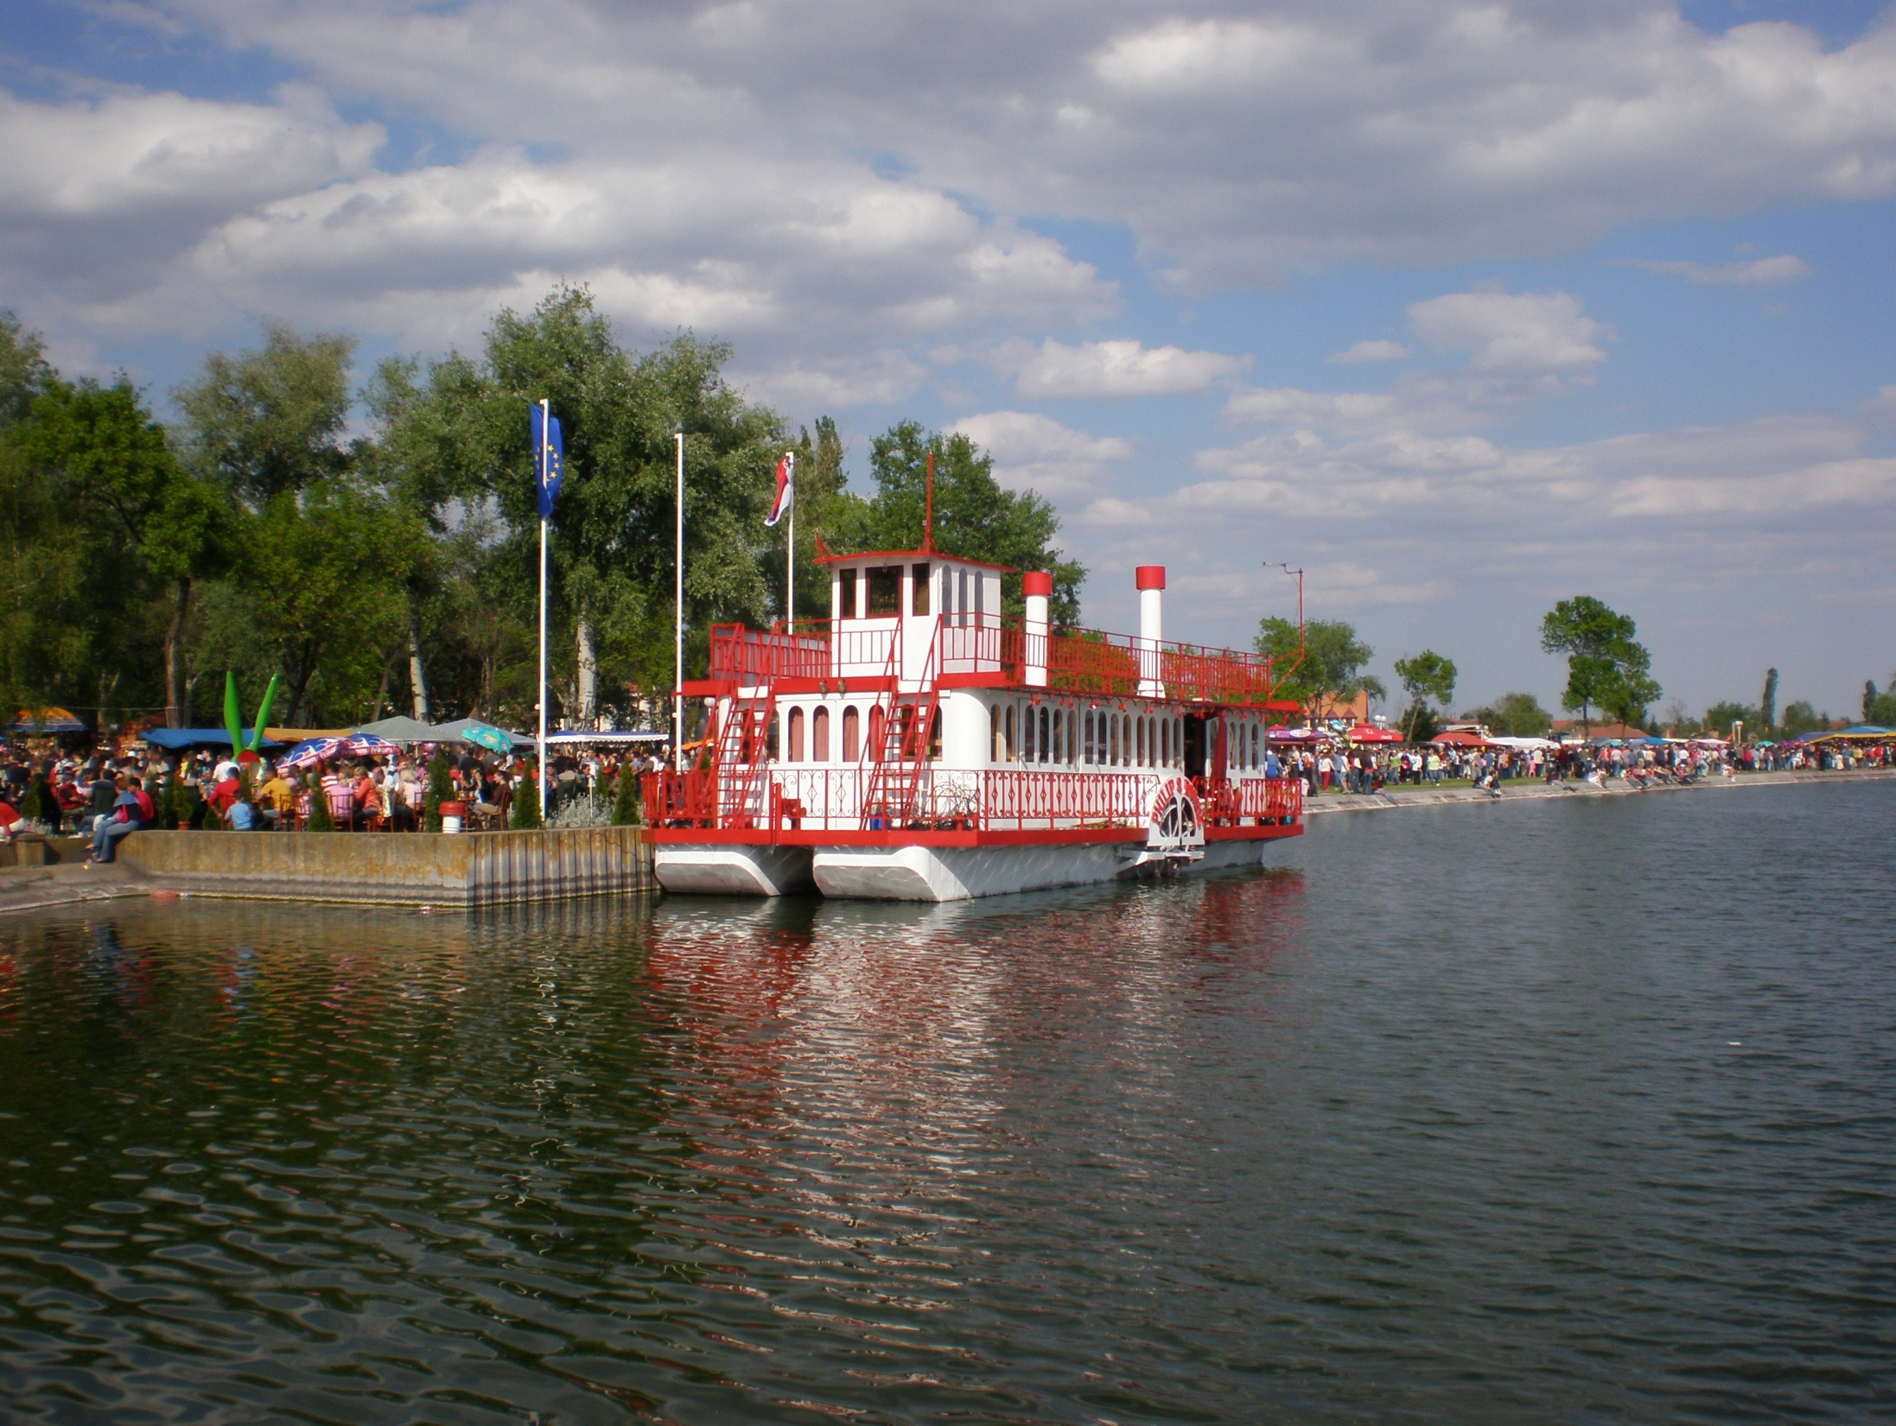
Palićko jezero
(Palicko Lake)

Slide 21
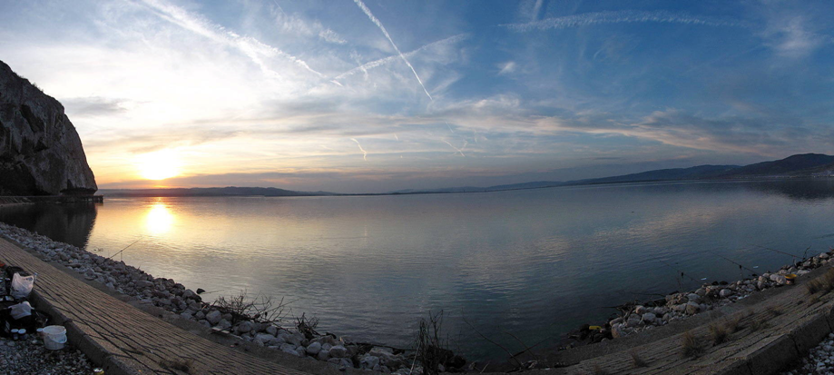
DJERDAPSKO JEZERO
(DJERDAP LAKE)
http://lakesinserbia.com/djerdap-lake

Slide 22
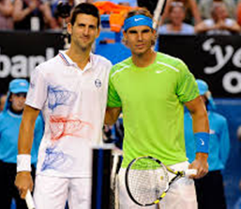
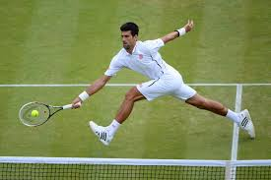
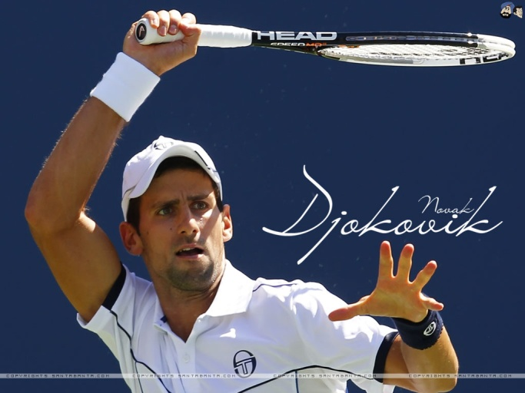
Sport in Serbia
People favorite sport in Serbia are: football, basketball, tennis, water polo, voleyball…
We are popular becouse of tennis…
Two words NOVAK ĐOKOVIĆ.
Novak is a Serbian professional tennis player who is currently ranked world N0. 1.

Slide 23
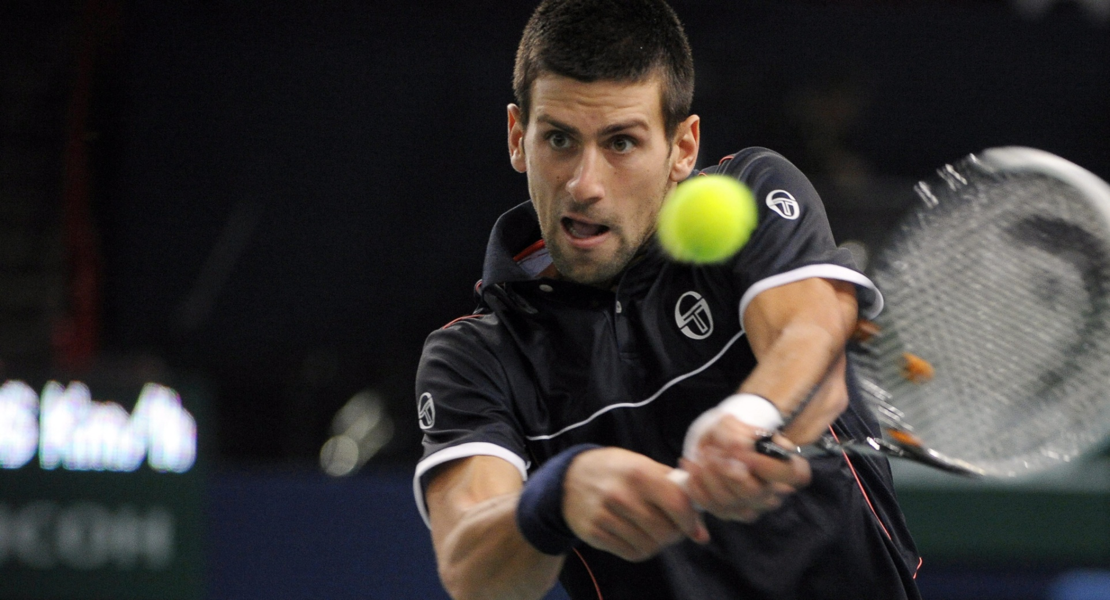
Novak Djoković

Slide 24
Our national basketball team

Slide 25
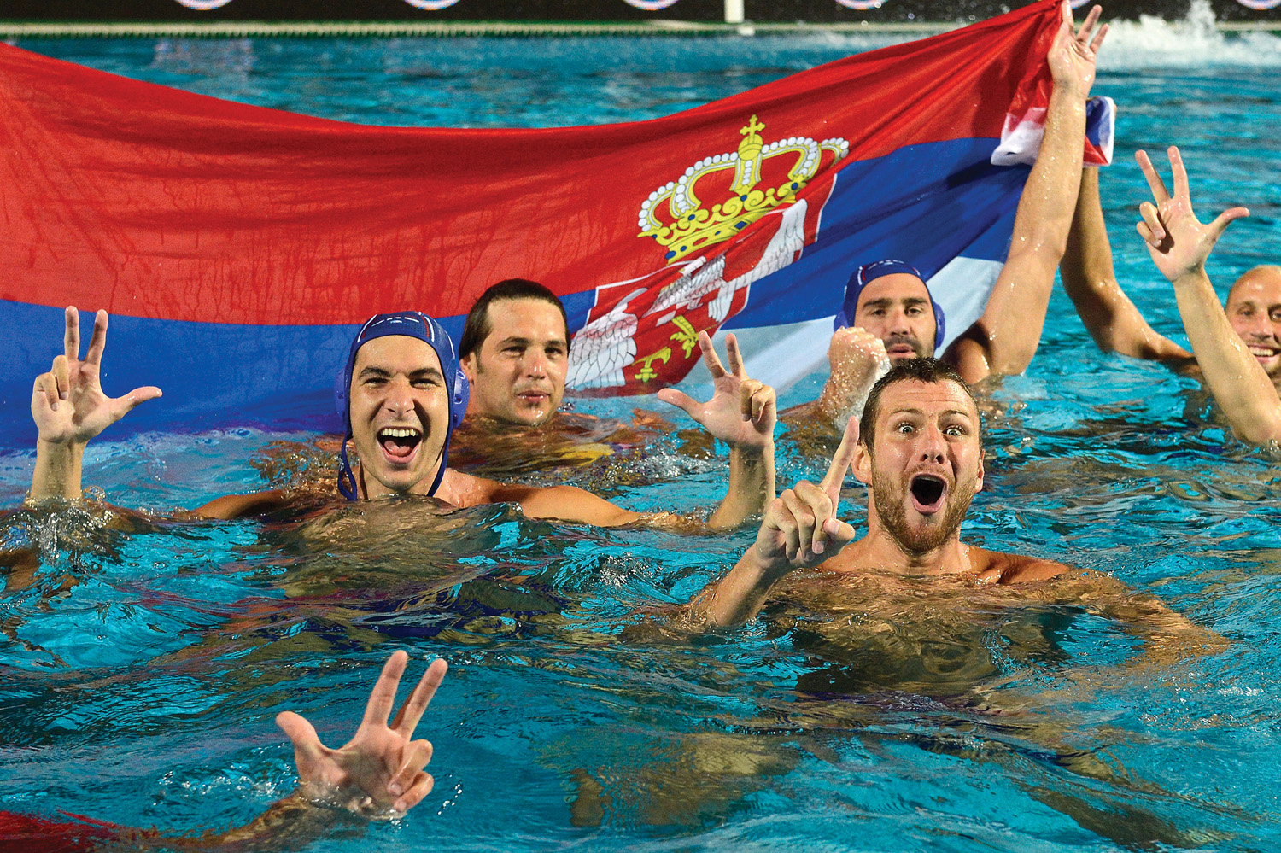
Our national water polo team

Slide 26
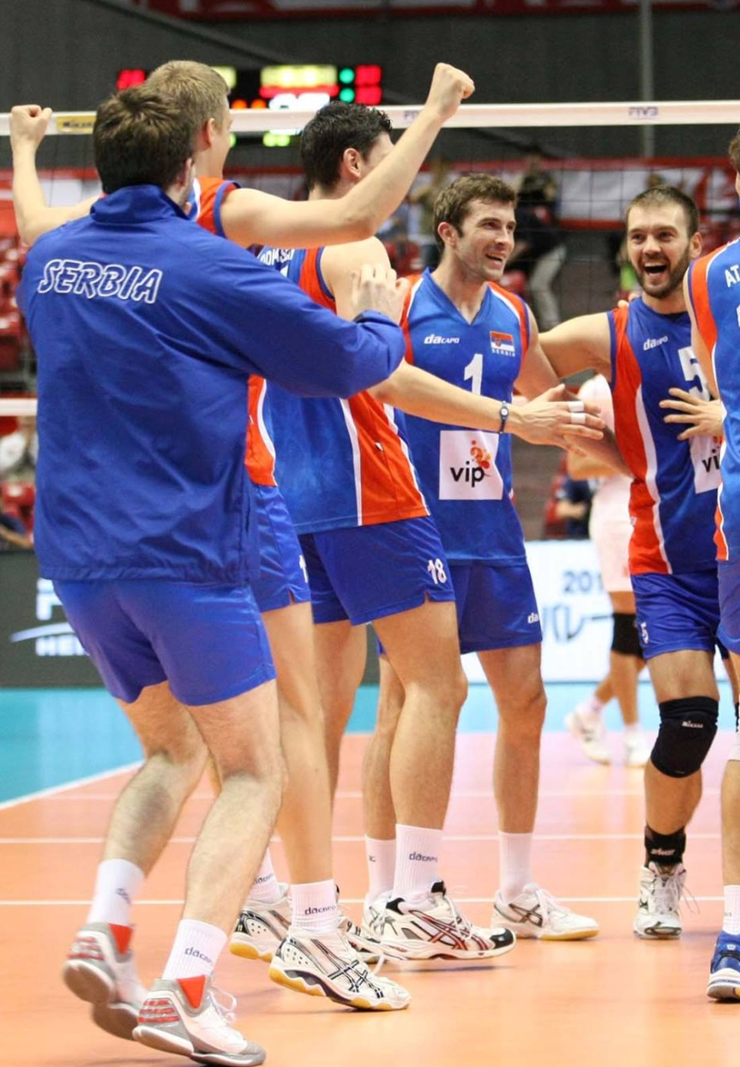
voleyball teams

Slide 27
Worked: Milena Radović ☺

