Slide 1
HOW TO BUILD FREE
WORDPRESS WEBSITE
Course teacher: Svetlana Kojić

Slide 2
What is WordPress?
WordPress is an online, open source website creation tool written in PHP. But in non-geek speak, it’s probably the easiest and most powerful blogging and website content management system (or CMS) in existence today.
You’re in good company if you use WordPress to publish on the web. Many famous blogs, news outlets, music sites, Fortune 500 companies and celebrities are using WordPress.For example, famous blogs like Mashable and TechCrunch are both on WordPress.

Slide 3
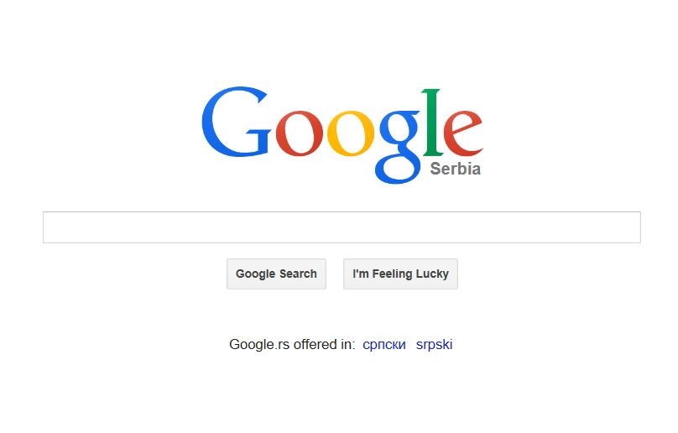
Getting an account with WordPress.com
Open your web browser (mozilla firefox, internet explorer, google chrome, etc.), tipe wordpress in a blank field and press search.
tipe wordpress

Slide 4
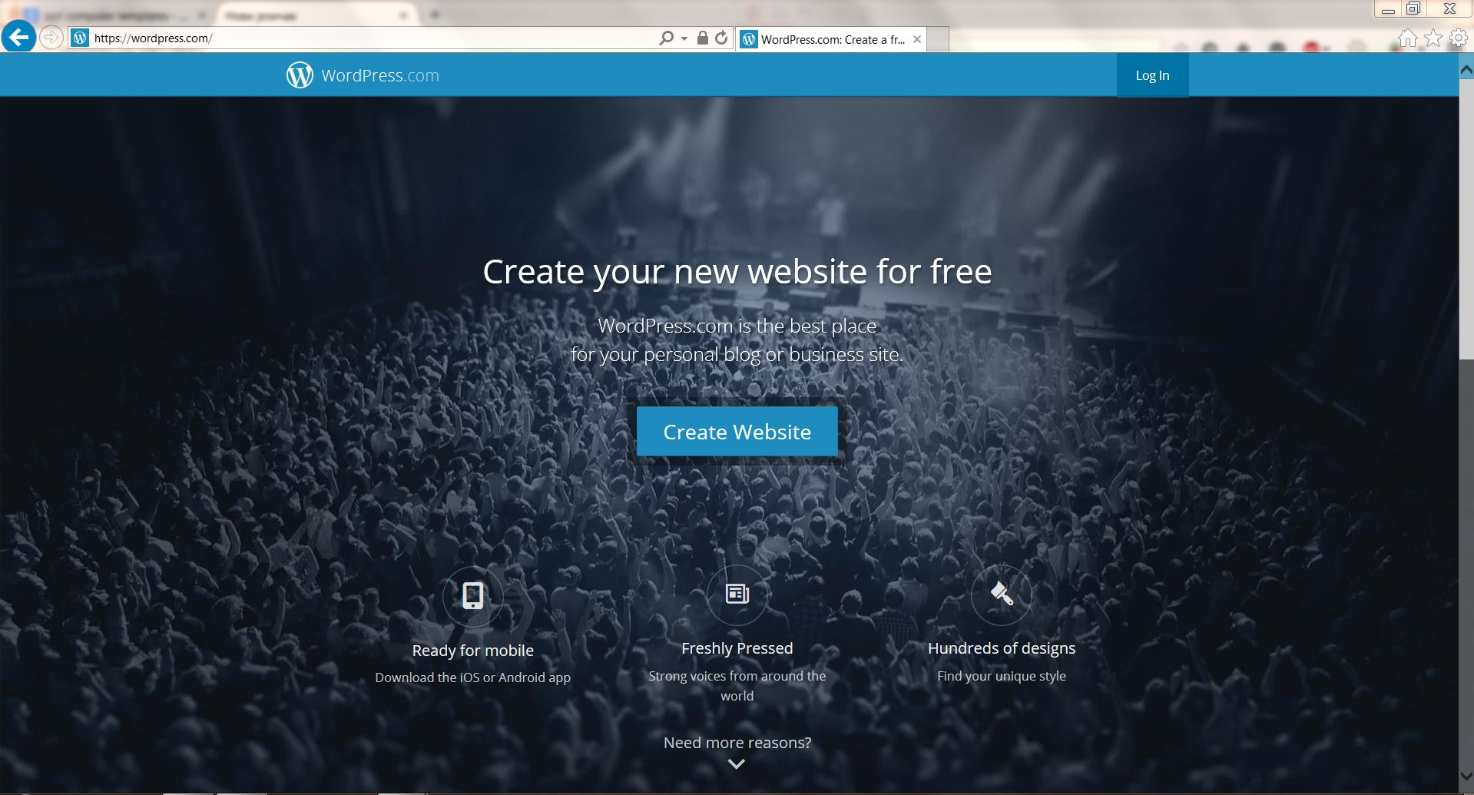
Getting an account with WordPress.com
In the WordPress.com homepage, click Create Website button.

Slide 5
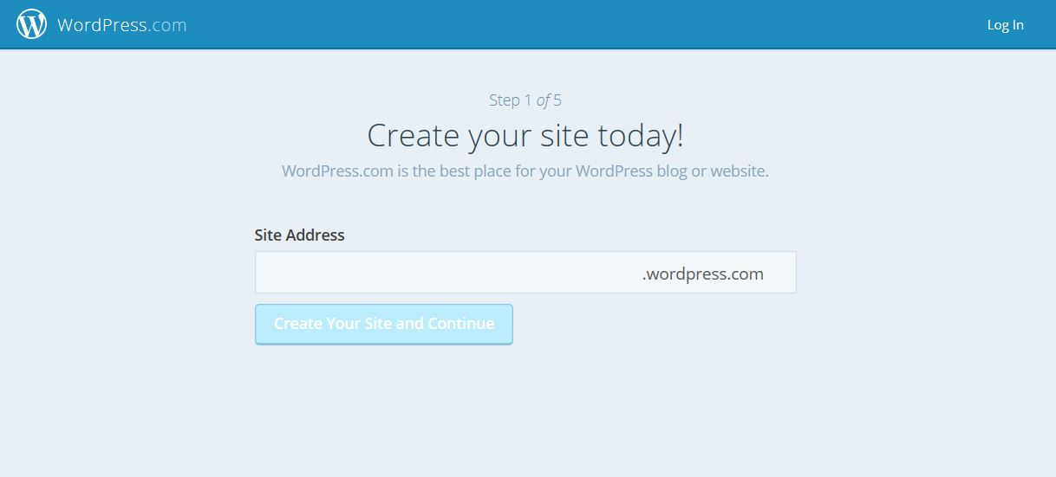
Getting an account with WordPress.com
Fill in your prefered address and then continue.
Tipe in your
prefered address
Click to continue

Slide 6
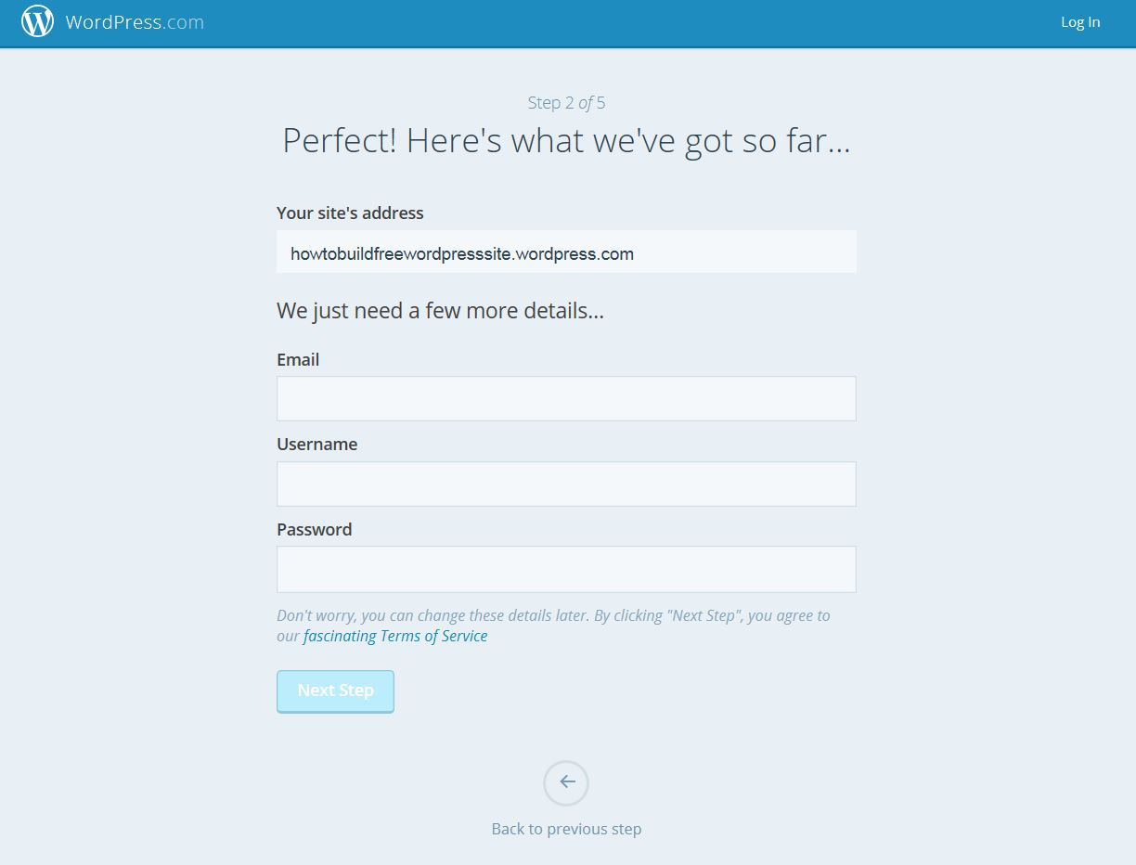
Getting an account with WordPress.com
Fill all the fields in the form, click the Next step button found at the bottom to continue.

Slide 7
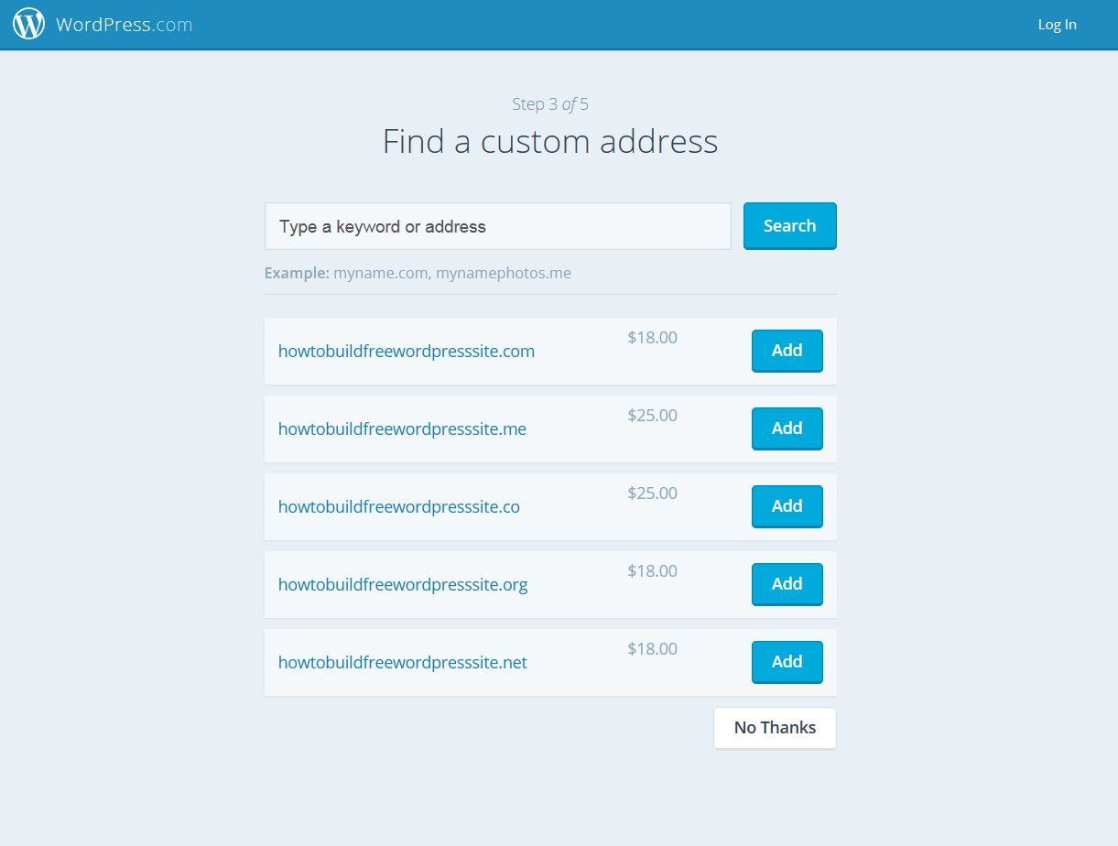
Getting an account with WordPress.com
You’ll be offered to find a custom address, don’t, just click on No Thanks and continue.

Slide 8
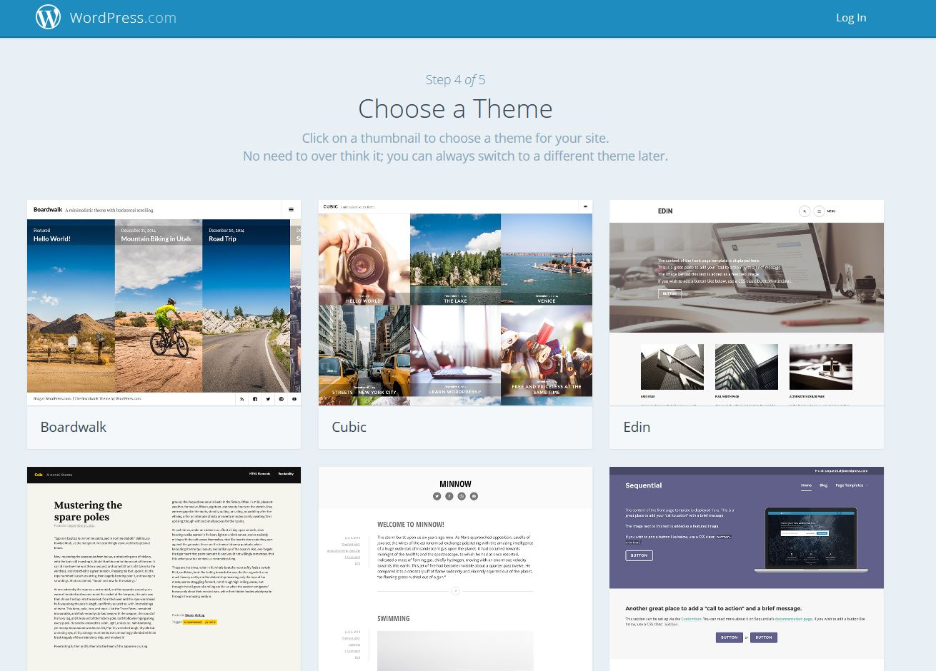
Getting an account with WordPress.com
Then you’ll have to choose a theme for your website, just click on one theme that you like.

Slide 9
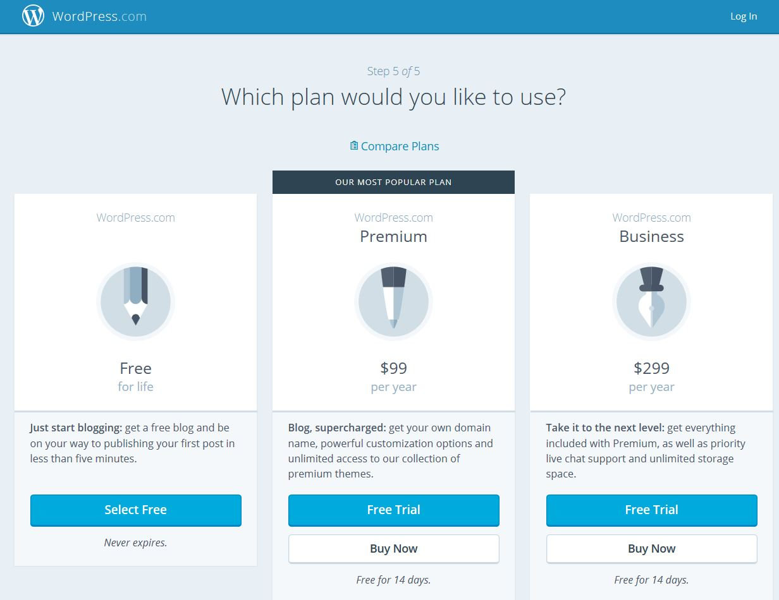
Getting an account with WordPress.com
Choose a free plan by clicking on Select Free.

Slide 10
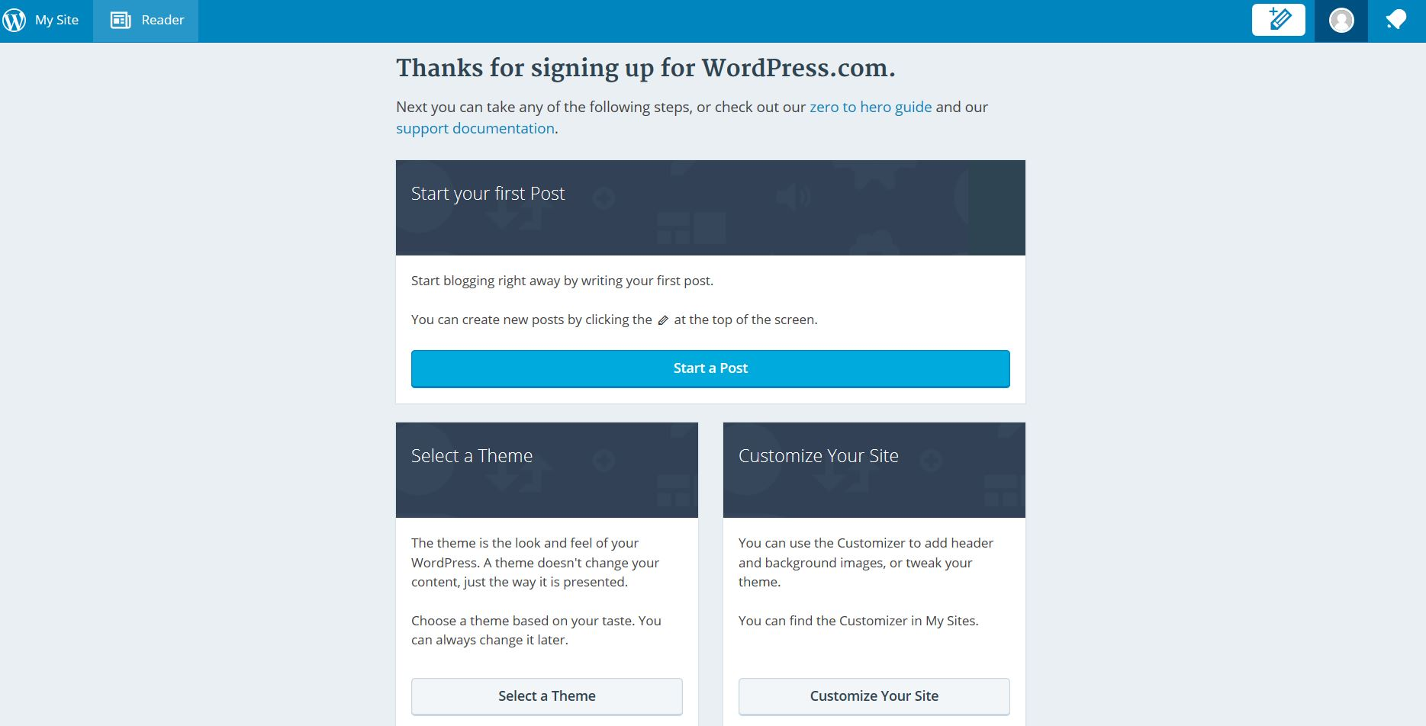
Getting an account with WordPress.com
This is the first screen on Wordpress you’ll see when you finish all of the previous obligatory tasks.

Slide 11
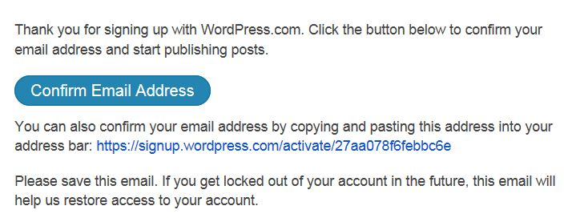
Getting an account with WordPress.com
Check the activation message from WordPress.com in your mailbox. Click on the button or use the provided link to activate your account.

Slide 12
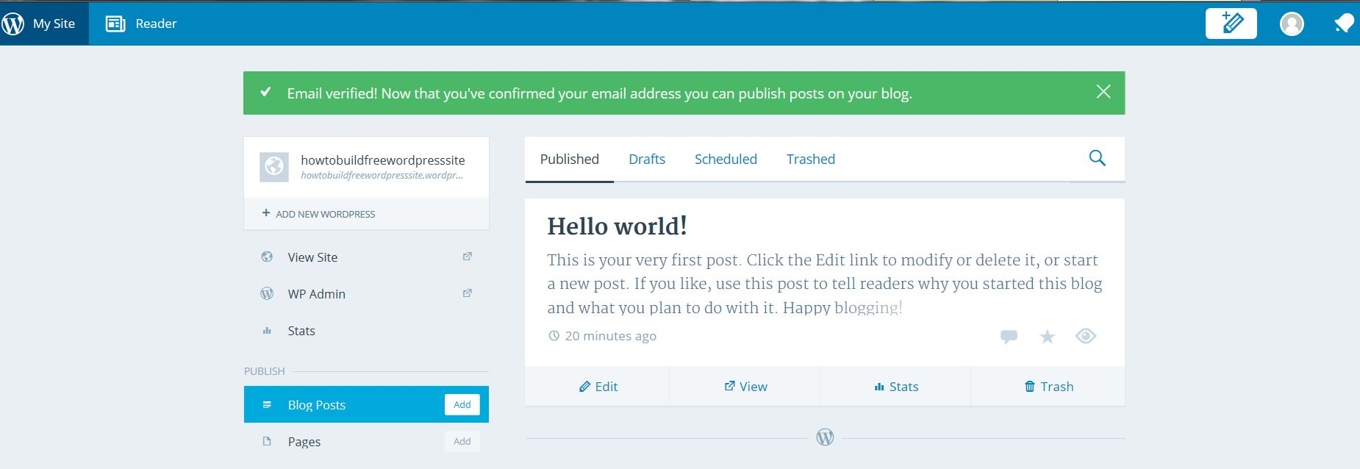
Getting an account with WordPress.com
This is how the page will look after activating your account.

Slide 13
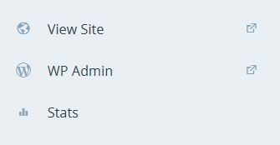
Getting an account with WordPress.com
To see how at this point your website looks like click on View Site.

Slide 14
End of the first lesson.
I hope you'll successfully create
your first free WordPress website.

