Slide 1
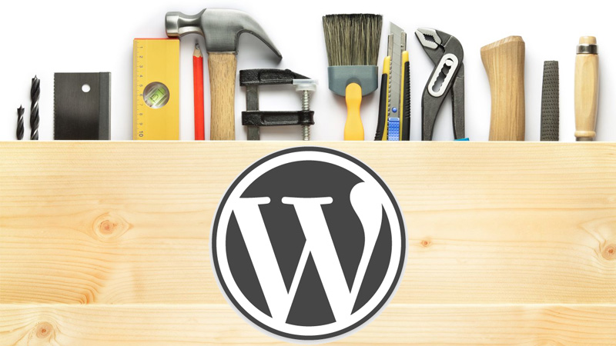
HOW TO BUILD FREE
WORDPRESS WEBSITE
Course teacher: Svetlana Kojić

Slide 2
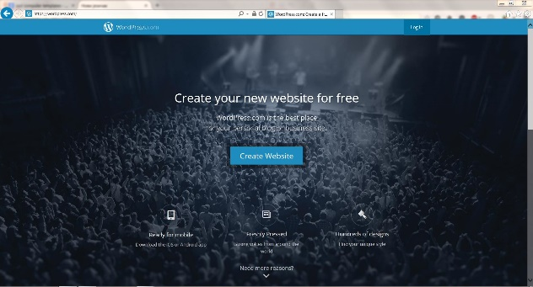
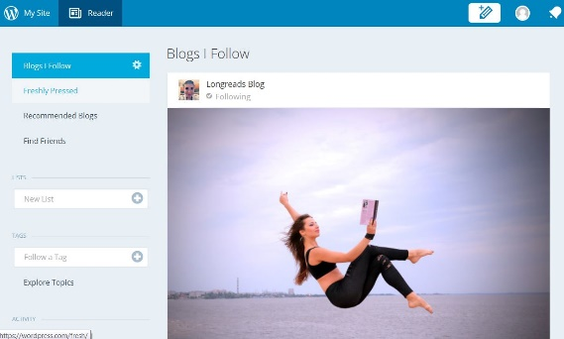
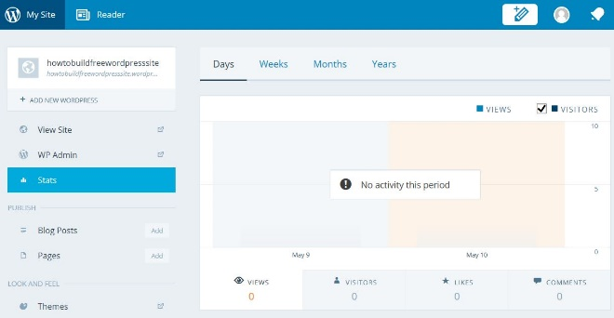
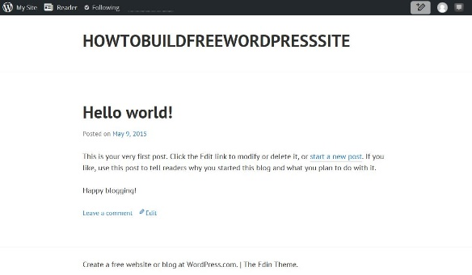
The look of the free WordPress site after first login
To see how your website looks you have to login to your WordPress account. Then you need to click on My Site, and on the next page click on View Site.
Your site

Slide 3
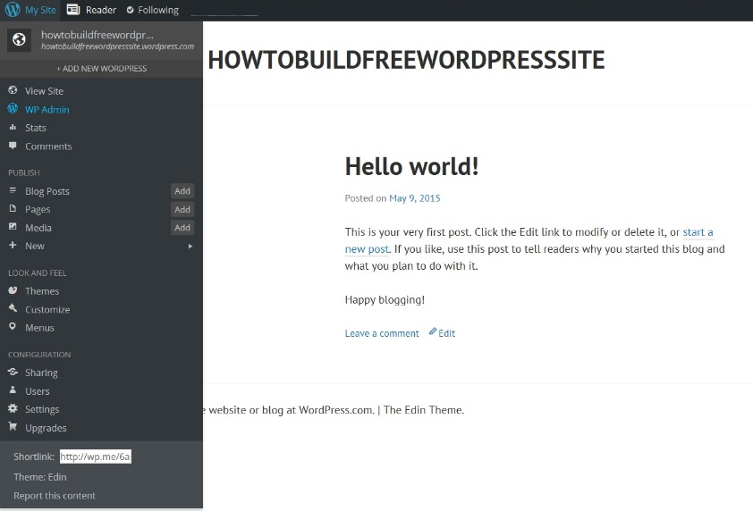
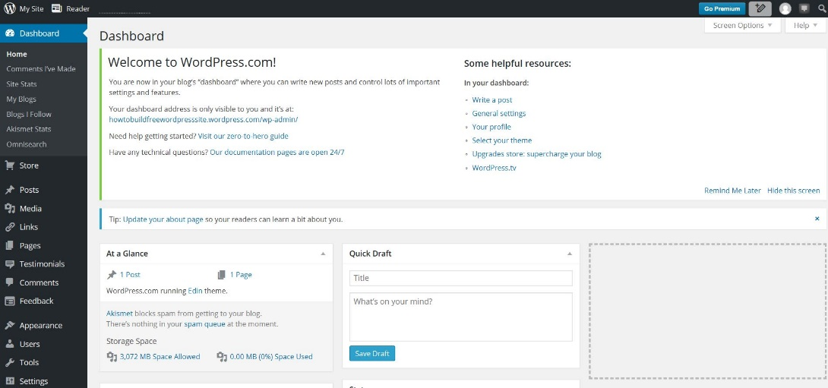
Accessing WP Admin - Dashboard
To start working with your website you have to point on My Site and then click on WP Admin. The page that opens is your WordPress website admin page – Dashboard.

Slide 4
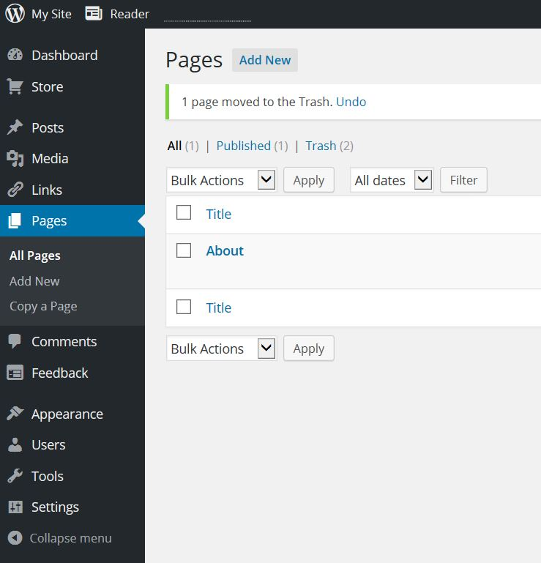
How to add pages to your web site
In your Dashboard click on Pages and then on Add New.

Slide 5
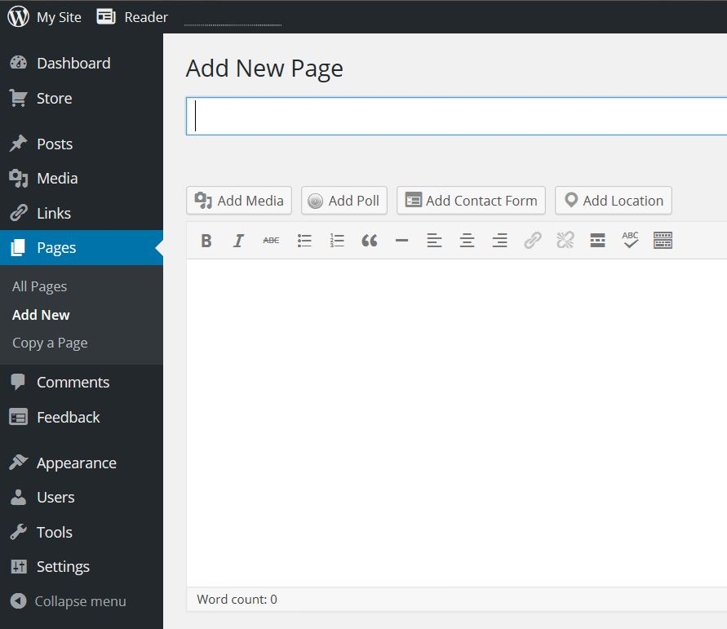
How to add pages to your web site
Write the name of your new page.
Add text or media that you’d like to appear on your page.

Slide 6
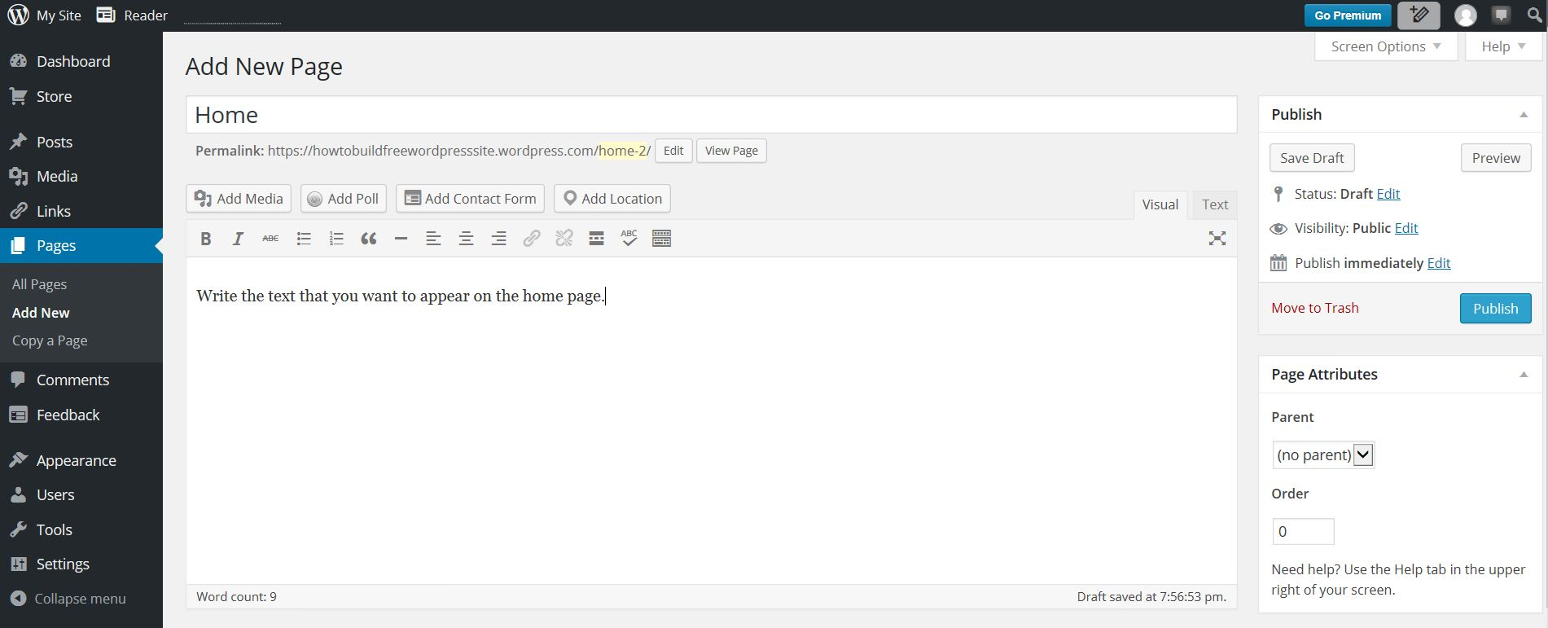
How to add pages to your web site
Click on Publish to finish work on your page. You can come back and edit later.
The decision about number of pages that you’ll create is up to you.

Slide 7
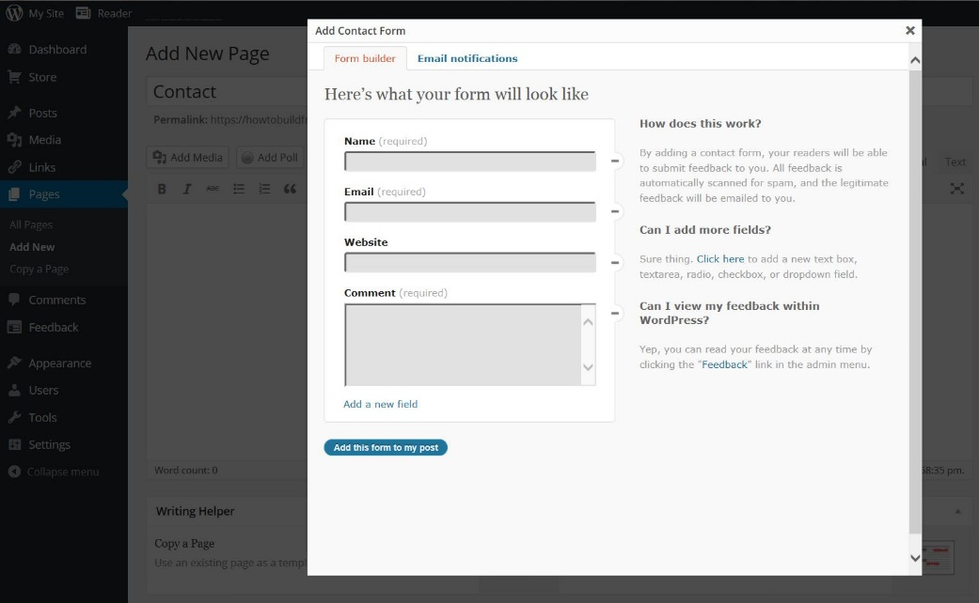
How to create Contact page
If you’re creating contact page just click on the Add Contact Form on the New Page and after confirmation you’ll have a new contact page finished.

Slide 8
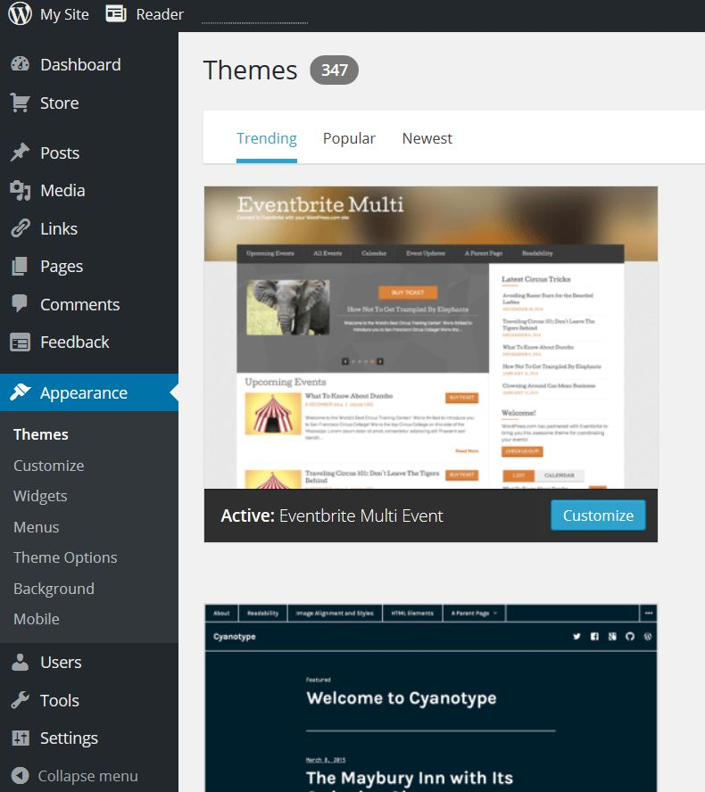
How to create the Menu
Click on the appearance and then on Menus.

Slide 9
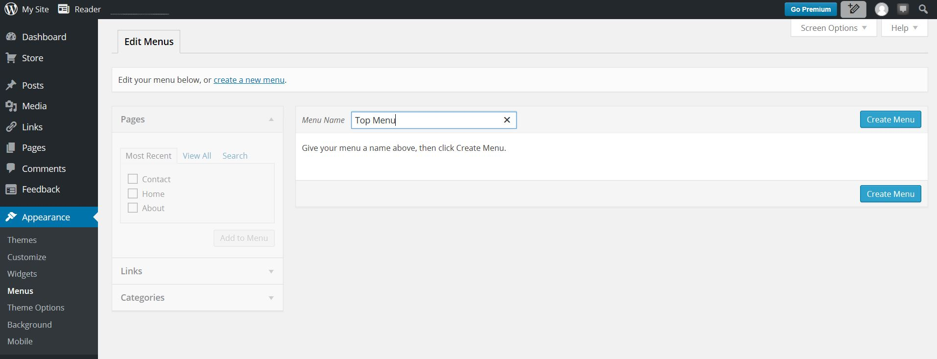
How to create the Menu
Name your menu and then
click on Create Menu.

Slide 10
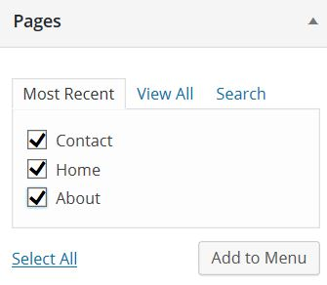
How to create the Menu
Under the Pages section of the Edit Menus page check all of the pages you want to appear in the menu and then click on Add to Menu.

Slide 11
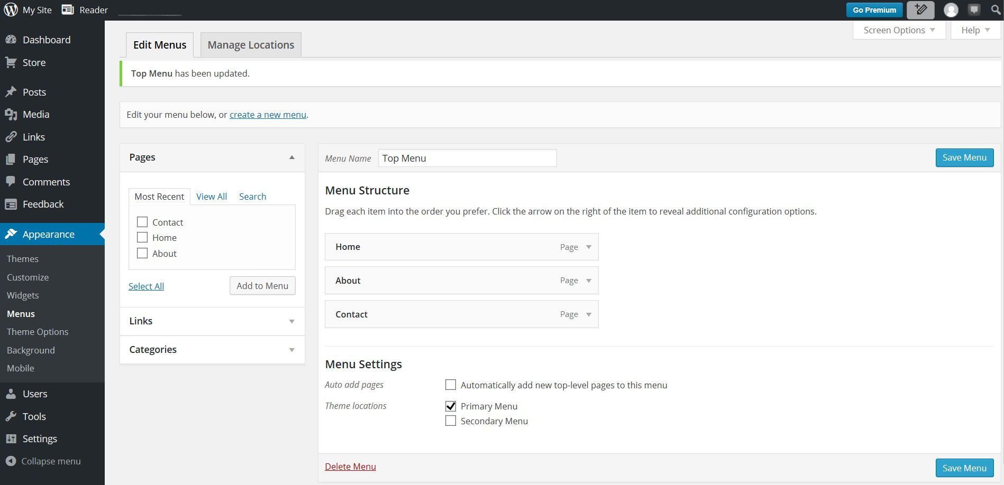
How to create the Menu
Under Menu Structure you can now see names of your pages. If you need to rearange the pages you’ll have to do it by draging them in the order you prefer. Check Primary Menu option. Click on the Save Menu when you’re done.

Slide 12
How to change website theme
You can change your site theme under Appearance - Themes. You just have to pick one theme you like and then confirm it by clicking on Activate and that’s it.

Slide 13
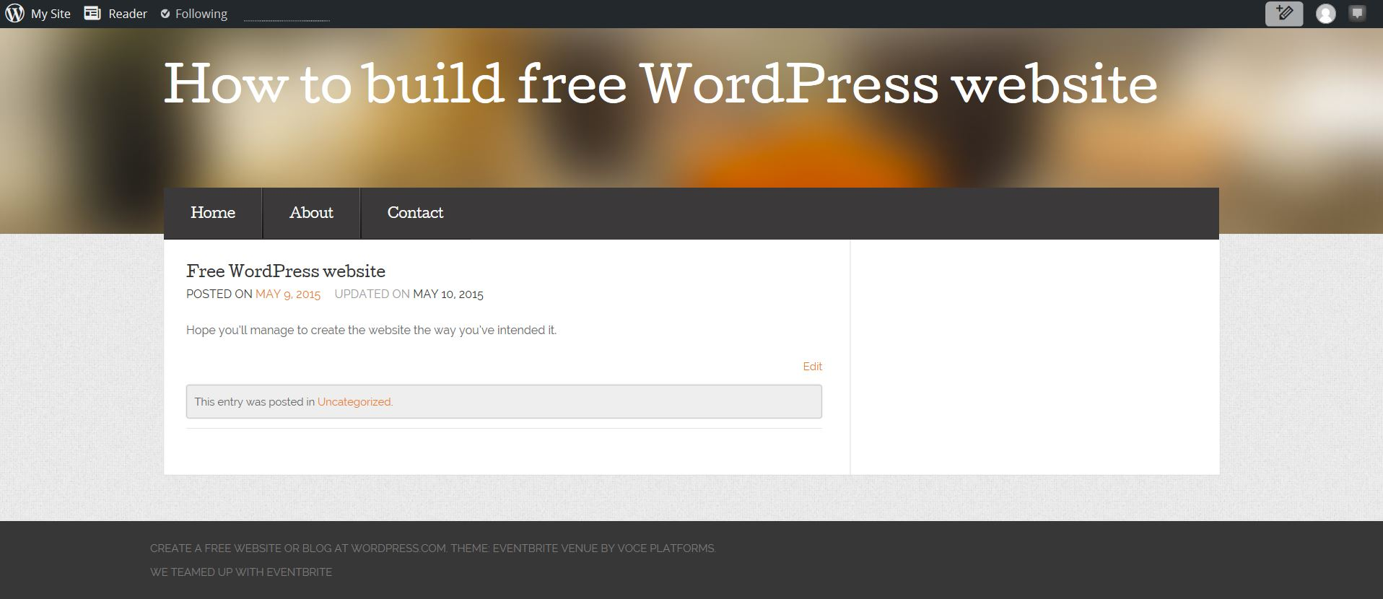
Your WordPress Website
Point to My Site and then click on View Site and you’ll see how your website looks now.

Slide 14
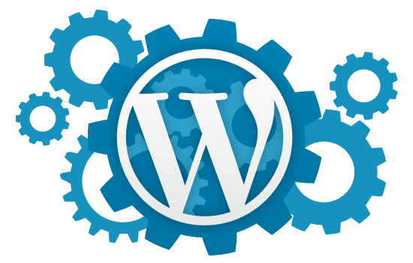
End of the Second lesson.
I hope you have successfully created
your first free WordPress website.
Editing is up to you and your creativity.

