Slide 1
The School we dream
Primary school of Gennadi
By
Leton voci and Mario Depa

Slide 2
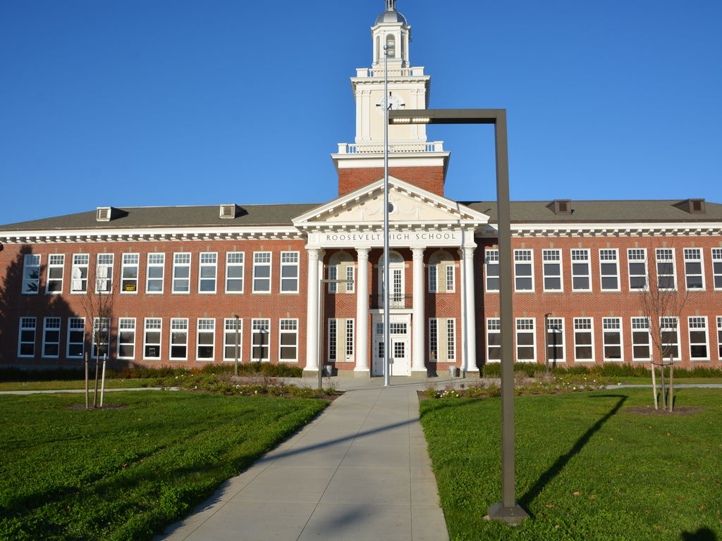
The school of our dreams will have:

Slide 3

Nice and polite teachers

Slide 4
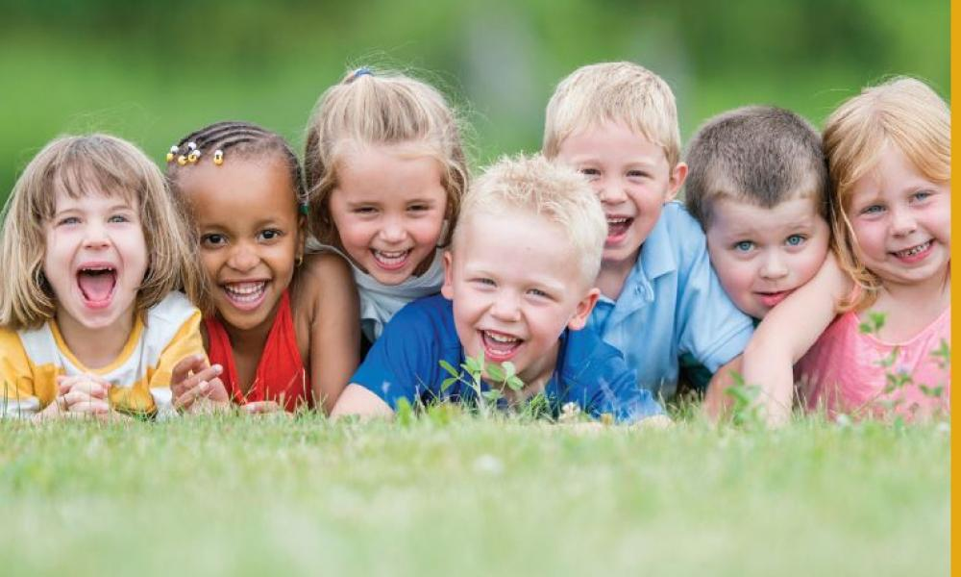
Obedient and kind children

Slide 5
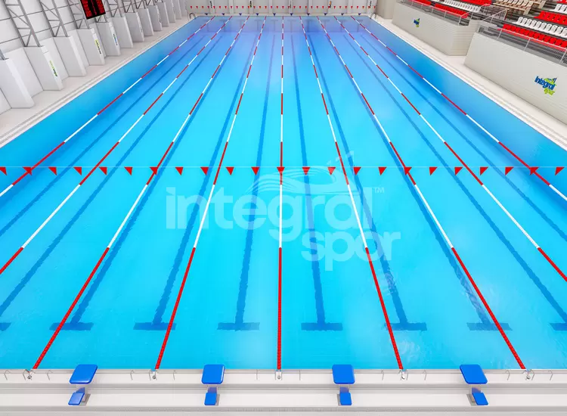
A swimming pool

Slide 6
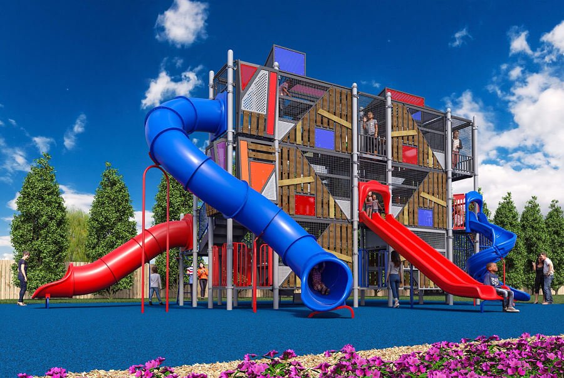
A playground

Slide 7
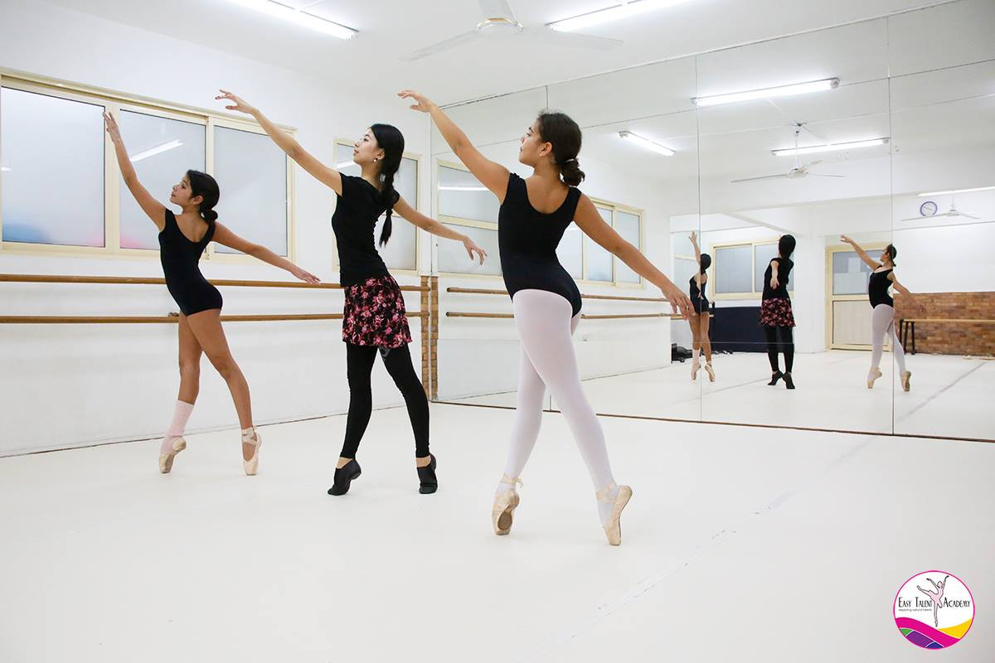
Dancing classes

Slide 8
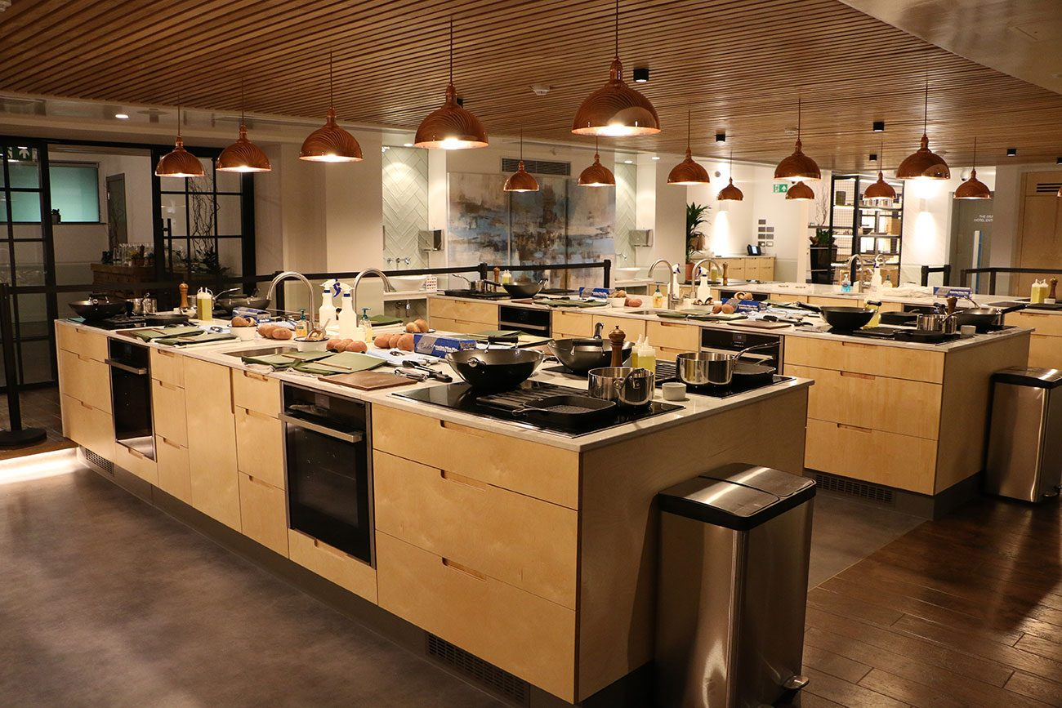
Cooking classes

Slide 9
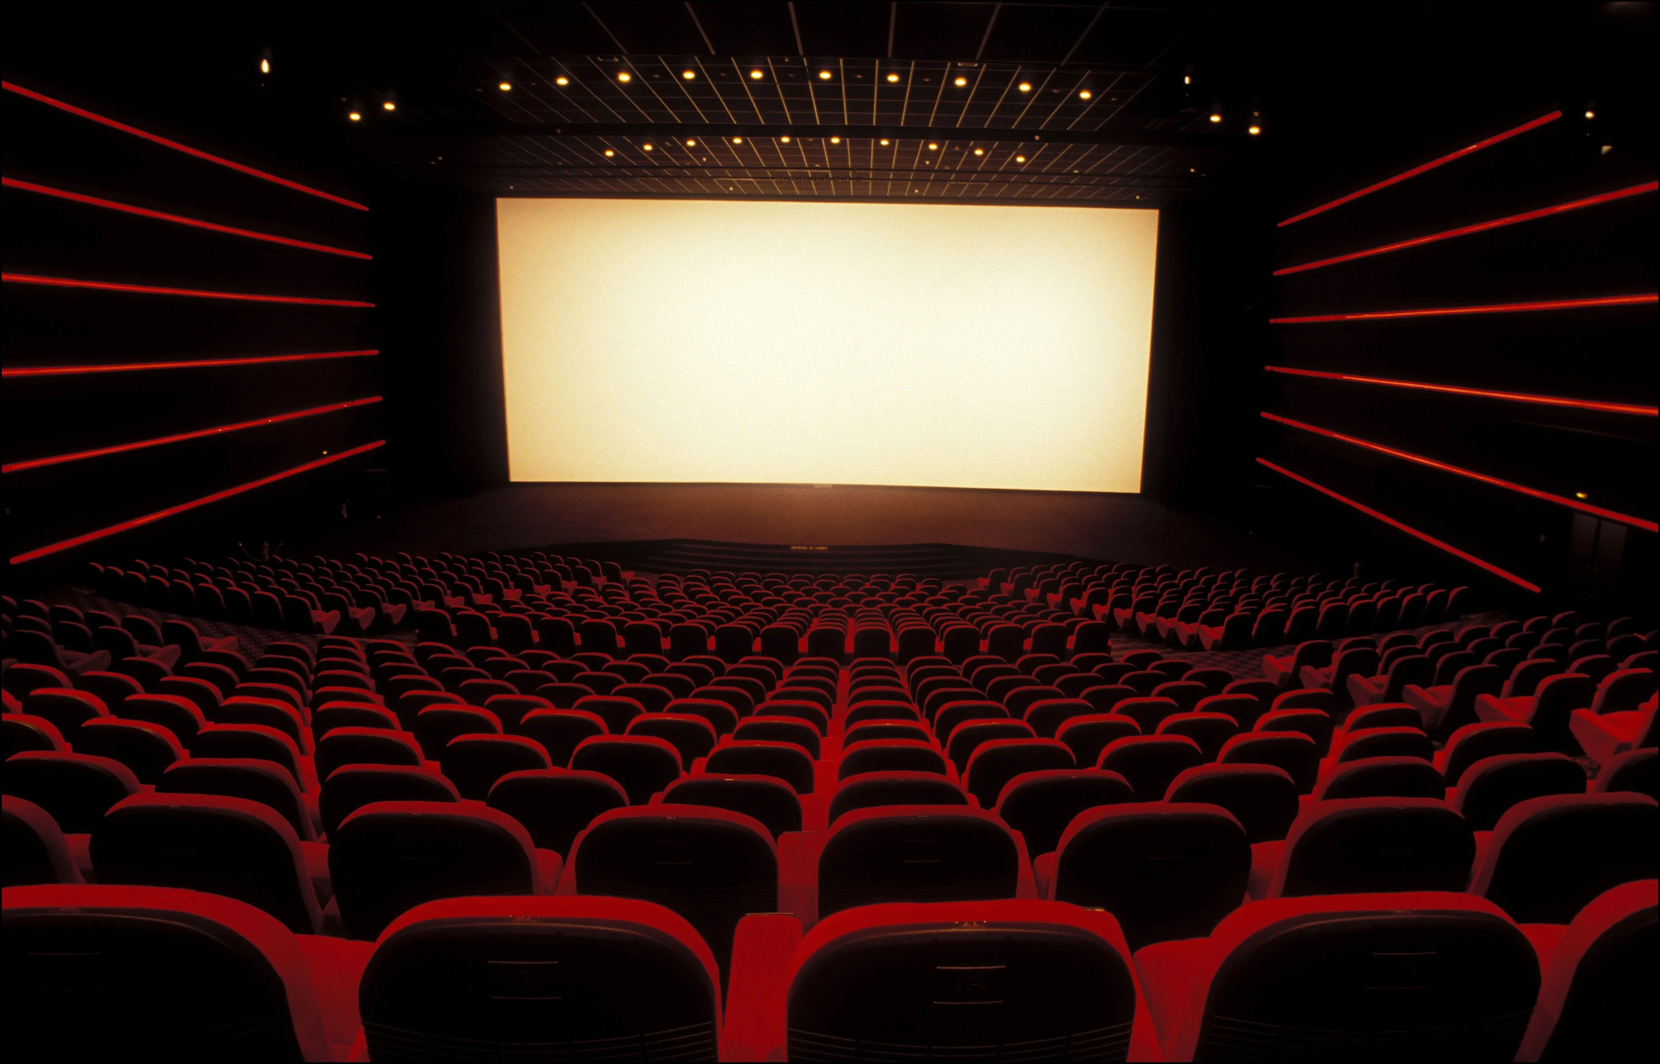
A movie theatre

Slide 10
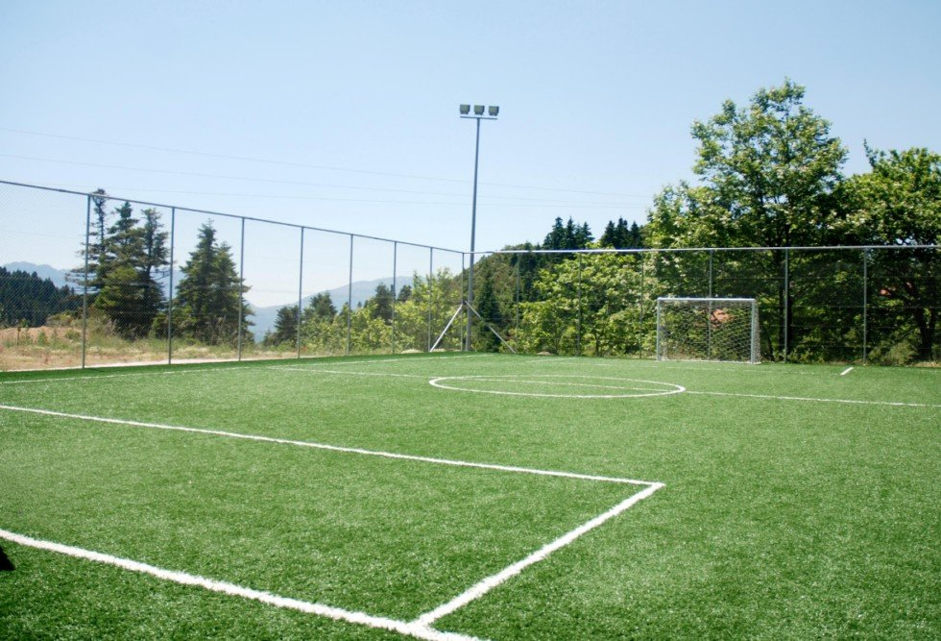
A football pitch

Slide 11
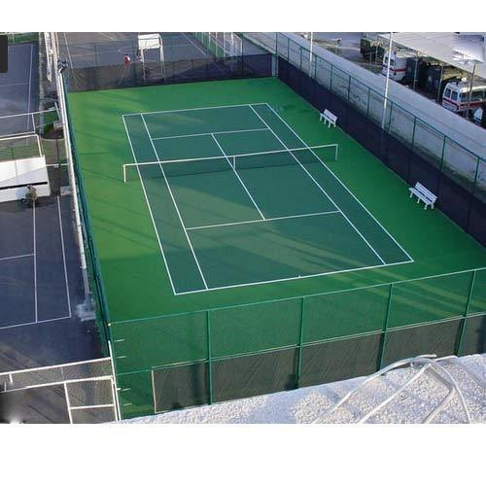
A tennis court

Slide 12
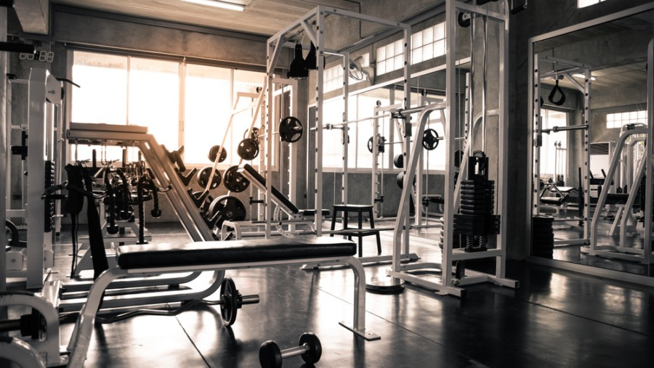
A gym

Slide 13
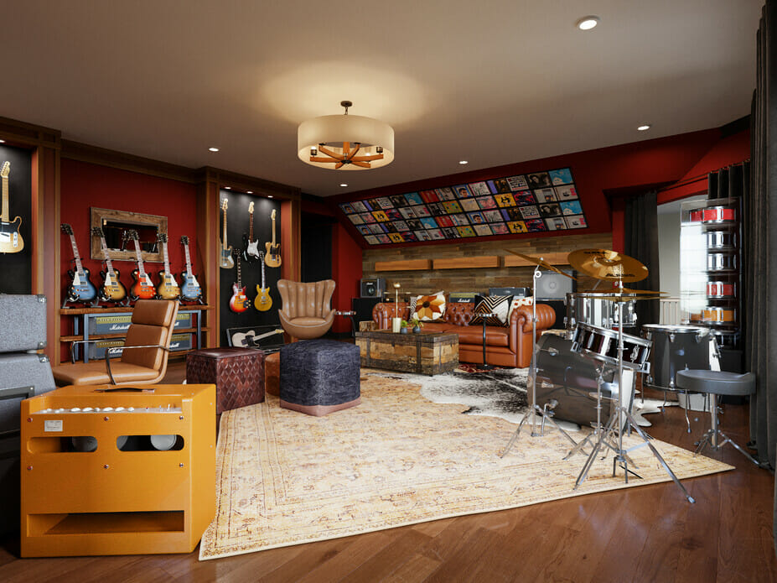
A music room

Slide 14
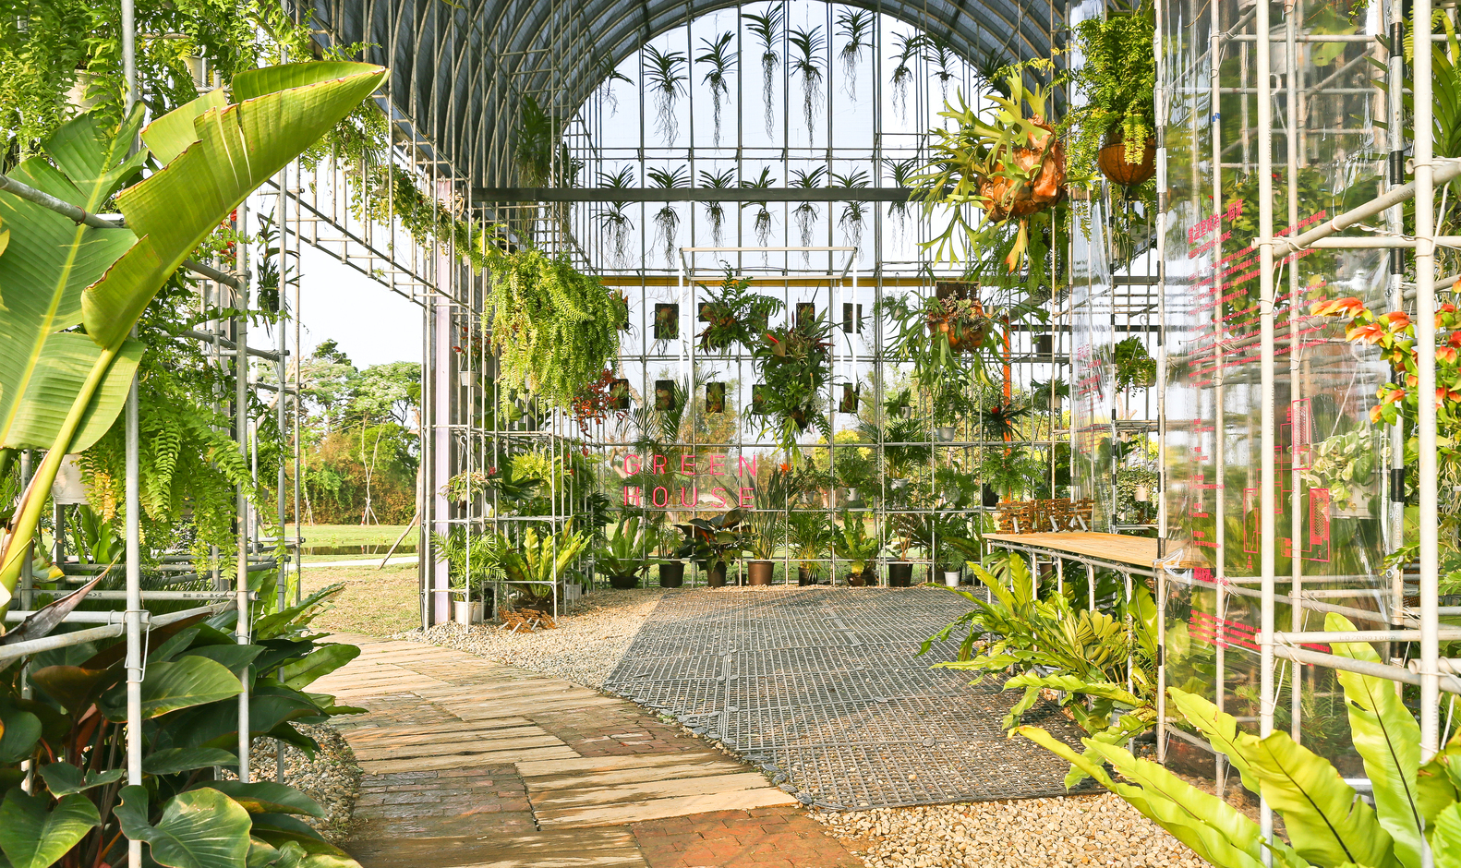
A green house

Slide 15
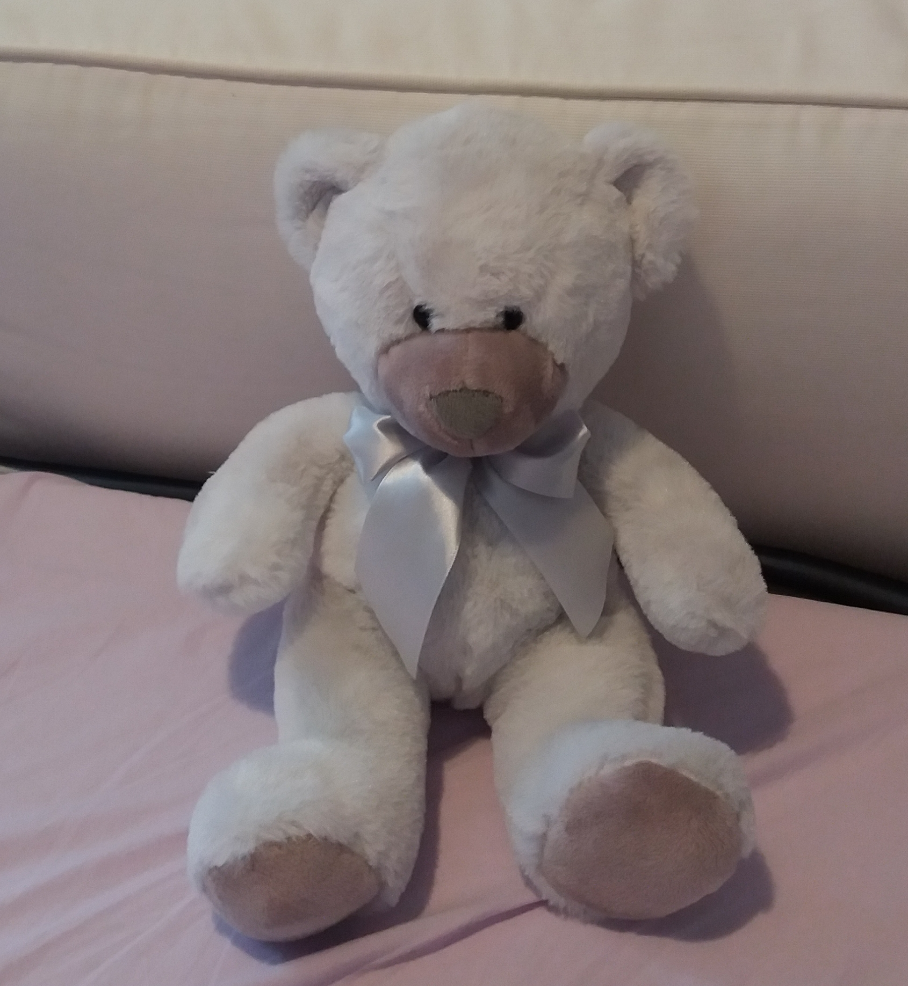
THIS IS THE SCHOOL That WE DREAM !!!

