Slide 1
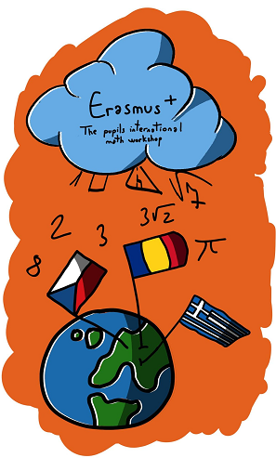
The laws of planetary motion
Carried out by Pravăț Călin and Galeș Matei
"The European Commission support for the production of this publication does not constitute an endorsement of the contents which reflects the views only of the authors, and the National Agency and Commission cannot be held responsible for any use which may be made of the information contained therein".

Slide 2
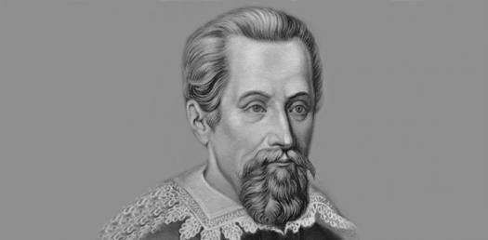
Johannes Kepler
Johannes Kepler (27 December 1571 – 15 November 1630) was a German astronomer, mathematician, and astrologer.

Slide 3
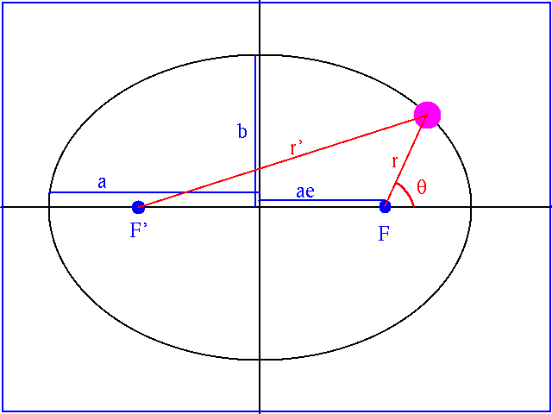
The first law
The orbit of every planet is an ellipse with the Sun at one of the two foci.
An ellipse is a curve surrounding two fixed points called foci, such that for all points on the curve, the sum of the two distances to the focal points is a constant.

Slide 4
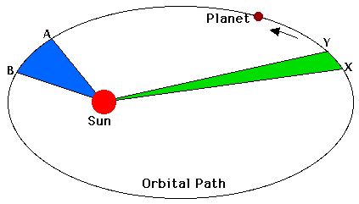
The second law
The straight line that unites the planet with the sun ("the vector ray of the planet") sweeps equal areas in equal periods of time or formulated equivalent to the areolar speed of the vector beam is constant.

Slide 6
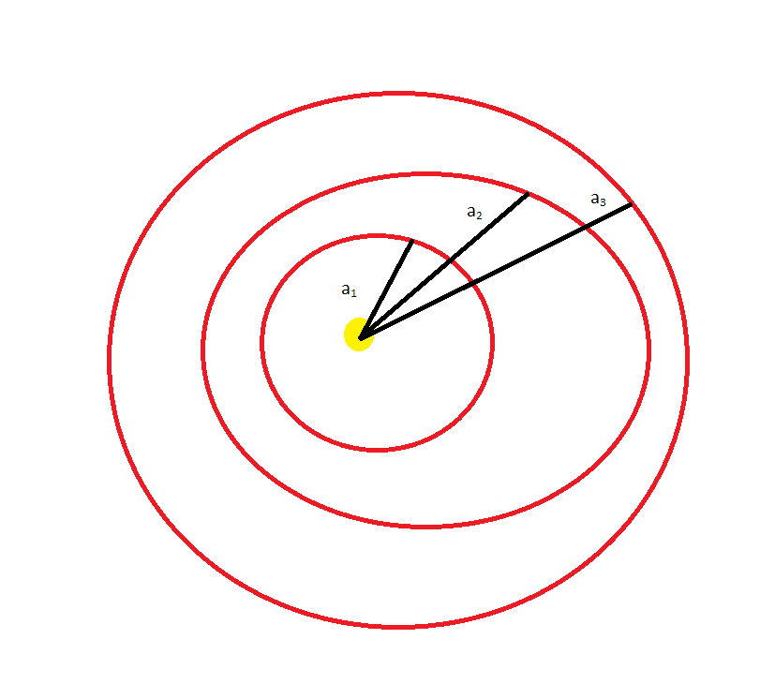
The third law
The ratio of the square of an object's orbital period with the cube of the semi-major axis of its orbit is the same for all objects orbiting the same primary.

Slide 7
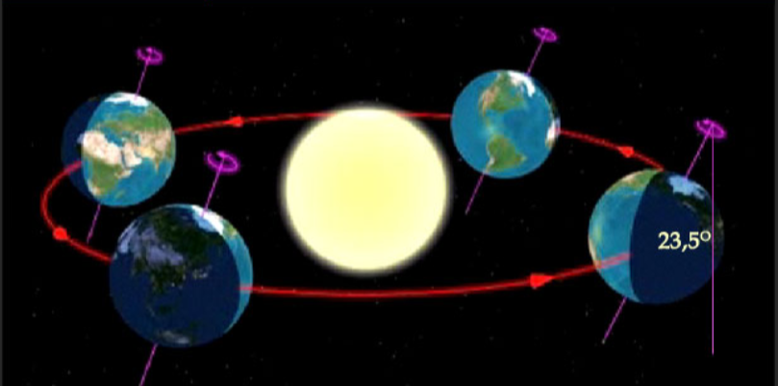
The revolution movement of planets around the sun
In astronomy, the revolution movement refers to the real motion as described in the previews slides (Kepler’s laws).

Slide 8
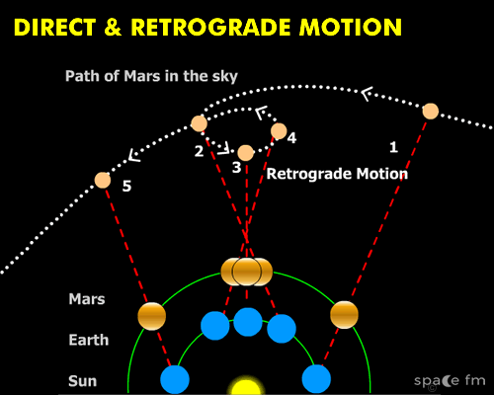
The apparent motion of the planets
By apparent motion we understand the motion of the planet as seen from the surface if the Earth .

Slide 9
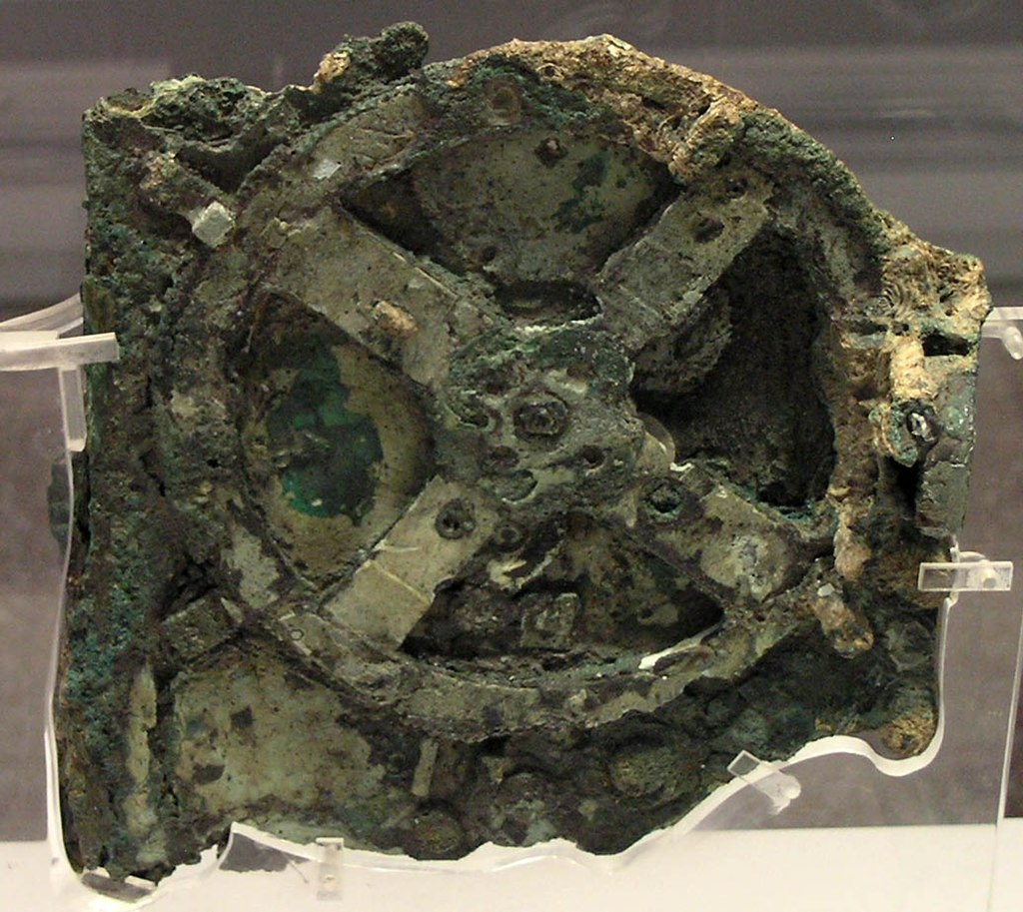
Ancient Greek astronomy
Greek astronomy is astronomy written in the Greek language in classical antiquity.
The Antikythera Mechanism was an analog computer from 150–100 BC designed to calculate the positions of astronomical objects.

Slide 10
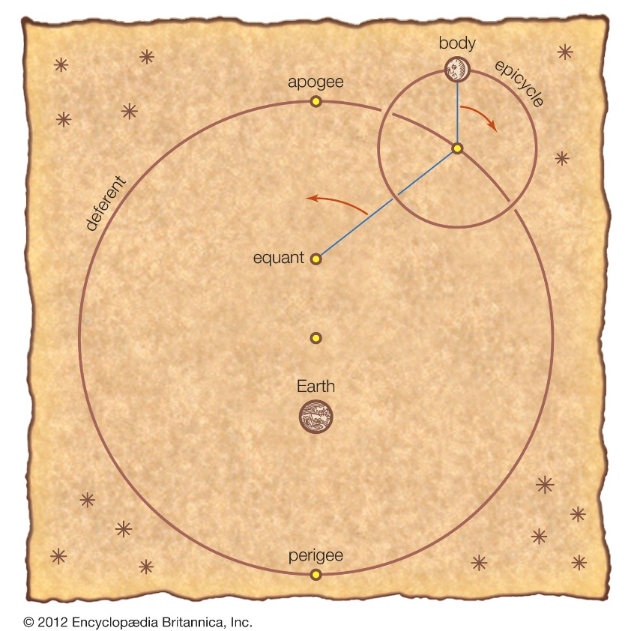
Deferent and epicycle
The equant is the point from which each body sweeps out equal angles along the deferent in equal times. The centre of the deferent is midway between the equant and Earth.

Slide 11
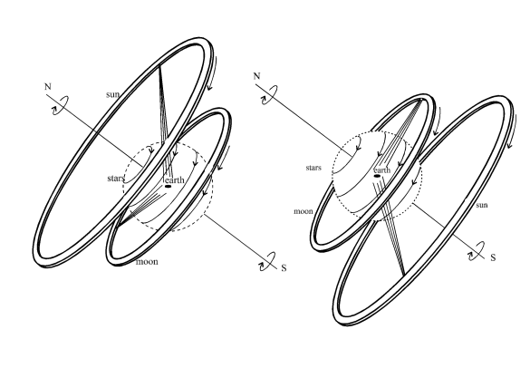
The geocentric system
In the 4th century BC, two influential Greek philosophers, Plato and his student Aristotle, wrote works based on the geocentric model.
Illustration of Anaximander's models of the universe. On the left, summer; on the right, winter.

Slide 12
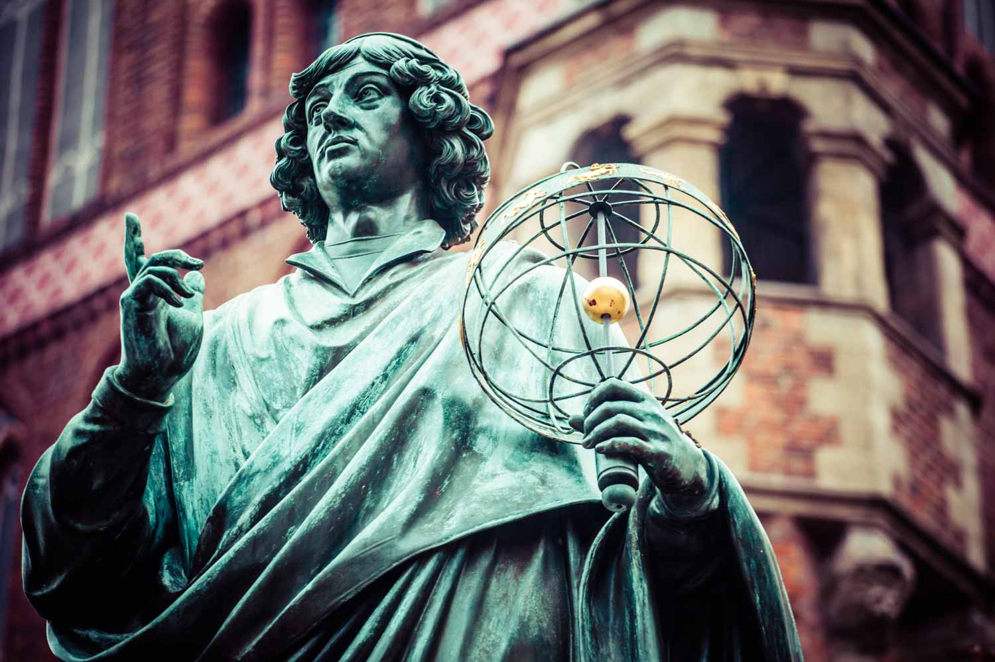
Nicolaus Copernicus
Nicolaus Copernicus (19 February 1473 – 24 May 1543) was a Renaissance-era mathematician, astronomer, and Catholic canon who formulated a model of the universe that placed the Sun rather than Earth at its center.

Slide 13
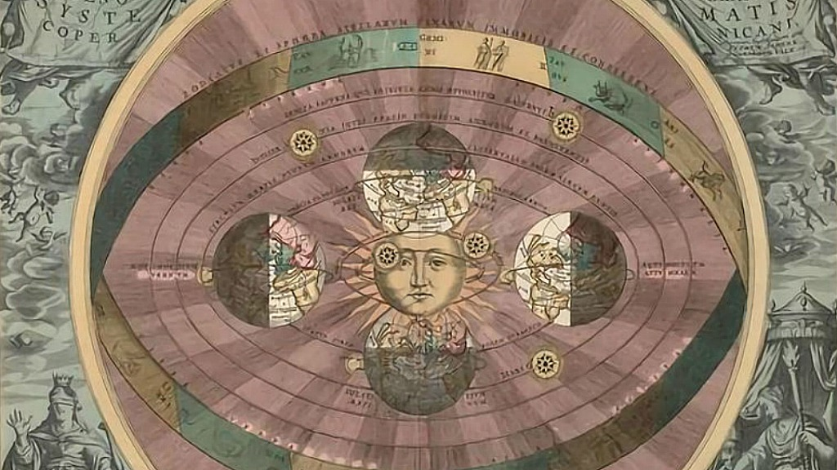
Heliocentric system
Heliocentrism is the astronomical model in which the Earth and planets revolve around the Sun at the center of the Universe.

Slide 14
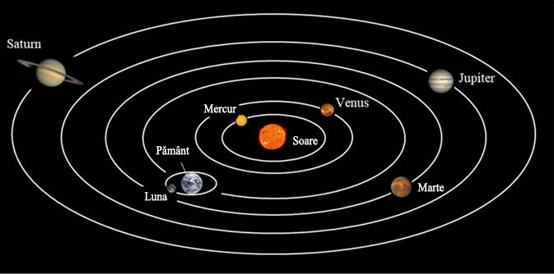
Heliocentrism
In mathematical astronomy, computational models of heliocentrism involve mathematical computing systems related to a heliocentric model and in which the positions of planets can be calculated.

Slide 15
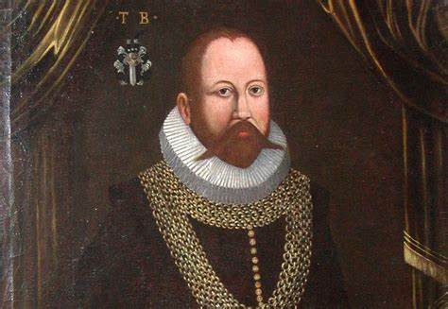
Tycho Brahe
Tycho Brahe (14 December 1546 – 24 October 1601) was a Danish nobleman, astronomer, and writer known for his accurate and comprehensive astronomical observations.

Slide 16
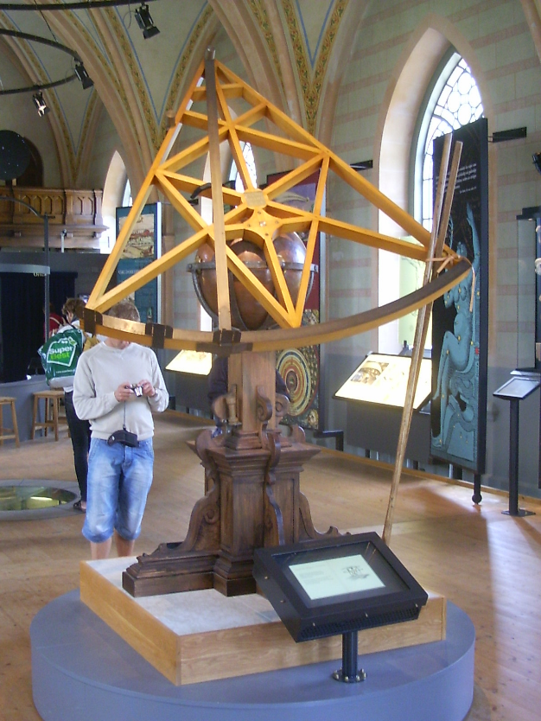
Tycho Brahe's discoveries
Tycho Brahe's quadrant

Slide 17
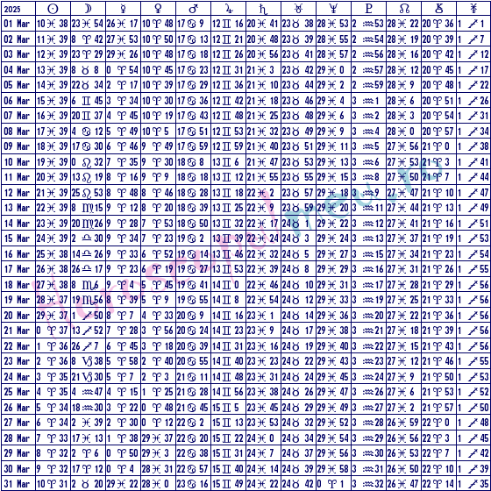
Ephemerides of the planets
In astronomy and celestial navigation, an ephemeris gives the trajectory of naturally occurring astronomical objects as well as artificial satellites in the sky, the position (and possibly velocity) over time.
Ephemerals March 2025

Slide 18
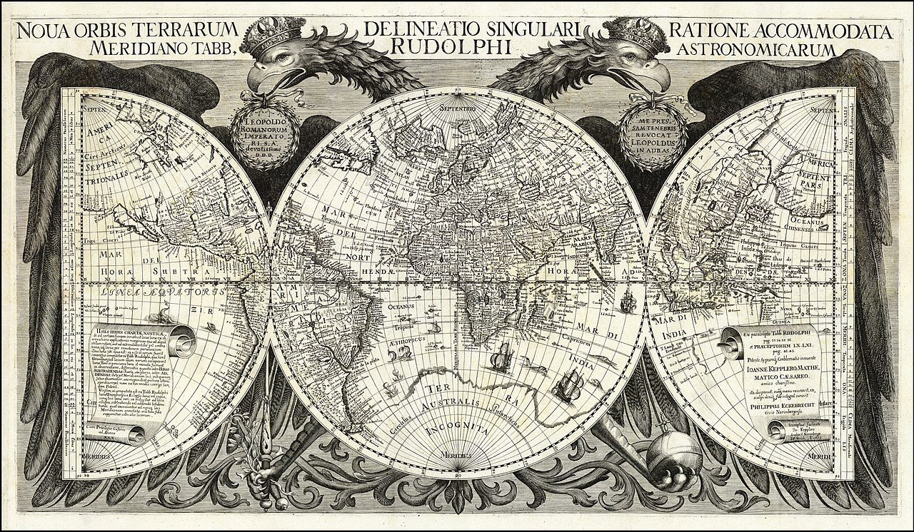
The Rudolphine Tables
The Rudolphine Tables consist of a star catalogue and planetary tables published by Johannes Kepler in 1627, using observational data collected by Tycho Brahe (1546–1601).

Slide 19
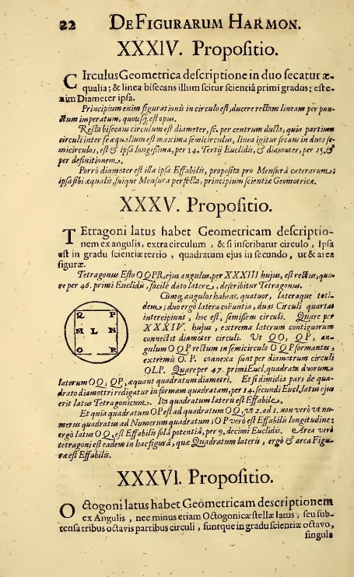
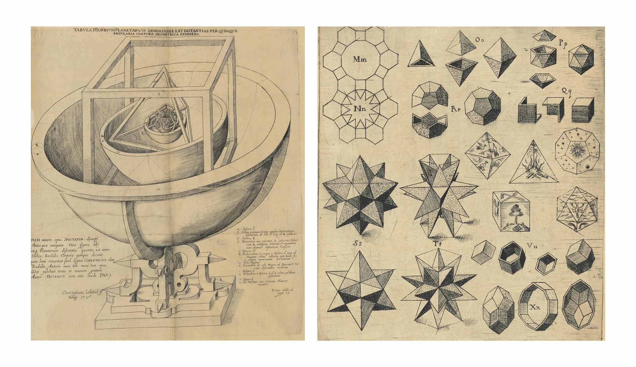
The Harmony of the World
Harmonices Mundi (Latin: The Harmony of the World, 1619) is a book by Johannes Kepler.

Slide 20
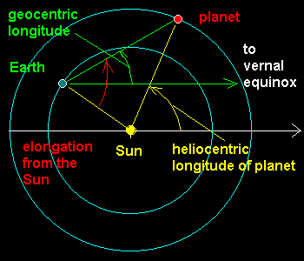
Heliocentric longitude of the Earth
Assuming that the orbit of a planet is circular and considering the reference line orientated towards the vernal equinox, the heliocentric longitude of a planet is the angle: vernal equinox, Sun, planet.

Slide 21
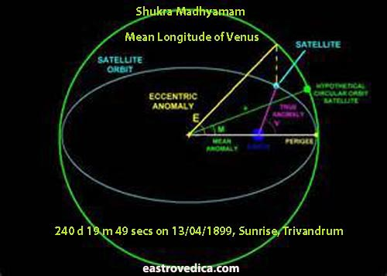
Heliocentric longitude of a planet
Assuming that the orbit of a planet is circular and considering the reference line orientated towards the vernal equinox, the heliocentric longitude of a planet is the angle: vernal equinox, Sun, planet.

Slide 22
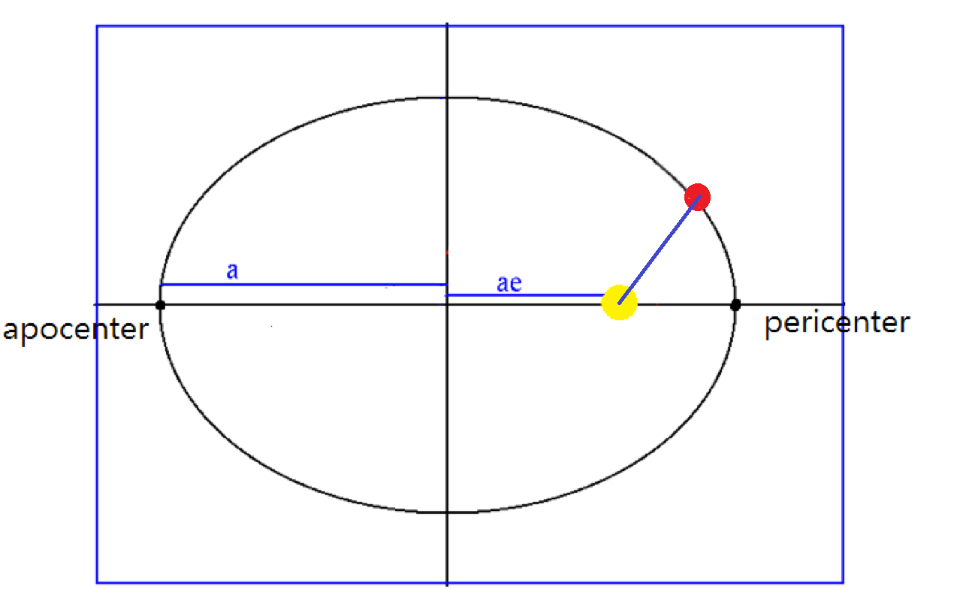
Ellipse
An ellipse is a curve surrounding two fixed points called foci, such that for all points on the curve, the sum of the two distances to the focal points is a constant.

Slide 23
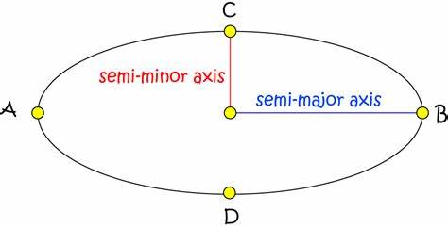
The semimajor axis
The semi-major axis (major semiaxis) is the longest semidiameter or one half of the major axis, and thus runs from the centre, through a focus, and to the perimeter.

Slide 24
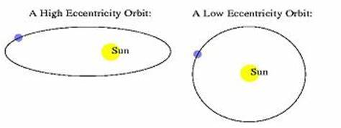
Eccentricity
Eccentricity is a measure of how an orbit deviates from circular. A perfectly circular orbit has an eccentricity of zero; higher numbers indicate more elliptical orbits. Neptune, Venus, and Earth are the planets in our solar system with the least eccentric orbits.

Slide 25
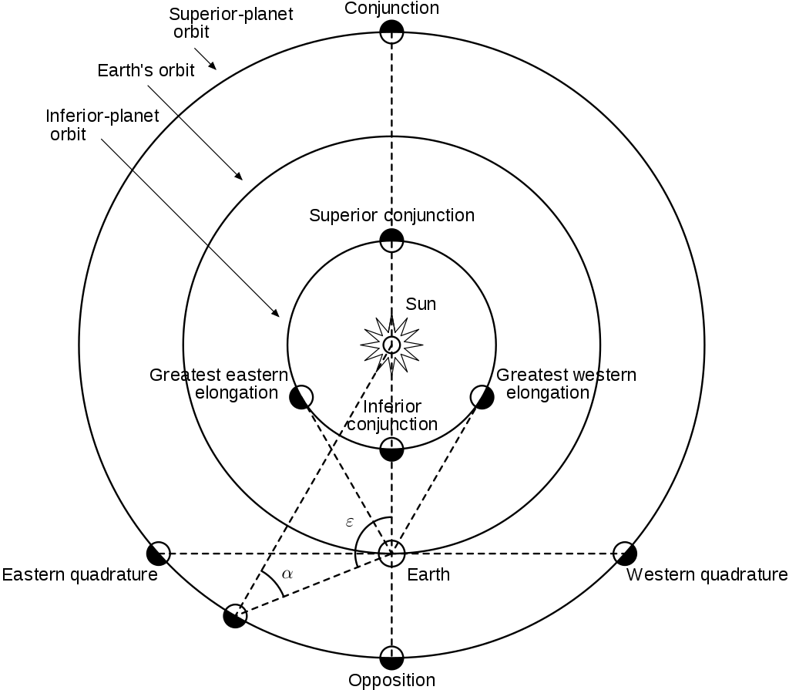
Opposition
Eccentricity is a measure of how an orbit deviates from circular. A perfectly circular orbit has an eccentricity of zero; higher numbers indicate more elliptical orbits. Neptune, Venus, and Earth are the planets in our solar system with the least eccentric orbits.

Slide 26
Positions of Mars(please take a screenshot of the table)
Day | Heliocentric longitude of Earth | Heliocentric longitude of Mars | Angle SEM
4.11.1926 | 41 | 41 | 180
21.9.1928 | 358 | 41 | 93
28.1.1931 | 127 | 127 | 180
14.12.1932 | 84 | 127 | 101
21.4.1920 | 211 | 211 | 180
9.3.1922 | 168 | 211 | 98
24.8.1924 | 330 | 330 | 180
11.7.1926 | 288 | 330 | 91

Slide 27
Determining the position of Mars
Kepler’s method
1. On a sheet of paper draw a circle.
This will represent the Earth’s orbit.
Draw also the line pointing towards the Vernal Point.

Slide 28
The orbit of the Earth: -approximated by a circle; -radius a_{Earth}=1 A.U (astronomical unit); -in our draw we take: 1 A.U =5cm

Slide 29
Draw also the line pointing towards the Vernal Point. Vernal point=Vernal equinox

Slide 30
2. Take the opposition of 1926 (first row of the table) and draw the position of the Earth and the direction of Mars

Slide 32
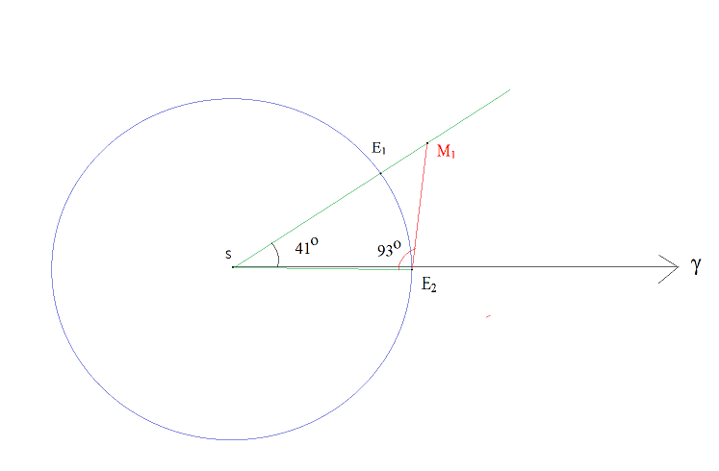
3. Take the data from the second row, draw the position of the Earth and by triangulation find the position of Mars

Slide 34
4. Now, repeat the algorithm for each pair of rows from the table. Using the rows 3 and 4 we obtain a new position of Mars, denoted by M₂

Slide 38
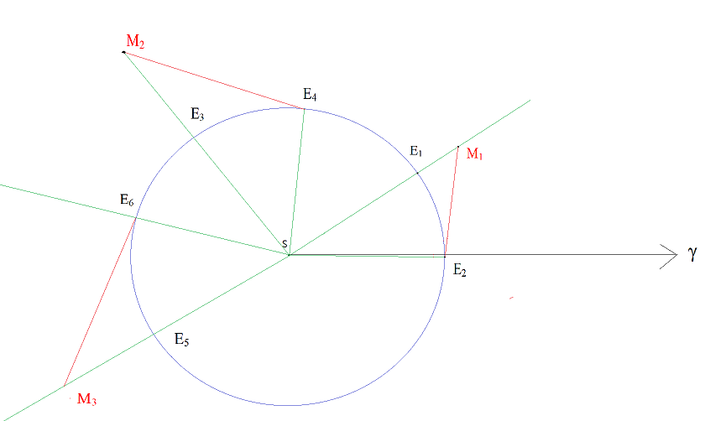
5. Using the rows 5 and 6 we obtain a new position of Mars, denoted by M₃

Slide 42
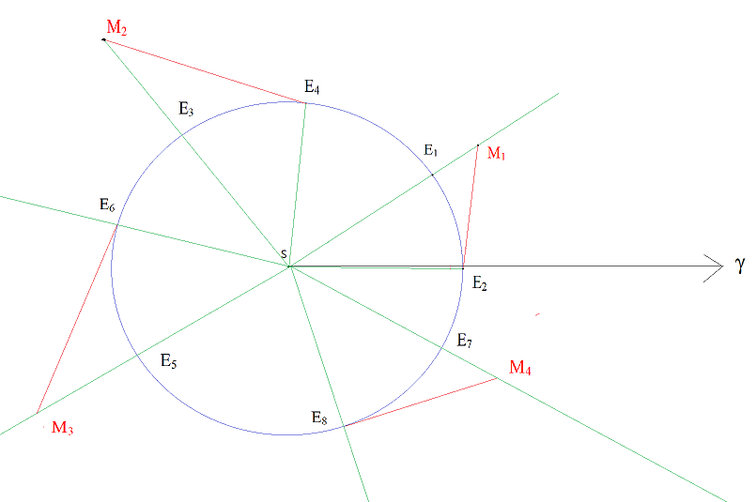
Finally let’s use the rows 7 and 8 to obtain the position M₄

Slide 45
Conclusions
In this talk we described the Kepler’s method of determining the first law of planetary motion;
Like Kepler we considered the planet Mars whose elliptic orbit is characterized by the parameters (semimajor-axis and eccentricity):
a_{Mars}=1.524 A.U (this means 7.62cm in our unit of distance);
e=0.0934;
A simple computation shows that the perihelion distance (minimum distance from the Sun) is a_{Mars} (1-e)=1.381 A.U is (6.9 cm in our unit of distance ) and the aphelion distance (maximum distance from the Sun) is a_{Mars} (1+e)=1.66 A.U is (8.33 cm in our unit of distance);
You can check that the distances of the points M₁ M₂ M₃ M₄ from the Sun are between 6.9 cm and 8.33 cm;
In our exercise we used a precision of the order of 1 degree. Kepler in his method used a precision of the order of several minutes (as the precision of the Rudolphine tables and the Ephemerides of the planets);
This exercise can be extended to prove Kepler’s second law.

Slide 46
Thank you for your attention!

