Slide 1
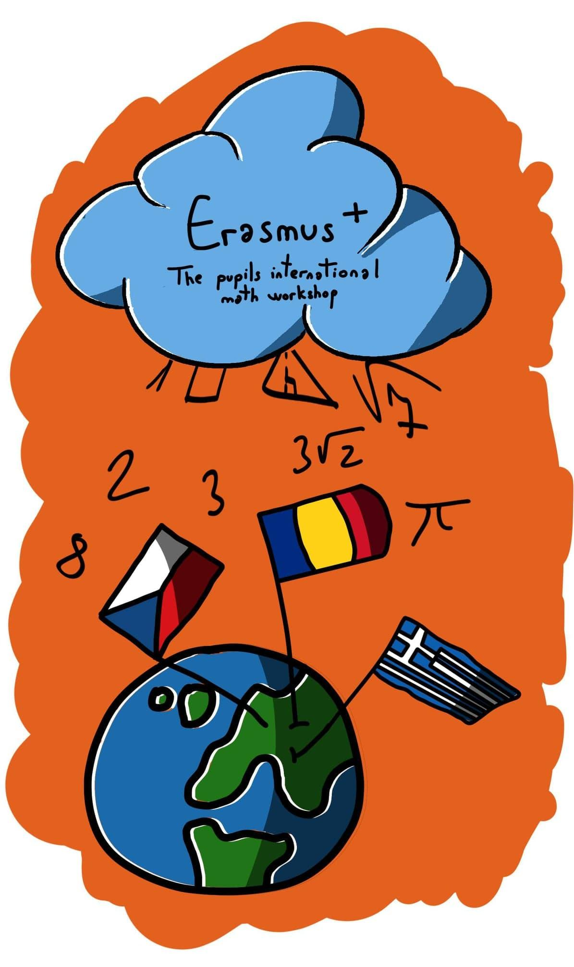
Fractals

Slide 2
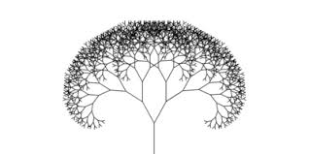
Fractals - Overview
From a geometric perspective, a fractal is an ensemble of smaller pieces, which are, to some degree, identical to the original.
“a complicated pattern in mathematics built from simple repeated shapes that are reduced in size every time they are repeated”
-Cambridge Dictionary

Slide 3
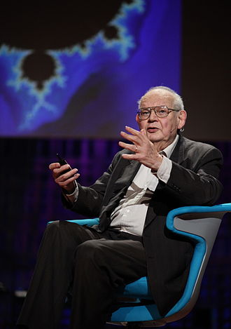
Benoît B. Mandelbrot
(November 1924 – October 2010)
Benoît B. Mandelbrot was a french mathematician who coined the term “fractal” in 1975.

Slide 4
Fractals - Characteristics
- Every fractal is a geometric shape;
- Any fractal can be divided into smaller fractals;
- Every smaller fractal is a copy of the whole;
- Every fractal has a simple, recursive definition;
- Every fractal is infinitely complex and detailed.

Slide 5
Fractals - Elements
Every fractal has 3 elements:
- An initiator (the initial shape of the fractal, can be a point, a line, a triangle etc.)
- A generator (the rule used in constructing the fractal)
- An iterator (the recursive process used to generate the fractal)

Slide 6
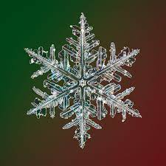
Fractals in Nature
Fractals appear in nature in many ways, including snowflakes and even coastlines!
They are also present in living creatures, for example in the wings of dragonflies and in pinecones.

Slide 7
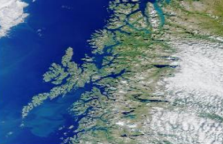
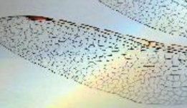
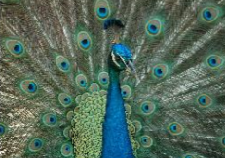
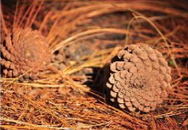
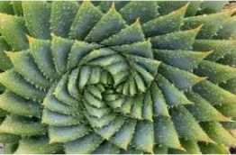
Fractals in Nature - Images

Slide 8
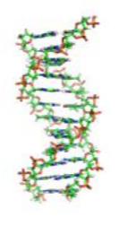
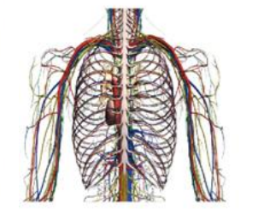
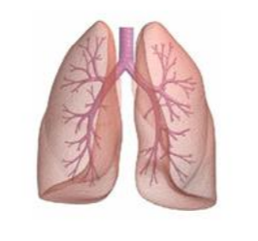
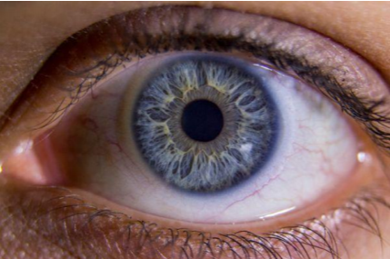
Fractals in the Human Body - Images

Slide 9
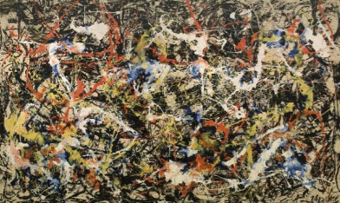
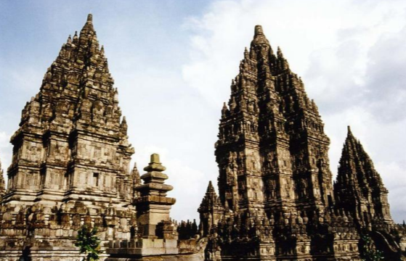
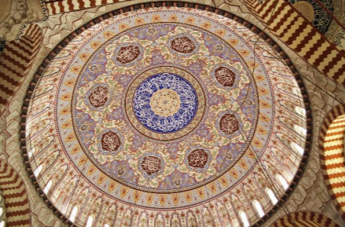
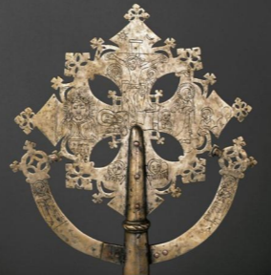
Fractals in Art - Images

Slide 10
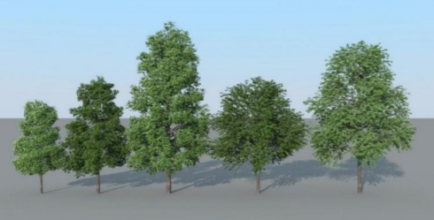
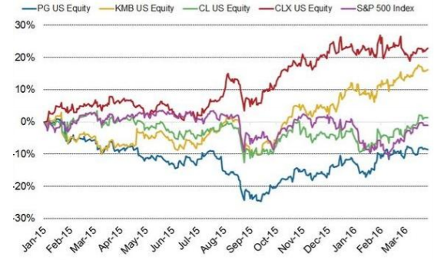
Fractals - Practical Uses
Fractals are useful, among other things, for plotting graphs, simulating natural growth, and for “fancy” 3D graphics.

Slide 11
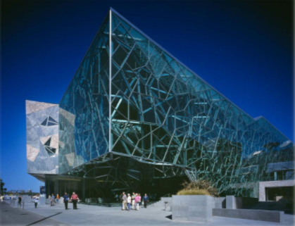
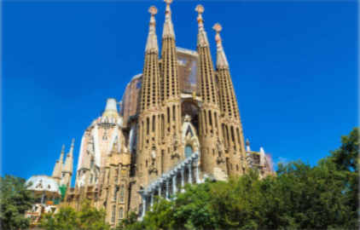
Fractals in Architecture - Images
Atrium Federation Square Melbourne, AU
Sagrada Familia
Barcelona, Spain

Slide 12
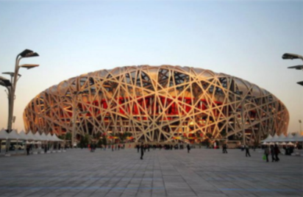
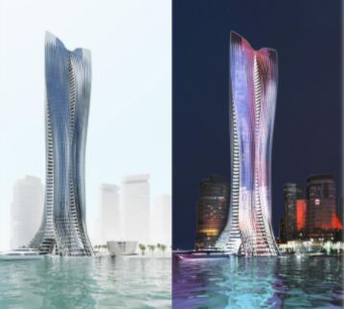
Fractals in Architecture - Images
National Stadium - Beijing, China
Michael Schumacher Tower - Dubai, UAE

Slide 13
Fractals in Geometry
As said in the overview, fractals are geometric shapes. Some of the most well known fractals include the:
Sierpinski Triangle, Sierpinski Square
Koch Snowflake, Koch Curve, Koch Surface
Cantor Bar
Menger Sponge
Hilbert Fractal / Hilbert Curve
Julia Sets
Peano Curve
Lyapunov Fractal
Dragon Curve

Slide 14
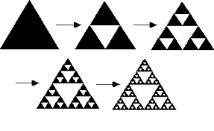
Sierpinski Triangle

Slide 15
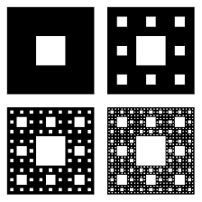
Sierpinski Carpet / Sierpinski Square

Slide 16
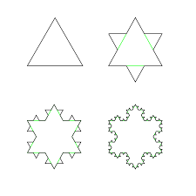
Koch Snowflake

Slide 17
Koch Curve / Koch Line

Slide 18
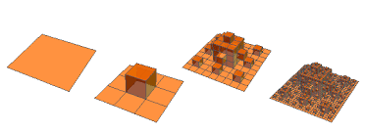
Koch Surface

Slide 19
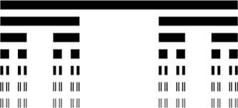
Cantor Bar

Slide 20
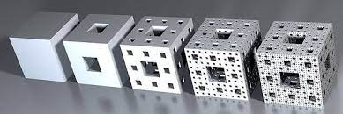
Menger Sponge

Slide 21
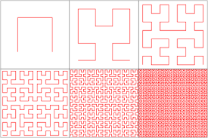
Hilbert Curve / Hilbert Fractal

Slide 22
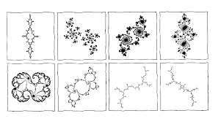
Julia Sets

Slide 23
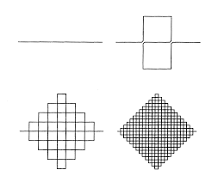
Peano Curve

Slide 24
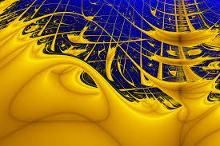
Lyapunov Fractal

Slide 25
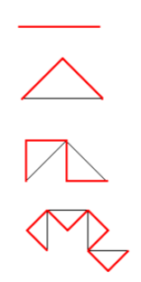
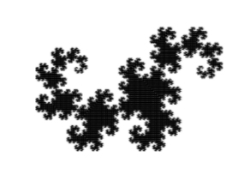
Dragon Curve

Slide 26
Drawing Fractals Using Computers
Fractals can be generated, and drawn, using computer programs. We’ve prepared a couple of these to try out for yourselves.
After following the instructions provided, you can draw your own fractals!

Slide 27
Disclaimer
The European Commission support for the production of this publication does not constitute an endorsement of the contents which reflects the views only of the authors, and the National Agency and Comission cannot be held responsible for any use which may be made of the information contained therein.

