Slide 1
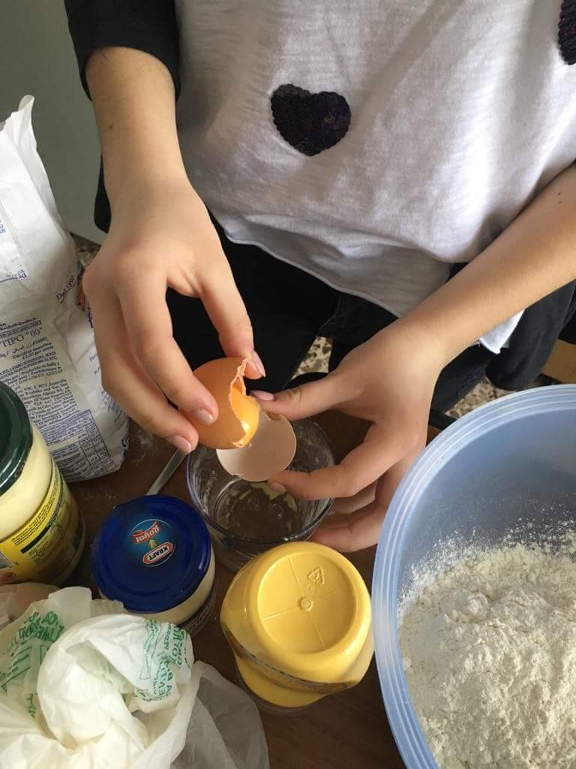
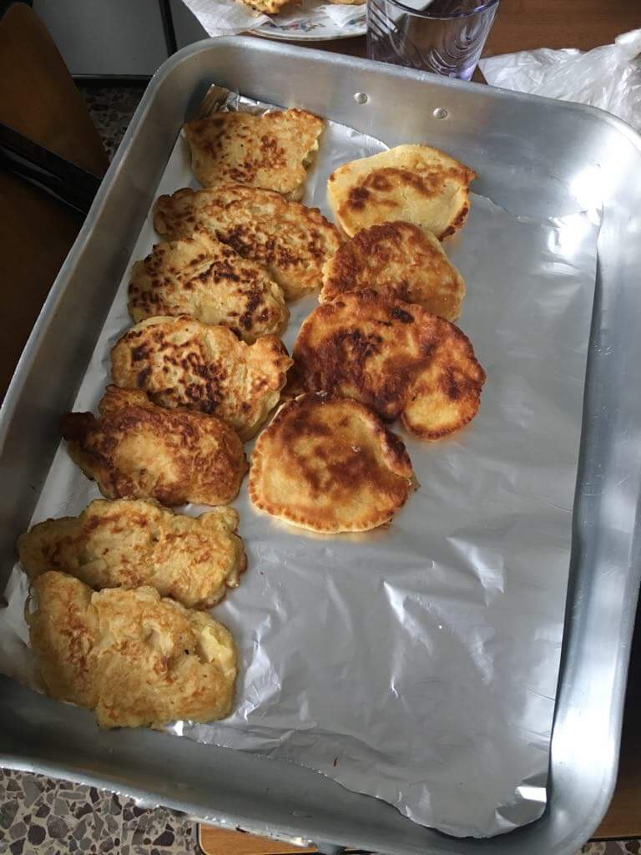
Crumpets

Slide 2
Ingredients
2 glasses of wheat flour
2 yolks
1 glass of milk
2 teaspoons of baking powder
1 or 2 big apples
oil
powdered sugar

Slide 3
Method
Grate the apples and leave them for a second.
Add the yolks to the flour, then slowly add the milk. Mix it together until smooth and creamy. Add baking powder and grated apple.
Heat a little oil in a frying pan, add the mixture forming little crumpets. Serve it with powdered sugar.

