Slide 1
Easter „BABA” cake
Michalina Jazdon

Slide 2
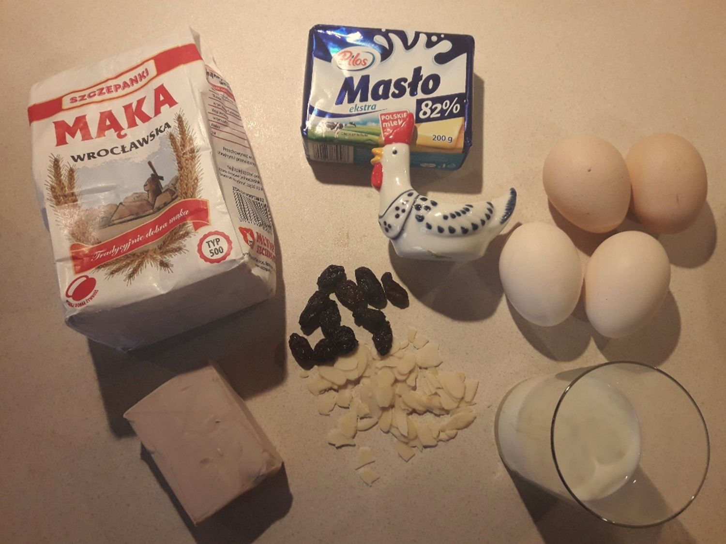
Ingredients:
125g sugar
0,5kg flour
125g butter
4 eggs
0,5 cup milk
pinch os salt

Slide 3
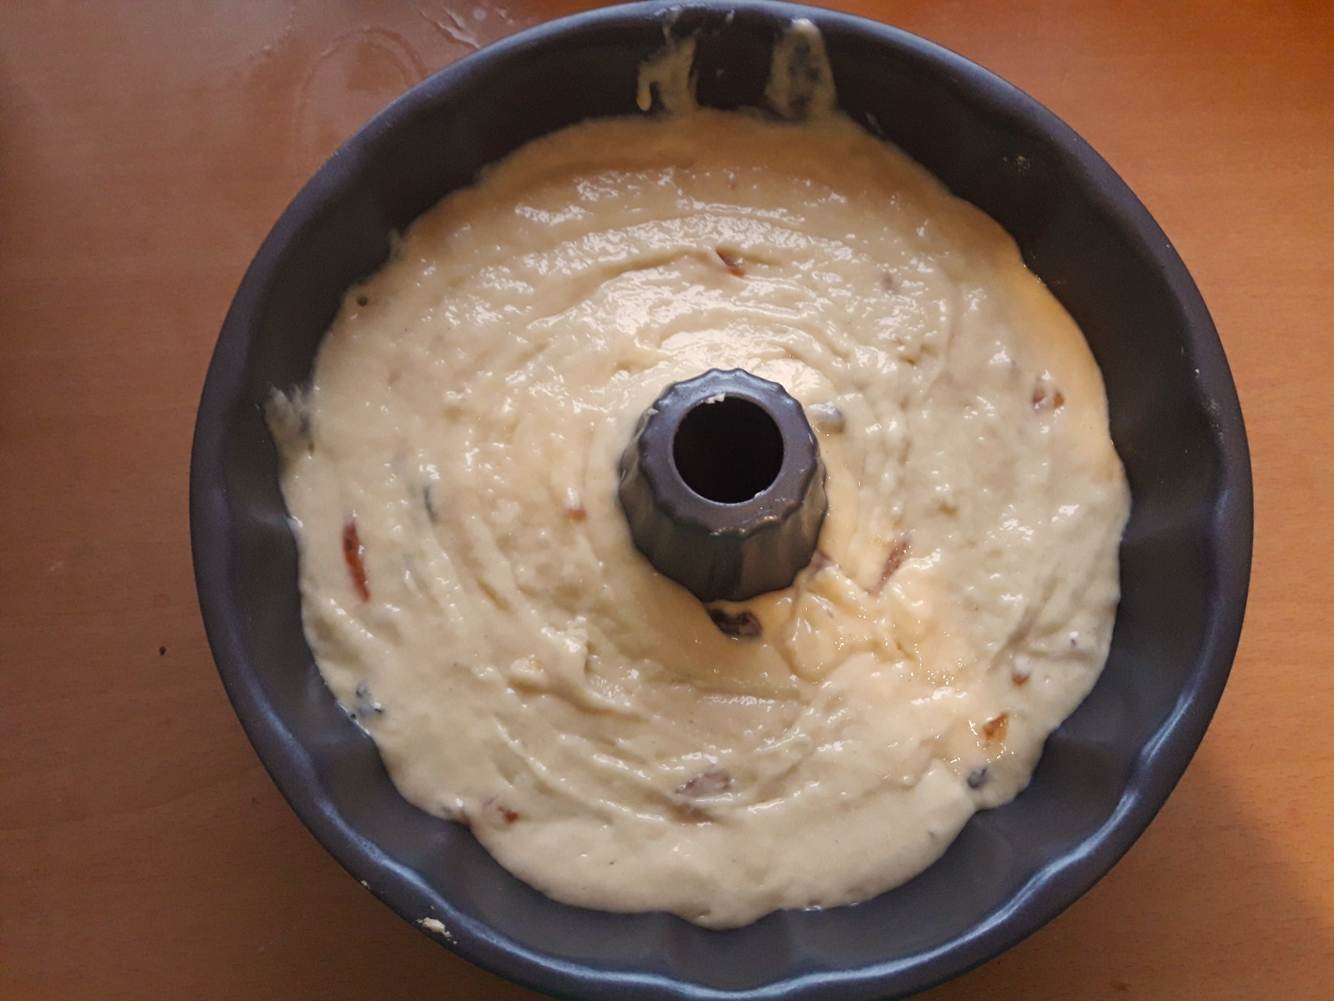
Pour dought into a specially-shaped form and bake 30 min in 200°C.

Slide 4
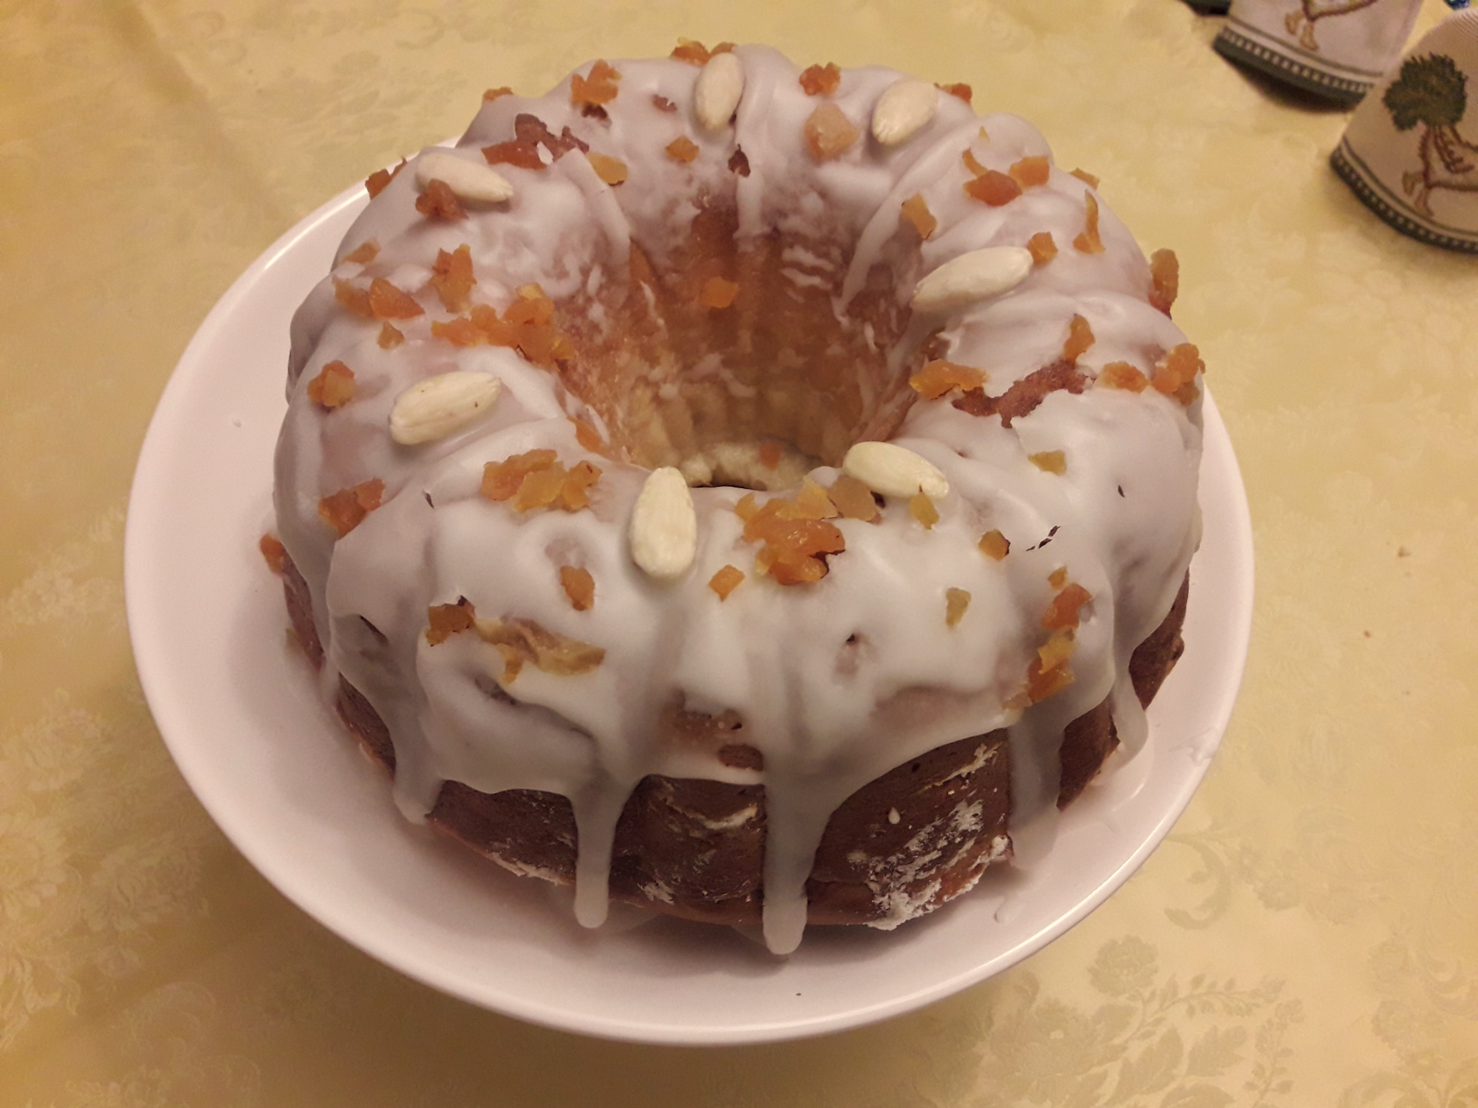
Et voilà!
Remove the cake carefully from the form and let it chill for some time.
You can decorate it with icing and dry fruits or almonds.

Slide 5
Bon appétit!
Michalina Jazdon

