Slide 1
Stuffed eggs with vegetable salad

Slide 2
Ingredients ( for 30 portions):
3 carrots
Half of parsleys
Half of celery
4 potatoes
15 eggs
Half of can of peas
4 pickled cucumbers
2 apples
1 big mayonnaise ( about 12 spoons )
1 mustard
Salt
Pepper

Slide 3
Cook potatoes, parsleys, celery and carrots with the skin. In other pot you can cook hard – boiled eggs. While veggies are cooking, chop cucumbers and apples very fine, mix into mayo and mustard with peas, and cream. When the eggs will be ready, shell them carefully, cut them in half and put near a bowl with other ingredients. Then separate yolks from whites – take them out. When the vegetables will be ready, dice them up. Mix everything together and add a pinch of salt and pepper. Put the salad into space, which rised after taking a yolk out. Bon appetit!!

Slide 4
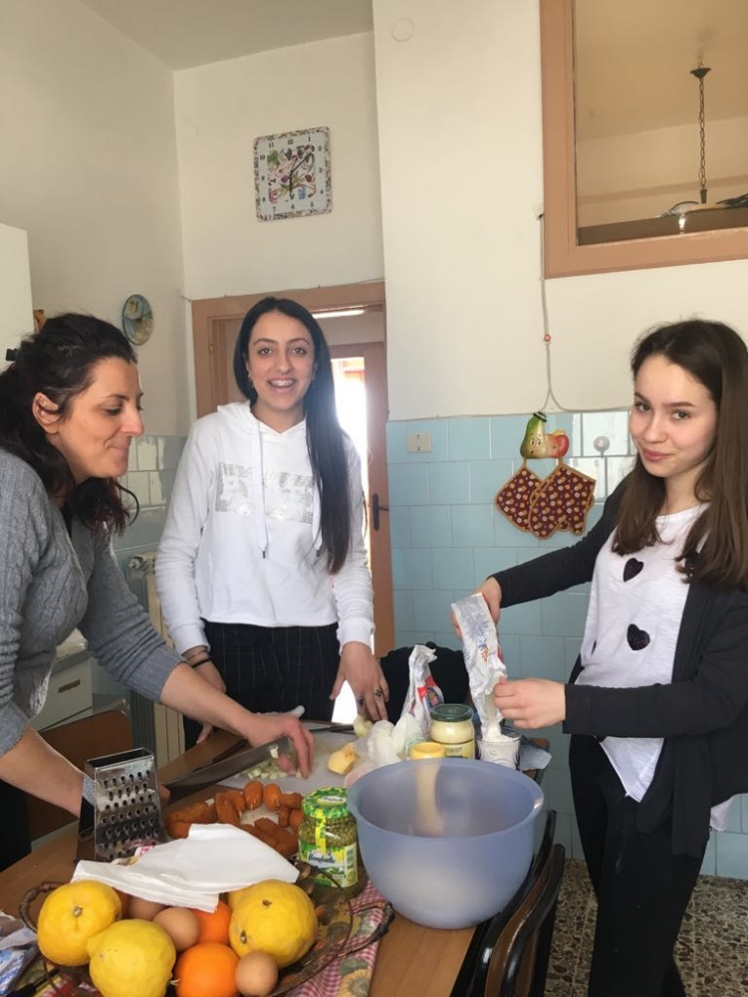

Slide 5
