Slide 1
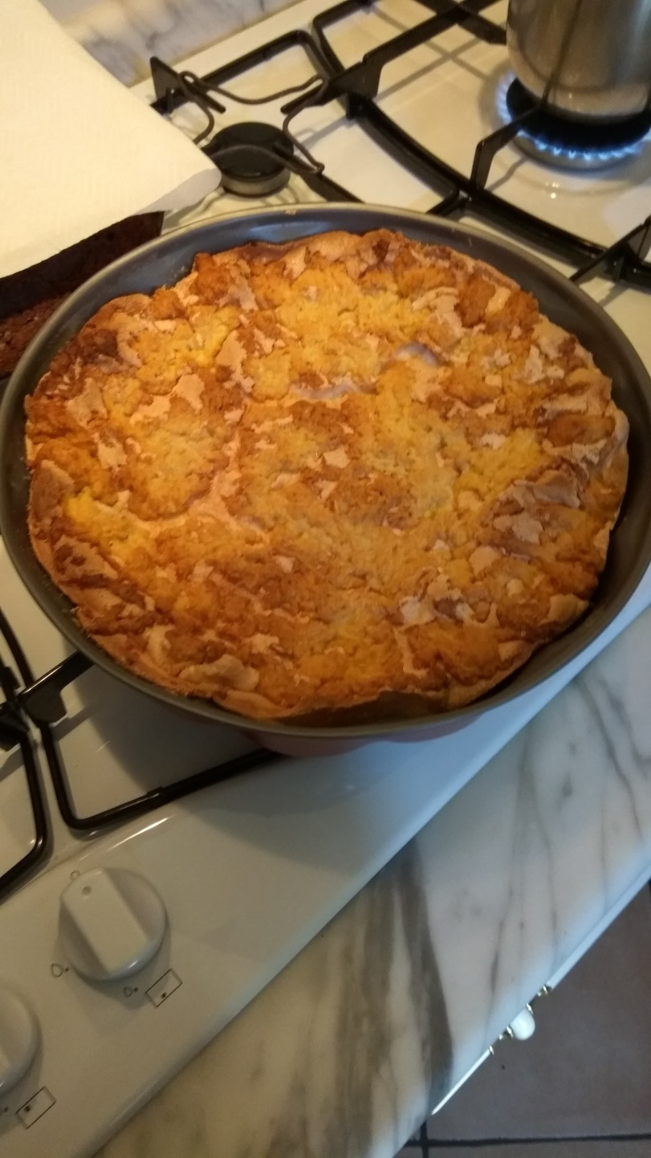
Pleśniak

Slide 2
Dough:
3 glasses of flour
250 g margarine
0.5 glass of sugar
5 egg yolks
1 teaspoon of baking powder

Slide 3
Filling:
Jar of plum jam
Egg white that's left after breaking eggs
3/4 glass of sugar
3 teaspoons of potato flour

Slide 4
Method
Knead the dough using all the ingredients. Split it into 3 parts. Cool two of them in the fridge. Line a baking tray with baking paper. Put the third part of the dough on the baking paper and spread the jam across it. Beat egg whites with 3/4 glass of sugar mixed with 3 teaspoons of potato flour until stiff. Grate one part of the cooled dough with a grater and put it on the jam. Spread the egg whites over. Grate the second part of the cooled dough and cover the egg whites with it.
Bake it all for about 45 minutes.

