Slide 1
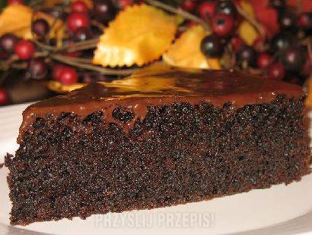
CHOCOLATE CAKE WITH COCA- COLA

Slide 2
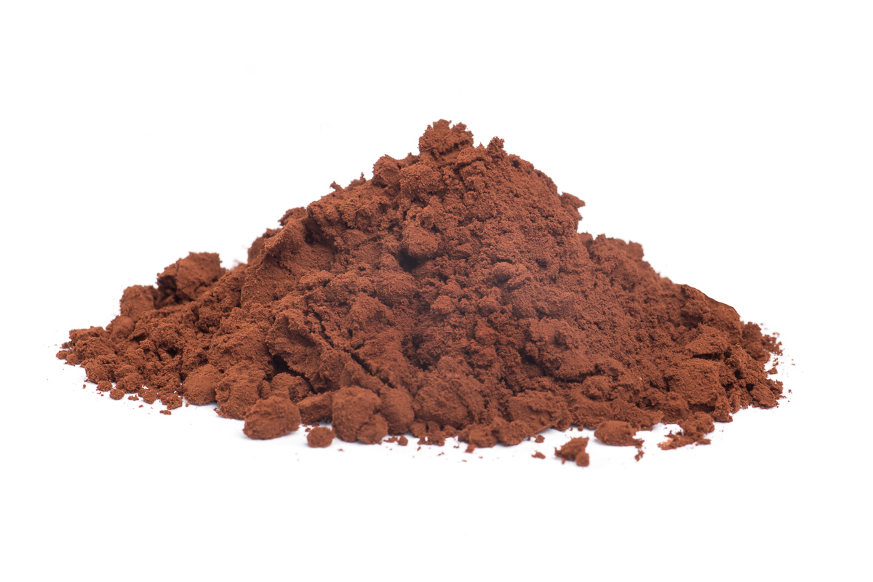
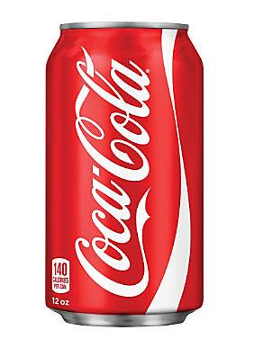
INGREDIENTS
250g of white flour
2 teaspoons of baking powder
300g of crystal sugar
3 table spoons of bitter cocoa
pinch of salt
1 packet of vanilla sugar
250g of butter
200ml of coca-cola
2 eggs
1chocolate with toffee filling
2/3 spoons of 30% cream

Slide 3
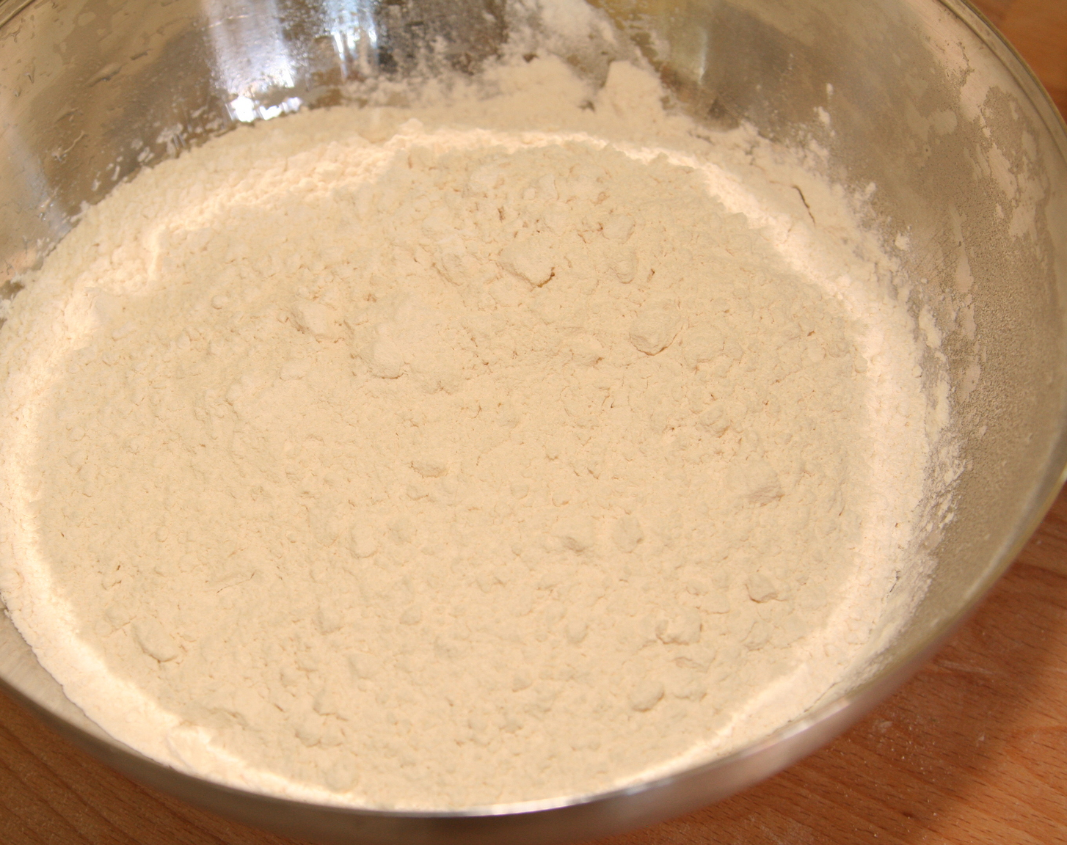
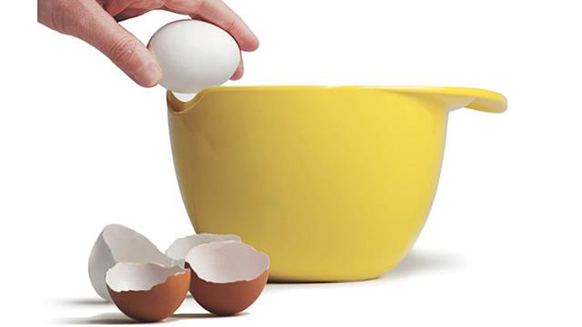
How to do it…
1. In one bowl, mix flour, baking powder, sugar, cocoa, salt and vanilla sugar.
2. Pour eggs into the other bowl, beat them well, then add milk, melted and cooled butter and coca-cola. Then mix.
3. Add the wet ingredients into the dry ones and mix them well.

Slide 4
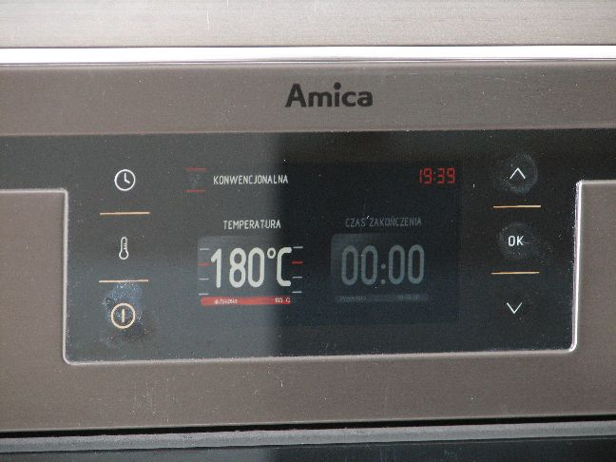
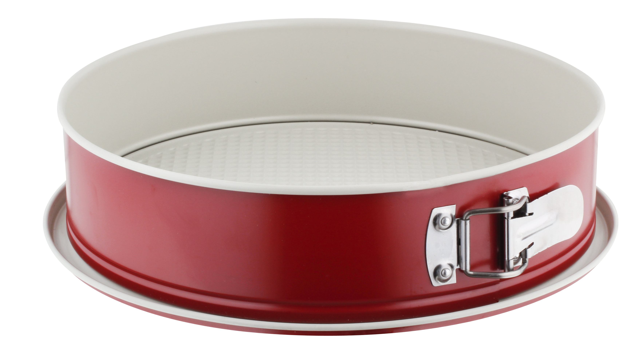
Baking
4. Spread the butter on the springform and sprinkle it with breadcrumbs. Pour the prepared mass into the springform and put in the oven preheated to 180ºC. Bake for 40-50 minutes. Remove and leave to cool.

Slide 5
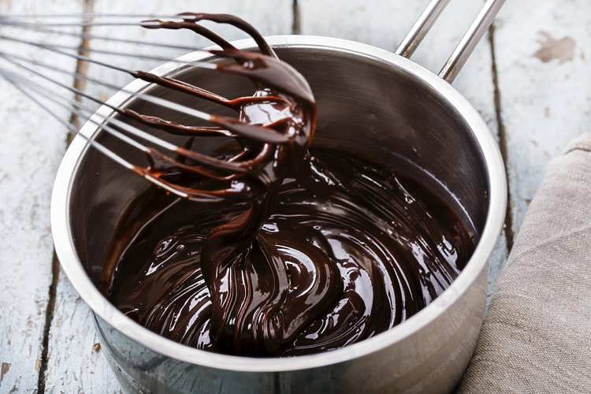
The glaze
5. Prepare the glaze: break the chocolate and melt in a water bath. Add the cream, mix. Pour the hot glaze over the cake, let it settle down.

Slide 6
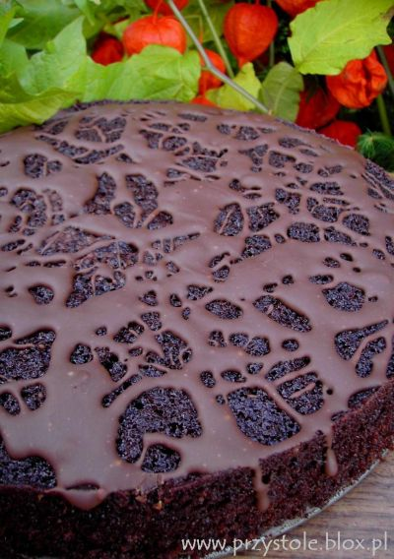
ENJOY ☺

