Slide 1
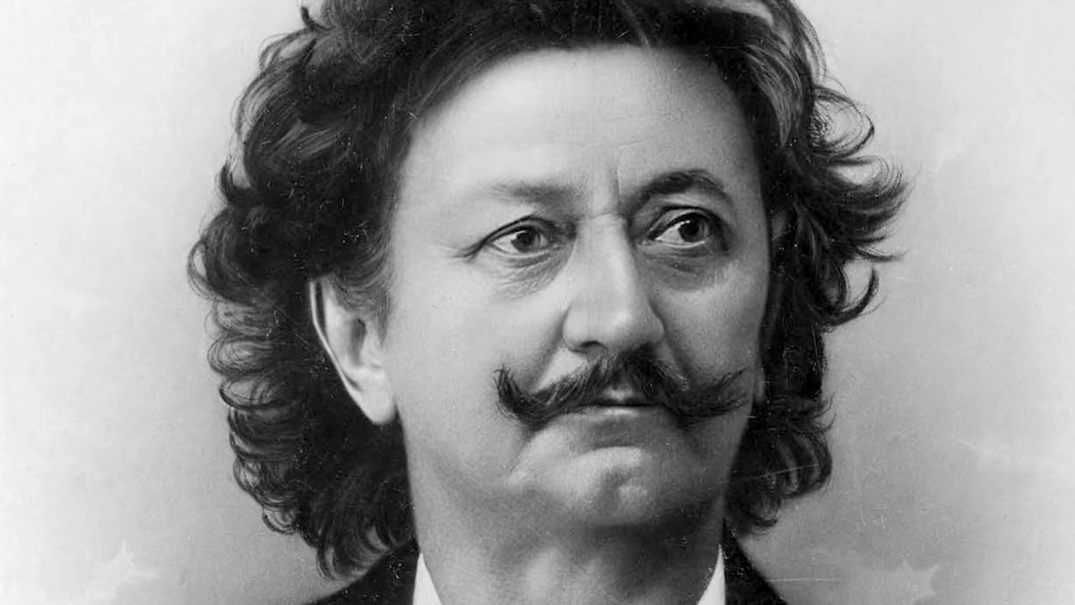
Presentation about Laza Kostić, the most famous poet of Serbian Romanticism
Hey, that’s pretty good!
Cool mustache right?
Presentation done by: Dušan Vejnović II-1

Slide 2
Laza Kostić was born in Kovilj on the Three Hierarchs on 31st January 1841.
Background and education of
Laza Kostić
He comes from a wealthy bourgeois family.
His education began in his native Kovilj, and ended in Budapest in 1866.

Slide 3
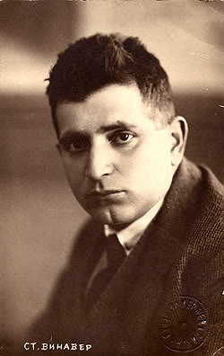
Stanislav Vinaver called Kostić’s poetry: “Dissaray before disarray“.
Proud and dignified, "I always stayed up there somewhere, beyond this world, in some higher heroic and contemplative areas." Such was his poetry.
Its basic principle is the poetic intersection of opposing forces as a basic cosmic law and the basis of beauty in the world.
Stanislav Vinaver

Slide 4
Laza Kostić as a high school student.
As a high school student he began publishing his first poems in magazines "Seven", “Serbian chronicle" and in Pest.
Begins to translate Shakespeare, then, Serbs didn’t know about Shakespeare..
The man who discovered Laza Kostić as a poet was Djordje Popovic, who later in his journal, "Danica" Kostic published three songs: "I dream Dreams," "Among reality and dream" and "Memorial to Ruvarac".

Slide 5
The song "Among reality and dream" is so musical that it’s possible to sing.
“Međ javom i međ snom”
“Among reality and dream”
Srce moje samohrano, ko te dozva u moj dom? neumorna pletisanko, što pletivo pleteš tanko među javom i med snom. Srce moje, srce ludo, sta ti misliš s pletivom? k'o pletilja ona stara, dan što plete, noć opara, među javom i med snom. Srce moje, srce kivno, ubio te živi grom! što se ne daš meni živu razabrati u pletivu među javom i med snom!
Oh, heart of mine, alone standing,
Who has called you to my home?
you tireless dreaming-knitter,
knitting from a quite thin fiber
'tween wakefulness and the dream.
Oh, heart of mine, heart demented,
with this knitting, what do you mean?
Like the knitting of that old maid's,
what the day knits, the night unbraids,
'tween wakefulness and the dream.
Oh, heart of mine, heart resentful,
may 'bolt take you from this realm,
why not let me while still living,
discern yourself in the knitting
'tween wakefulness and the dream!

Slide 6
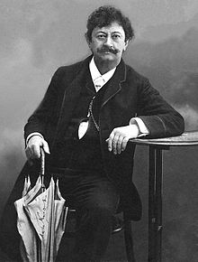
As well as Laza Kostić was an intellectual and express individual, one feature of his extremely adorned him...That is defy.
He was practicing running and gymnastics in Cetinje..While people looked at him like he was crazy.
Although, this picture suggests otherwise.

Slide 7
Although best known for his poetry, Laza Kostic wrote plays, essays and critical studies. He also wrote several short stories.
Works:
Songs I, II (1873, 1874)
Songs (1909)
Drama: "Maksim Crnojević" (1890), "Pera Segedinac" (1875), "Gordana" (1890)
Studies, essays and treatises: "Fundamentals of beauty in the world, with particular regard to the Serbian folk songs" (1880), "The basic principle: a critical introduction to the general philosophy" (1884), "O Jovan Jovanovic Zmaj (Book about t he Dragon)" (1902 )

Slide 8
"On the Serbian literary scene Kostic stupa unusual step minstrel. The hearing carries the block of ten, and in the spirit of old and new poetic myths. In his early poems there are two layers of influence: National and classical (Hellenic). They found and the latter flows Kostic's poetry, in which they often implicated interlace. "
Miodrag Popovic

Slide 9
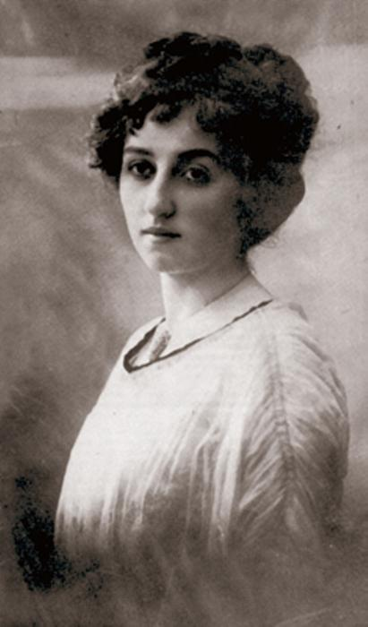
Laza Kostić’s first love.
Jovanka Kirjaković, then Laza was only 19 years old ..

Slide 10
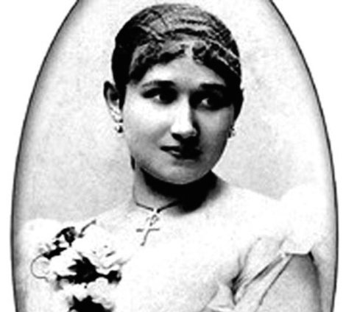
In Pest in 1892, faces a Nikola Tesla which in 1895. recommended to marry Lenka Dunđerski,although Laza was in love with her.

Slide 11
In honor of Laza Kostić, established the award "Laza Kostić" in honor of "Santa Maria della Salute" in Sombor, every 3rd of June, the manifestation called “Dan Laza Kostic” has been organized and the selected poet is awarded wreath Laze Kostića.
Laza Kostić died in 1910 in Vienna, and was buried at the Great Orthodox Cemetery in Sombor. He will be remembered as one of the greatest writers of Serbian romanticism!

Slide 12
Sources:
https://sr.wikipedia.org/wiki/Лаза_Костић
https://www.sutori.com/story/laza-kostitsh-zhivot-omiedjien-javom-i-snom
That’s pretty much it fawkes.

