Slide 1
The magical journey
Kindergarten with Extended Program no.37 Braila
18.10.2021-22.10.2021

Slide 2
The Girl with golden hair lived in Bulgaria, at the Balchik Palace. She loved to walk through the beautifully landscaped gardens, listened to the birds' voices and often stood with her feet in the spring water. She had everything she wanted ... but she had no friends.

Slide 3
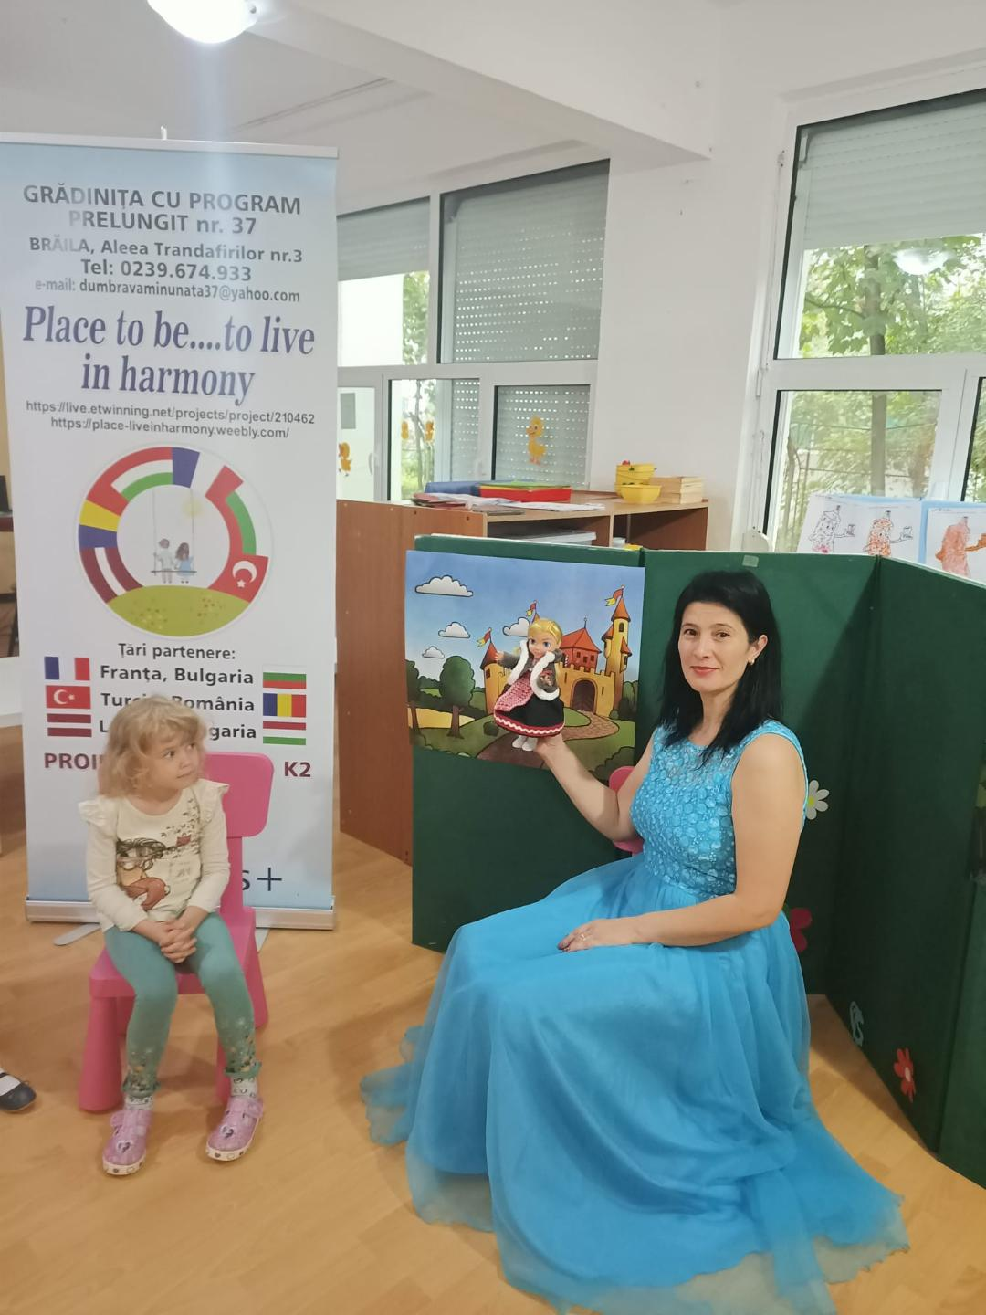

Slide 4
One night, in a dream, the Good Fairy advised her to crochet a glove, which will help her find friends and travel with them in the most wonderful places. It didn't even light up well during the day and the Girl with golden hair got to work. She wanted so much to have friends and travel!

Slide 5
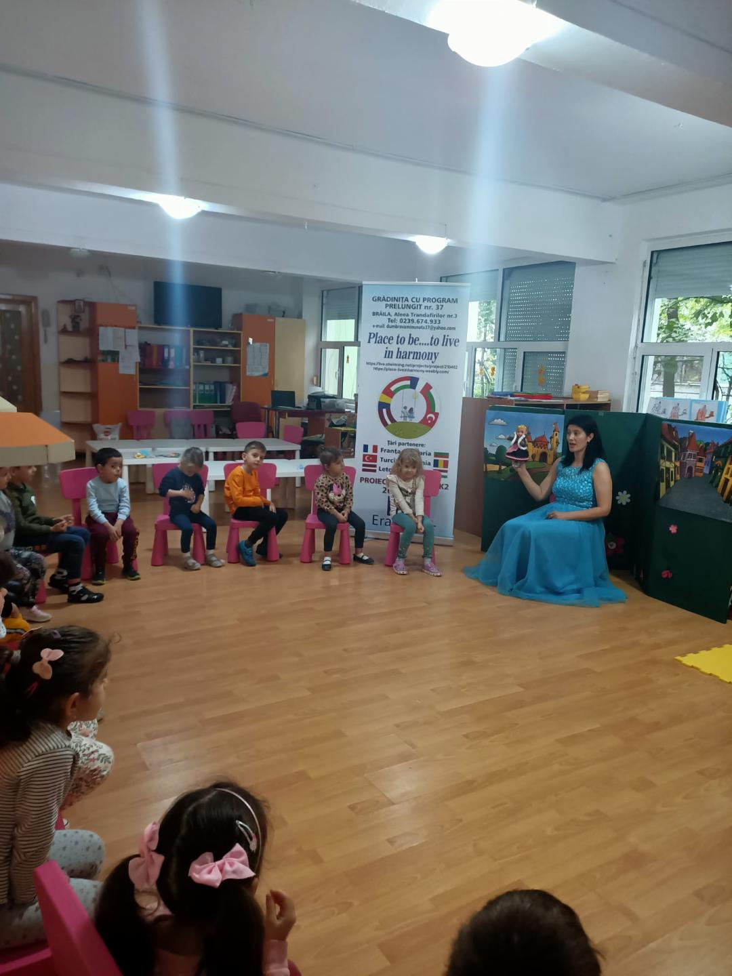

Slide 6
When the Glove was ready, she caught her voice!
The Good Fairy told me how impatient you are, so let's say the magic formula together: Aram sam sam .... https://www.youtube.com/watch?v=935UBEm0gg0
They immediately arrived in Latvia, at the Rundale Palace. She was impressed by the garden and the architecture of the palace.

Slide 7
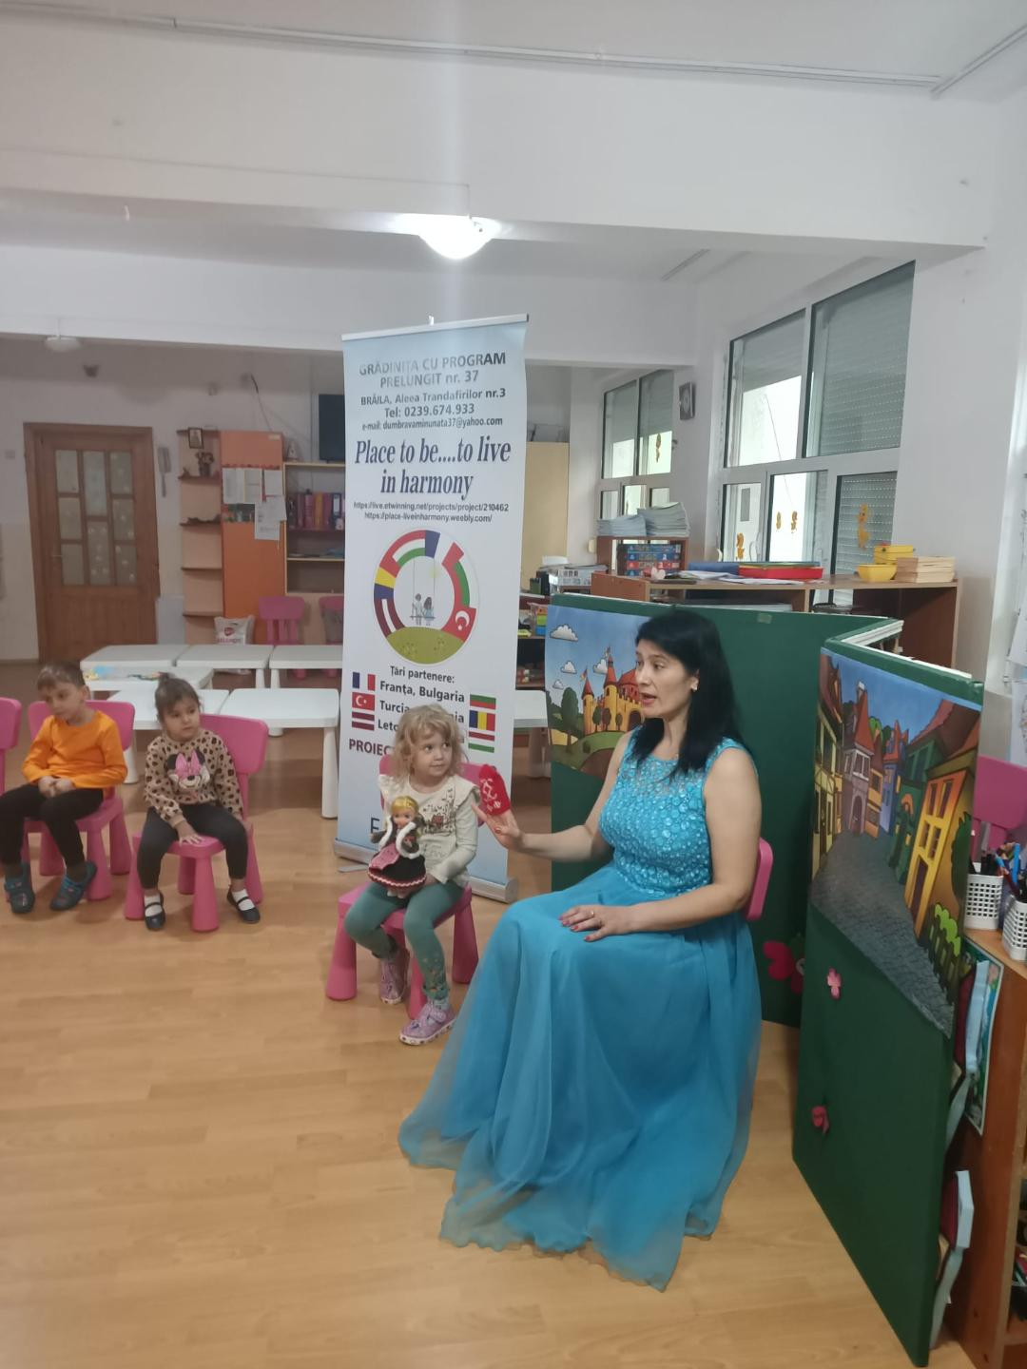

Slide 8
- Dear Glove, thank you for bringing me to these wonderful lands! But, even though it's sunny, the weather is a little bit cold here!
-I still have surprises for you ....Let's go to a country with warmer weather!
They closed their eyes and said the magic formula: Aram sam sam ... https://www.youtube.com/watch?v=935UBEm0gg0

Slide 9
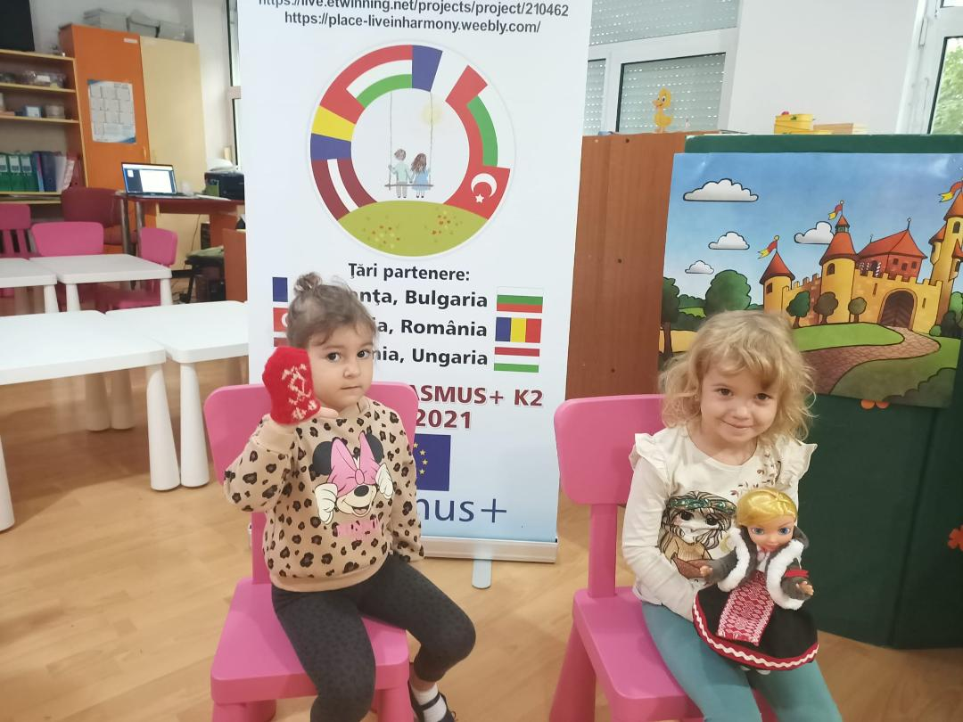

Slide 10
Suddenly they arrived at Ankara Castle, where the Donkey met them.
-Welcome to these lands! Follow me in the wonderful world of Ankara Castle!
They visited many rooms, towers and of course the weapons exhibition. The Donkey expressed his desire to travel with the Girl with golden hair and the Glove. They held hands, closed their eyes and said the magic formula together: Aram sam sam ... https://www.youtube.com/watch?v=935UBEm0gg0

Slide 11
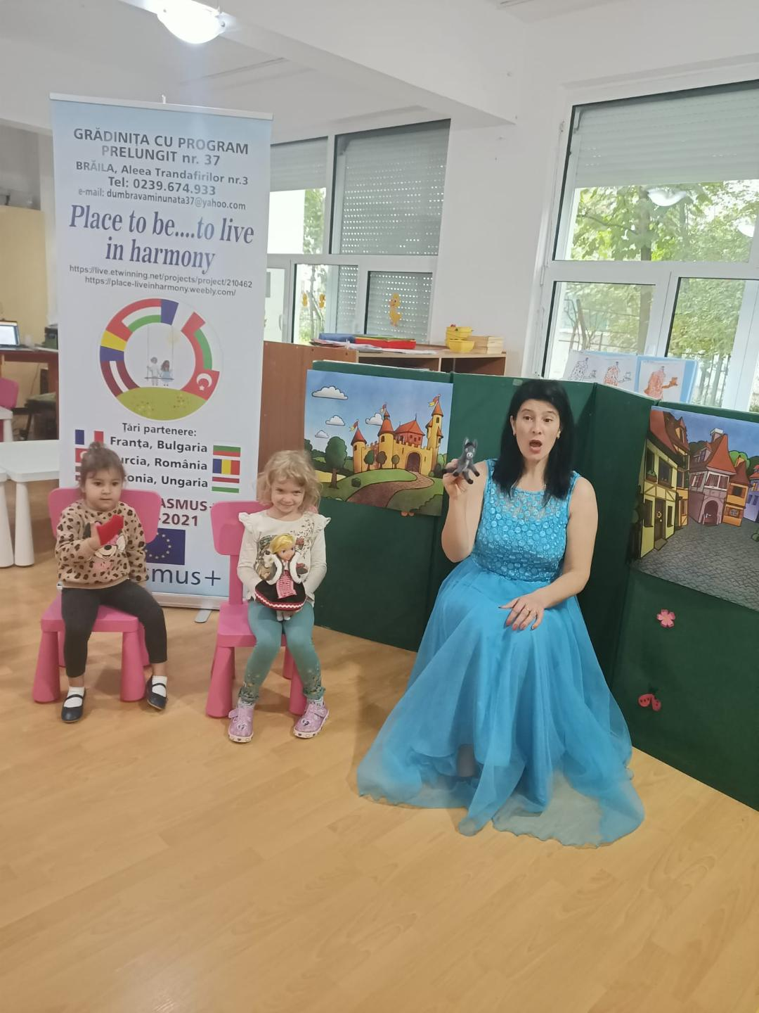

Slide 12
They reached at the gates of Peles Castle, in Romania, where the Goat met them.
- I'm so glad to meet you! I really wanted to make new friends! I invite you to the atmosphere of the royal era! What a special entrance, worthy of a queen! I would like to have such a library with many interesting books at home! said the Girl with golden hair. When they reached the castle courtyard, they shook hands, closed their eyes and said the magic formula together:Aram sam sam ....

Slide 13
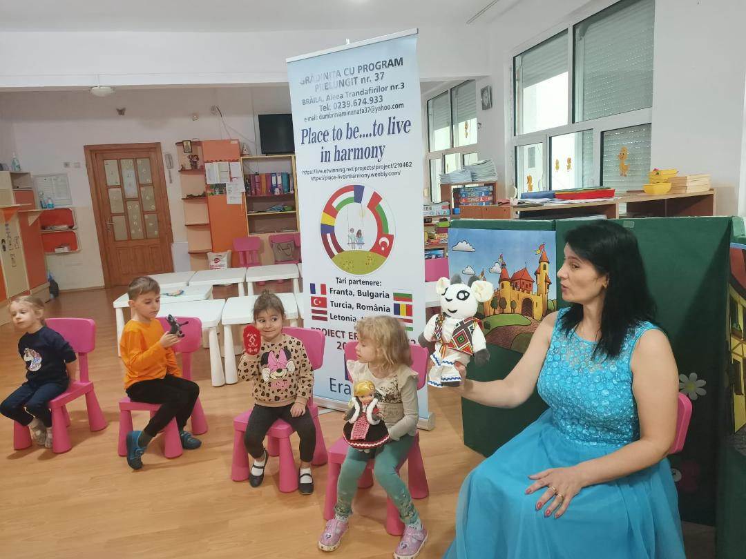

Slide 14
In the blink of an eye, they traveled to France. At the gates of the Strasbourg Zoo, the Wolf guide was waiting for them. Together they walked on the alleys of the nature reserve, delighted in the beauties around them.
- I invite you to dinner, in the Little Paris neighborhood, where you will also see Alsatian houses!
- We look forward to visit them! said the Donkey

Slide 15
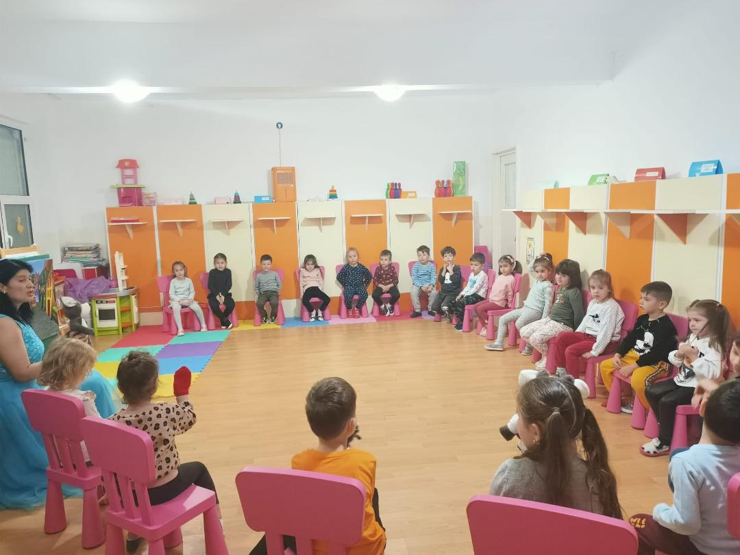

Slide 16
At the end of the evening, the Glove offered them one last trip to Hungary. They shook hands, closed their eyes and said the magic formula together: Aram sam sam .... Buda Castel and the Little Pig immediately appeared before their eyes. At the beginning, he was afraid of the Wolf, because they were not really good friends.
-Let's say the magic formula together, said the Glove: Aram sam sam ... https://www.youtube.com/watch?v=935UBEm0gg0

Slide 17
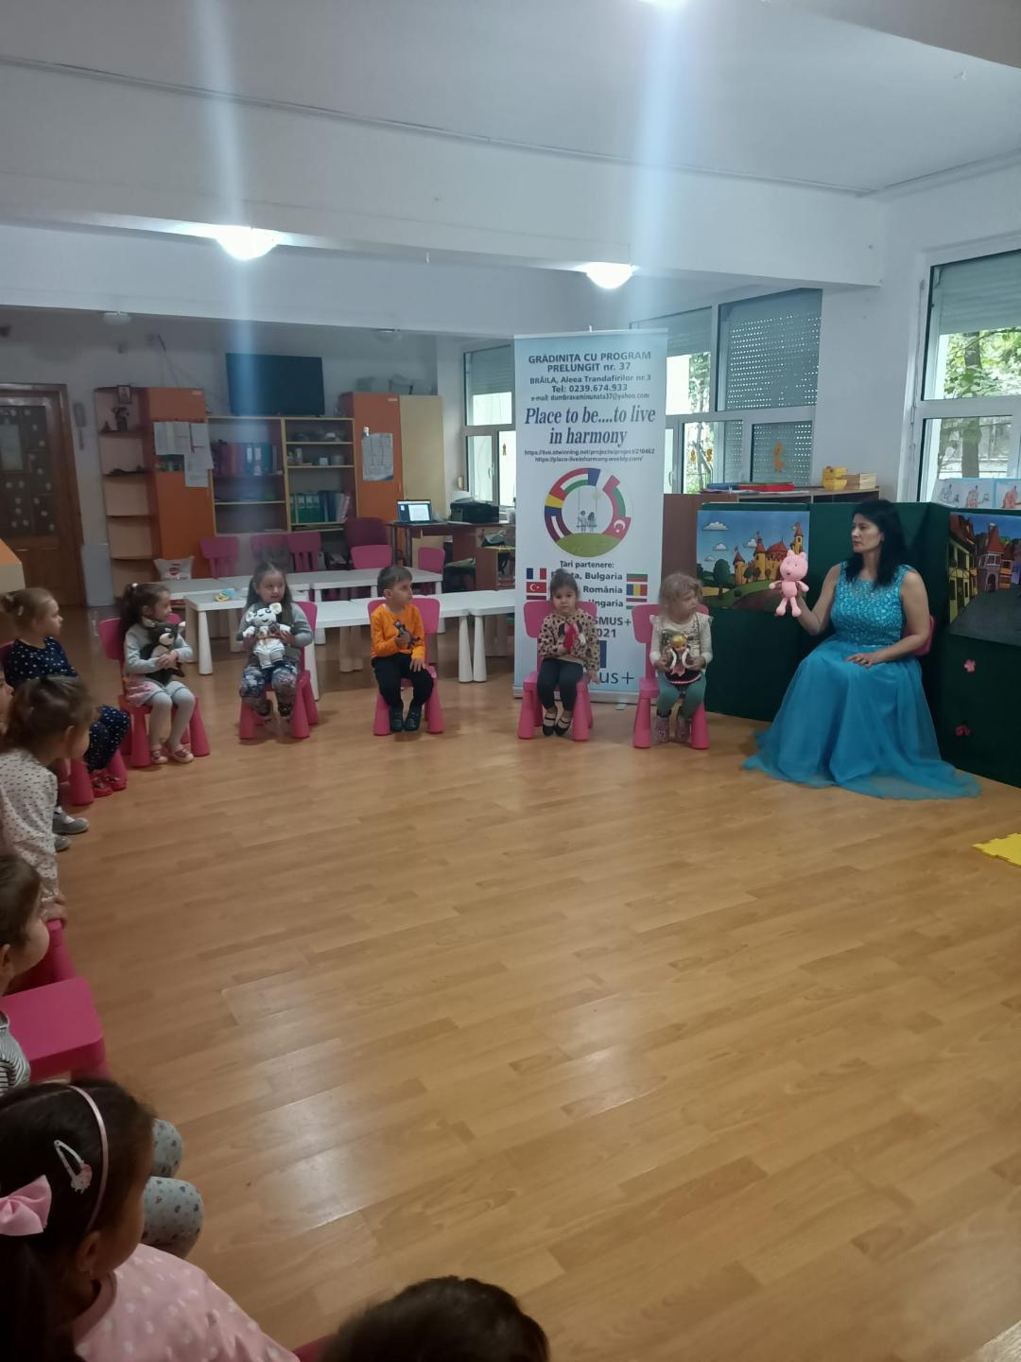

Slide 18
And they all became friends! Full of joy, the Little Pig invited them to visit Buda Castle, rocked by the waves of the Danube River.

Slide 19
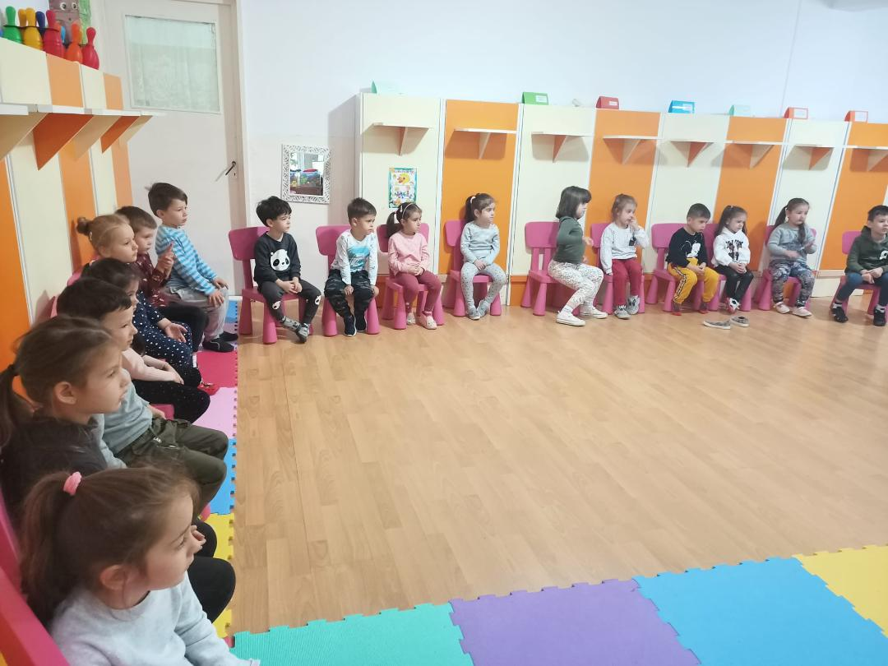

Slide 20
At the end of this magical journey, all the protagonists concluded that the best place to live is at home, the place where you have your family and your best friends!

Slide 21
