Slide 1
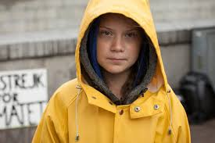
Greta Thunberg

Slide 2
In December 2018
she was named one of the world's 25 most influential teenagers by Time Magazine.

Slide 3
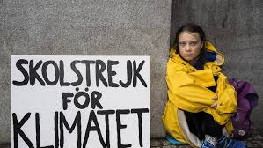
School Strike for Climate
In August 2018, Greta Thunberg started her sit in strike, outside the Parliament House in Stockholm with a sign. The message was brief: "School strike for the climate".
She intended to continue her school strike every Friday until the day Sweden had fulfilled the Paris agreement.

Slide 4
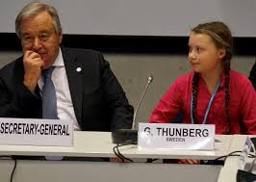
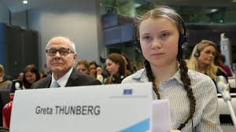
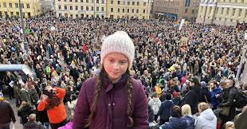
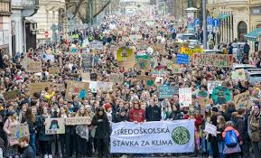
Within a couple of months she participated in several international conferences and spoke at numerous demonstrations around Europe.

Slide 5
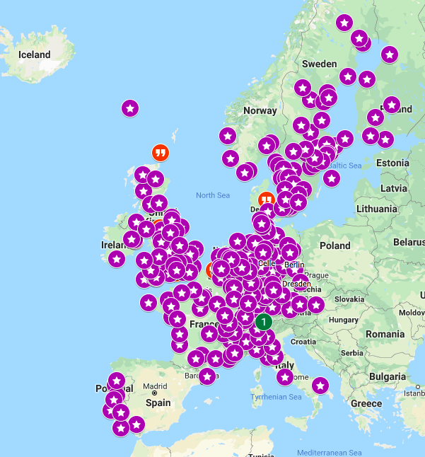
Her school strike spread all
over the world

Slide 6
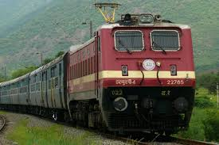
Wherever she goes, she travel climate smart
She never fail to criticize other conference
participants, who travel by airplane.
Two weeks on a sailboat across the
Atlantic

Slide 7
In December 2019 she spoke on the UN COP24 in Poland
In March 2019, she was nominated for the Nobel Peace Prize.
In April 2019, Greta Thunberg spoke in the European Parliament, the Italian Senate and in the British Parliament. In addition, she met Pope Francis.
In May 2019, Greta Thunberg's book "No one is too small to make a difference" was published. The book consists of eleven of her speeches.
During summer 2019, she attended environmental activists in the Ende Gelände movement in Germany and participated in Fridays for Future's summer conference in Lausanne.
In August 2019, Greta Thunberg was named "Game Changer of the Year" by GQ Magazine, and began her sailing to the UN Climate Summit in New York.

Slide 8
In september 2019, she was honoured with the top Amnesty award "Ambassador of conscience award", along with Fridays for future movement.
She opened the UN Climate Action Summit in NY

Slide 9
Greta’s 5 Call to People
Try to understand the significance of the climate crisis!
Inform yourself by:
reading
listening

Slide 10
Greta’s 5 Call to People
Spread the information to others
inform
discuss

Slide 11
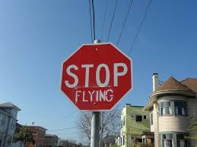
Greta’s 5 Call to People
Stop flying

Slide 12
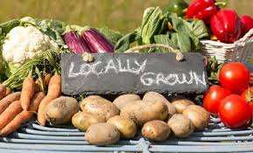
Greta’s 5 Call to People
Eat climate smart
locally produced food
no or less meat

Slide 13
Greta’s 5 Call to People
Stop consuming
don’t buy things you don’t really need
buy things secondhand

Slide 14
Asperger
Greta is a role model, not only when it comes so climate change, but also for people with different forms of autism.
Asperger syndrome (AS), is a disorder characterised by difficulties in social interaction and nonverbal communication, along with restricted and repetitive patterns of behavior and interests.
Greta is convinced that without her diagnosis she would have been caught up in the mainstream social game and not been acting out her beliefs of climate change

Slide 15
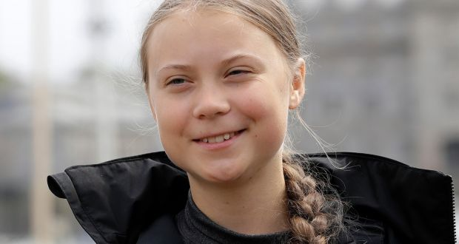
No one is too small to make a difference!

Slide 16
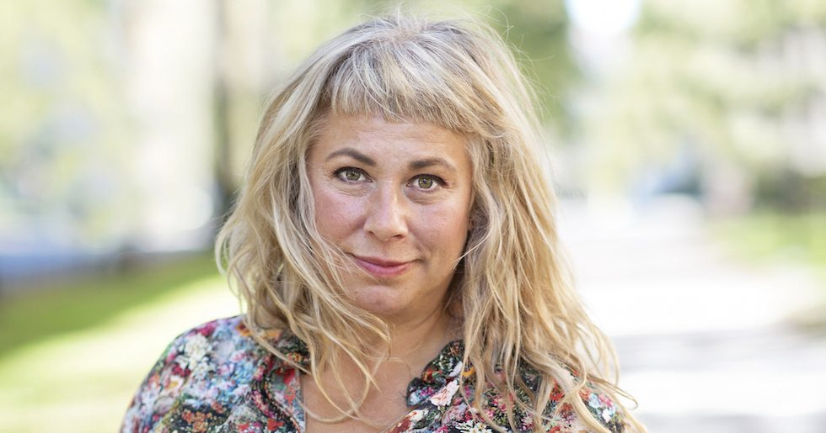
Stina Wollter - Body Activist

Slide 17
Spokeswoman for the right of all bodies
“The public flesh”
Fights body incite, for the right to look the way you do, to liberate the female body
Resist norms and conquer mass medial ideals

Slide 18
Mother's unspoken but strict ideas for what a girl should be like
Object for young boys and men, who thought they had the right to touch her
Subjected to a rape trial, she was 14 years old

Slide 19
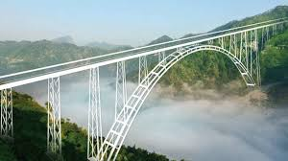
“Outfluencer”
Build bridges between the worlds of men and women

Slide 20
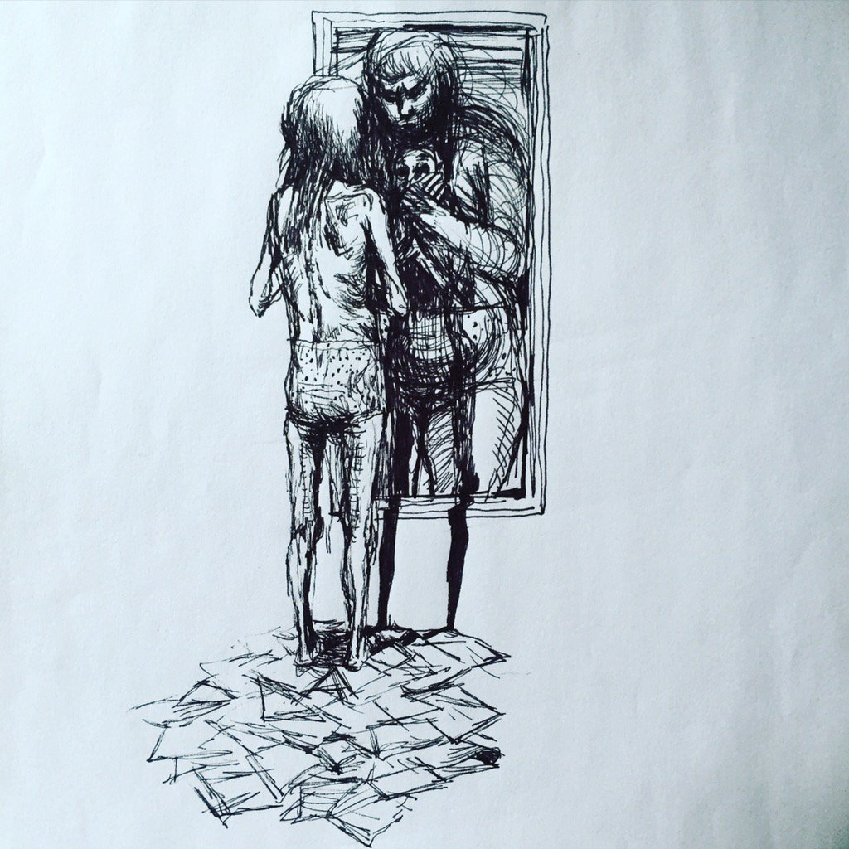
With art illustrate
what millions of words
cannot describe

Slide 21
Social Media
Tool: her own body

Slide 22
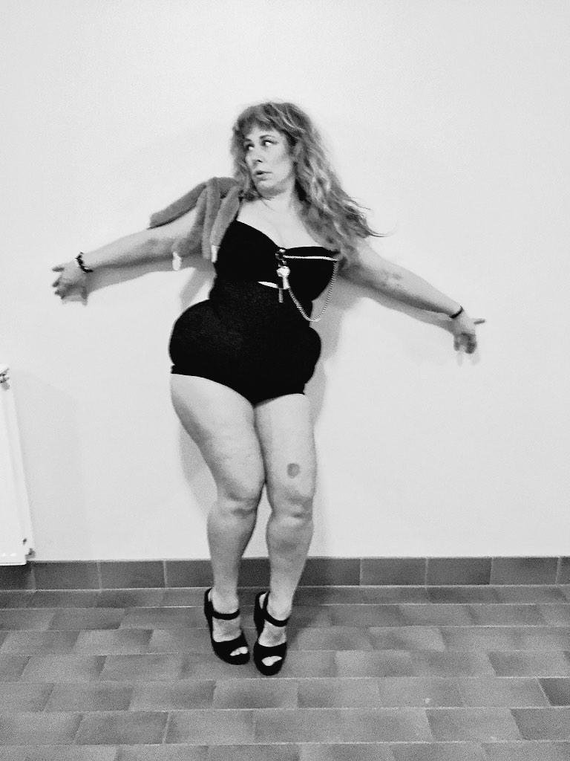
Everyone can be Beyonce!

Slide 23
unga tend to kategorisera människor som ful/snygg, konstig/normal
neutralisera och sätta den feta kroppen i fokus.
Kroppsaktivism som begrepp inkluderar alla kroppar som idag finns utanför normen
motstå objektifieringen av den kvinnliga kroppen samt bygga en modell av kvinnlig skönhet som 9 möjliggör acceptans för olika kroppstyper

