Slide 1
Traian Popovici
A warrior
of human rights

Slide 2
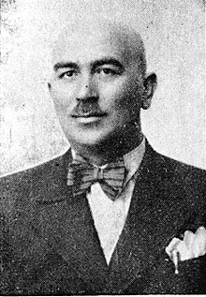
Introduction
Who was Traian Popovici?
Traian Popovici was born on 17 october 1892,
at Rușii Mănăstioarei village of the Ducky of Bukovina in the Austro-Hungarian Empire.
He deceased on 4 june 1946, at Colacu, Fundu Moldovei village, Suceava county.
He was a romanian lawyer and mayor of Cernăuți during World War II known for saving 20,000 Jews of Bukovina from Ion Antonescu’s plans of deportation.

Slide 3
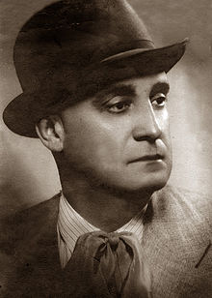
When he was found guilty of certificate eliberation for avoiding deportation, after 10 months he was removed from his function.
After being replaced by the new mayor, 5,000 people, who have been initially saved by Popovici, had died.
Because he didn’t join the
Anti-Semitic current, Popovici was nicknamed „Jidovitul” (the „turned” Jewish) and the jews were called „Poporul lui Traian” (Traian’s people).

Slide 4
When Germany signed its non-aggression pact with the Soviet Union, it took Besserabia and Northern Bukovina from Romania and gave it to the Soviet Union. In July 1941, when Germany attacked the Soviet Union with Romania at its side, the two territories were returned to Romania. For three days the returning Romanian soldiers carried out a massacre among the local Jewish population.

Slide 5
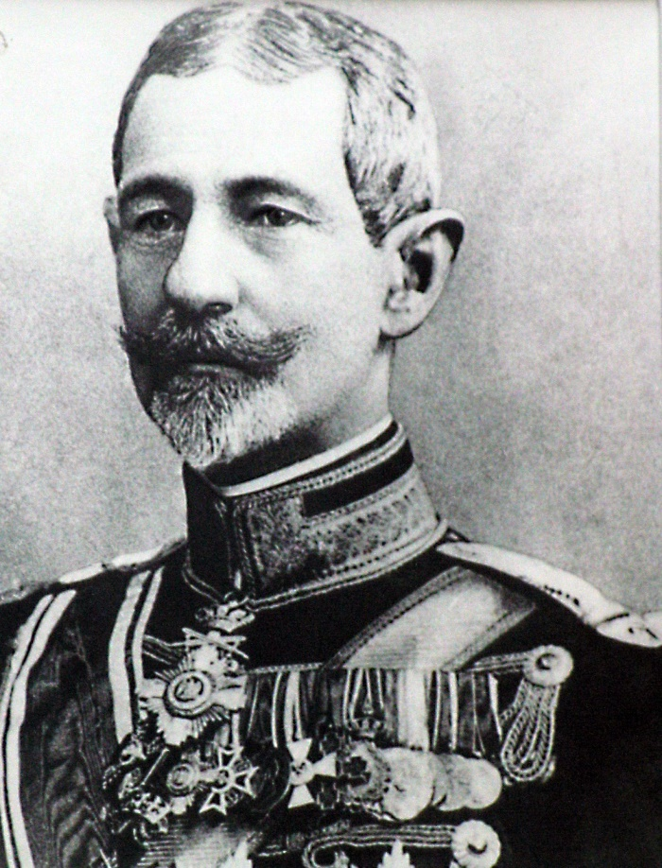
Biography
Traian Popovici was the son of Andrei Popovici
of Suceava and grandson of the priest Ioan Popovici,
a famous priest, who, in 1777, refused to take the oath to the Austrian Empire.
His uncle was Dorimedont Popovici,
who became a minister for Bukovina
under the government led by
General Alexandru Avrescu.
General
Alexandru Avrescu

Slide 6
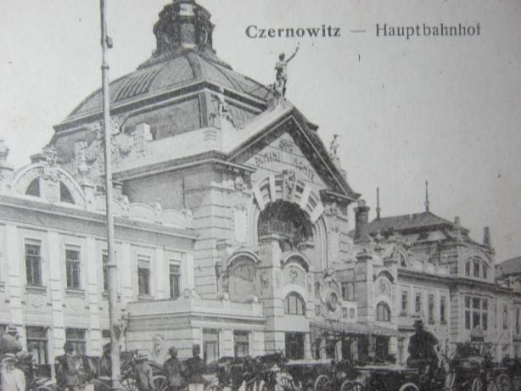
He studied at the Suceava high school (1903-1911), then enrolled at the Faculty of Law of the University of Chernivtsi, which he graduated at the end of World War I. He was a former president of Societatea Academică Junimea.
In 1908, while a high school student, he crossed from Austria-Hungary into Romania illegally, in order to see Nicolae Iorga who was visiting the town of Burdujeni.
When World War I started, he went to Romania and enlisted in the Romanian Army, fighting until the end of the war. After World War I, he settled briefly in Chișinău, where he was secretary at "Our House" organization that dealt with land reform.
In the interwar period, he worked as a lawyer in the city of Chernivtsi. After the Soviet occupation of Northern Bukovina in June 1940, he took refuge in the city of Bucharest, where he continued to work as a lawyer.

Slide 7
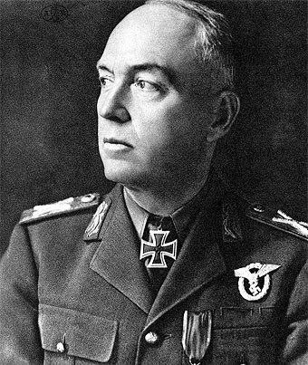
Military dictator Ion Antonescu requested him to become mayor of Cernăuţi, but Popovici initially refused, unwilling to serve a fascist government. He changed his mind, however, based on advice from his friends.
A few days after acceptance, he was ordered to create a ghetto for the Jews of Cernăuţi, but Popovici refused to accept that part of the city's population could be confined behind barbed wire fences. After long debates, the governor of the region accepted his point of view. Due to Popovici's defense of Jews, his political adversaries nicknamed him "jidovitul" ("the turned-Jewish").
Ion Antonescu

Slide 8
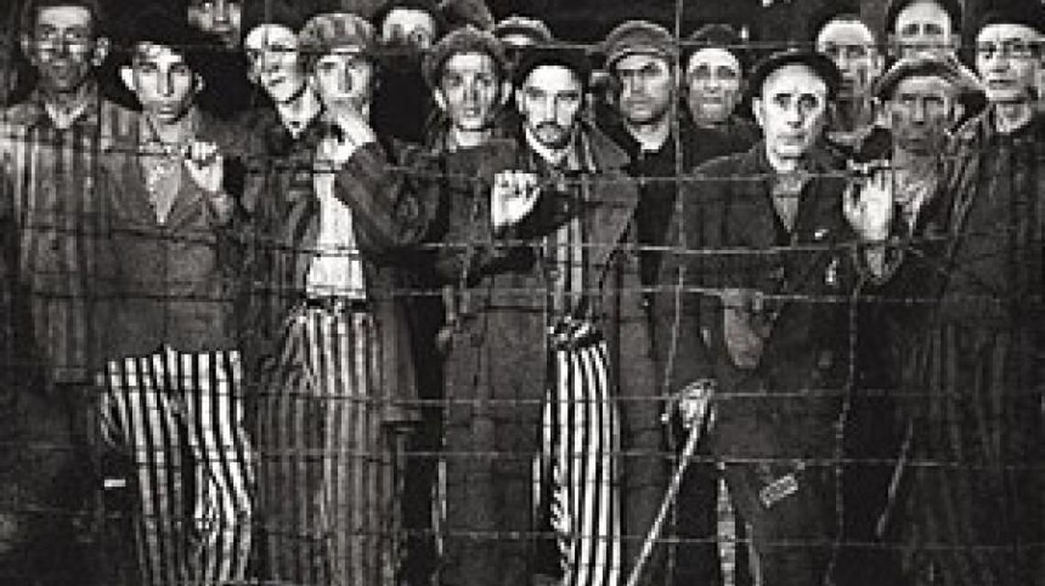
Establishment of the Cernăuți ghetto and the start of deportations
On October 10, 1941, the new military governor of Bukovina, General Corneliu Calotescu, announced the decision that all Jews from Cernăuţi should also be deported, giving orders for the immediate confiscation of their assets and for setting up the Cernăuți ghetto where the Jews were forced to gather until 6 PM under threat of death penalty.
This action was to be carried out under the leadership of the City Hall and under the control of the Army Pretorat, against the pleadings of the Mayor and General Vasile Ionescu.
The ghetto was established in the perimeter of the Jewish quarter. The living conditions in the ghetto were very harsh, the ghetto accommodation spaces could not accommodate more than 10,000 people, here 50,000 Jews were to be imprisoned.

Slide 9
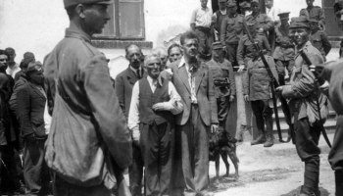
Traian’s people
The major challenge is to tighten anti-Semitic measures.
Ethnic Jews are prevented from exercising their profession, they are forbidden to participate in the divine worship, their goods are confiscated, their children are not allowed to attend public schools, they are just some of the anti-Semitic measures.
Strange and revolting in a city renowned for tolerance. The only refuge for those persecuted, expelled from hospitals and sanatoriums, forced to work in industry, without the right to a card, is the town hall.

Slide 10
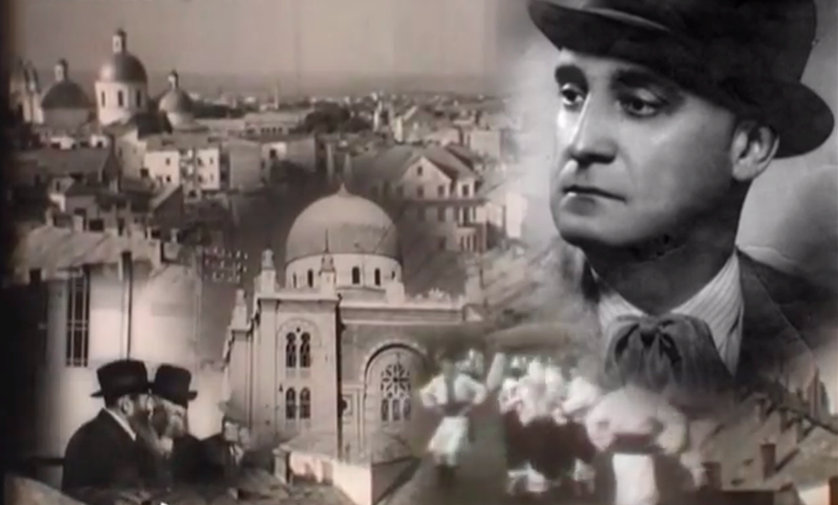
Tensions between the mayor and the governor become inevitable. The first, in the face of the inability to stop the expressions of anti-Jewish politics, Traian resigns. The request is rejected because "I do not have, sir, with whom to replace you".
The Jews become "the people of Trajan."
It is the project of the ghetto that Traian Popovici accepts, offering his own variant for his organization, being aware that, in the new context, following the German pressures, the major evil of the summer had become, at the end of September, the compromise solution. For the deportation to Transnistria was to be implemented.

Slide 11
October 10, 1941. The governor requests the mayor of Chernivtsi to cooperate in order to prepare for deportation. The indignation, the evocation of past mistakes, the appeal to the verdict of posterity break out of the orders received from Bucharest.
The only way to help the citizens was to provide food, by bringing them to the ghetto, which was to be occupied by 50,000 people, although the available space was enough for 10,000. Barbed wire, wooden gates, military guard. A crate in which hygiene conditions are lamentable.

Slide 12
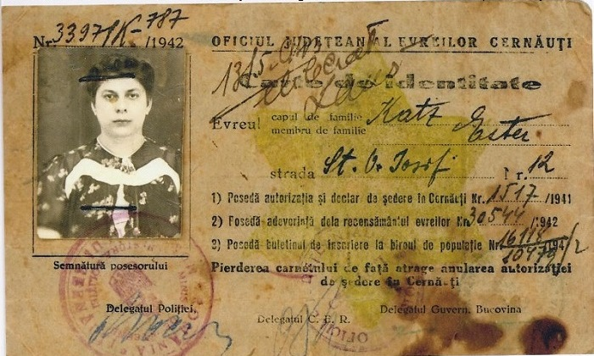
Authorization for a Jewish residence in Cernăuți, offered by Popovici

Slide 13
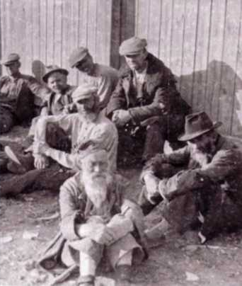
Intervention for the partial rescue of Jews from deportations
At a special conference with all the provincial authorities convened by the governor on the morning of October 12, 1941, Mayor Popovici argued that in the situation of deportation of all Jews from the city, the war production of Cernăuţi would be severely affected.
He demanded that the baptized Jews, intellectuals, artmen, those who served the Romanian state, pensioners, army officers, invalids, industry specialists, doctors, engineers, architects and the judiciary to be excepted from deportation.
The governor accepted that 100-120 Jews should be excepted. Dissatisfied, Traian Popovici tried to influence Antonescu himself, demanding a postponement until substitutes were found for them.

Slide 14
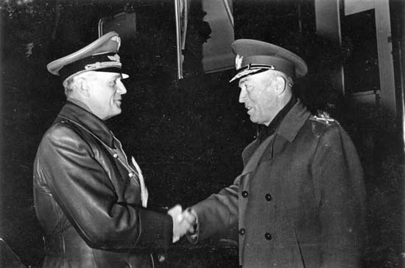
On 3 days from the conference, Marshal Antonescu, consented to an exemption of up to 20,000 souls from the evacuation, through a telephone conversation with the governor, which ordered the deportation to be stopped for a period of 4 days for drawing up their lists.

Slide 15
Based on 179 lists, called "Calotescu authorizations", 5619 heads of household, totaling 16,569 persons from the Cernăuți ghetto were saved from deportation. Another 3120 Jews received "Popovici authorizations", which allowed them to return to their homes after they were forced before moving to the ghetto.
In the following weeks until the cessation of November 15, 1941, 30,000 Jews out of the 50,000 who lived in Cernăuți were deported. Later in July 1942, another 4100 Jews were deported.
While people from Calotescu's entourage, other relatives were passing on the back of the permits in exchange for large sums of money (according to a report of the Security), Popovici created a new category of exempted, without any payment and exceeding its empowerment, adding "Valid also for ..." with the mention of the degree of relation, his signature and the town hall stamp on the back of some authorizations. This action saved several hundred others from deportation. On the other hand, "many specialists who did not have any" links "remained off the list".

Slide 16
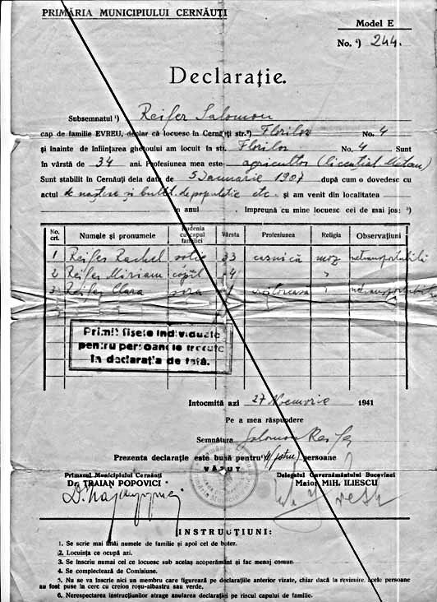
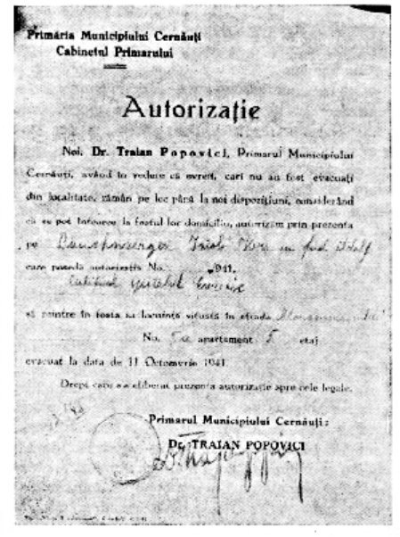
Permit for the exemption from deportation,
signed by Mayor Traian Popovici.

Slide 17
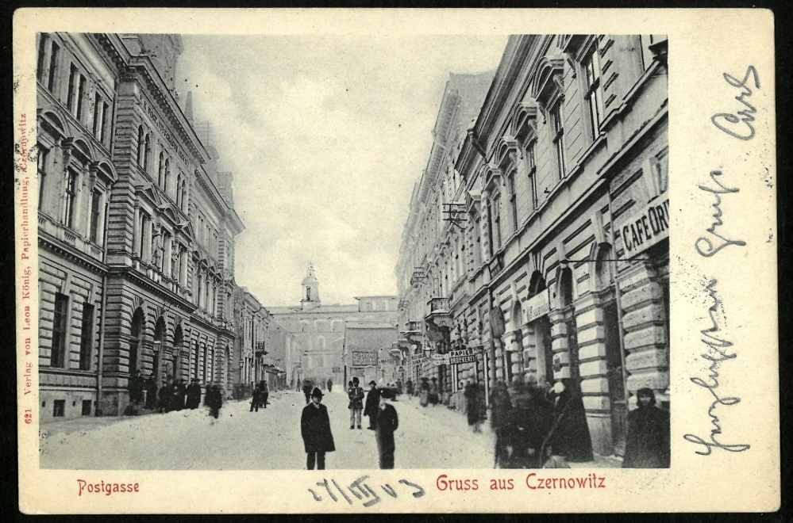
Traian Popovici was released from the position of mayor on December 18, 1941, being replaced by Dimitrie Galeș, first president of the Court of Cernăuţi. The new mayor resumed deportations to Transnistria after five thousand Jews who had been initially rescued by Popovici died.
A 1942 investigation that investigated the selection of Jewish specialists following the whistleblower denunciations found Popovici guilty of issuing certificates that allowed Jews to avoid deportation.

Slide 18
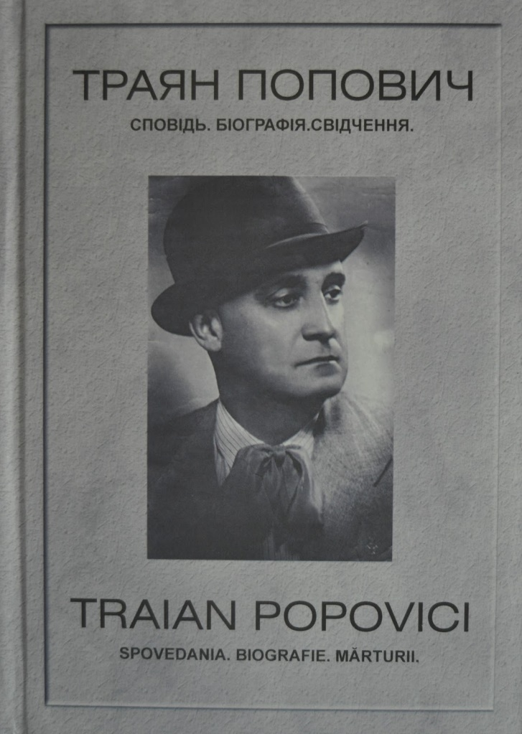
After war
After the war, Traian Popovici published the book Spovedania (The Confession), also known under the name Spovedania unei conștiințe (The confession of a conscience), after the piece from the introduction :
"Spovedania unei conștiințe, care în tragedia umană ce a trăit-o, a făcut tot ce i-a fost cu putință să zăgăzuiască furia, să îmblânzească pe cel sălbatic, să încurajeze pe cel înfricoșat, să mângâie pe cel disperat și să toarne nădejde în cel plecat în surghiun".
(The confession of a conscience, which in the human tragedy that it experienced, did all it could to restrain anger, to tame the savage, to encourage the frightened, to comfort the desperate, and to pour hope into the departed)
In the book, the former mayor evokes the tragedy of the Bucovina Jews, which he perceives as a "barbarism" and a Romanian tragedy. Marked by the tragedy of Bukovina, he wrote lyrics with a pronounced patriotic character, remaining in the manuscript.

Slide 19
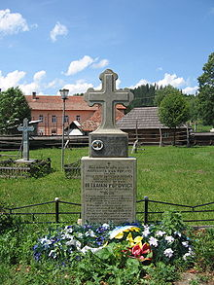
Dr. Traian Popovici died on June 4, 1946 in the village of Colacu in the commune of Fundu Moldovei (Suceava county), being buried in the courtyard of the church in the village.
The grave of Dr. Traian Popovici in the courtyard of the wooden church in Colacu.

Slide 20
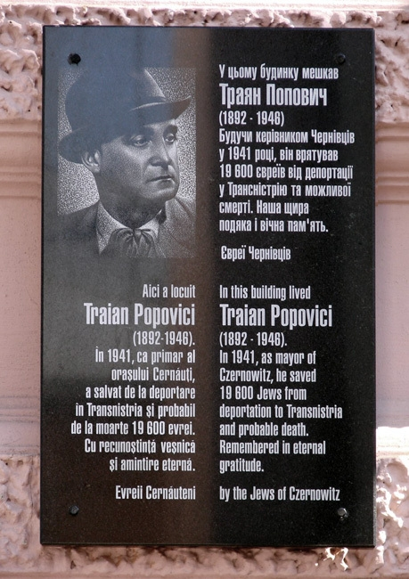
Honoring his memory
In 1969, he is honored by Israel's Yad Vashem memorial as one of the Righteous Among the Nations, an honour given to non-Jews who behaved with heroism in trying to save Jews from the genocide of the Holocaust.
As a proof of his courageous attitude and efforts to save the Jews of Bucovina, a monument of Dr. Traian Popovici was erected in Tel Aviv.

Slide 21
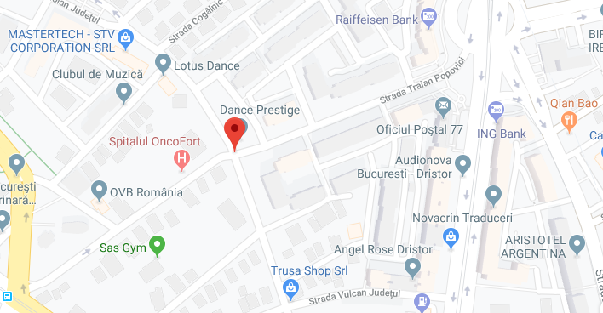
In June 2002, at the request of the Ministry of Culture and Religious Affairs, the City Hall of Sector 3 of the Municipality of Bucharest elaborated a decision by which it changed the name of the “Unity” street into the one of “Dr. Traian Popovici ”, thus honoring the memory of the famous Cernăuțiului mayor (1941), who saved almost 20,000 Jews from deportation.

Slide 22
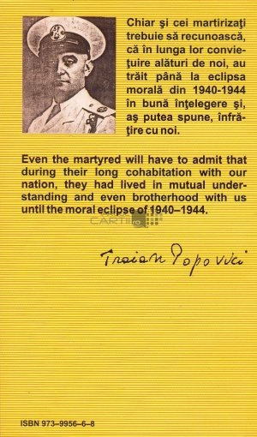
In the same year, it was published on the initiative of the Dr. Wilhelm Filderman Foundation and with the material support of the Ministry of Culture and Religious Affairs, Traian Popovici's memoir, entitled "Spovedanii" (in Romanian and English bilingual edition). The volume was prefaced by the acad. Prof. dr. Răzvan Theodorescu, Romanian Minister of Culture and Religious Affairs.

Slide 23
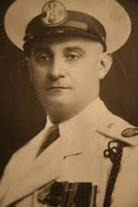
In 2008, the initiative of the Association for Education, Democracy and Tolerance "Traian Popovici" and with the funding of the Ministry of Culture and Cultor was revealed in the village of Colacu a bust in memory of the first Chernivtsi.
Traian
Popovici

Slide 24
On April 21, 2009, at the initiative of the Holocaust survivors, as well as with the support of the local authorities in Cernăuți, a commemorative black marble plaque was placed on the wall of Traian Popovici's former Cernăuți dwelling (from 6 Zankovetka Street). This event was attended by others Volodimir Kuliș (governor of Cernăuți region) and Dorin Popescu (diplomatic adviser, interim consul of Romania in Cernăuți). Written in three languages: Romanian, Ukrainian and English, the commemorative plaque honors the personality of Mayor Traian Popovici.
On October 6, 2016, in the village of Fundu Moldovei, where Traian Popovici died, a bust was unveiled and wreaths were deposited.

Slide 25
Paragraphs of „Spovedania”
In his book, Dr. Popovici describes the formation of the ghetto:
On the streets in front of the window, a whole place of humanity in sight. Old people helped by children, women with babies in their arms, infirmities crawling their limbs, all with packages in hand, carrying bags in carts or wheelbarrows or in their backs, trunks tied in the trench, litter, clothes, clothes, heading for the pilgrimage. much to the suffering valley of the city, to the ghetto.
I realized that their unluck wheel was in motion. I got dressed and hurried to the town hall. On the road; weeping women, crying with children, murmuring of old people, tears and tears again, some flowing, others dry on the cheeks of suffering, others dropping anonymously into the plump beards. "Jidovimea had been taken out of her den" and harassed, as a savage to her stumbling block.

Slide 26
The inhuman living conditions have terrified Mayor Popovici:
Accommodation capacity was minimal. Even though the available rooms had to accommodate up to 30 and more individuals, most were forced to shelter in corridors, bridges, cellars, sheds and where they found shelter from rain and snow. I won’t even start talking about hygiene. Lack of safe drinking water; insufficient existing wells. I notice that the city was suffering, two of the three water plants being destroyed. A smell of sweaty sweat, urine and feces, of damp moisture, seized the neighborhood, differentiating it from the rest of the city. Exactly the concentrated smell of a sheepfold, stretched over by green pastures. Surprising as the barbed wire ghetto, with wooden gates at its main exits and military guard, was almost hermetically encircled.

Slide 27
Intervention for the partial rescue of Jews from deportations
Description of the communication of this decision:
The dramatic scene I was experiencing when I brought them the news of hope, a most solemn, most moving account of my life, and I do not think the future has reserved a bigger one for me.
Old rabbis, intellectuals of all ages, leaders from all sections of social life, merchants, workers, with one word all their breath, broke into a sobbing cry, knelt blessing their God, thanking the heaven for mercy, the Marshal for mercy, again to kiss my hands, feet and the flesh of my clothes. Tears do not always shame a man. At that moment, excited by this spontaneous outburst of gratitude, my tears cleared and I, "the father of the city„ cried.

