Slide 1
Queen Helen

Slide 2
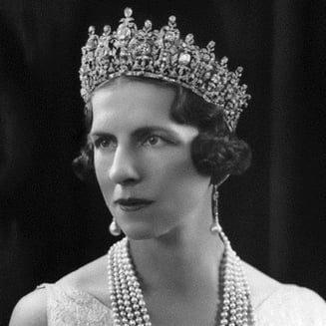
Biography
Helen was born on May 3, 1896 in Athens, and
at birth had the title of princess of Greece and
Denmark. She had three brothers George, Alexander and Paul and two sisters Irina and Ecaterina. She was the eldest daughter of Constantine I and Sofia. In her childhood she was raised by an English governess (Miss Nicholls) and served as servant to a peasant Rosa, who would remain in service for decades. From childhood she wore the nickname Sitta, a consequence of her younger brother Alexander's attempts to pronounce the English word "sister" (Romanian sister).

Slide 3
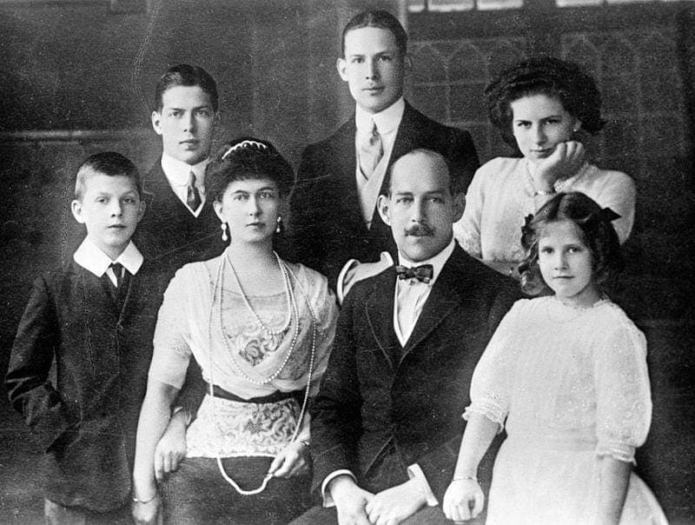
Her childhood was spent in Athens, the . offspring of the Greek royal family rarely . leaving the capital's surroundings - due to poor conditions in Greece - except for trips on the royal Amphitriti yacht and visits to Germany, to the widow of King Frederick III. In her childhood, Elena was very close to her brother Alexander, who was close in age.
On 11 June 1917 the Greek royal family secretly fled from their palace, surrounded by a loyalist mob that refused to see them go.

Slide 4
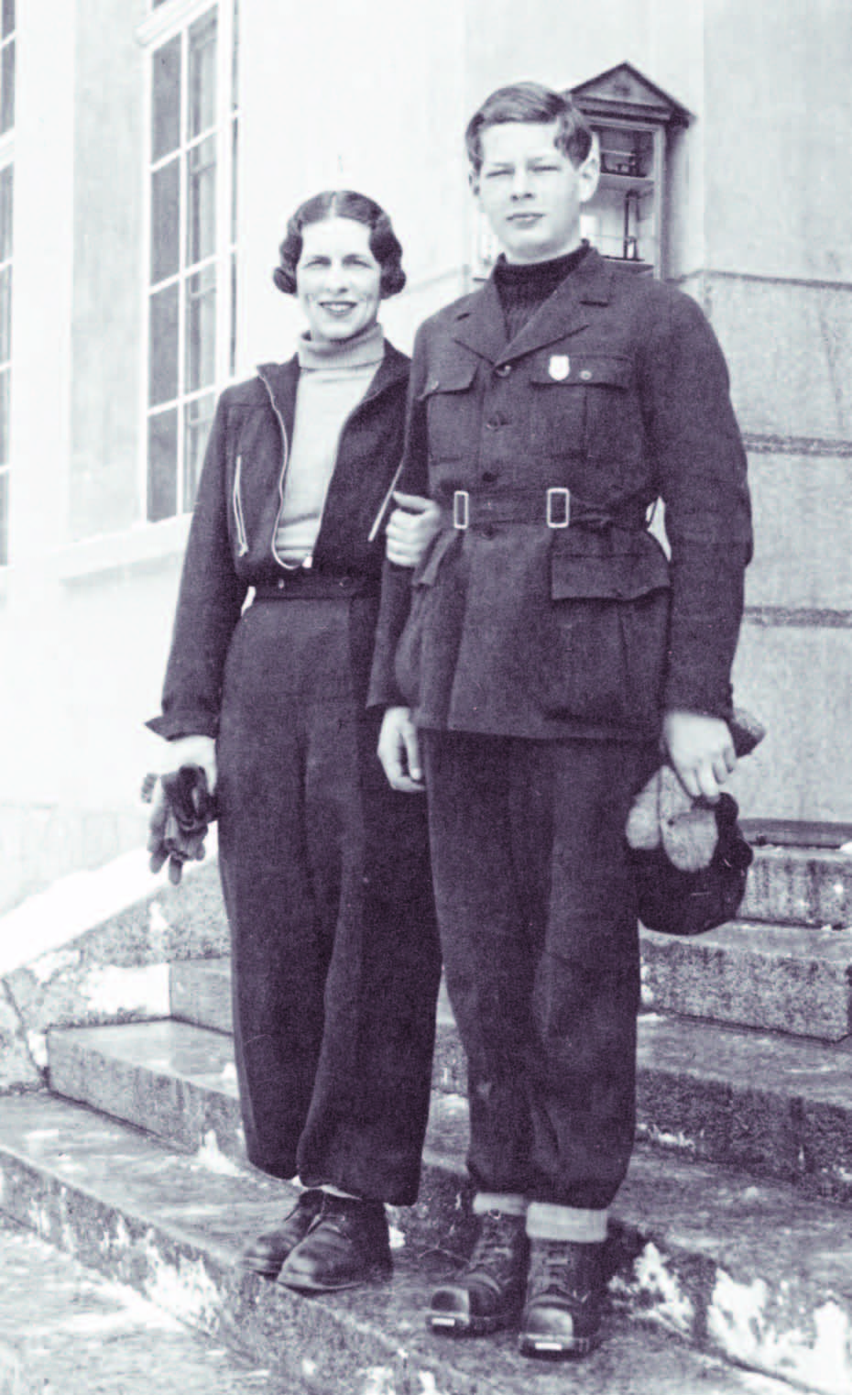
In the days that followed, Constantine I,
Queen Sophia and five of their children
left Greece from the port of Oropos
and took the road to exile. This was the
last time that Helen saw her favorite
brother. In fact, on their return to
power, the Venizelists prohibited any
contact between King Alexander I and the rest of the royal family.

Slide 5
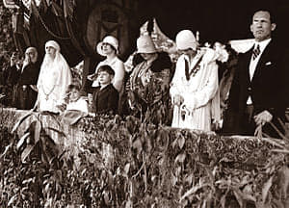
After crossing the Ionian Sea and Italy, Helen and her family settled in Switzerland, mainly among the cities of St. Moritz, Zürich and Lucerne.In exile, Helen's parents were soon followed by almost all members of the royal family, who left their country with the return of
Venizelos as Prime Minister and
the entry of Greece to the war
alongside the Triple Entente.

Slide 6
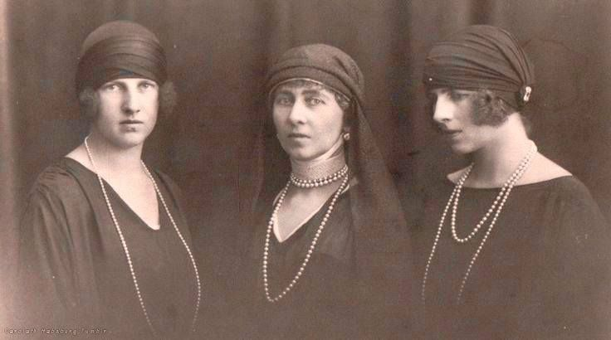
However, the financial position of the royal family was precarious and Constantine I, haunted by a deep sense of failure, soon fell ill. In 1918, he contracted Spanish flu and again was close to death.
Very concerned about the fate of their father, Helen and her sisters
Irene and Katherine
spent a long time with
him to distract him from
his worries.

Slide 7
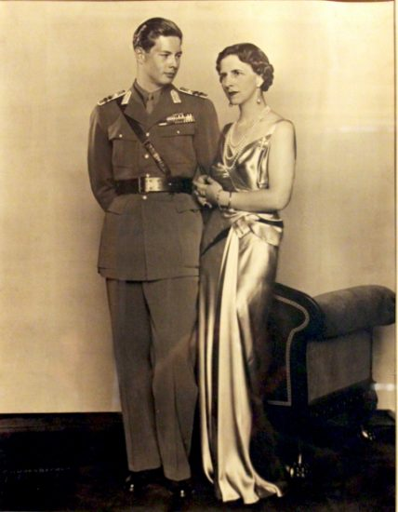
Helen also sought to reconnect with Alexander I. She tried to take advantage of the visit of her brother to Paris in 1919 to call him by phone. However, the officer who escorted the king in the French capital refused to pass along either her communications or those of other members of the royal family.

Slide 8
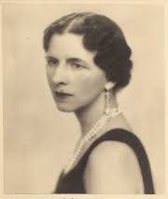
Queen Helen is the one who confronted Antonescu, in a meeting she has with ion antonescu, at the end of 1941. She called for the deportation to be stopped. At some point, vn Killinger begins to offend her face to everyone for her daring to ask something like that. Insulted, the queen then threatened to leave the country in protest.

Slide 9
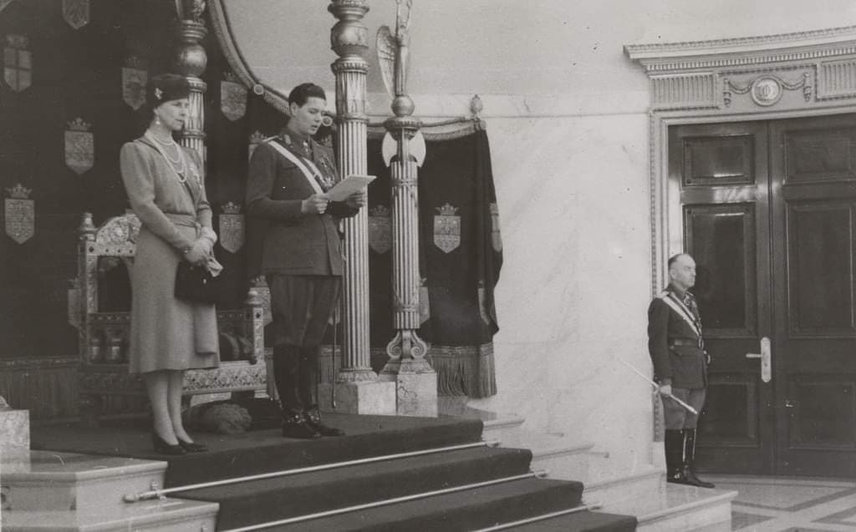
One of the great saving actions of the queen is obtaining the agreement of the president of the council of ministers, Mihai
Antonescu, that the Jews
of the Old Kingdom could
send aid to the deported
confreres, escaping from the safe death several tens of thousands of souls.The fact that the Jews of the Old Kingdom did not share the fate of the others is due in part to Queen Helen.

Slide 10
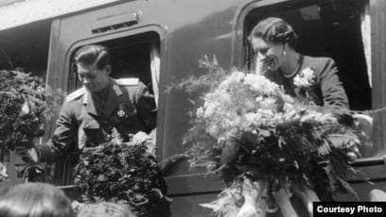
Queen Elena didn't stop here.
In December 1941, a meeting
takes place at the Vatican
with Papa Pius, following which he is instructed to become more involved in the protection of not only baptized Jews, but also non-baptized Jews.In the following year, the mother queen saves the literary historian and the publicist Barbu Lazareanu from deportation, but it is not the same success for young people who were part of the Zionist organization Hashomer Hatsair.

Slide 11
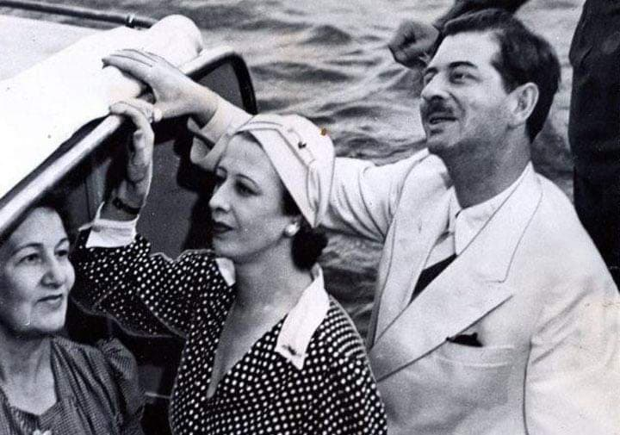
Again, she called on the head of state to commute death sentences, but it proved to be unwavering. But her interventions exposed her to considerable risks. Her sister, Princess Irina, was in the German hands and walked through the Austrian and Polish labor camps, while in the summer,Princess Mafalda dies at Buchenwald. She knew very well that he was in incredible danger, especially since the German secret services had woven around Queen Elena an entire network of informants.

Slide 12
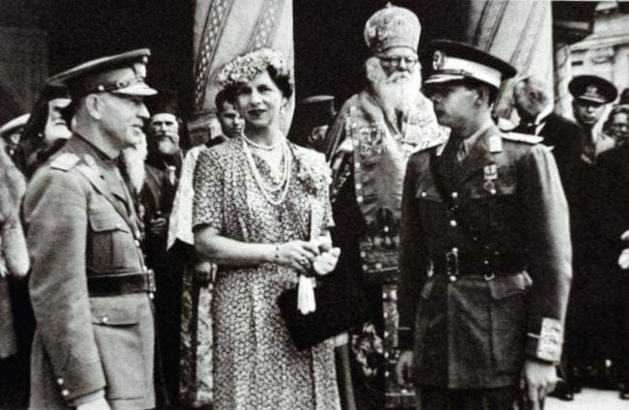
For this and all the others, the mother queen remains in the memory of those saved by her a living example of humanity in those troubled times. But it will be half a century before Queen
Elena's merits will be
recognized by the
Holocaust Victim
Memorial and not by
a little effort from those saved by it.

Slide 13
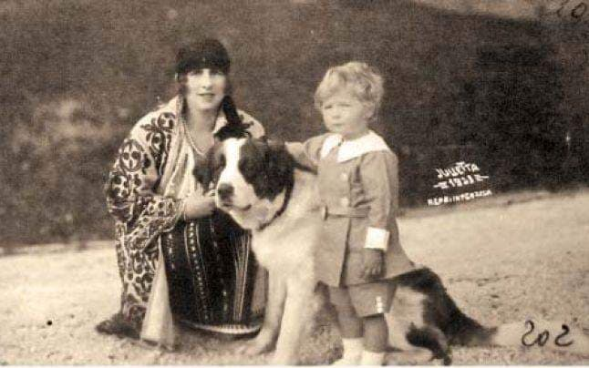
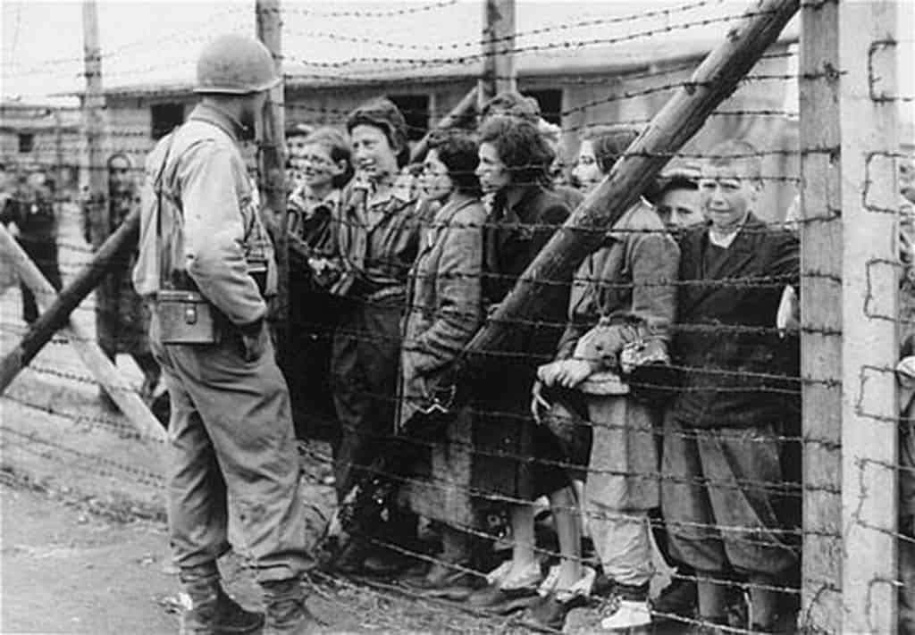

Slide 15
THE END

