Slide 1
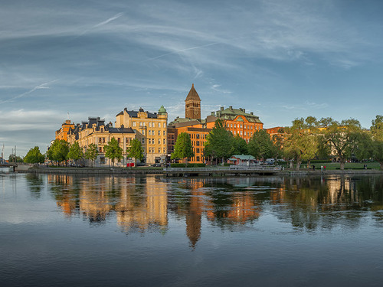
Norrköping

Slide 2
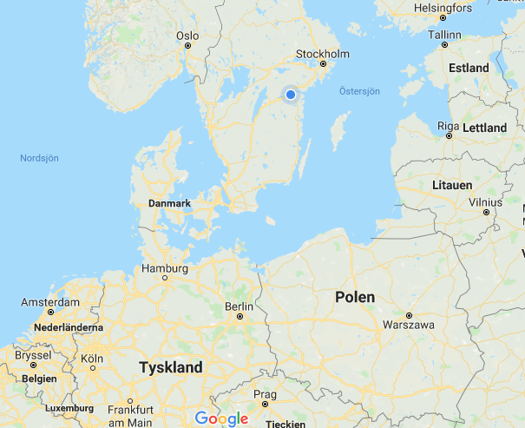

Slide 3
Norrköping is an old industrial city, centered along a river.
About 140 000 inhabitants
Univeristy
Many restaurants

Slide 4
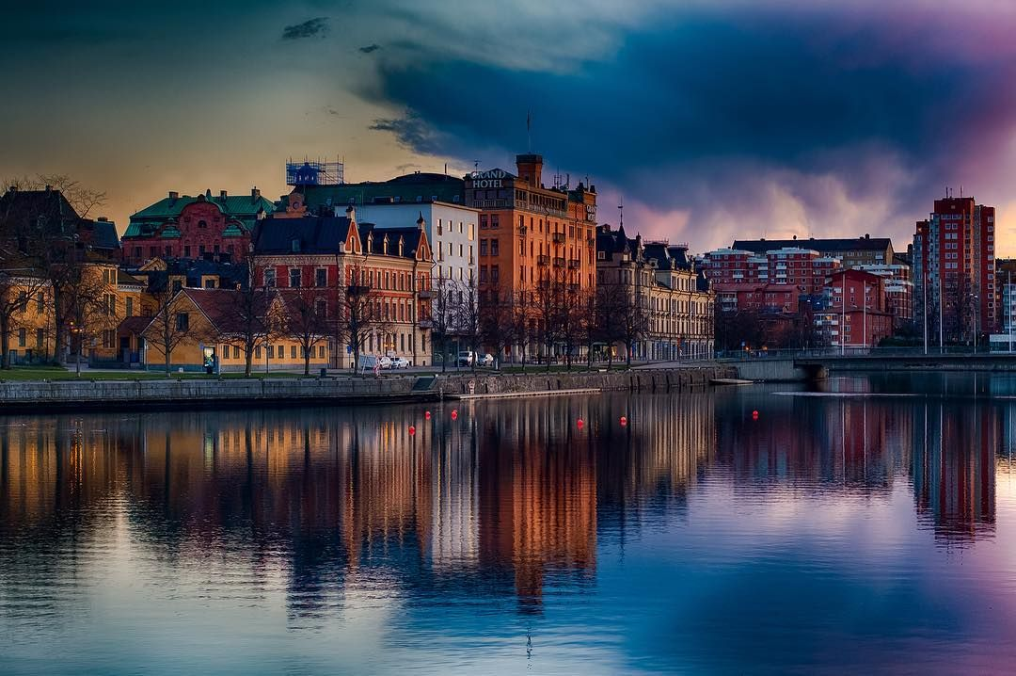
Norrköping is known for its yellow trams, beautiful old industrial buildings and the stream that rushes through the city center.
zoranfoto https://www.instagram.com/p/BTgvLtKj9i2/?utm_source=ig_web_copy_link

Slide 5
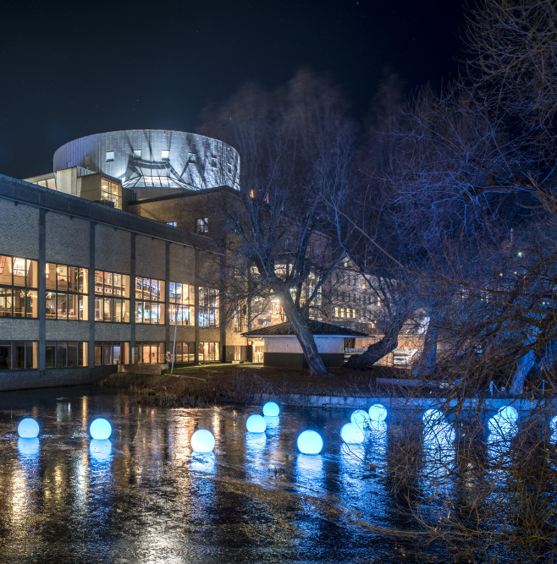
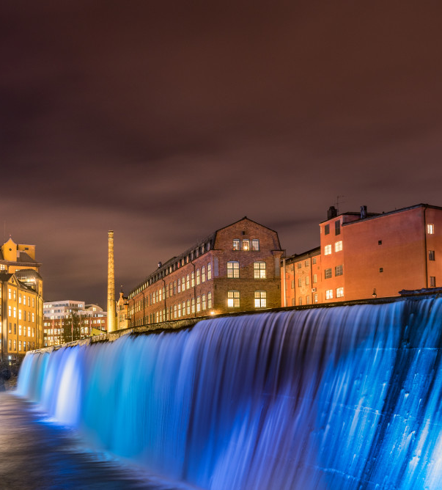
The first building in the Industrial Landscape is the Louis De Geer Concert & Congress, housed in an old paper mill.
Angus Muir Design, Nya Zeeland

Slide 6
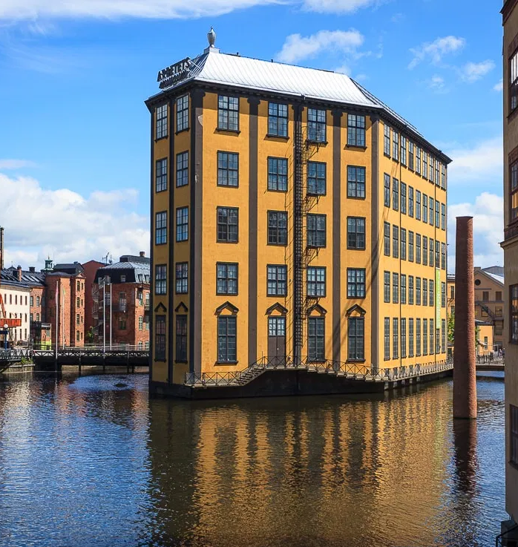

Slide 7
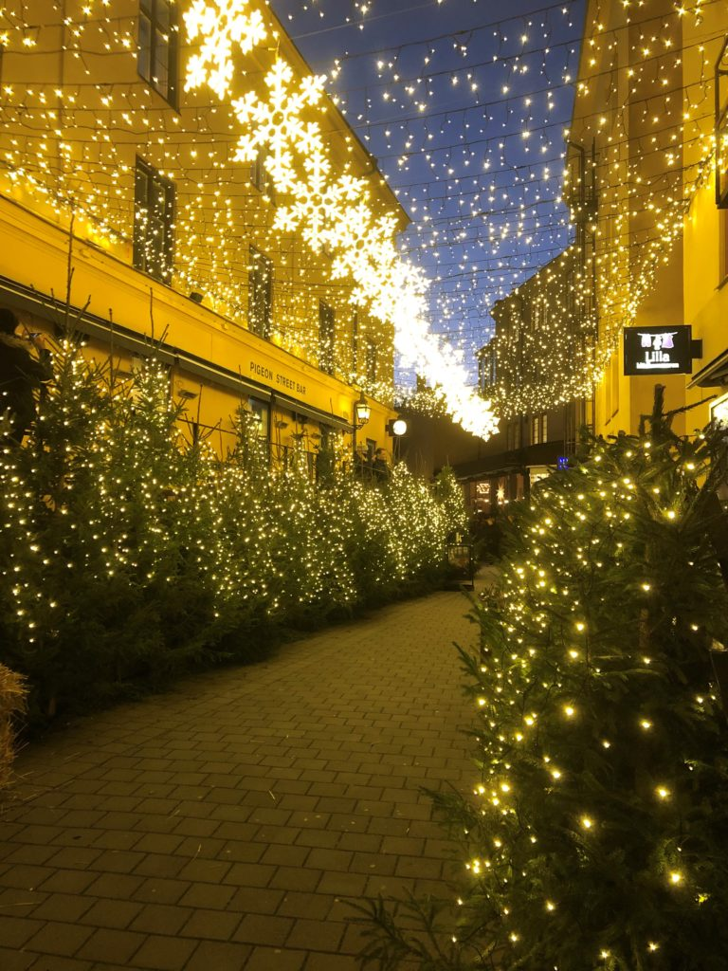
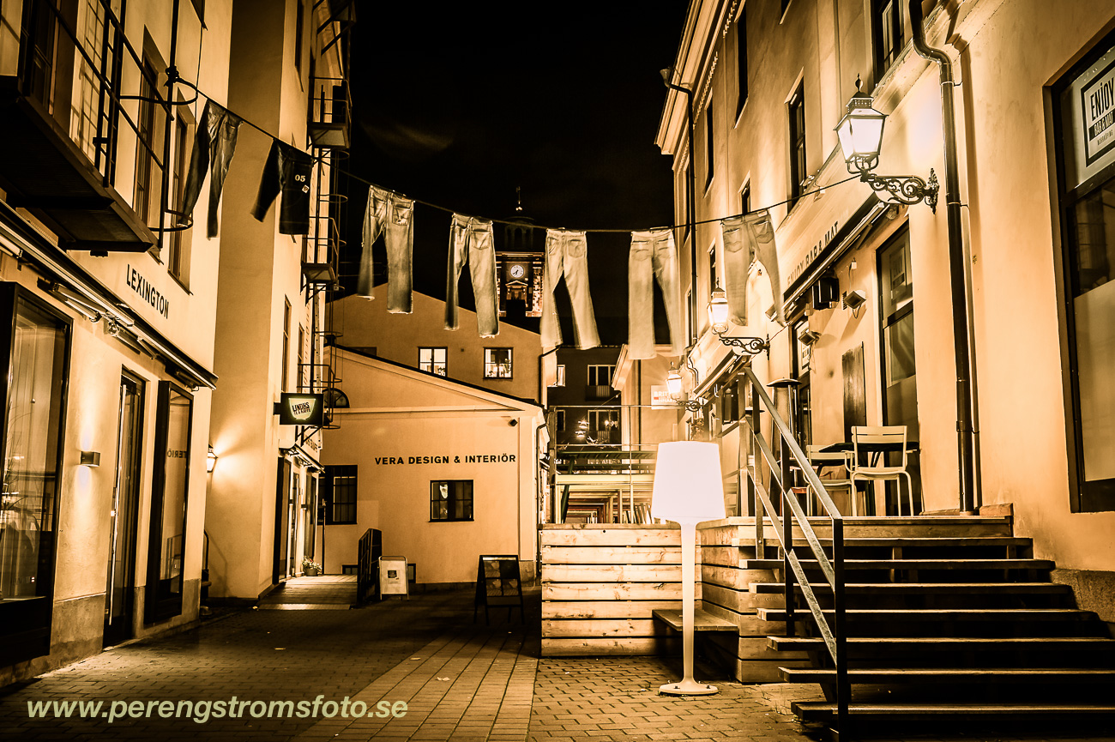
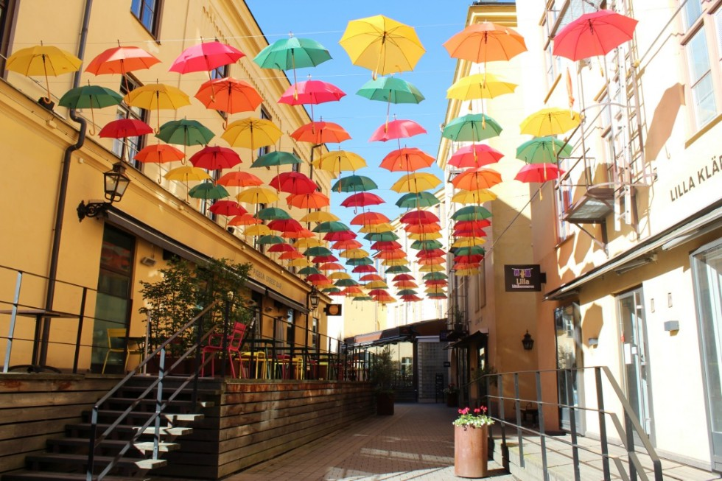
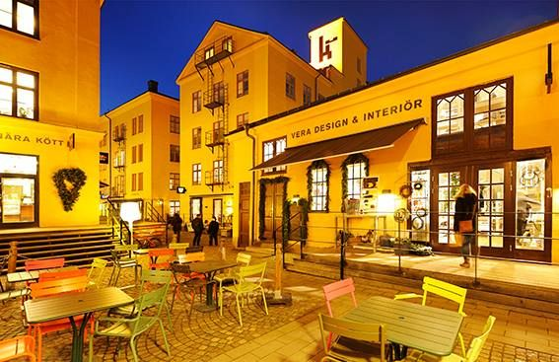
In the middle of Norrköping City, is a unique historic neighborhood, where the oldest buildings are from 1767.

Slide 8
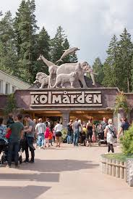
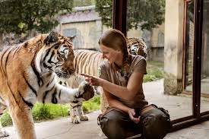
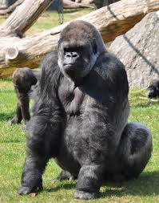
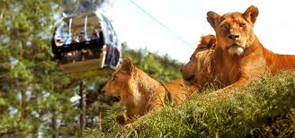
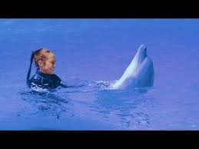
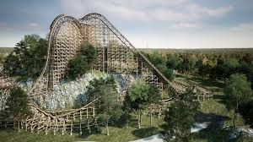
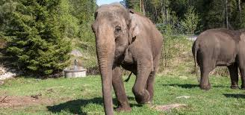
Outside the city center you will find Kolmården Zoo
Kolmården is the largest zoo in Nordic region

Slide 9
Our School
E

Slide 10
Djäkneparksskolan
Djäkne = Youngling (young boy/man)

Slide 11
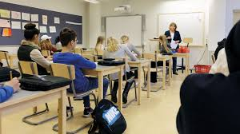
Centrally situated
450 pupils
40 nationalities
Aged 13-16
Inclusive
5x3 classes year 7-9
40 teachers

Slide 12
Profiled classes
2-4h/week
Basketball Music class
Football Art class
Dance classes Handicraft class
IT-media International class
Writer’s class

Slide 13
Digital School
Computers
Digital teaching

