Slide 1
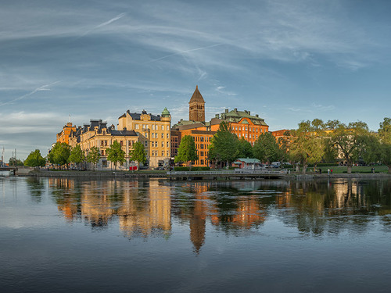
Norrköping

Slide 2
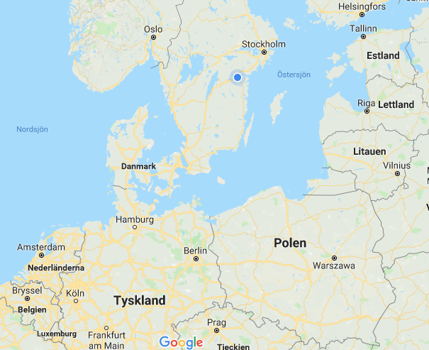

Slide 3
E

Slide 4
Djäkneparksskolan
Djäkne = Youngling (young boy/man)

Slide 5
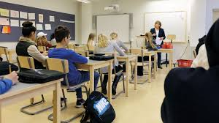
Centrally situated
450 pupils
40 nationalities
Aged 13-16
Inclusive
5x3 classes year 7-9
40 teachers

Slide 6
Profiled classes
2-4h/week
Basketball Music class
Football Art class
Dance classes Handicraft class
IT-media International class
Writer’s class

Slide 7
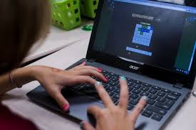
Digital School
Computers
Digital teaching

